Slide 1
Algorithm Development in Neural Networks: Insights from the Streaming Parity Task (Loek van Rossem, Andrew M. Saxe, ICLR 2025)
2025.09.05 Journal Club
M.S. student
Sungyoung Kim

Slide 2
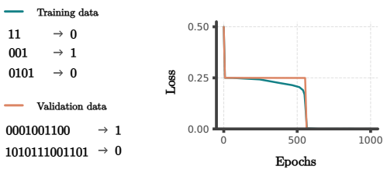
Introduction
Parity Task: 0 if even number of 1s, 1 if odd number of 1s in a sequence

Slide 3
Introduction
Even when RNN is trained only with short sequences, it generalizes infinitely to infinitely long sequences
Moreover, it happens in two-phase which is interesting

Slide 4
Introduction
Why and how does RNN generalize an algorithm in such a way instead of simply interpolating?
> Explanation based on interaction theory and merger dynamics

Slide 5

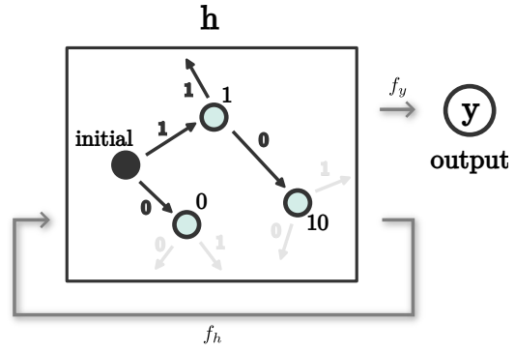
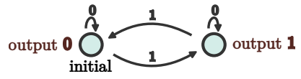
Observation
Explanation
Analysis
Deterministic Finite Automata (DFA) of RNN
RNN
DFA (tuple; algebraic structure)
DFA extraction from RNN (basically a Markov Chain)
Notes:
- tuple/algebraic structure that Illustrates the internal computation of an algorithm
- In the streaming parity task case.. Initial state you are yet to receive any sequence of numbers

Slide 6
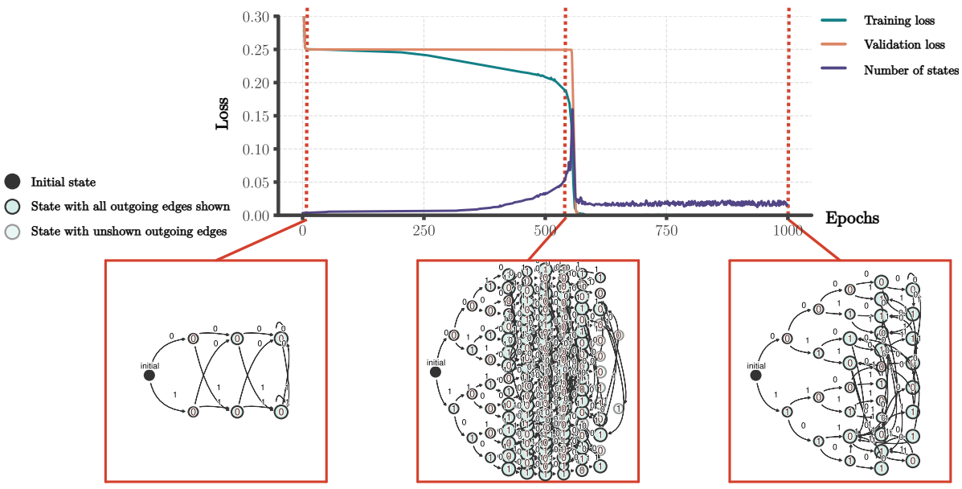
Observation
Explanation
Analysis
Automata During Training
Initially few states and random outputs (due to random small weights)
Phase I Automaton expands into
a complete tree
fitting the training data
Phase II States in the automaton merge until it becomes finite (this is when training loss = 0, generalization on all data happens)
Notes:
- Two phases in the training process :
- Looked into how this DFA looks like in each phase
- Phase I : allowing the redundant states, fitting the training data
- Phase II: even if new hidden states come in >> its going to be mapped to the exact hidden state that output exact output (1,0)

Slide 7
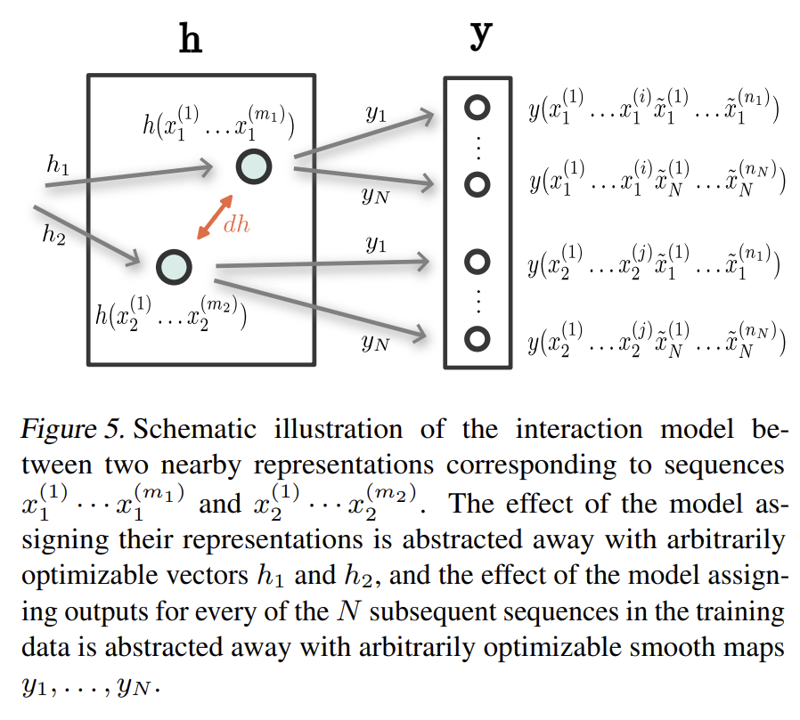
Observation
Explanation
Analysis
Interaction Theory
Theory on behaviour of representations as hidden representations of two input sequences get near during training (in a highly expressible arbitrary NN, where smooth continuous mapping is doable due to UAT)
h: input > representation map
y: representation > output map
Suppose N subsequent sequences after x1 and x2, hence N output maps
Notes:
WHAT’s happening /// Why this is happening based on Interaction theory that they came up with
It is a theory on behaviour
Discrete automata >> continuous dynamical system

Slide 8
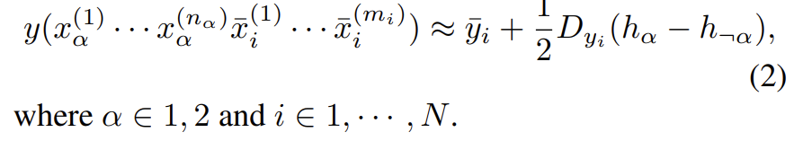
Observation
Explanation
Analysis
Interaction Theory
Local linear approx. of output yi around (h1+h2)/2
y* (true val)
For the supervised learning of predicting the right y, optimize with the MSE loss btw y and y*
Linear approx. of y
y* (true val)
Gradient descent, Anzats representational movement and a bit of algebra gives next page
Notes:
- To get an insight of how this predicted output y (blue boxes) is being computed from the interaction between the hidden states (the output of h1 and h2)
Linearized y = predicted output of the mean of the hidden representations + half Jacobian dh (direct application of Taylor series)
- Goal of this entire training minimize the mean squared error between y* y …
- Gradient descent with respect to …. By hand

Slide 9
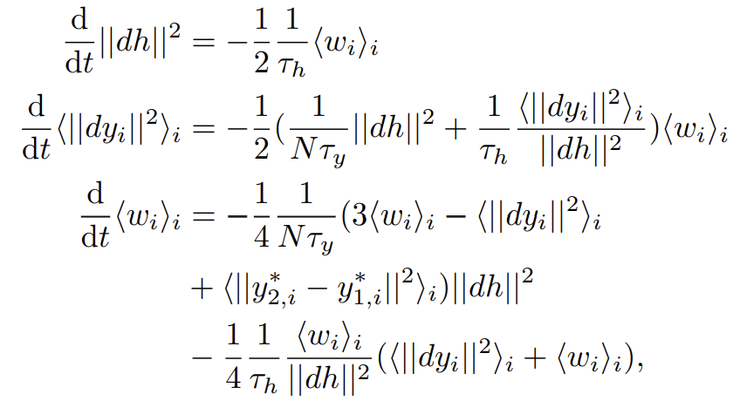
Observation
Explanation
Analysis
Interaction Theory
3 Self-Contained Scalar System
Representational distance sqrd
y* (true val)
Avg. prediction distance sqrd
Avg. output alignment
Notes:
Dh
Dy : Jacobian times the distance (how much these two are going to differ in the output) how much these two blue boxes are going to be different calculated from the hidden state representation
Wi : alignment between the outputs and the predictions. How much these two orange boxes are going to be different and how that differs from what’s predicted with the hidden states
So far we’ve linearized blue with red and green > applied gradient descent > 3 scalar system in terms of red and green (and a bit of orange)

Slide 10
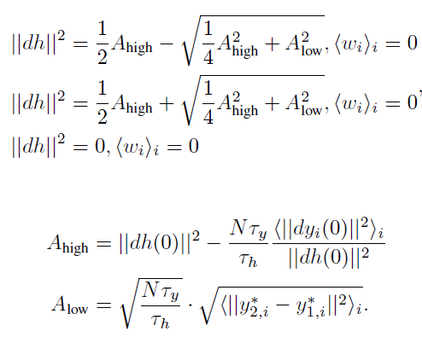
Observation
Explanation
Analysis
Merger Dynamics
The system can be reduced to a 2-dimensional system of dh and wi and has three fixed points, only one of which are stable, being the final solution when sufficient time has passed
Negative representational distance > not valid
stable
saddle
Notes:
There’s a system we have to look into fixed points because these are the points that a system will eventually get to (stable fixed point)
3 three fixed points one in the complex domain one that’s stable (smth that we want and we know that the system is going to get there)

Slide 11
Observation
Explanation
Analysis
Merger Dynamics
Representational merge happens when Ahigh < 0 and Alow = 0, the moment partially determined by data and the network architecture
0 iff
< 0 iff
* C: unknown constant determined by the architecture G: average decrease of representational distance when applying the recurrent map m: minimal seq len for representations n: that for potential subsequences
0 iff
Notes:
Why we did this entire thing of finding a system and its stable fixed point >> formalizing this observation into equation
* Dh = 0 ==

Slide 12
Observation
Explanation
Analysis
Summary
Output states can be expressed in terms of hidden states
In particular, Output and hidden states dynamics can be expressed as a 3-scalar system, whose stable fixed point gives an equation for the final representational distance (||dh||^2)
We’re interested in the moment when this distance becomes 0, as this is when hidden states merge, incurring a sharp drop of the training/validation loss to 0 when training RNN to learn Parity task
And distance is guaranteed to become 0 for states (1) with the same output (2) whose sequences they correspond to are long enough (big m) (3) given enough data (big N) and small initial scale (G < 1)
Notes:
Two outputs from hidden state 1,2 with the same subsequent sequences
Exists a constant C determined by the network architecture that is smaller than N G ^n-m.
N: number of subsequences
G: weight scale how much weights decrease
m: lengths of hidden states
n: length of the subsequent sequences

Slide 13
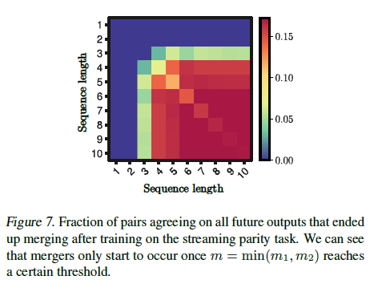
Observation
Explanation
Analysis
Sequence Length (+redundant states)
Mergers only occur for pairs with long enough sequence lengths
Majority of output-matching hidden states do not merge, forming redundant states – a possible explanation is that some pairs never get close during training, thus not interact

Slide 14
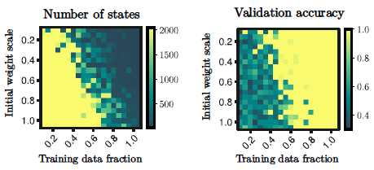
Observation
Explanation
Analysis
Weight Scale and Training Data Fraction (+phase transition)
Sharp boundary in number of states and validation accuracy as initial weight scale (G) decreases and training data fraction increases (N)

Slide 15
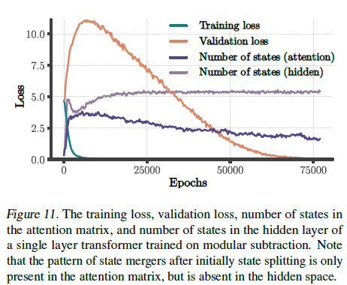
Observation
Explanation
Analysis
Application to Transformer
Attention in Transformer exhibit merger, leading to a decrease in validation loss
However, hidden states outside attention did not show the same pattern

Slide 16
Thank You
2025.07.01 Lab Seminar

