Slide 1
Investigating Message Passing in Reasoning Tasks via Algorithmic Alignment
2025.07.01 Lab Seminar
M.S. student
Sungyoung Kim

Slide 2
Contents
Introduction
Related Works
Research Design
Results from prev. project

Slide 3
Introduction
Human
Reasoning
MF
Algorithmically Aligned Neural Network
Message Passing Behavior
MB
RQ: How may an agent solve Bellman Optimality Eqn.? 1) Rule-wise: a unified agent that continuously moves between MF and MB variants 2) Structure-wise: with relaxed constraints on the rollout graph structure

Slide 4
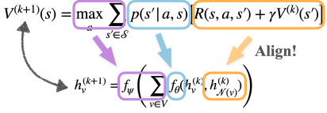
Related Works
Research Design
Previous Works
1. Algorithmic Alignment Idea
Value Iteration
GNN Update
[1] Li M., Littman M.L., (2021) Towards Sample Efficient Agents through Algorithmic Alignment, AAAI Student Abstract

Slide 5
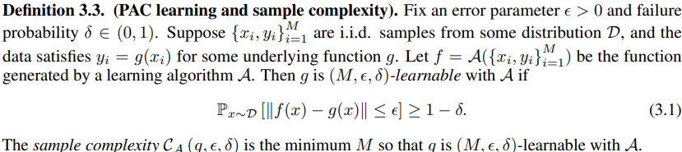

Related Works
Research Design
Previous Works
1. Algorithmic Alignment Definition
Xu et al. (2020) [1] established formal definition for algorithmic alignment based on PAC learning framework [2]
[1] Xu, K., Li, J., Zhang, M., Du, S.S., Kawarabayashi, K., Jegelka, S. (2020). What Can Neural Networks Reason About?, ICLR (https://arxiv.org/pdf/1905.13211) [2] Valiant, L. (1984) A theory of the learnable,. In Proceedings of the sixteenth annual ACM symposiumon Theory of computing

Slide 6
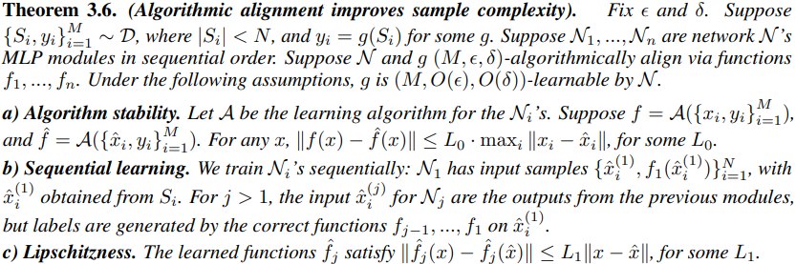
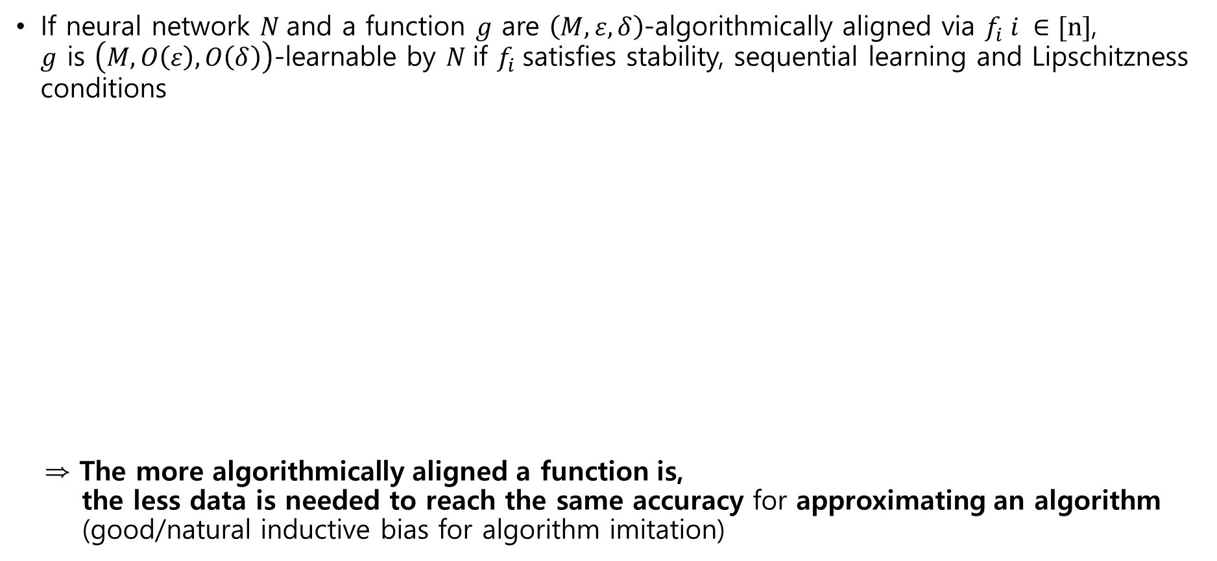
Related Works
Research Design
Preliminary Works
1. Algorithmic Alignment Theoretical Results
If neural network $N$and a function $g$ are $\left(M,ε, δ\right)$-algorithmically aligned via $f_{i} i ∈[n]$, $g$ is $\left(M, O\left(ε\right), O\left(δ\right)\right)$-learnable by $N$if $f_{i}$satisfies stability, sequential learning and Lipschitzness conditions
⇒ The more algorithmically aligned a function is, the less data is needed to reach the same accuracy for approximating an algorithm (good/natural inductive bias for algorithm imitation)

Slide 7
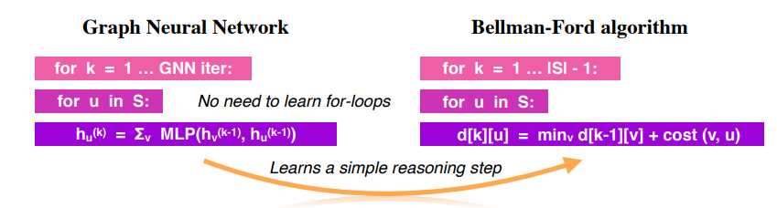

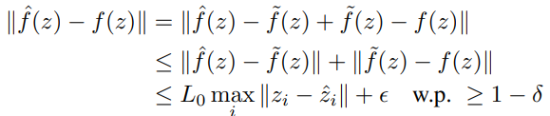




Related Works
Research Design
Previous Works
1. Algorithmic Alignment Proof & Intuition
With sample size M, if individual module $f_{i} i ∈\left[n\right]$ is guaranteed to have an error less than $ε$ to the true function with probability greater than 1 - $δ$, sequentially applying the modules for $i ∈\left[n\right]$ only at most linearly increases the error ($O\left(ε\right)$) with probability 1-$O\left(δ\right)$
Many layers (proof by induction)
*First module: by definition of algorithmic alignment
One layer
f: learned k+1th module
true k+1th module
z: output of learned kth module
output of true kth module
$O\left(ε\right)$ by Lipschitz
$O\left(ε\right)$ by Algorithm stability
$ε$ by algorithmic alignment

Slide 8
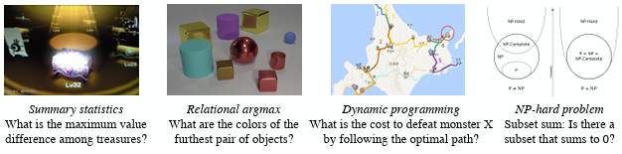
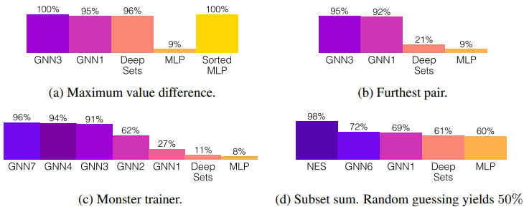
Related Works
Research Design
Previous Works
1. Algorithmic Alignment Empirical Justification
Multiple NN architectures (MLP, Deep Sets, GNN) were implemented to solve different kinds of (combinatorial) reasoning tasks where the more algorithmically aligned NN showed better performances given the same sample size
Reasoning Tasks
Performance

Slide 9

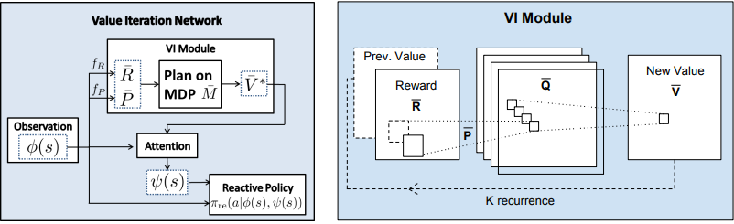
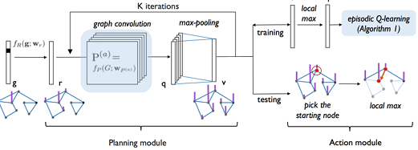
Related Works
Research Design
Previous Works
1. Architectures aligned to Value Iteration
Value Iteration Network [1] - Pioneer work that imitated Value Iteration based on CNN
Generalized Value Iteration Network [2] - Generalized VIN based on graph convolutions
[1] Tamar, A., Wu, Y., Thomas, G., Levine, S., Abbeel, P. (2016). Value Iteration Networks, NIPS
[2] Niu, S., Chen, S., Guo, H., Targonski, C., Smith, M.C., Kovačević, J. (2017). Generalized Value Iteration Networks: Life Beyond Lattices

Slide 10
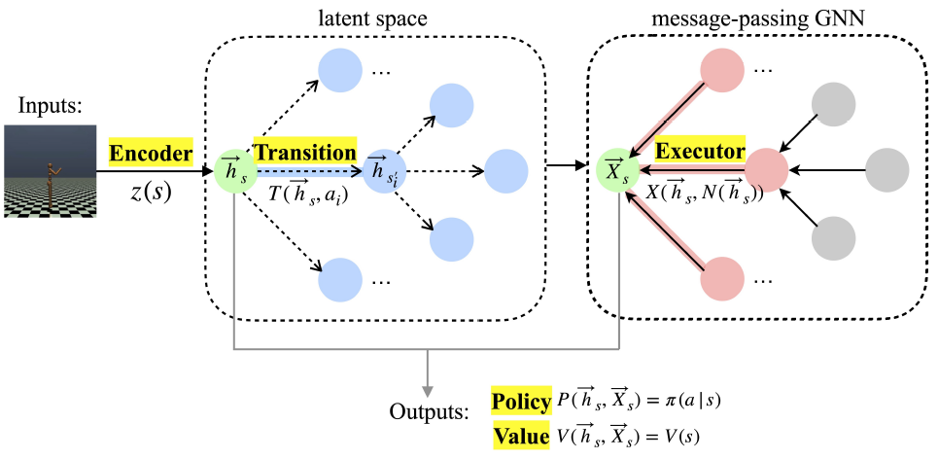
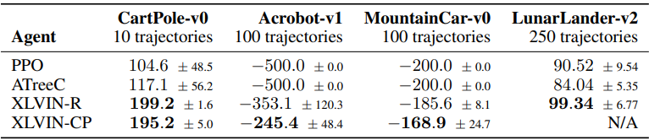
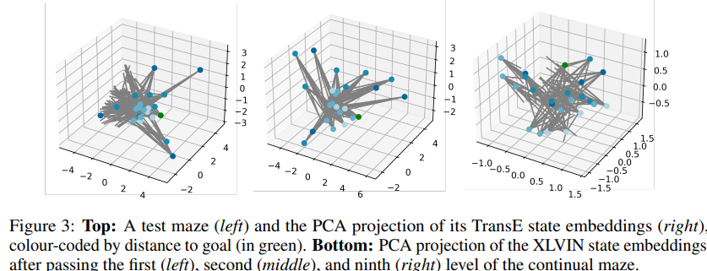

Related Works
Research Design
Previous Works
1. Architectures aligned to Value Iteration with Implicit Planning
XLVIN [1] - Encoder: consumes state representation and produces hidden state embeddings $h_{s}=z\left(s\right)$(CNN) - Transition: consumes state embedding $h_{s}$ and action to produce the next state embedding $h_{s′}$ (pretrained with MLP, TransE) - Executor: combines neighborhood $h_{s}$ to produce an updated embedding $x_{s}=X(h_{s} , N\left(h_{s}\right))$ (pretrained with GNN) - Policy/Value Tail: consumes hidden and updated state embeddings and outputs action probabilities or state-values $A(h_{s} ,x_{s})$
Method
Results
[1] Deac, A., Veličković, P., Milinković, O., Bacon, P., Tang, J., Nikolić, M. (2021). Neural Algorithmic Reasoners are Implicit Planners, NeurIPS

Slide 11












Related Works
Research Design
Previous Works
1. Unified Agent that moves between MF and MB variants
Agg2: MF-like vs MB-like
Agg1: SARSA-like vs Q-learning-like
Bellman Optimality
Agg2
Agg1
Bipartite Asynchronous GNN
S1
S1
$$m(s_{1})$$
$$h(s_{1},a_{1})$$
a1
S2
a1
*Agg by attention *h: hidden state-action embedding, m: hidden state embedding (cached)
S2
$$m(s_{2})$$
$$m(s_{2})$$
.
.
.
attn2
.
.
.
a2
a2
$$h(s_{n−1},a_{1})$$
.
.
.
.
$$m(s_{n−1})$$
$$h(s_{n−1},a_{2})$$
$$m(s_{n})$$
Sn-1
$$m(s_{n−1})$$
Sn-1
$$h(s_{n−1},a_{m})$$
am
am
attn1
Sn
$$m(s_{n})$$
Sn

Slide 12


Related Works
Research Design
Previous Works
1. Unified Agent that moves between MF and MB variants
Training
Pretraining 1) decode transition and reward from attn2 → loss_model = its MSE loss against true model 2) decode each iteration’s state-action value update from h(s,a) → loss_vi = its MSE loss against true value iteration update ⇒ separate or end-to-end pretraining with loss_model and loss_vi
Finetuning online reward update (original XLVIN used PPO)
*implementation concern1: pretraining may be a constraint but without it there is no inductive bias for the model to imitate value iteration
*implementation concern2: there is no guarantee that this neural network produces convergent value iteration (original Bellman Optimality Eqn. does because it is a contraction)
Attention Alternative
Decode → apply operator → encode back to the latent space
Mellowmax [1]: contraction
Softmax [2]: not a contraction, but converges to the original Bellman operator exponentially
[1] Asadi, K. and Littman, M. L. (2017) An alternative softmax operator for reinforcement learning, ICML [2] Zhao Song, Ronald E. Parr, Lawrence Carin (2019) Revisiting the Softmax Bellman Operator, ICML

Slide 13
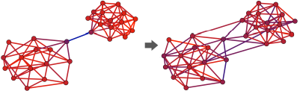
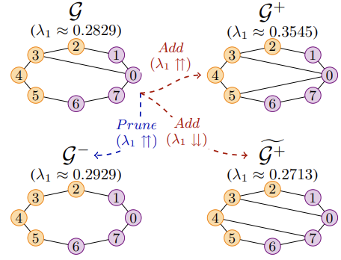
Related Works
Research Design
Previous Works
2. Oversquashing
Oversquashing is a key limitation of GNN where information that is multi-hop away may not be propagated well to the current node due to its repetitive neighborhood aggregation across multiple layers
Topping et al. (2022) formalized oversquashing with (1) Jacobian of hidden feature wrt. input node features (2) where (informally) its upper bound is lower bounded by Ricci curvature between two nodes on a graph ⇒ negative curvature induces information bottleneck of GNN, which can be mitigated by adding edges around it
Jamadandi et al. (2024) showed that deleting an edge of a graph may increase its spectral gap (second smallest eigenvalue of graph Laplacian, (informally) indicating information flow) based on Braess’ paradox ⇒ information flow may be enhanced by deleting edges whose effect on spectral gap may be monitored for its systematic deletion rule
negative
edges added
[1] Topping, J., Di Giovanni, F., Chamberlain, B. P., Dong, X., and Bronstein, M. M. (2022) Understanding over-squashing and bottlenecks on graphs via curvature, ICLR [2] Adarsh Jamadandi, Celia Rubio-Madrigal, Rebekka Burkholz (2024) Spectral Graph Pruning Against Over-Squashing and Over-Smoothing

Slide 14
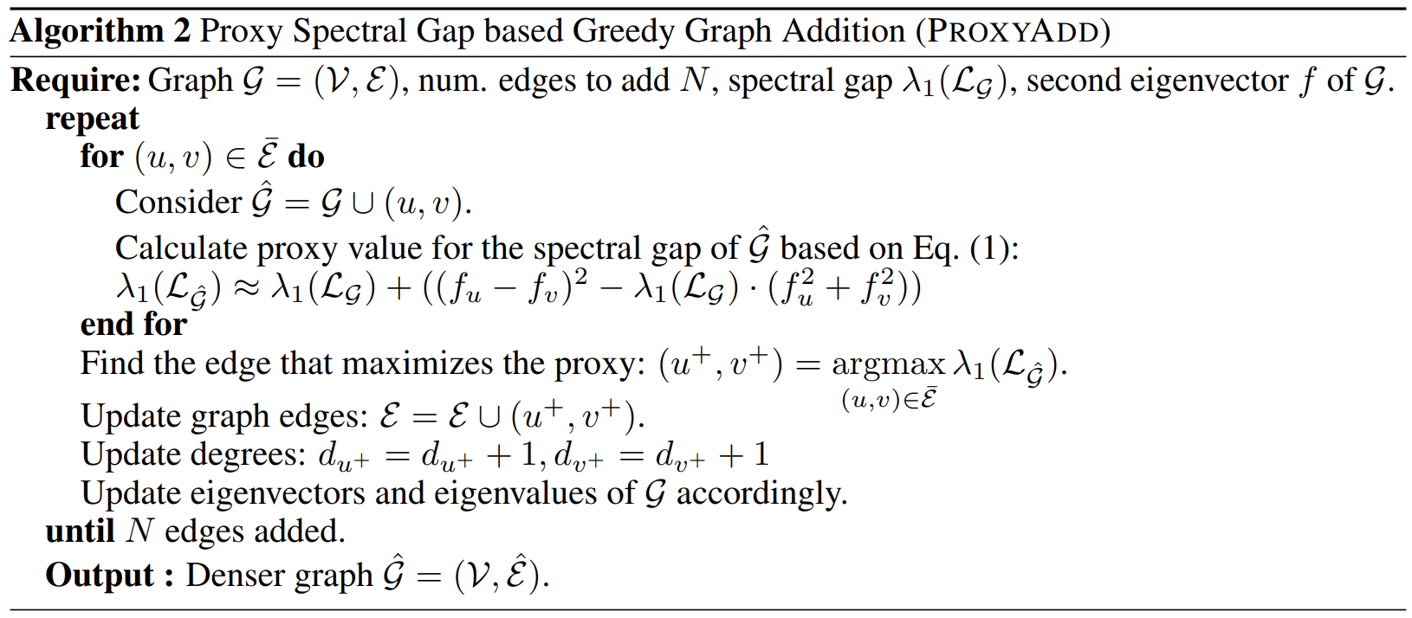
Related Works
Research Design
Previous Works
2. Relaxed Constraints on the Rollout Graph Structure (TBD)
Additional Parameters
Edge formation/deletion parameters regulating probability distribution on which edge to form/delete → form/delete edge above threshold
Observe edge formation/deletion and incurred spectral gap change depending on variables such as the task environment (e.g. goal specific, high uncertainty), message passing stage (e.g. later stages of value iteration)
[1] Adarsh Jamadandi, Celia Rubio-Madrigal, Rebekka Burkholz (2024) Spectral Graph Pruning Against Over-Squashing and Over-Smoothing

Slide 15
Related Works
Research Design
Previous Works
Theory
algorithmic alignment for the current architecture
attention Lipschitz,,, mellowmax softmax – regularized RL
relationship between attention entropy and reward vs task Q, transition entropy
algorithm development

Slide 16
Related Works
Research Design
Previous Works
fMRI Project Overview
1. Subject-wise Goal Decoding - goal decoding accuracy varied across subjects
2. Goal Decodability & Subject Characteristics - goal decoding accuracy correlated with subjects’ RL variables
3. Goal Decoding Model’s Latent & Subject Latent Characteristics - subjects’ RL variables decodable from goal decoding model’s latent layers - goal decoding model latent layers correlated with subjects’ RL parameters

Slide 17
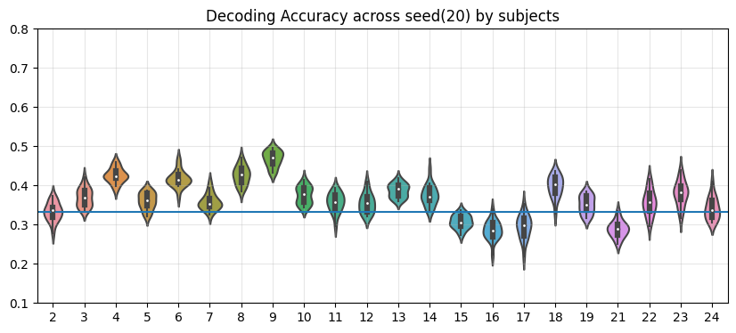
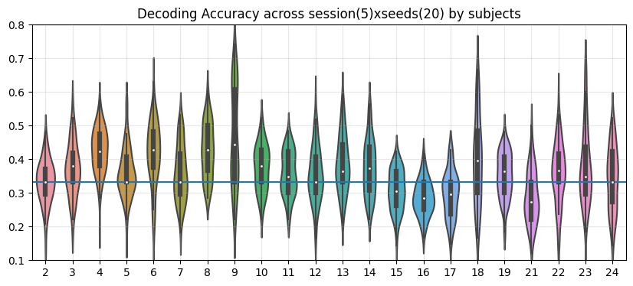
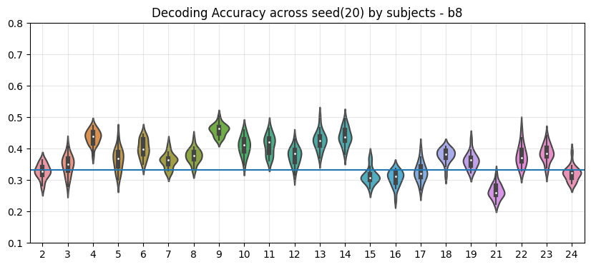
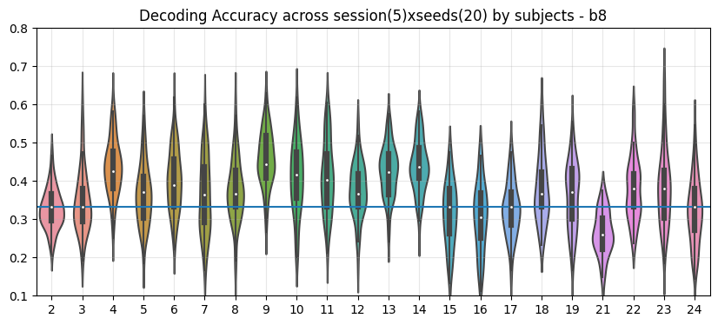
Related Works
Research Design
Previous Works
1. Subject-wise Goal Decoding
Both MLProi (signal averaged within each roi) and MLPvoxel resulted in goal decoding accuracy that are varying depending on subjects - ROIs (sphere 5): HPC, V1, Insula, Caudate, IT, vStriat, ilPFC (left and right separately), omPFC, FPC, pPut, vmPFC, rACC
MLProi
MLP
voxel

Slide 18
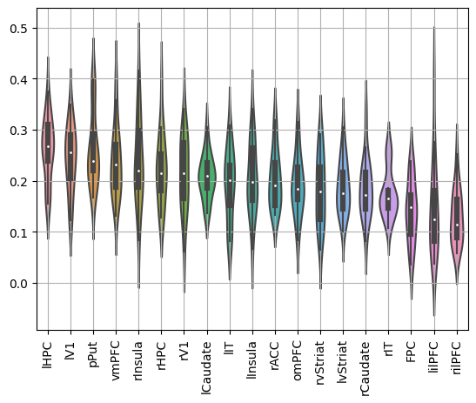
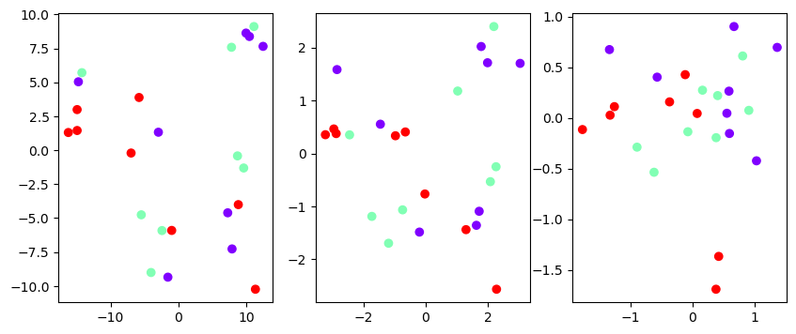
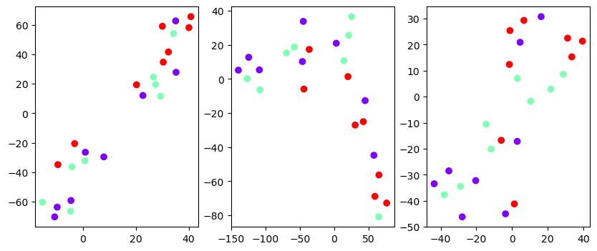
Related Works
Research Design
Previous Works
1. Subject-wise Goal Decoding Sanity Check
Influential Regions
Embedding Space of model latents depending on goal label (color)
PCA
tSNE

Slide 19
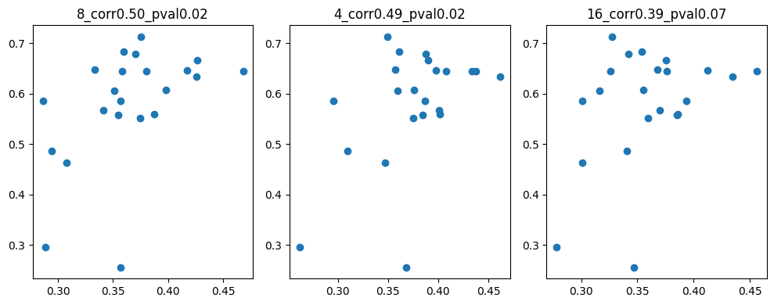
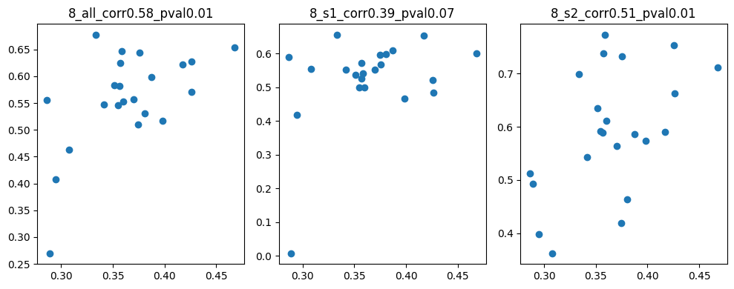
Related Works
Research Design
Previous Works
2. Goal Decodability & Subject Characteristics Behavioral Measure (MLProi)
mlp1
mlp2
mlp3
Success Rate
Goal Flexibility
all stages
s1
s2

Slide 20
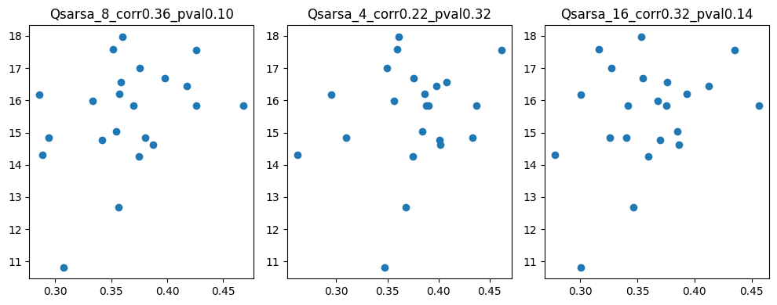
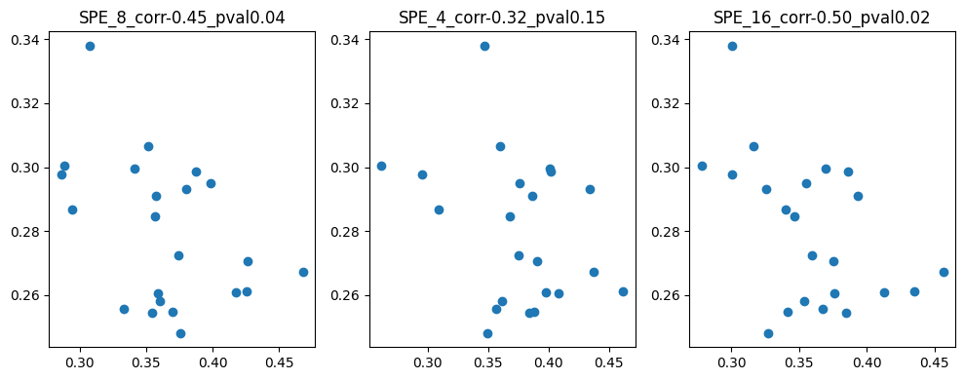
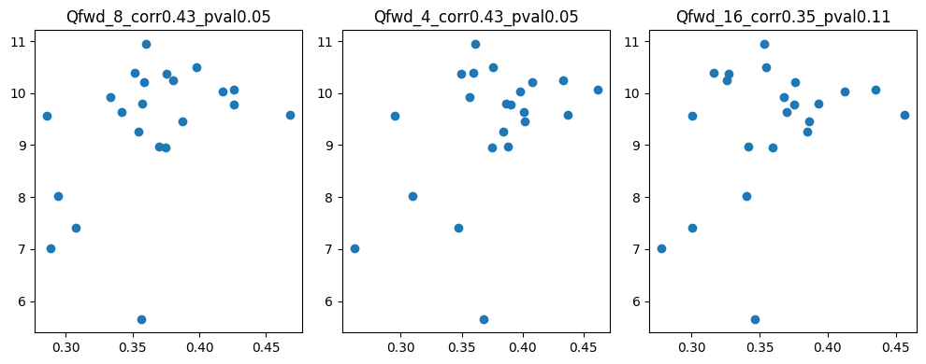
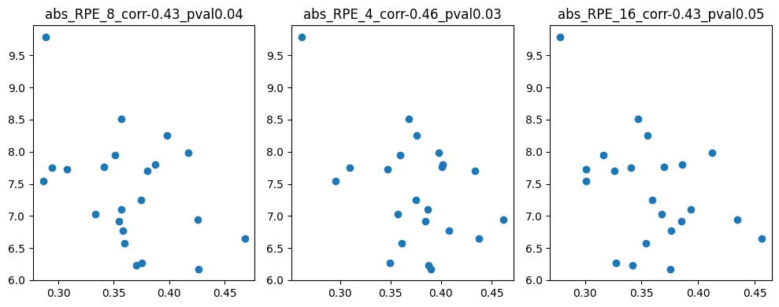
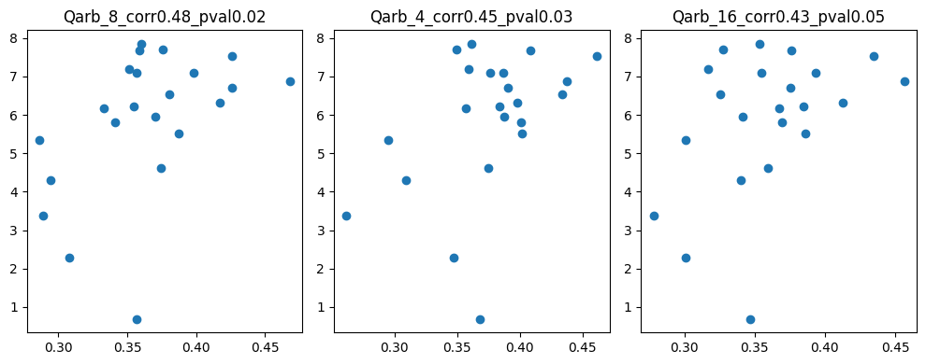
Related Works
Research Design
Previous Works
2. Goal Decodability & Subject Characteristics RL Variables (MLProi)
SPE
Qmf
Qmb
abs RPE
Qarb

Slide 21
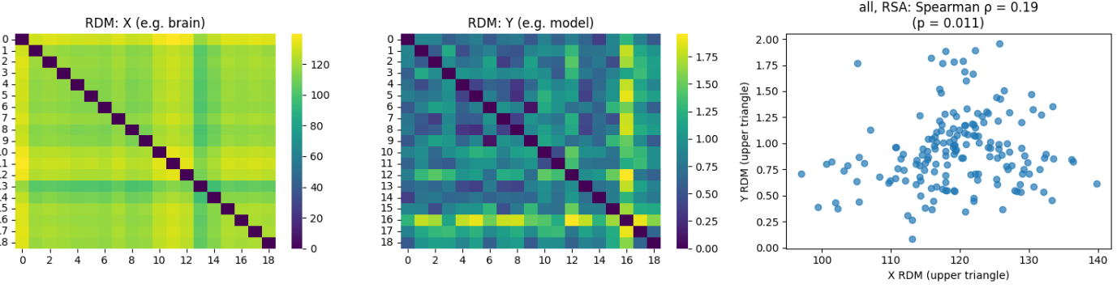
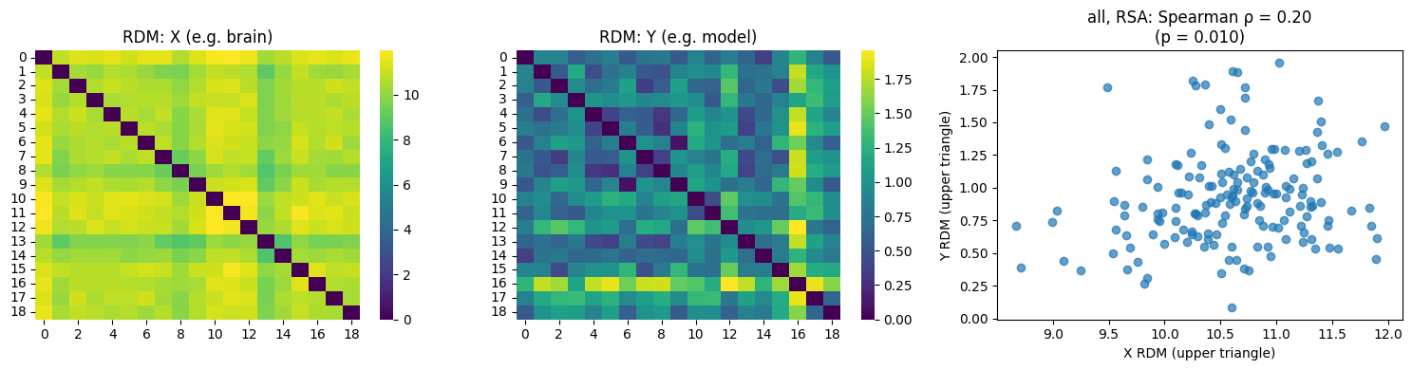
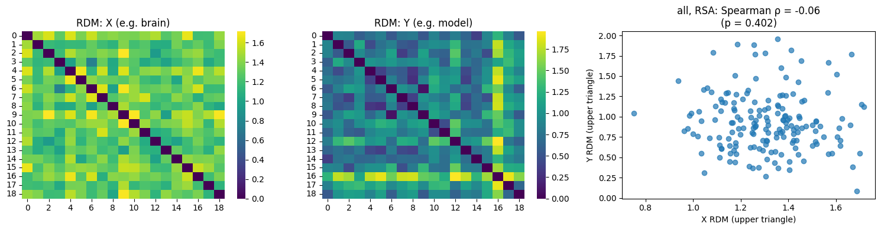
Related Works
Research Design
Previous Works
3. Goal Decoding Model’s Latent & Subject Latent Characteristics (MLPvoxel)
layer1
layer2
layer3

Slide 22
Thank You
2025.07.01 Lab Seminar

