Slide 1
CSE322
(CONVERTING REGULAR EXPRESSIONS TO REGULAR GRAMMARS)
Unit 3 : REGULAR GRAMMARS

Slide 2
REGULAR GRAMMAR
A Regular Grammar (RG) is a type of grammar used to generate Regular Languages.
Regular Languages are languages that can be described using regular expressions, finite automata, or regular grammars.
They represent the simplest class in the Chomsky hierarchy (Type-3).
The production rules of a Regular Grammar follow these patterns:
Right Linear Grammar
Left Linear Grammar
Notes:
Cpt S 317: Spring 2009
School of EECS, WSU

Slide 3
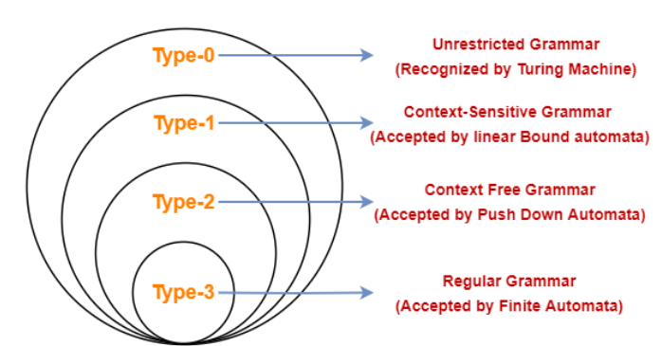
CHOMSKY HIERARCHY

Slide 4
A regular Grammar is a formal grammar that generates regular languages. It consists of:
Terminals: Symbols that form strings (e.g., a, b).
Non-terminals: Variables used to derive strings (e.g., S, A).
Production Rules: Rules for transforming non-terminals into terminals or other non-terminals.
Start Symbol: The non-terminal from which derivations begin.
Generates strings over {a, b} ending with a
Example:
S → aS | bA | a
A → bS | a
Notes:
Cpt S 317: Spring 2009
School of EECS, WSU

Slide 5
CONVERTING REGULAR EXPRESSIONS TO REGULAR GRAMMARS
The process involves these steps:
Step 1: Convert Regular Expression (RE) to NFA
Construct an NFA with epsilon transitions (ε-NFA) that accepts the given RE.
Step 2: Convert NFA to DFA
Eliminate epsilon transitions, then determinize the automaton (subset construction).
Step 3: Convert DFA to Regular Grammar
Each state in DFA → Non-terminal
Each transition → Production Rule
The final state → Produces ε (null string) if needed.
Notes:
Cpt S 317: Spring 2009
School of EECS, WSU

Slide 6
Example:
RE = (a+b)*a
This means: “All strings of a’s and b’s that end with an a.”
Step 1: Construct NFA with Epsilon Transitions
From RE = (a+b)*a
(a+b)\* → loop on a and b
Finally, a at the end
So NFA looks like:
q0 --a--> q0
q0 --b--> q0
q0 --a--> qf (final state)
a,b
a,b
q0
qf
a
Notes:
Cpt S 317: Spring 2009
School of EECS, WSU

Slide 7
Example:
Step 2: Convert to DFA
The DFA description:
States: Q = {q0, qf}
Alphabet: Σ = {a, b}
Transitions (δ):
  (q0, a) → q0 and also qf (since an a can end the string)
  (q0, b) → q0
  (qf, a) → qf
  (qf, b) → qf
Initial State: q0
Final State: qf
Notes:
Cpt S 317: Spring 2009
School of EECS, WSU

Slide 8
Example:
Step 3: Convert DFA to Regular Grammar
We define grammar G = (V, T, P, S)
V (Variables / Non-terminals) = {q0, qf}
T (Terminals) = {a, b}
S (Start symbol) = q0
P (Productions):
q0 → aq0 | bq0 → loop for (a+b)*
q0 → a | aqf → transition that ensures the string ends with a
qf → aqf | bqf → once we reach final, any continuation is possible
qf → a | b → allows termination
Therefore, q0 → aq0 | bq0 | a | aqf
qf → aqf | bqf | a | b
Notes:
Cpt S 317: Spring 2009
School of EECS, WSU

Slide 9
Example:
Example check for :
ba: q0 → bq0 → a → qf (Accept)
abba: q0 → a → q0 → bq0 → bq0 → a → qf (Accept)
Notes:
Cpt S 317: Spring 2009
School of EECS, WSU

Slide 10
RE = ab*
This means: “A string that starts with a followed by zero or more b’s.”
Step 1: Construct NFA with Epsilon Transitions
From RE = ab*:
First symbol must be a.
After that, zero or more bs are allowed.
So NFA looks like:
q0 --a--> q1
q1 --b--> q1 (loop for b*)
q1 is a final state
Step 2: Convert to DFA
The DFA description:
States: Q = {q0, q1}
Alphabet: Σ = {a, b}
Transitions (δ):
  (q0, a) → q1
  (q1, b) → q1
Initial State: q0
Final State: q1

Slide 11
Step 3: Convert DFA to Regular Grammar
We define grammar G = (V, T, P, S)
V (Variables / Non-terminals) = {S, A}
(S = q0, A = q1)
T (Terminals) = {a, b}
S (Start symbol) = S
P (Productions):
S → aA
A → bA | ε
Example String Derivations:
"a“: S → aA → aε → a ✅
"abbb“: S → aA → abA → abbA → abbbA → abbbε ✅
Thus, grammar successfully generates the same language as RE = ab*.

Slide 12
REGULAR GRAMMAR
A formal grammar used to describe regular languages (recognized by finite automata).
One of the simplest and most fundamental models in the Chomsky hierarchy.
Widely used in computer science for:
  Lexical analysis
  Pattern matching
  Text processing
Known for efficiency and straightforward structure.
Types of Regular Grammar:
Right-Linear Grammar
Left-Linear Grammar
Both follow strict production rule formats to ensure the language remains regular.
Notes:
Cpt S 317: Spring 2009
School of EECS, WSU

Slide 13
Right Linear Grammar (RLG)
Right Linear Grammars are special type of CFGs, where each production rule has at most 1 variable on RHS & that variable is on right most position.
A ⇢ xB
A ⇢ x
where A,B ∈ V and x ∈ T*
Example 1: S -> aA | B
A -> aaB
B -> bB | a
Grammar G is right-linear
Notes:
Cpt S 317: Spring 2009
School of EECS, WSU

Slide 14

Example 2: FA for accepting strings that start with b
Finite Automata
∑ = {a, b}
Initial state(q₀) = A
Final state(F) = B
The RLG corresponding to FA is
A ⇢ bB
B ⇢ ∈/aB/bB
The regular language corresponding to RLG is
L= {b, ba, bb, baa, bab, bba, bbb, ... }

Slide 15
If we reverse the above production of the above RLG, then we get
A ⇢ Bb
B ⇢ ∈/Ba/Bb
It derives the language that contains all the strings which end with b.
i.e. L' = {b, bb, ab, aab, bab, abb, bbb, ...}
After reversing RLG we get LLG which represents language L'(i.e. reverse of L).
Notes:
Cpt S 317: Spring 2009
School of EECS, WSU

Slide 16
Left Linear Grammar (LLG)
Left Linear Grammars are Special type of CFGs, where Each Production Rule has At Most 1 Variable on RHS & that variable is on Left Most position.
A ⇢ Bx
A ⇢ x
where A,B ∈ V and x ∈ T*
Example 1 :
A -> Da | Bc | b
B -> Bf | Ca | a
C -> Ca | D
D -> 𝛆
Notes:
Cpt S 317: Spring 2009
School of EECS, WSU

