Slide 1
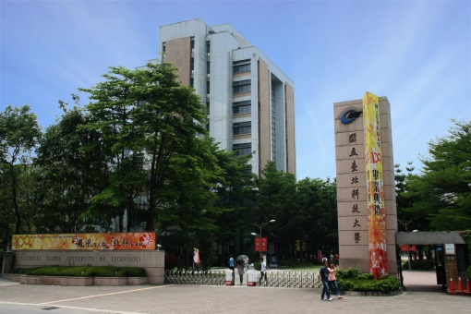

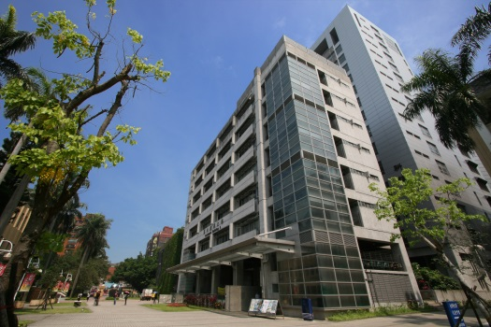

Arrays, Stacks, and Queues
Chuan-Ming Liu
Computer Science & Information Engineering
National Taipei University of Technology
Taiwan

Slide 2
Contents
Arrays
Stacks
Queues
Double Ended Queues

Slide 3
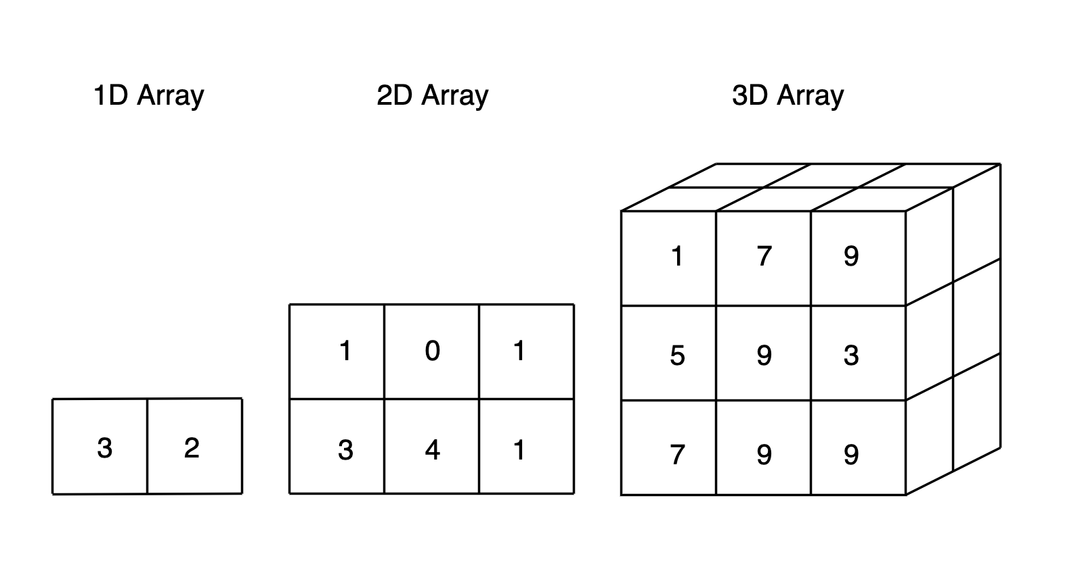
Array ADT
Objects: A set of pairs <index, value> where for each value of index there is a value from the item set.
Operations:
Create()
Retrieve()
Store() (or, Insert() )
Delete() (or, Remove() )
A pair is referred to as an entry.
https://towardsdatascience.com/numpy-array-cookbook-generating-and-manipulating-arrays-in-python-2195c3988b09

Slide 4
Managing an Array
Let
the maximum number of scores the array can store be represented by maxEntries.
the variable numEntries keep the number of entries currently in the array.
If numEntries < maxEntries, we let the rest cells in the array store null references.
If numEntries = maxEntries, the array is full.

Slide 5
Example – Storing High Scores
Consider an application for storing entries in an array – high score entries for a video game
What should be included in a high score entry
score: integer
name: string
date
etc …
We consider two fields: score and name in an entry.

Slide 6
Example – High Score Array
entry
index
0
1
2
i
n-1
name
name
name
…
name
…
name
score
score
score
score
score
value

Slide 7
Array Operations
If the values in the entries are comparable, we can further have two types of arrays: sorted and unsorted arrays.
Sorted Arrays:
all the entries are kept according to the order of values
easy to find a specific entry using the corresponding key
an effort is necessary for insertion and removal
Unsorted Arrays:
all the entries are stored arbitrarily
searching a specific entry usually needs a linear scan
easy to insert and remove an entry

Slide 8
Insertion
Inserting an entry to an array
One of the most common update to an array
Note that we are working on storing high scores
How do we perform the action?
If the array is not full, add it
Else, if the new score is larger than the lowest score, replace the new entry with the lowest one

Slide 9
Challenges
If the entries in the array are arranged left-to-right from the highest score to the one with lowest score, what we will do for insertion?
0
1
2
3
4
5
6
7
8
9
116
99
89
78
56
34
90
new entry

Slide 10
Removal
Remove and return an entry from the array
How to implement the operation:
If the index is out of bound, an exception
Else, remove the entry according to the index and all the entries on the right shift one position to the left
0
1
2
3
4
5
6
7
8
9
116
99
89
78
56
34

Slide 11
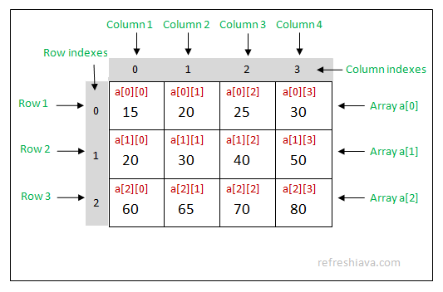
Two-dimensional Arrays
A two-dimensional array
is an array with each of its cells being another array
is sometimes called a matrix
https://refreshjava.com/java/multi-dimensional-array

Slide 12
Extendable Arrays
When an overflow occurs and method insert (add, or push) is called,
Allocate a new array B of size 2N
Copy A to B
Set A=B (now |A|=2N)
Insert the new element in A
This array replacement strategy is known as an extendable array

Slide 13
Growing an Extendable Array
How large should the new array be?
incremental strategy: increase the size by a constant c
doubling strategy: double the size
A
B
A

Slide 14
Comparison of the Strategies
The insertion of an element to be the last element is defined as a push operation
Comparing by analyzing the total time T(n) needed to perform a series of n push operations
Assume that we start with an empty stack represented by an array of size 1
We call amortized time of a push operation the average time taken by a push over the series of operations, i.e., T(n)/n

Slide 15
Incremental Strategy Analysis
We replace the array k = n/c times
The total time T(n) of a series of n push operations is proportional to
n + c + 2c + 3c + 4c + … + kc =
n + c(1 + 2 + 3 + … + k) =
n + ck(k + 1)/2
Since c is a constant, T(n) is O(n + k²), i.e., O(n²)
The amortized time of a push operation is O(n)

Slide 16
An array of size 4 and 20 push operations
n=20
c=4
k=20/4=5
20+4*(1+2+3+4+5)
5*4
4*4
3*4
2*4
1*4

Slide 17
Doubling Strategy Analysis
We replace the array k = log₂ n times
Total time T(n) of a series of n push operations is proportional to
n+1×2^{k-1}+2×2^{k-2} +3×2^{k-3}+…+k×2⁰+(log n+1)
≤ 3n +(log n+1)
T(n) is O(n)
The amortized time of a push operation is O(1)
≤ 2n

Slide 18
An array of size 4 and 20 push operations
n=20
c=4
k=log 20
…
3×2¹
2×2²
2³

Slide 19
Using Charging Credits to Count
$
$
$
$
$
$
$
$
$
$
Each push we charge 3 credits: one for insertion and
the other two for copies.

Slide 20
Contents
Arrays
Stacks
Queues
Double Ended Queues

Slide 21

Stacks
A stack is a container of objects that are inserted and removed according to the last-in first-out (LIFO) principle.
Examples:
Cafeteria plate dispenser
Web browser
Two major operations
Push
Pop
top
bottom

Slide 22
Applications of Stacks
Direct applications
Page-visited history in a Web browser
Undo sequence in a text editor
Chain of method calls in the Java Virtual Machine
Indirect applications
Auxiliary data structure for algorithms
Component of other data structures

Slide 23
Stack ADT
The stack ADT stores arbitrary objects and supports two methods:
push(o): insert an element o at the top
pop( ): remove and return the last inserted element
Additional operations for managing a stack
size( ): return the number of elements in the stack
isEmpty( ): indicate whether no elements are stored
top( ): return the last inserted element without removing it

Slide 24
Array-based Stacks
Using an n-element array S with an integer t
n is fixed (max # of objects stored in the array)
t is the index and starts at 0 as well as ends at n-1
Via two steps:
Construct an array with its size
Implement the methods
Array S may become full
push operation on a full array causes an error

Slide 25
Pseudo-code – Array-based Stacks
Algorithm size()
return t + 1
Algorithm pop()
if isEmpty() then
print “stack is empty, stops”
else
t ← t − 1
return S[t + 1]
Algorithm push(o)
if t = S.length − 1 then
print “stack is full, stops”
else
t ← t + 1
S[t] ← o
…
S
0
1
2
t

Slide 26
Performance and Limitations
Performance
The space used is O(n)
Each operation runs in time O(1)
Limitations
The maximum size of the stack must be defined a priori and cannot be changed
Trying to push a new element into a full stack causes an implementation-specific exception

Slide 27
Reversing an Array
Recall the problem of reversing an array
The solution becomes straightforward when using a stack
Main idea: the LIFO property

Slide 28
Matching Parentheses
Matching parentheses problem:
matching of grouping symbols in an arithmetic expression with a single left-to-right scan
Give: a token sequence X=x₀x₁x₂…x_{n-1}
Problem: if all the grouping symbols in X match
Each “(”, “{”, or “[” must be paired with a matching “)”, “}”, or “]”
correct: ()( )(( )){([( )])}
incorrect: )(( )){([( )])}
incorrect: ({[ ])}

Slide 29
Parentheses Matching Algorithm
Algorithm ParenMatch(X,n):
Input: An array X of n tokens, each of which is either a grouping symbol, a
variable, an arithmetic operator, or a number
Output: true if and only if all the grouping symbols in X match
Let S be an empty stack
for i=0 to n-1 do
if X[i] is an opening grouping symbol then
S.push(X[i])
else if X[i] is a closing grouping symbol then
if S.isEmpty() then
return false {nothing to match with}
if S.pop() does not match the type of X[i] then
return false {wrong type}
if S.isEmpty() then
return true {every symbol matched}
else
return false {some symbols were never matched}

Slide 30
HTML Tag Matching
<body>
<center>
<h1> The Little Boat </h1>
</center>
<p> The storm tossed the little
boat like a cheap sneaker in an
old washing machine. The three
drunken fishermen were used to
such treatment, of course, but
not the tree salesman, who even as
a stowaway now felt that he
had overpaid for the voyage. </p>
<ol>
<li> Will the salesman die? </li>
<li> What color is the boat? </li>
<li> And what about Naomi? </li>
</ol>
</body>
The Little Boat
The storm tossed the little boat
like a cheap sneaker in an old
washing machine. The three
drunken fishermen were used to
such treatment, of course, but not
the tree salesman, who even as
a stowaway now felt that he had
overpaid for the voyage.
1. Will the salesman die?
2. What color is the boat?
3. And what about Naomi?

Slide 31
Contents
Arrays
Stacks
Queues
Double Ended Queues

Slide 32
Queues
A queue is a container of objects that are inserted and removed according to the first-in first-out (FIFO) principle.
Examples:
Barber shops
Waiting lines
Two major operations
Enqueue
Dequeue
grows in this direction
1
2
3
4
5
6
7
…
front
(delete or dequeue)
rear
(insert, add, or enqueue)

Slide 33
Applications of Queues
Direct applications
Waiting lists, bureaucracy
Access to shared resources (e.g., printer)
Multiprogramming
Indirect applications
Auxiliary data structure for algorithms
Component of other data structures

Slide 34
Queue ADT
The queue ADT stores arbitrary objects and supports two methods:
enqueue(o): inserts an object o at the rear
dequeue(): removes and returns the object at the front
Additional operations for managing a queue
size(): returns the number of elements in the queue
isEmpty(): indicates whether no elements are stored
front(): returns the front object without removing it

Slide 35
Array-based Queue(1)
Similar to the array-based stack
Using an n-element array Q
Q[0] is the front and Q grows from there
Array location r is kept empty
The space usage is O(N), where N is the size of the array
Note that the space is fixed after the queue is instantiated.

Slide 36
Array-based Queue(2)
Not efficient to perform a dequeue operation at the front – O(n) time where n is the current number of elements in the queue. (Why?)
Possibly,
There still exists a problem:
The rear may reach the end of the array soon.
Q
0
1
2
f
r

Slide 37
Circular Array-based Queue(1)
Use an array of size N in a circular fashion
Two variables keep track of the front and rear
f : index of the front element
r : index immediately past the rear element
Array location r is kept empty
Q
0
1
2
f
r

Slide 38
Circular Array-based Queue(2)
Avoid moving elements in the queue
Queue Q is empty iff. f=r
Using modulo (mod) operator
Remainder of division
dequeue: f=(f+1) mod N
enqueue: r=(r+1) mod N
Queue Q is a circular array

Slide 39
Configurations
normal configuration
Q
0
1
2
f
r
wrapped-around configuration
Q
0
1
2
r
f

Slide 40
Queue Operation – Enqueue
Operation enqueue may meet the case that the queue is full
Need to handle the queue when it is full.
Algorithm enqueue(o)
if size() = N − 1 then
print “the queue is full, stop”
else
Q[r] ← o
r ← (r + 1) mod N
Q
0
1
2
f
r
Q
0
1
2
r
f

Slide 41
Queue Operation – Dequeue
Operation dequeue may meet the case that the queue is empty
Need to handle the queue when it is empty.
Algorithm dequeue()
if isEmpty() then
print “the queue is empty, stop”
else
o ← Q[f]
f ← (f + 1) mod N
return o
Q
0
1
2
f
r
Q
0
1
2
r
f

Slide 42
Queue Operation – Others
We use the modulo operator (remainder of division)
Algorithm size()
return (N − f + r) mod N
Algorithm isEmpty()
return (f = r)
Q
0
1
2
f
r
Q
0
1
2
r
f

Slide 43
Is the Queue Full?
Does f=r mean that queue Q is empty?
No!! It could be full
To judge a circular-array based queue Q is full, we may use a constraint that
Q can not hold more than N-1 objects
size = (N-f+r) mod N
When size = N-1, Q is full and our method will signal that no more object can be inserted

Slide 44
Performance and Limitations
Performance
The space used is O(n)
Each operation runs in time O(1)
Limitations
The maximum size of the queue must be defined a priori and cannot be changed
Trying to enqueue a new element into a full queue causes an implementation-specific exception

Slide 45
Round Robin Schedulers
Iterate through a collection of elements in a circular fashion
Example: time-sharing scheme in OS
Using a queue, Q, by repeatedly performing the following steps:
e = Q.dequeue()
Service element e
Q.enqueue(e)
The Queue
1
.
Deque the
2
.
Service the
3
.
Enqueue the
next element
next element
serviced element
Shared
Service

Slide 46
Contents
Arrays
Stacks
Queues
Double Ended Queues

Slide 47
Double-Ended Queues
A double-ended queue (or deque) is basically a queue and supports insertion and deletion at both the front and the rear of the queue
Major operations
insertFirst(e): insert a new element at the beginning
insertLast(e): insert a new element at the end
removeFirst(): remove and return the element at the beginning
removeLast(): remove and return the element at the end

Slide 48
Deque ADT
The deque ADT stores arbitrary objects and supports the following methods:
insertFirst(o): inserts an object o at the beginning
insertLast(o): inserts an object o at the end
removeFirst(): removes and returns the object at the beginning
removeLast(): removes and returns the object at the end
Additional operations for managing a deque
size(): returns the number of objects in the queue
isEmpty(): indicates whether no objects are stored
first(): returns the first object without removing it
last(): returns the first object without removing it

Slide 49
Case Study: Polish Notation
Methods of writing all operators before their operands, after them, or between them can be classified as
Before: prefix form (Polish form)
After: postfix form (or, suffix form)
Between: infix form
Example: the expression (infix form) a+b becomes +ab in prefix form and ab+ in postfix form.

Slide 50
Examples
Infix | Postfix | Prefix | Notes
A * B + C / D | A B * C D / + | + * A B / C D | multiply A and B, divide C by D, add the results
A * (B + C) / D | A B C + * D / | / * A + B C D | add B and C, multiply by A, divide by D

Slide 51
Infix Notation
Infix notation
the most common way to write expression
Parentheses are used to override the precedence of operators
Example: consider 7-2*3
In general, 7-2*3=1
However, it is possible that (7-2)*3=15 and parentheses are necessary

Slide 52
Parenthesis-free Notations
With polish notation or postfix notation, the parentheses are not necessary and the presented expression is unambiguous.
Example: consider again 7-2*3 in infix form
The prefix form, -7*23, corresponds to the general infix form without parentheses
The prefix form, *-723, corresponds to the infix form with parentheses of (7-2)*3

Slide 53
Postfix Notations
Compilers typically use parenthesis-free notations to interpret mathematical expressions
Prefix notation of simple arithmetic is largely of academic interest
Postfix notation of simple arithmetic is commonly used among compilers
Example: 7-2*3 in infix form
The postfix form, 723*-, corresponds to the general infix form without parentheses
The postfix form, 72-3*, corresponds to the infix form with parentheses of (7-2)*3

Slide 54
Evaluating Postfix Expressions
Given a postfix expression, one can evaluate this expression with a single left-to-right scan
Consider the following postfix expression
246+*
The answer is 2*(4+6) = 20 using infix form
How to evaluate it directly?

Slide 55
Ideas
10
20
2
4
6
+
*
6
postfix expression
4
2
stack

Slide 56
Pseudo-code
Algorithm PostfixEvaluation(expression)
Initialize a stack S
Scan the expression from left to right character by character
If (character c is an operand) then
push(S, c)
else /* c is an operator */
a=pop(S); b=pop(S);
calculate the result as value
push(S, value)
Return pop(S)

Slide 57
Infix to Postfix
Given an infix expression, how to convert the expression into postfix form?
Manual Conversion
Fully parenthesize the expression.
Change all infix notations in each parenthesis to postfix notation, starting from the innermost expression.
Remove all parenthesis.

Slide 58
Example by Manual Conversion
(A+B)*C+D+E*F-G
((A+B)*C)+D+(E*F)-G
(((((A+B)*C)+D)+(E*F))-G)
(((((AB+)C*)+D)+(EF*))-G)
((((AB+C*) D+) (EF*)+)G-)
AB+C* D+EF*+G-

Slide 59
Algorithmic Conversion
Let’s start with a simple case, A*B
The answer is easy and we can derive AB* by postponing putting it in the output
Approach will fail for A*B+C
To have the right conversion for A*B+C, we can fix our rule as
Postpone an operator only until we get another operator
Still fail for other cases, like A+B*C

Slide 60
Rules for Conversion
The problem exists in the precedence of the operators
So, when converting from infix to postfix, we need to consider the precedence too
When we need to push an operator into the stack,
if its precedence is higher than the operator at the top of the stack, we go ahead and push it
else, before pushing it, the operator at the top of the stack is popped and placed in the output expression (Note: this action should be repeatedly at the top)

Slide 61
Example
infix
postfix
*
A
+
B
*
C
A
B
C
+
We did not consider the parentheses yet. Please think about how to convert when there exist parentheses.
stack

