Slide 1
Maps and Dictionaries
Chuan-Ming Liu
Computer Science & Information Engineering
National Taipei University of Technology
Taiwan

Slide 2
Contents
Maps and Dictionary
Hash Tables
Ordered Search Tables
Skip Lists

Slide 3
Maps
A map models a searchable collection of key-value entries (k, v), where k is the key and v is its corresponding value
Each key should be unique
Multiple entries with the same key are not allowed
The main operations of a map are for searching, inserting, and deleting items
Applications:
address book
student-record database

Slide 4

The Map ADT
Map ADT methods:
get(k): return the associated value of key k
put(k, v): if key k does not exist, then insert entry (k, v) into the map and return null; else, replace with v and return the old value associated with k
remove(k): remove the entry of key k and return the associated value
size(), isEmpty()

Slide 5
Example
Operation Output Map
isEmpty() true Ø
put(5,A) null (5,A)
put(7,B) null (5,A),(7,B)
put(2,C) null (5,A),(7,B),(2,C)
put(8,D) null (5,A),(7,B),(2,C),(8,D)
put(2,E) C (5,A),(7,B),(2,E),(8,D)
get(7) B (5,A),(7,B),(2,E),(8,D)
get(4) null (5,A),(7,B),(2,E),(8,D)
get(2) E (5,A),(7,B),(2,E),(8,D)
size() 4 (5,A),(7,B),(2,E),(8,D)
remove(5) A (7,B),(2,E),(8,D)
remove(2) E (7,B),(8,D)
get(2) null (7,B),(8,D)
isEmpty() false (7,B),(8,D)

Slide 6
A Simple List-Based Map
We can simply implement a map using an unsorted list
We store the items of the map in a list S (based on a doubly-linked list), in arbitrary order
header
nodes/positions
trailer
9
c
6
c
5
c
8
c
entries

Slide 7
The get(k) Algorithm
Algorithm get(k):
B = S.positions() {B is an iterator of the positions in S}
while B.hasNext() do
p = B.next() {the next position in B}
if p.element().getKey() = k then
return p.element().getValue()
return null {there is no entry with key equal to k}

Slide 8
The put(k, v) Algorithm
Algorithm put(k,v):
B = S.positions()
while B.hasNext() do
p = B.next()
if p.element().getKey() = k then
t = p.element().getValue()
B.srt(p,(k,v))
return t {return the old value}
S.addLast((k,v))
n = n + 1 {increment variable storing number of entries}
return null {there was no previous entry with key equal to k}

Slide 9
The remove(k) Algorithm
Algorithm remove(k):
B =S.positions()
while B.hasNext() do
p = B.next()
if p.element().getKey() = k then
t = p.element().getValue()
S.remove(p)
n = n – 1 {decrement number of entries}
return t {return the removed value}
return null {there is no entry with key equal to k}

Slide 10
Performance of a List-Based Map
Performance:
put, get and remove methods all take O(n) time since in the worst case (the item is not found) we traverse the entire sequence to look for an item with the given key
The unsorted list implementation is effective only for maps of small size or for maps in which puts are the most common operations, while searches and removals are rarely performed (e.g., historical record of logins to a workstation)

Slide 11
Dictionaries
Like a map, a dictionary models a searchable collection of key-element entries.
The main operations of a dictionary are searching, inserting, and deleting items
Multiple items with the same key are allowed
Two types:
Unordered dictionary (unsorted lists, hash tables)
Ordered dictionary (ordered search tables)

Slide 12
Dictionary ADT
Methods:
find(k): if the dictionary has an entry with key k, returns it, else, returns null
findAll(k): return an iterator of all entries with key k
insert(k, o): insert and return the entry (k, o)
remove(e): remove the entry e from the dictionary
size(), isEmpty()

Slide 13
Example
Operation Output Dictionary
insert(5,A) (5,A) (5,A)
insert(7,B) (7,B) (5,A),(7,B)
insert(2,C) (2,C) (5,A),(7,B),(2,C)
insert(8,D) (8,D) (5,A),(7,B),(2,C),(8,D)
insert(2,E) (2,E) (5,A),(7,B),(2,C),(8,D),(2,E)
find(7) (7,B) (5,A),(7,B),(2,C),(8,D),(2,E)
find(4) null (5,A),(7,B),(2,C),(8,D),(2,E)
find(2) (2,C) (5,A),(7,B),(2,C),(8,D),(2,E)
findAll(2) (2,C),(2,E) (5,A),(7,B),(2,C),(8,D),(2,E)
size() 5 (5,A),(7,B),(2,C),(8,D),(2,E)
remove(find(5)) (5,A) (7,B),(2,C),(8,D),(2,E)
find(5) null (7,B),(2,C),(8,D),(2,E)

Slide 14
A List-Based Dictionary
A log file or audit trail is a dictionary implemented by means of an unsorted list
Performance:
insert takes O(1) time since we can insert the new item at the beginning or at the end of the sequence
find and remove take O(n) time since in the worst case (the item is not found) we traverse the entire sequence to look for an item with the given key
The log file is effective only for dictionaries of small size or for dictionaries on which insertions are the most common operations, while searches and removals are rarely performed (e.g., historical record of logins to a workstation)

Slide 15
The findAll(k) Algorithm
Algorithm findAll(k):
Input: A key k
Output: An iterator of entries with key equal to k
Create an initially-empty list L
B = D.entries()
while B.hasNext() do
e = B.next()
if e.getKey() = k then
L.addLast(e)
return L

Slide 16
insert and remove Methods
Algorithm insert(k,v):
Input: A key k and value v
Output: The entry (k,v) added to D
Create a new entry e = (k,v)
S.addLast(e) {S is unordered}
return e
Algorithm remove(e):
Input: An entry e
Output: The removed entry e or null if e was not in D
{We don’t assume here that e stores its location in S}
B = S.positions()
while B.hasNext() do
p = B.next()
if p.element() = e then
S.remove(p)
return e
return null {there is no entry e in D}

Slide 17
Contents
Maps and Dictionary
Hash Tables
Ordered Search Tables
Skip Lists

Slide 18
Hash Tables
One of the most efficient ways to implement a map is to use a hash tables.
The worst case running time of map operations in an n-entry hash table is O(n), but a hash table can usually perform the operations in O(1) expected time.
A hash table consists of two major components
Bucket array
Hash function

Slide 19
Bucket Arrays
A bucket array for a hash table is an array A of size N, where each cell of A is though of as a “bucket” and N is the capacity of the array.
If keys are unique in the range [0, N-1], then each bucket holds at most one entry and all the operations can be done in O(1) time.
Two drawbacks:
Wasting space: N>>n, n is the number of entries
Hard to have keys in the range of [0, N-1]

Slide 20
Figure – A Bucket Array
0
1
2
3
4
5
6
7
8
9
(1, D)
(3, C)
(6, A)
(7, Q)
(3, F)
(6, C)
(3, Z)

Slide 21
Hash Functions
A hash function h maps each key of a given type to an integer in a fixed interval [0, N - 1].
Example: h(x) = x mod N is a hash function for integer keys.
The integer h(x) is called the hash value of key x and is an index to the bucket array.
When implementing a map with a hash table, the goal is to store item (k, v) at index i = h(k).

Slide 22
Example
0
∅
We design a hash table for a map storing entries as (SSN, Name), where SSN (social security number) is a nine-digit positive integer
Our hash table uses an array of size N = 10,000 and the hash function
h(x) = last four digits of x
1
025-612-0001
2
981-101-0002
3
∅
4
451-229-0004
…
9997
∅
9998
200-751-9998
9999
∅
Is there any problem to use such a hash table?
A collision occurs when two or more
keys having the same hash value.

Slide 23
Hash Functions
A hash function is usually specified as the composition of two functions:
Hash code: h₁: keys → integers
Compression function: h₂: integers → [0, N - 1]
The hash code is applied first, and the compression function is applied next on the result, i.e., h(x) = h₂(h₁(x))
The goal is to “disperse” the keys in an apparently random way

Slide 24
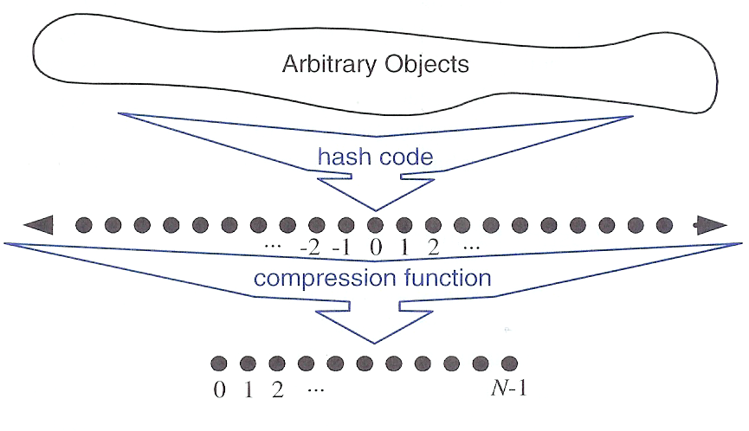
Two Parts of a Hash Function

Slide 25
Hash Codes
Memory address:
reinterpret the memory address of the key object as an integer
Good in general, except for numeric and string keys
Integer cast:
reinterpret the bits of the key as an integer
Suitable for keys of length less than or equal to the number of bits of the integer type
Component sum:
partition the bits of the key into components of fixed length (e.g., 16 or 32 bits) and we sum the components (ignoring overflows)
Suitable for numeric keys of fixed length greater than or equal to the number of bits of the integer

Slide 26
Polynomial Hash Codes
Steps:
Partition the bits of the key into a sequence of components of fixed length (e.g., 8, 16 or 32 bits): a₀ a₁ … a_{n-1}
Evaluate the polynomial
p(z) = a₀ + a₁ z + a₂ z² + … + a_{n-1}z^{n-1}
at a fixed value z, ignoring overflows
Polynomial p(z) can be evaluated in O(n) time using Horner’s rule:
p₀(z) = a_{n-1}; p_{i} (z) = a_{n-i-1} + zp_{i-1}(z) (i = 1, 2, …, n -1)
p(z) = p_{n-1}(z)

Slide 27
Compression Functions
The Division Method
h₂ (y) = y mod N
N is usually chosen to be a prime
The reason has to do with number theory and is beyond the scope of this course
The MAD (Multiply, Add and Divide) Method
h₂ (y) = |ay + b| mod N
a>0 (scaling factor) and b≥ 0 (shift) are integers
N is a prime

Slide 28
Collisions
Occur when different elements are mapped to the same cell
Complicate the procedure for performing the get(k), put(k, v), and remove(k) operations

Slide 29
Separate Chaining
Each cell in the table points to a linked list of entries that map there
Separate chaining is simple, but requires additional memory outside the table
0
∅
1
025-612-0001
2
∅
3
∅
4
451-229-0004
981-101-0004

Slide 30
Methods with Separate Chaining
Algorithm get(k):
Output: The value associated with the key k in the map, or null if there is no entry with key equal to k in the map
return A[h(k)].get(k) {delegate the get to the list-based map at A[h(k)]}
Algorithm put(k, v):
Output: If there is an existing entry in our map with key equal to k, then we
return its value (replacing it with v); otherwise, we return null
t = A[h(k)]. put(k, v) {delegate the put to the list-based map at A[h(k)]}
if t = null then {k is a new key}
n = n + 1
return t
Algorithm remove(k):
Output: The (removed) value associated with key k in the map, or null if there
is no entry with key equal to k in the map
t = A[h(k)]. remove(k) {delegate the remove to the list-based map at A[h(k)]}
if t ≠ null then {k was found}
n = n - 1
return t

Slide 31
Load Factor
A bucket array of size N for n entries of a map.
The expected size of each bucket is n/N for a hash function.
The load factor λ of a hash table is the expected size of each bucket and preferably below 1.

Slide 32
Open Addressing Scheme
Separate chaining rule uses an auxiliary list to hold entries having the same keys.
If space is at a premium, an alternative scheme, open addressing, can be applied.
Open addressing requires
The load factor is at most 1
The entries are stored directly in the cells
Different variants include linear probing, quadratic probing, and double hashing

Slide 33
Linear Probing
Place the colliding item in the next (circularly) available table cell
Each table cell inspected is referred to as a “probe”
Colliding items lump together, causing future collisions to cause a longer sequence of probes

Slide 34
Example – Linear Probing
h(x) = x mod 13
insert 18
insert 41
0
1
2
3
4
5
6
7
8
9
10
11
12
insert 22
41
18
59
22
73
insert 44
insert 59
44
31
32
insert 32
insert 31
insert 73

Slide 35
Search with Linear Probing
Consider a hash table A that uses linear probing
get(k)
We start at cell h(k)
We probe consecutive locations until one of the following occurs
An item with key k is found, or
An empty cell is found, or
N cells have been unsuccessfully probed
Algorithm get(k)
i ← h(k)
p ← 0
repeat
c ← A[i]
if c = ∅
return null
else if c.key () = k
return c.element()
else
i ← (i + 1) mod N
p ← p + 1
until p = N
return null

Slide 36
Updates with Linear Probing
put(k, o)
We throw an exception if the table is full
We start at cell h(k)
We probe consecutive cells until one of the following occurs
A cell i is found that is either empty or stores AVAILABLE, or
N cells have been unsuccessfully probed
We store entry (k, o) in cell i
remove(k)
We search for an entry with key k
If such an entry (k, o) is found, we replace it with the special item AVAILABLE and we return element o
Else, we return null

Slide 37
Double Hashing
Uses a secondary hash function h’(k) and handles collisions by placing an item in the first available cell of the series (i + jh’(k)) mod N, for j = 0, 1, … , N – 1 and i=h(k).
h’(k) cannot have zero values.
N must be a prime to allow probing of all the cells
Common choice: h’(k) = q – (k mod q) where q < N and is a prime
The possible values for h’(k) are 1, 2, … , q.

Slide 38
Example – Double Hashing
h(x) = x mod 13
h’(k) = 7 - (k mod 7)
insert 18
0
1
2
3
4
5
6
7
8
9
10
11
12
insert 41
41
18
32
59
73
22
insert 22
insert 44
44
31
31
insert 59
insert 32
h’(44) = 7 - (44 mod 7)=5
insert 31
∴ i=(h(44)+1*h’(44)) mod 13=10
insert 73
h’(31) = 7 - (31 mod 7)=4
∴ i=(h(31)+1*h’(31)) mod 13=9
∴ i=(h(31)+2*h’(31)) mod 13=0

Slide 39
Contents
Maps and Dictionary
Hash Tables
Ordered Search Tables
Skip Lists

Slide 40
Ordered Search Tables
An ordered search table is a dictionary implemented by means of sorted array lists
Performance:
find takes O(log n) time, using binary search
insert takes O(n) time since in the worst case we have to shift n items to make room for the new item
remove takes O(n) time since in the worst case we have to shift n items to compact the items after the removal
effective only for dictionaries of small size or for dictionaries on which searches are the most common operations, while insertions and removals are rarely performed (e.g., credit card authorizations)

Slide 41
Binary Search
Binary search performs searching on a dictionary implemented by means of an array-based sequence, sorted by key
at each step, the number of candidate items is halved
terminates after a logarithmic number of steps
Example: find(7)
0
1
3
4
5
7
8
9
11
14
16
18
19
l
m
h
0
1
3
4
5
7
8
9
11
14
16
18
19
l
m
h
0
1
3
4
5
7
8
9
11
14
16
18
19
l
m
h
0
1
3
4
5
7
8
9
11
14
16
18
19
l=m =h

Slide 42
Example 1 – Binary Search
x=151
1
2
3
4
5
6
7
8
9
10
11
12
13
14
-15
-6
0
7
9
23
54
82
101
112
125
131
142
151
low
mid
high
found

Slide 43
Example 2 – Binary Search
x=-14
1
2
3
4
5
6
7
8
9
10
11
12
13
14
-15
-6
0
7
9
23
54
82
101
112
125
131
142
151
low
mid
high
not
found

Slide 44
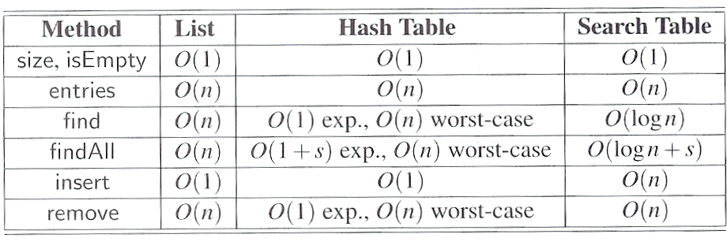
Comparing Different Implementations

Slide 45
Contents
Maps and Dictionary
Hash Tables
Ordered Search Tables
Skip Lists

Slide 46
Skip Lists
A skip list can be used to implement the map(dictionary) ADT
A skip list for a set S of distinct (key, element) items is a series of lists S₀, S₁ , … , S_{h} such that
Each list S_{i} contains the special keys +∞ and −∞
List S₀ contains the keys of S in nondecreasing order
Each list is a subsequence of the previous one, i.e., S₀ ⊇ S₁ ⊇ … ⊇ S_{h}
List S_{h} contains only the two special keys

Slide 47
Example – A Skip List
S₃
−∞
+∞
S₂
−∞
31
+∞
S₁
−∞
23
31
34
64
+∞
S₀
−∞
12
23
26
31
34
44
56
64
78
+∞
The entries in S_{i+1} are chosen at random from the
entries in S_{i} by picking each entry from S_{i} to also
be in S_{i+1} with probability ½.

Slide 48
Search
Searching for a key x in a skip list :
start at the first position of the top list
At position p, compare x with y ← key(next(p))
x = y: we return element(next(p))
x > y: we “scan forward”
x < y: we “drop down”
If we try to drop down past the bottom list, we return null

Slide 49
Example – Search in A Skip List
Search for 78
S₃
−∞
+∞
S₂
−∞
31
+∞
S₁
−∞
23
31
34
64
+∞
S₀
−∞
12
23
26
31
34
44
56
64
78
+∞

Slide 50
Randomized Algorithms
A randomized algorithm performs coin tosses (i.e., uses random bits) to control its execution
It contains statements of the type
b ← random()
if b = 0
do A …
else { b = 1}
do B …
Its running time depends on the outcomes of the coin tosses
We analyze the expected running time of a randomized algorithm under the following assumptions
the coins are unbiased, and
the coin tosses are independent
The worst-case running time of a randomized algorithm is often large but has very low probability (e.g., it occurs when all the coin tosses give “heads”)
We use a randomized algorithm to insert items into a skip list

Slide 51
Insertion
To insert an entry (x, o) into a skip list, we use a randomized algorithm:
repeatedly toss a coin until we get tails, and we denote with i the number of times the coin came up heads
If i ≥ h, we add to the skip list new lists S_{h+1}, … , S_{i +1}, each containing only the two special keys
search for x in the skip list and find the positions p₀, p₁ , …, p_{i} of the items with largest key less than x in each list S₀, S₁, … , S_{i}
For j ← 0, …, i, we insert item (x, o) into list S_{j} after position p_{j}

Slide 52
Example – Insertion
insert 15, with i = 2 after tossing a coin
p₂
S₂
−∞
+∞
p₁
S₁
−∞
23
+∞
p₀
S₀
−∞
10
23
36
+∞
S₃
−∞
+∞
S₂
−∞
15
+∞
S₁
−∞
15
23
+∞
S₀
−∞
10
15
23
36
+∞

Slide 53
Removal
To remove an entry with key x from a skip list, we proceed as follows:
We search for x in the skip list and find the positions p₀, p₁ , …, p_{i} of the items with key x, where position p_{j} is in list S_{j}
We remove positions p₀, p₁ , …, p_{i} from the lists S₀, S₁, … , S_{i}
We remove all but one list containing only the two special keys

Slide 54
Example – Removal
remove key 34
S₃
−∞
+∞
p₂
S₂
−∞
+∞
S₂
−∞
34
+∞
p₁
S₁
−∞
23
+∞
S₁
−∞
23
34
+∞
p₀
S₀
S₀
−∞
12
23
45
+∞
−∞
12
23
34
45
+∞

Slide 55
Implementation
We can implement a skip list with quad-nodes
A quad-node stores:
entry
link to the node prev
link to the node next
link to the node below
link to the node above
Also, we define special keys PLUS_INF and MINUS_INF, and we modify the key comparator to handle them
quad-node
x

Slide 56
Probabilistic Analysis
Due to the randomization involved in the algorithm, the performance analysis involves a bit of probability
Facts used:
The probability of getting i consecutive heads when flipping a coin is 1/2^{i}
If each of n events has probability p, the probability that at least one event occurs is at most np
If each of n entries is presented in a set with probability p, the expected size of the set is np
The expected number of coin tosses required in order to get tails is 2

Slide 57
Height of A Skip List
The expectation for a skip list with n items being of height O(log n) is pretty high
P_{i}: probability that list S_{i} has at least one entry
By Fact 1, we insert an entry in list S_{i} with probability 1/2^{i}
By Fact 3, the expected value of P_{i} = n/2^{i}
The expected value of height h ≥ i , E_{(h≥i)}, is equal to the expected value of P_{i}
Suppose h ≥ c log n, then E_{(h≥c log n)}≤ 1 / n^{(c-1)}
The case of h < c log n can be highly expected with E_{(h<c log n )} ≥1- 1 / n^{(c-1)}

Slide 58
Search and Update Times
The search time in a skip list is proportional to
the number of drop-down steps: bounded by the height of the skip list and thus are O(log n) with high probability
the number of scan-forward steps
Scanning forward at level i
n_{i}: the number of keys examined
Examined keys does not belong to a higher level > i
Probability that any key is counted in n_{i} is 1/2
By Fact 4, in each list the expected value of n_{i} is 2

Slide 59
Search and Update Times
The expected number of scan-forward steps at each level i is O(1)
We conclude that a search in a skip list takes O(log n) expected time
The analysis of insertion and deletion gives similar results

Slide 60
Space Usage
Consider a skip list with n entries
By Fact 1, we insert an entry in list S_{i} with probability 1/2^{i}
By Fact 3, the expected size of list S_{i} is n/2^{i}
The expected number of nodes used by the skip list is
The expected space usage of a skip list with n items is O(n)

Slide 61
Summary
A skip list is a data structure for dictionaries that uses a randomized insertion algorithm
In a skip list with n entries
The expected space used is O(n)
The expected search, insertion and deletion time is O(log n)
Using a more complex probabilistic analysis, one can show that these performance bounds also hold with high probability
Skip lists are fast and simple to implement in practice

