Slide 1
Networking VPC with Direct Connect & Site-To-Site VPN

Slide 2
There are 2 topics to cover
Site-To-Site VPN
Direct Connect

Slide 3
Site-To-Site VPN - What is VPN?
VPN, or Virtual Private Network, is a technology that allows us to connect two or more devices or networks, encrypting and securing all data that is transmitted between them via the public internet.

Slide 4
Site-To-Site VPN – AWS Services
AWS Site-To-Site VPN is a fully managed service that creates a secure connection between remote network and your AWS cloud resources.
AWS Client VPN is a fully managed service that creates a secure connection between your device/computer (i.e. when you are working from home) and your AWS cloud resources.

Slide 5
Site-To-Site VPN - Use Cases
Connect VPC/resources to on-prem data centres.
Connect VPC/resources to branch offices.
Connect VPC/resources to partner/customer offices.
Connect VPC/resources to another cloud provider (Azure, GCP).

Slide 6
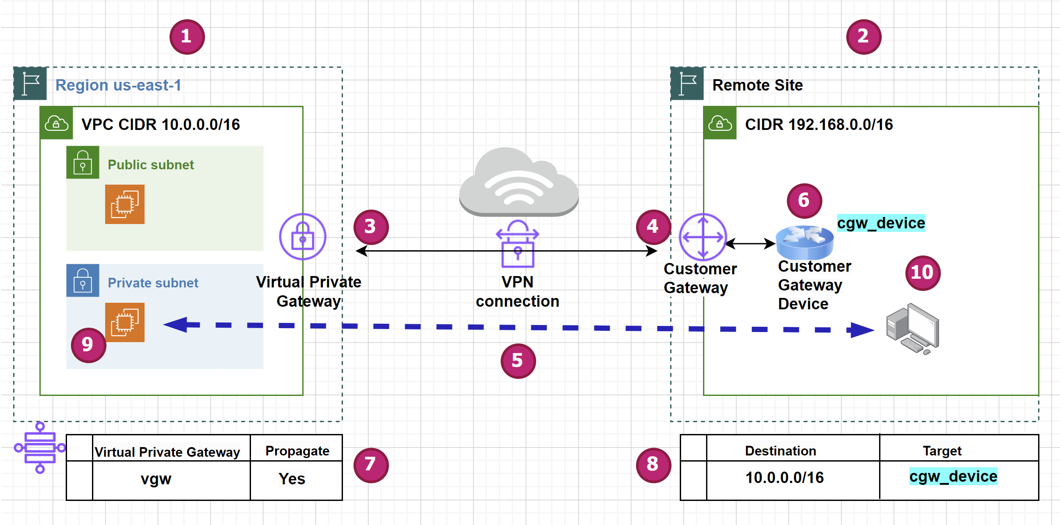
Site-To-Site VPN - Components
1
3
5
7
9
Main network Virtual Private Gateway VPN Connection Main RouteTable Main EC2 Instance
Remote network Customer Gateway Customer Gateway Device Remote RouteTable Remote computer
2
4
6
8
10

Slide 7
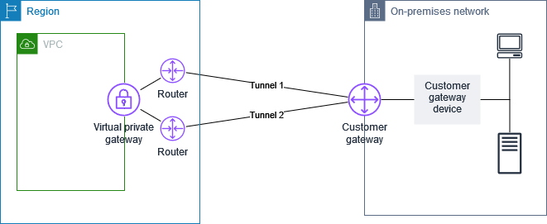
Site-To-Site VPN - 2 Tunnels Per VPN

Slide 8
Site-To-Site VPN – Components… 2
1
3
5
7
9
Main network Virtual Private Gateway VPN Connection Main RouteTable Main EC2 Instance
Remote network Customer Gateway Customer Gateway Device Remote RouteTable Remote computer
2
4
6
8
10

Slide 9



Site-To-Site VPN - Customer Gateway Devices
Vendor | Platform | Software
Checkpoint | Gaia | R80.10+
Cisco Meraki | MX Series | 15.12+ (WebUI)
Cisco Systems, Inc. | ASA 5500 Series | ASA 9.7+ VTI
Cisco Systems, Inc. | CSRv AMI | IOS 12.4+
Fortinet | Fortigate 40+ Series | FortiOS 6.4.4+ (GUI)
Juniper Networks, Inc. | J-Series Routers | JunOS 9.5+
Juniper Networks, Inc. | SRX Routers | JunOS 11.0+
Mikrotik | RouterOS | 6.44.3
Palo Alto Networks | PA Series | PANOS 7.0+
SonicWall | NSA, TZ | OS 6.5
Sophos | Sophos Firewall | v19+
Strongswan | Ubuntu 16.04 | Strongswan 5.5.1+
Yamaha | RTX Routers | Rev.10.01.16+

Slide 10
Site-To-Site VPN – Components… 3
1
3
5
7
9
Main network Virtual Private Gateway VPN Connection Main RouteTable Main EC2 Instance
Remote network Customer Gateway Customer Gateway Device Remote RouteTable Remote computer
2
4
6
8
10

Slide 11
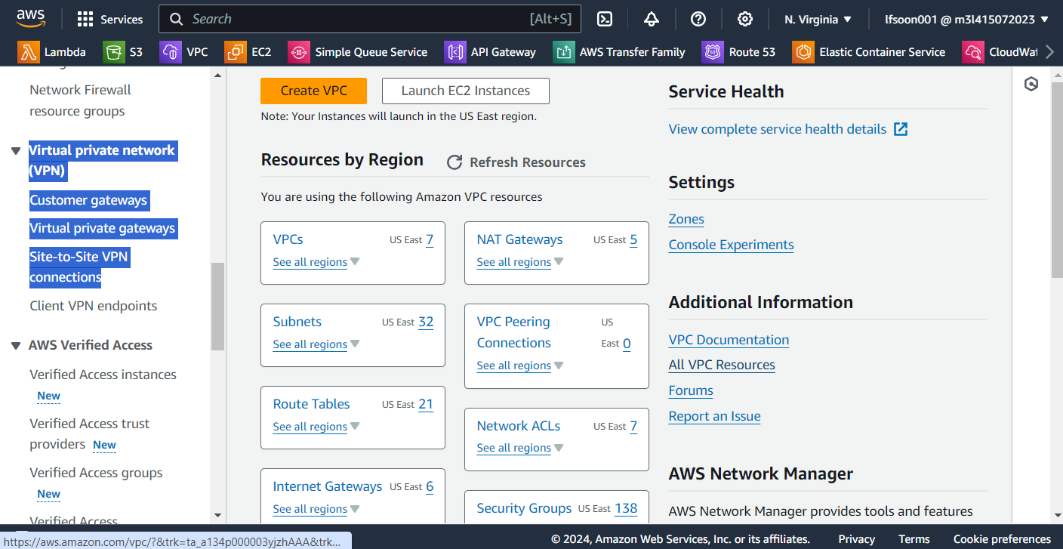
Site-To-Site VPN – Provisioning Steps
Go to the VPC Dashboard and scroll to Virtual private network (VPN) on the left panel.

Slide 12
Site-To-Site VPN – Provisioning Steps… 2
Create the below resources in the following order:
Customer gateway
Virtual private gateway
Site-to-Site VPN connection.

Slide 13
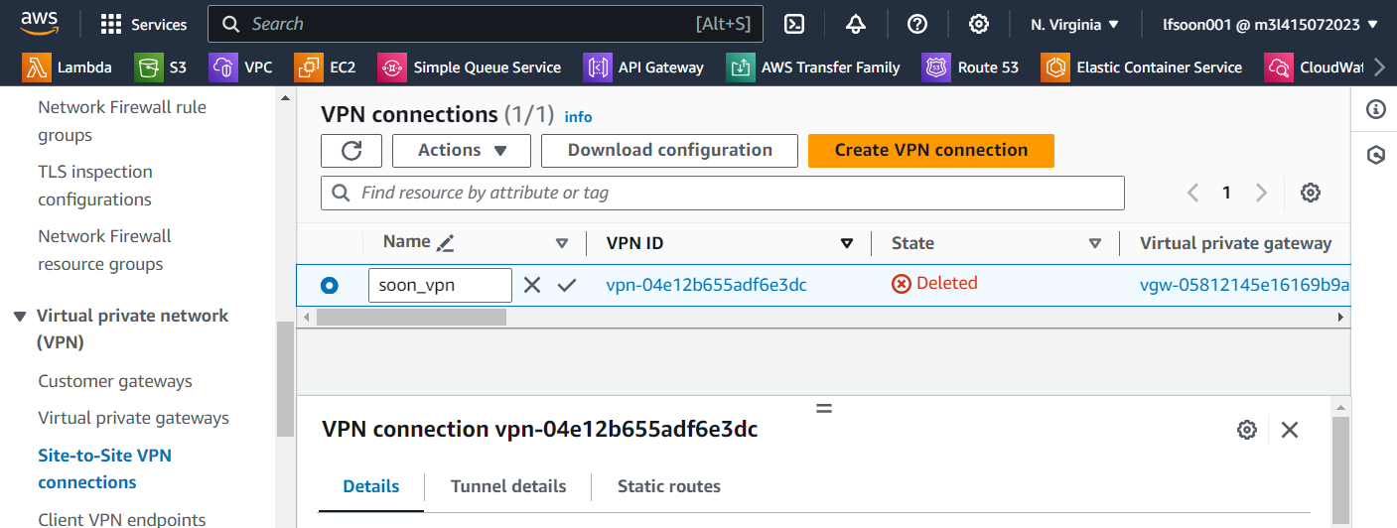
Site-To-Site VPN – Provisioning Steps… 3
Download the configuration file and send the file to the network engineer who has permission to configure the customer gateway device.

Slide 14
Site-To-Site VPN – Provisioning Steps… 4
1
3
5
7
9
Main network Virtual Private Gateway VPN Connection Main RouteTable Main EC2 Instance
Remote network Customer Gateway Customer Gateway Device Remote RouteTable Remote computer
2
4
6
8
10

Slide 15
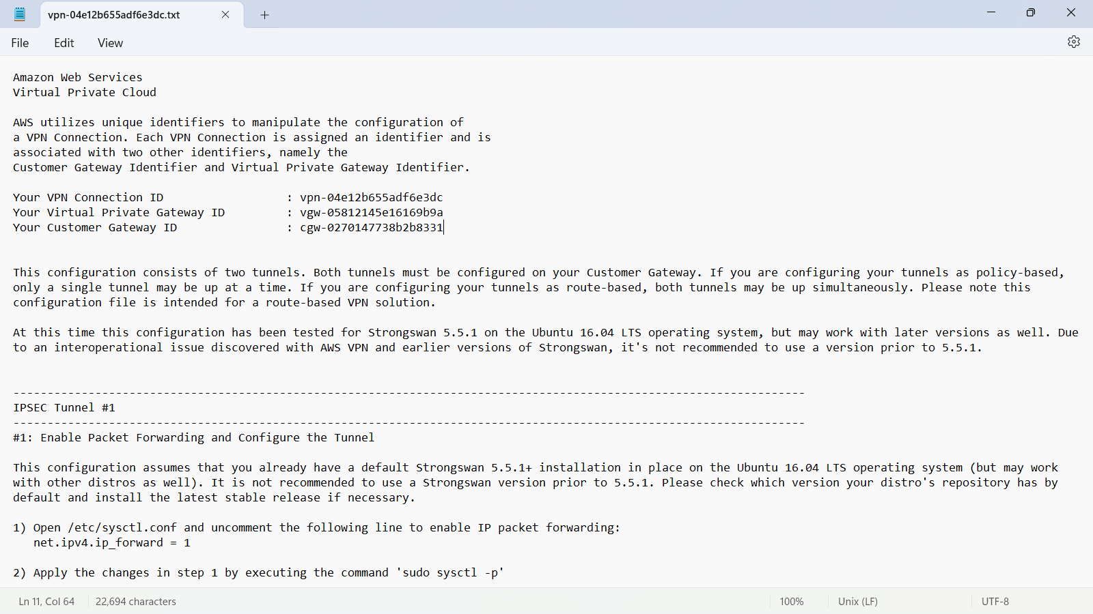
Site-To-Site VPN – Provisioning Steps… 5
Details of the configuration file:

Slide 16
Site-To-Site VPN - Pricing
You created an AWS Site-To-Site VPN connection to your Amazon VPC in US East (Ohio). The connection is active for 30 days, 24 hours a day. You transfer 1,000 GB in and transfer 500 GB out through this connection.
AWS Site-To-Site VPN connection fee
There is an hourly fee for AWS Site-To-Site VPN, while connections are active. For the US East (Ohio) Region, the fee is $0.05 per hour. You pay $36.00 (0.05 x 24 x 30) per month in connection fees.
Data transfer out fee: The first 100 GB are free, so you pay for 400 GB at $0.09 per GB. You pay $36.00 (0.09 x 400) per month in data transfer out fees.
You pay $72.00 per month for AWS Site-To-Site VPN.

Slide 17
Site-To-Site VPN – Design Consideration
The private IP addresses (i.e. CIDR Block) of the VPC should not overlap the private IP addresses assigned to the subnets in the remote network.

Slide 18
Site-To-Site VPN - Design Consideration… 2
IP Addressing | Issue | Description
Main network: 192.168.20.10 / 255.255.255.0 Remote network: 192.168.20.30 / 255.255.255.0 | Both IP address ranges are in the same IP subnet. | Both are in the 192.168.20.x / 255.255.255.0 subnet.
Main network: 192.168.20.100 / 255.255.255.0 Remote network: 192.168.22.100 / 255.255.252.0 | One IP range is within the IP range of another network. | Main network IP range: 192.168.20.1 to 192.168.20.254. This is the smaller IP subnet. Remote network IP range: 192.168.20.1 to 192.168.23.254 This is the bigger IP subnet covering: 192.168.20.x / 255.255.255.0 192.168.21.x / 255.255.255.0 192.168.22.x / 255.255.255.0 192.168.23.x / 255.255.255.0

Slide 19
Site-To-Site VPN – Alternative Solution
Unpredictable latency due to the use of public internet.
For more stable and predictable connection performance, we may consider using Direct Connect.

Slide 20
Direct Connect – What Is It?
Direct Connect is a fully managed service offered by AWS to allow us to connect to the VPC (and public services such as Amazon S3 and Glacier, etc) via AWS backbone of high-speed network.

Slide 21
Direct Connect – When To Use?
Direct Connect uses a dedicated link that operates at 1, 10 or 100 Gbps (Speed depending on availability in the region).
Because of this, it's not subject to the high and unpredictable latency of a broadband Internet connection.
If you need fast, consistent connectivity to AWS, Direct Connect is a good option instead of connecting via the Internet.

Slide 22
Direct Connect – When To Use?... 2
It may be possible for companies to save a lot of money if there is a lot of data transfer between the office or data centre locations to the AWS VPCs.
For example, it costs about 9 cents per GB of traffic that we send out to the internet, and this is the price that we pay for data leaving AWS back to our office or data centre as the data goes out over the internet.
However, with Direct Connect, the data transfer only costs 2 cents per GB of data being sent out from AWS to our office or data centre.
Hence, if you send tens of terabytes or more of traffic from AWS to our office or data centre, the data transfer cost savings can be quite significant.

Slide 23
Direct Connect – Other Costs
However, there is the port hours that we need to consider and these are the costs AWS charges us for maintaining the private connections regardless of whether you send any data over the Direct Connect link or not.
Depending on the connection bandwidth and capacity you request, the cost may range from 3 cents an hour up to 22 dollars an hour.

Slide 24
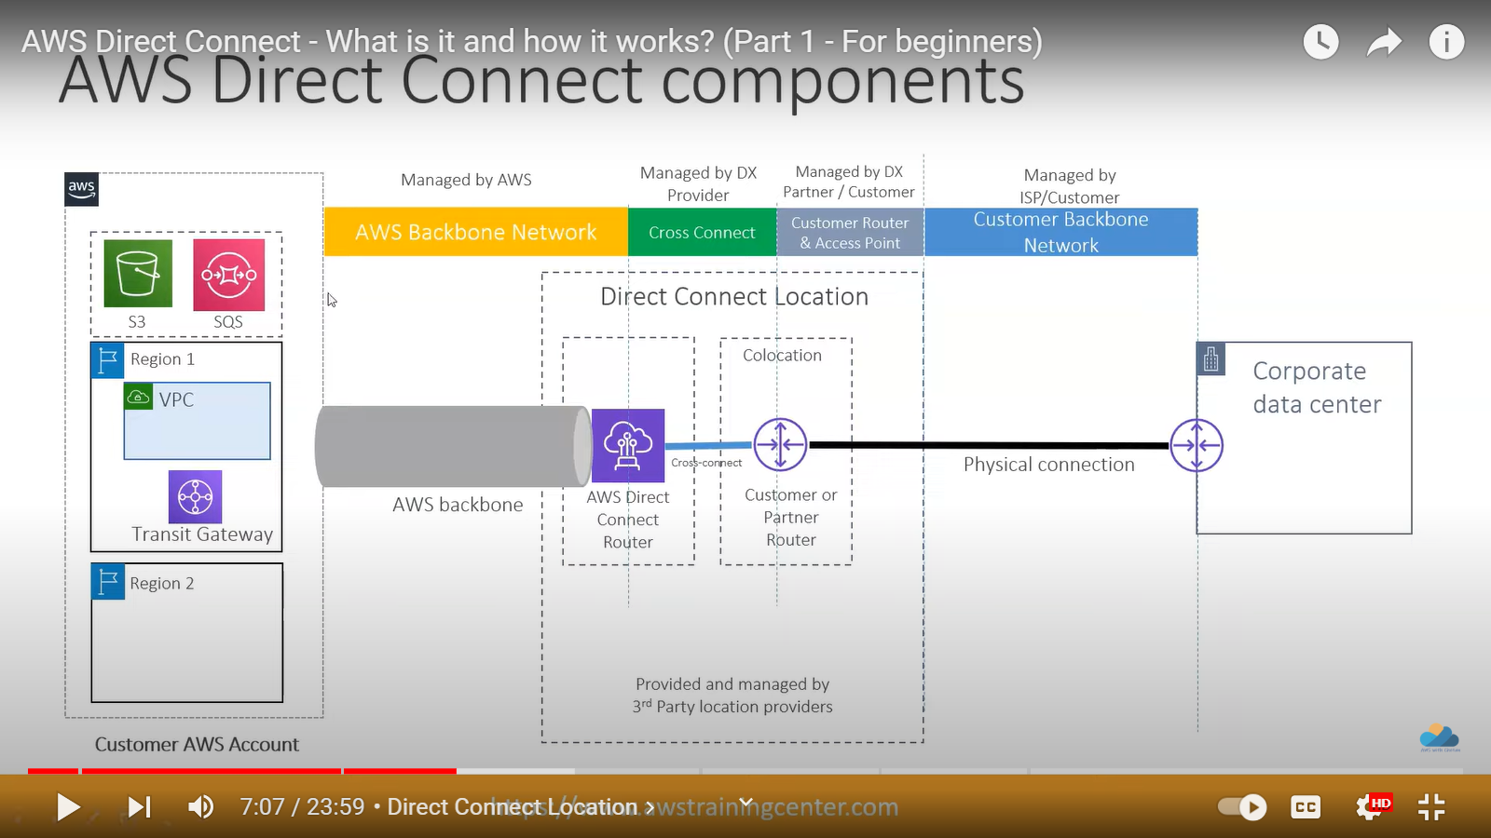
Direct Connect – Components
1
4
5
3
2
Direct Connect Location Customer Router Partner Router AWS Router Cross-Connect
1
2
3
4
5

Slide 25
Direct Connect – Locations
AWS Direct Connect locations are located throughout the world and these are third-party data centres that are used to house the AWS Direct Connect routers.
For an up-to-date list of Direct Connect collocation facilities, go to the AWS online documentation at:
https://aws.amazon.com/directconnect/locations

Slide 26
Direct Connect – Locations for Singapore region
AWS Direct Connect Location | Associated AWS Region | 1G | 10G | 100G
ePLDT VM2, Makati City, Philippines (1) | Asia Pacific (Singapore) | ✔ | ✔M
Equinix SG2, Singapore | Asia Pacific (Singapore) | ✔ | ✔M | ✔M
Global Switch, Singapore | Asia Pacific (Singapore) | ✔ | ✔M | ✔M
Equinix MB1, Mumbai, India | Asia Pacific (Singapore) | ✔ | ✔
iAdvantage Mega-i, Hong Kong SAR (1) | Asia Pacific (Singapore) | ✔ | ✔
Menara AIMS, Kuala Lumpur, Malaysia | Asia Pacific (Singapore) | ✔ | ✔
TCC Data Center, Bangkok, Thailand | Asia Pacific (Singapore) | ✔ | ✔M
Speeds available by location are indicated with "✔".
MACSec support for a specific port speed is indicated with a "✔M".

Slide 27
Direct Connect – Locations… 2
Choose the AWS Direct Connect location and AWS Region closest to your on-premises infrastructure to minimize cost, management overhead, and latency. If necessary, you can setup AWS Direct Connect with the assistance of a member of the AWS Partner Network (APN).
AWS has a growing list of AWS Direct Connect Delivery Partners who can assist you in accessing the AWS Direct Connect service. These APN Partners can help you establish network circuits between an AWS Direct Connect location and your data centre, office, or colocation environment.
https://aws.amazon.com/directconnect/partners/

Slide 28
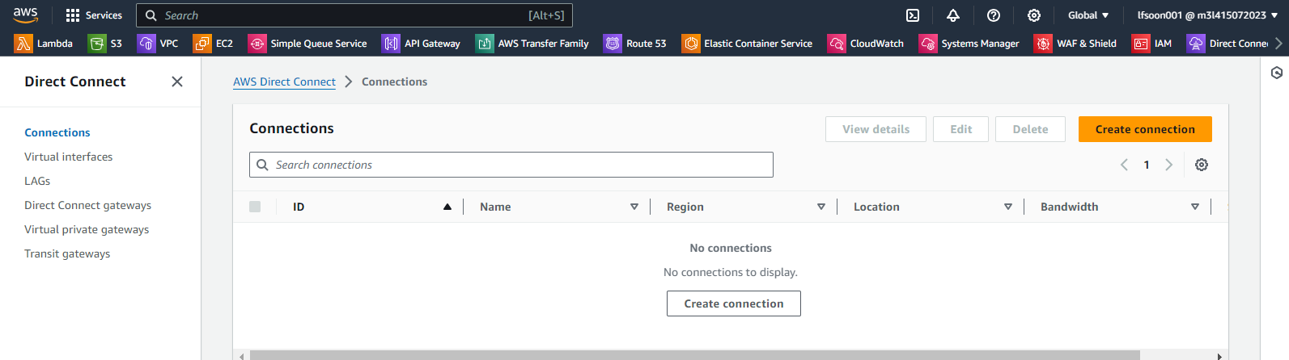
Direct Connect – Provisioning Steps
Open the AWS console and enter Direct Connect in the search box.
Then go to the Direct Connection menu.
Next select Create connection on the Connection screen.

Slide 29
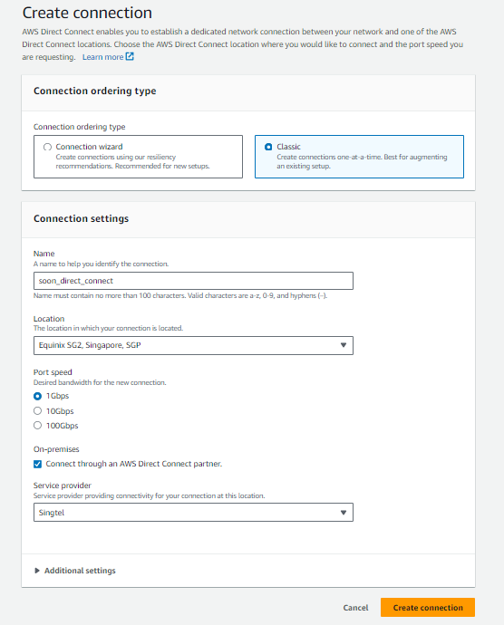
Direct Connect – Provisioning Steps… 2
Enter a name for the connection and
the location and choose Create connection.

Slide 30
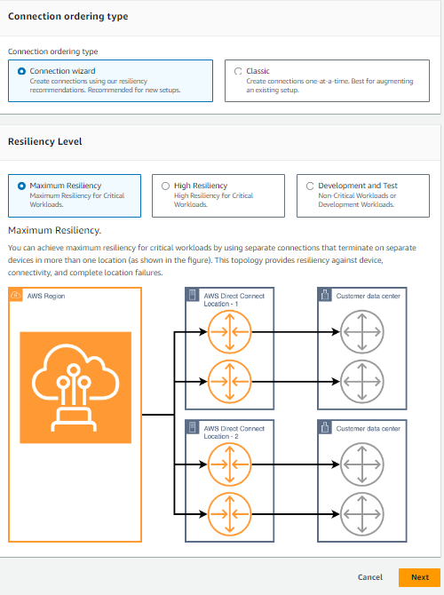
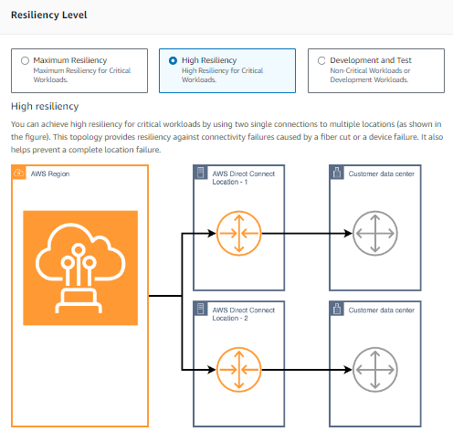
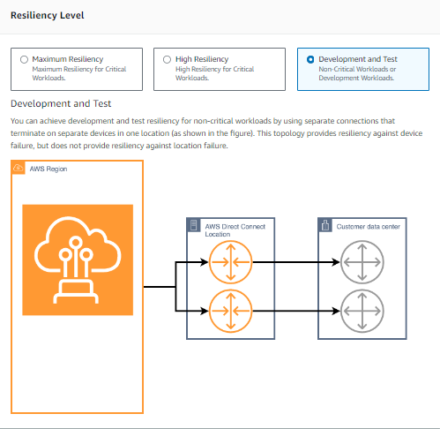
Direct Connect – Provisioning Steps… 3
You can choose the Resiliency Level via
the Connection wizard.

Slide 31
Direct Connect – Provisioning Steps… 4
You will be provided a Letter of Authorization - Connecting Facility Assignment LOA-CFA by AWS to authorise any connection works done at the Direct Connect location.
Once the physical connection has been made, use the AWS console to complete the logical configurations.

Slide 32
VPN + Direct Connect – Design Patterns
The design patterns for VPN and Direct Connect connection are taken from the latest AWS whitepaper published on 05 Apr 2023.
Source:
Network-to-Amazon VPC connectivity options - Amazon Virtual Private Cloud Connectivity Options

Slide 33
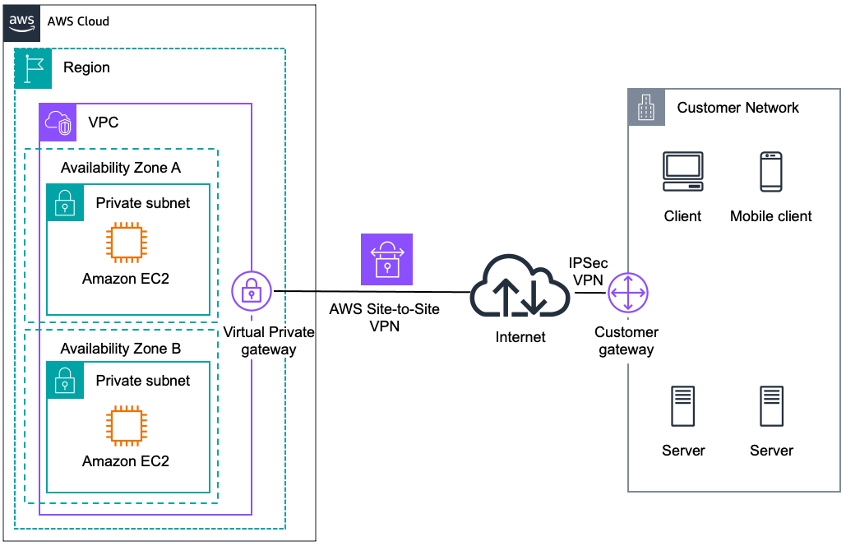
VPN + Direct Connect – Design Patterns… 2
AWS Site-To-Site VPN.
Use case: AWS managed IPsec VPN connection over the internet to individual VPC.

Slide 34
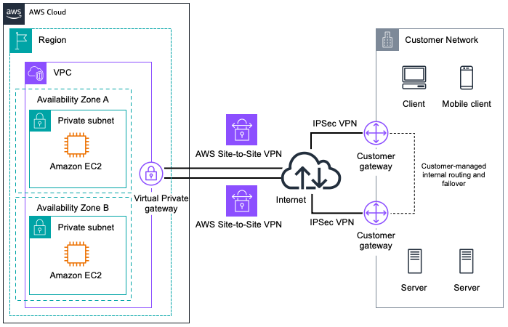
VPN + Direct Connect – Design Patterns… 3
AWS Site-To-Site VPN With Redundancy.

Slide 35
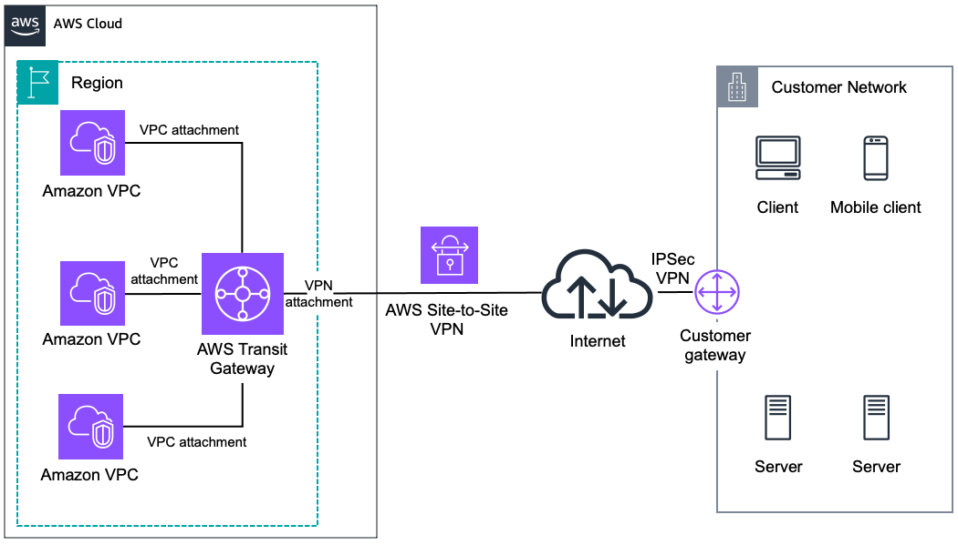
VPN + Direct Connect – Design Patterns… 4
AWS Transit Gateway + AWS Site-To-Site VPN
Use case: AWS managed IPsec VPN connection over the internet to regional router for multiple VPCs.

Slide 36
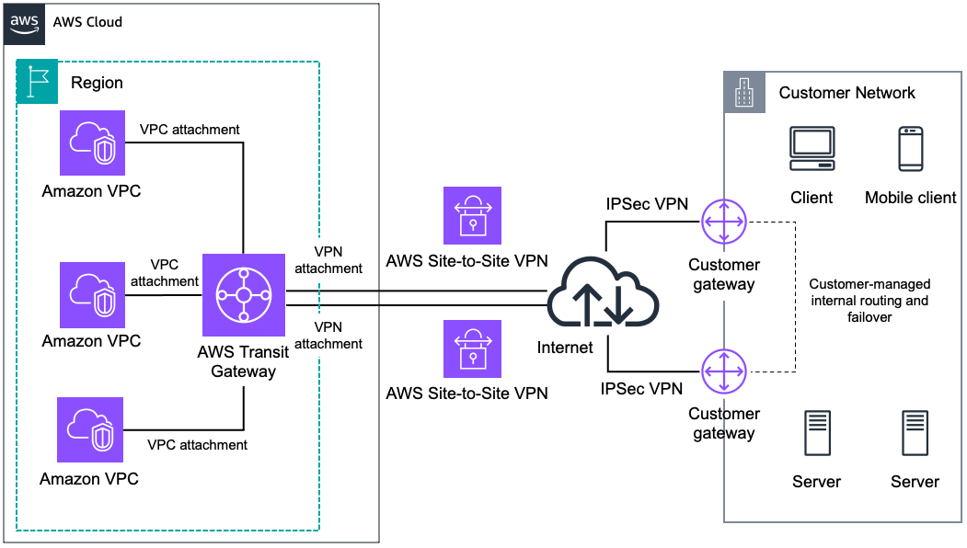
VPN + Direct Connect – Design Patterns… 5
AWS Transit Gateway and Redundant VPN

Slide 37
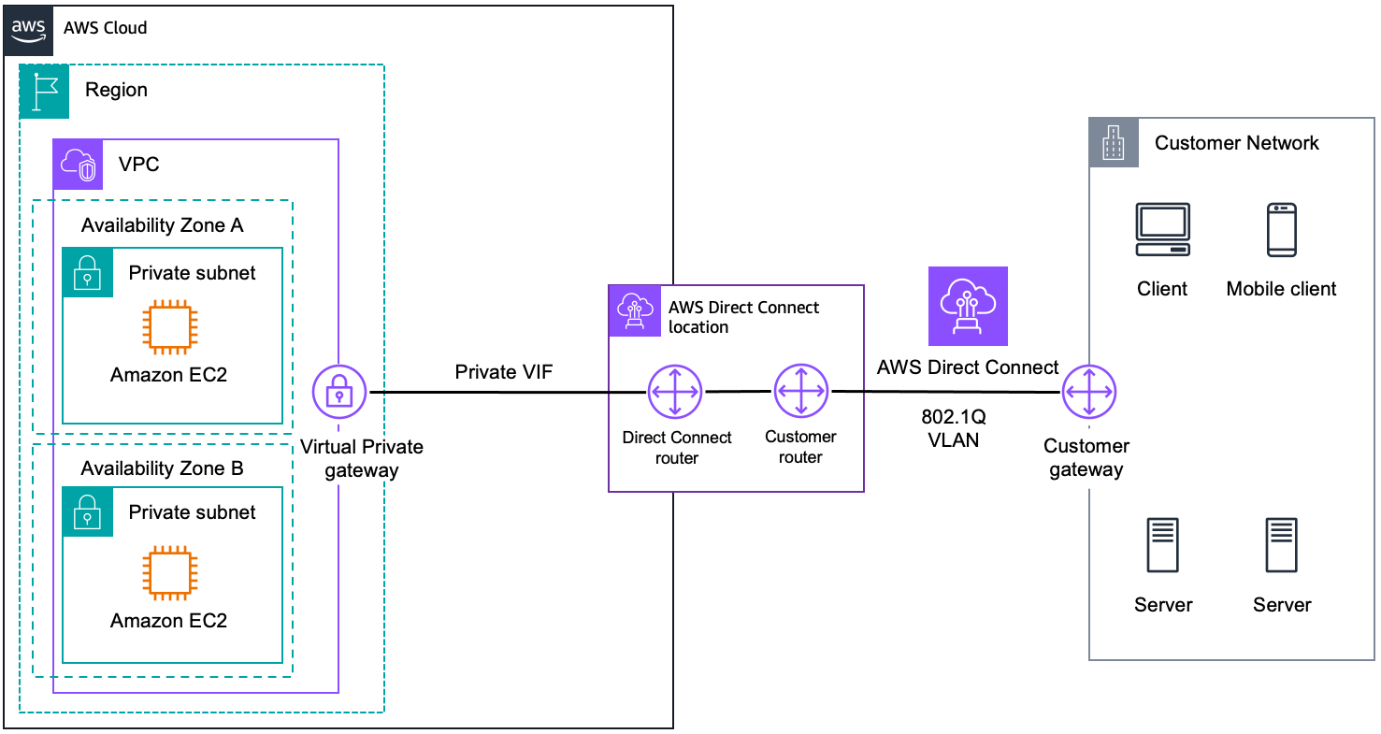
VPN + Direct Connect – Design Patterns… 6
AWS Direct Connect
Use case: Dedicated network connection over private lines.

Slide 38
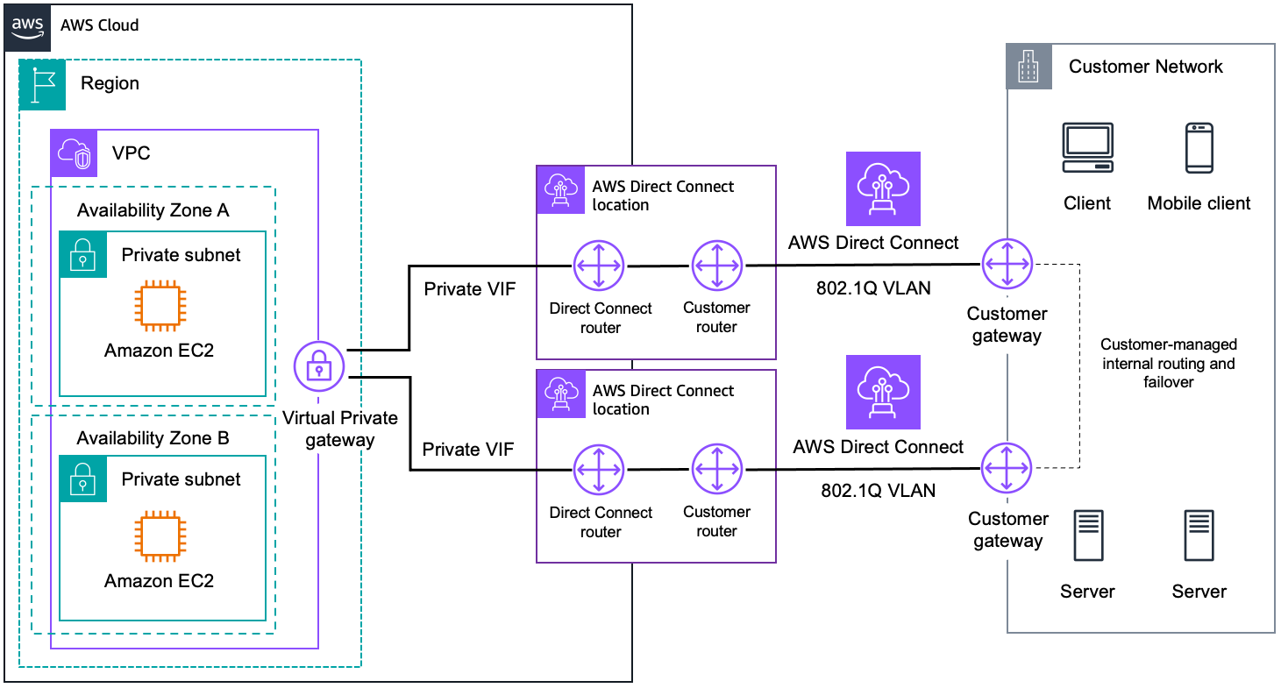
VPN + Direct Connect – Design Patterns… 7
AWS Direct Connect With Redundancy

Slide 39
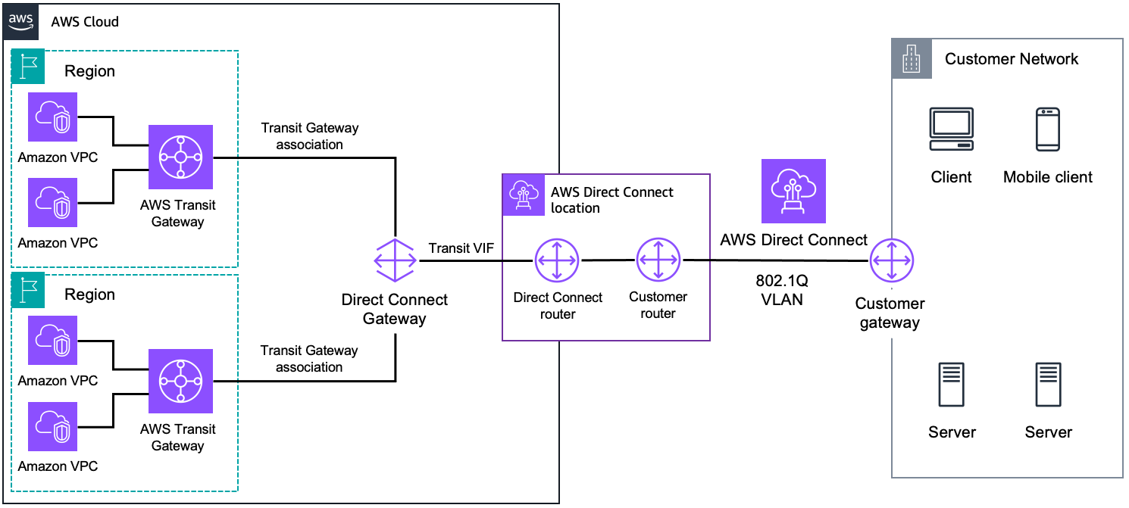
VPN + Direct Connect – Design Patterns… 8
AWS Direct Connect + AWS Transit Gateway
Use case: Dedicated network connection over private lines to regional router for multiple VPCs.

Slide 40
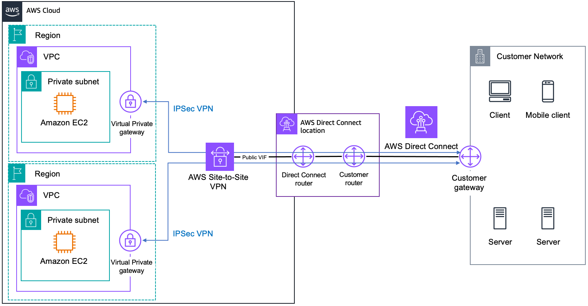
VPN + Direct Connect – Design Patterns… 9
AWS Direct Connect + AWS Site-to-Site VPN
Use case: IPsec VPN connection over private lines.

Slide 41
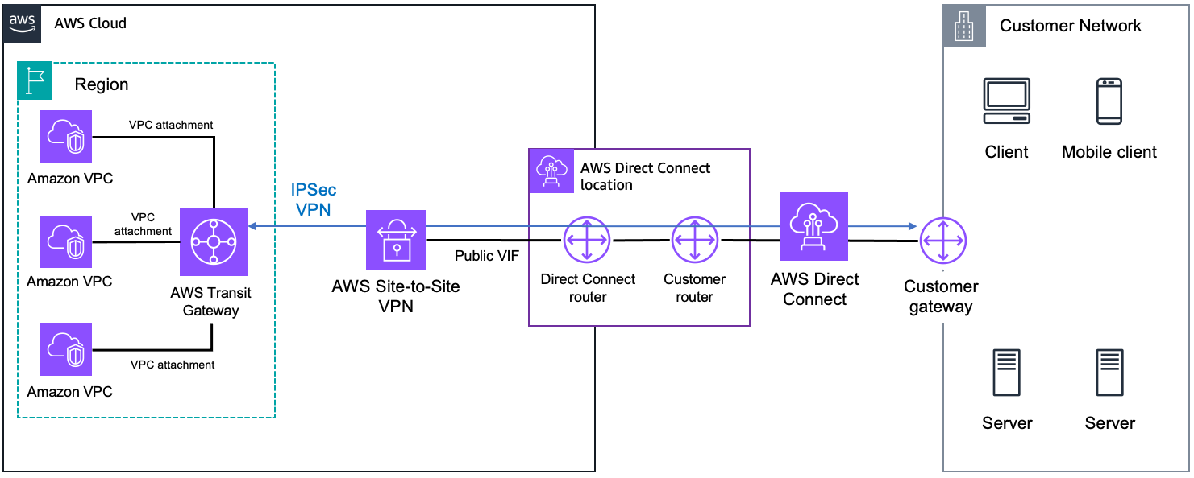
VPN + Direct Connect – Design Patterns… 10
AWS Direct Connect + AWS Transit Gateway + AWS Site-To-Site VPN
Use case: IPsec VPN connection over private lines to regional router for multiple VPCs.

Slide 42
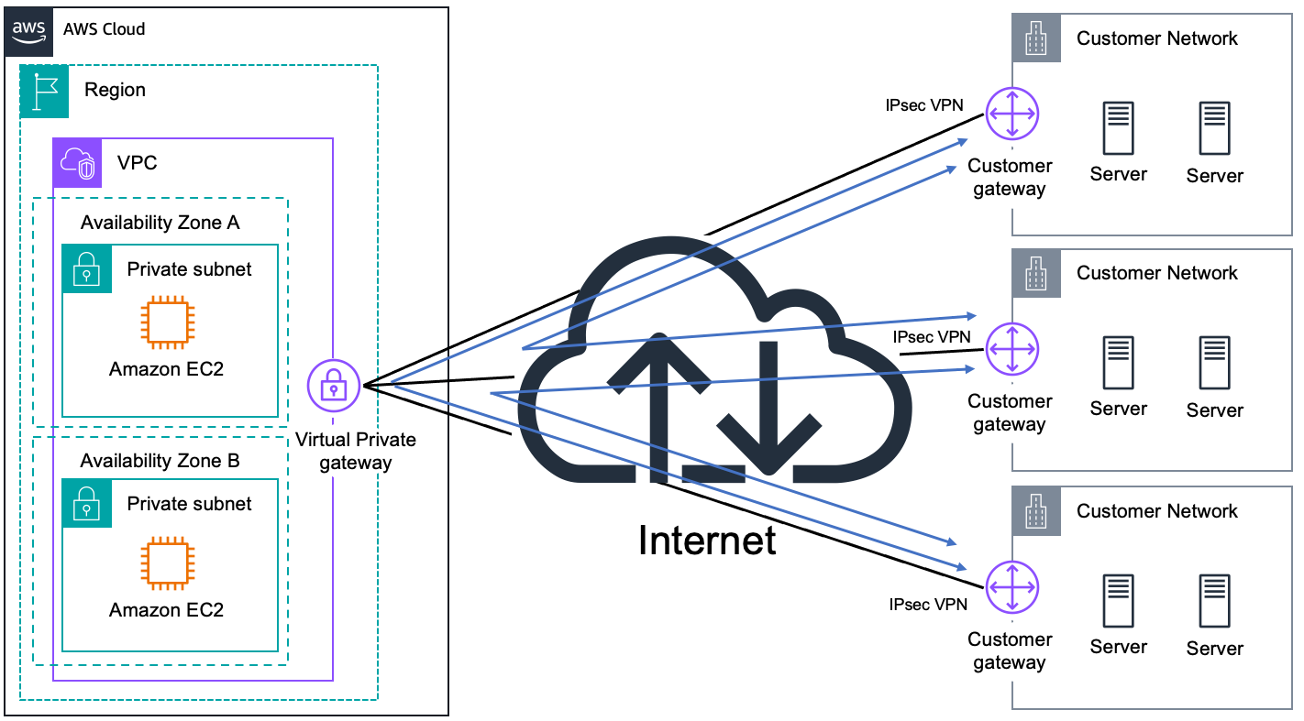
VPN + Direct Connect – Design Patterns… 11
AWS VPN CloudHub
Use case: Connect remote branch offices in a hub-and-spoke model for primary or backup connectivity.

Slide 43
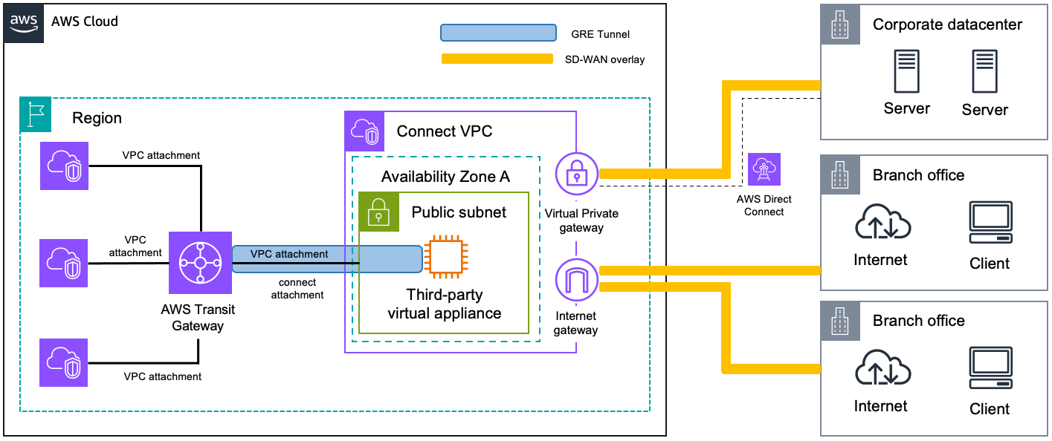
VPN + Direct Connect – Design Patterns… 12
AWS Transit Gateway + SD-WAN solutions
Use case: Connect remote branches and offices with a software-defined wide area network by using the AWS backbone or the internet as a transit network.

Slide 44
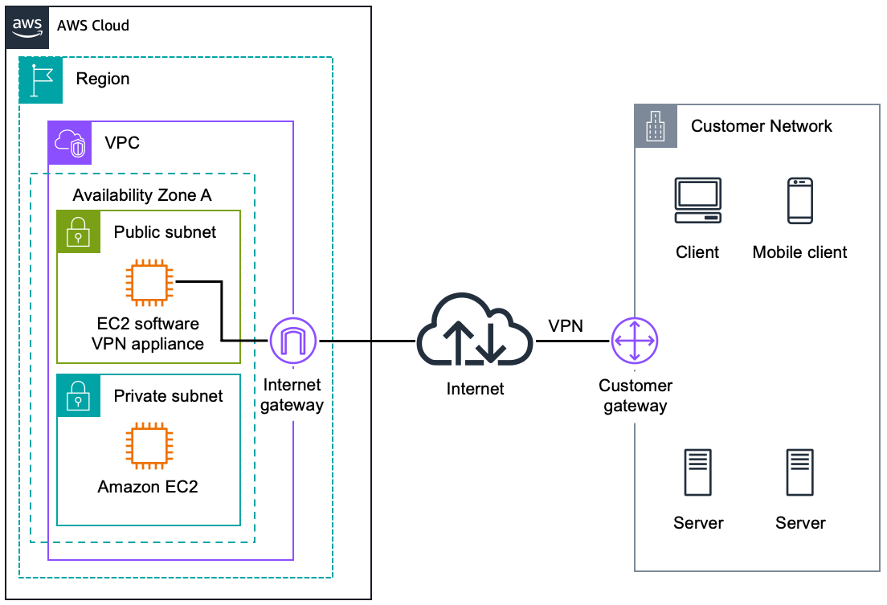
VPN + Direct Connect – Design Patterns… 13
Software VPN
Use case: Software appliance-based VPN connection over the internet.

Slide 45
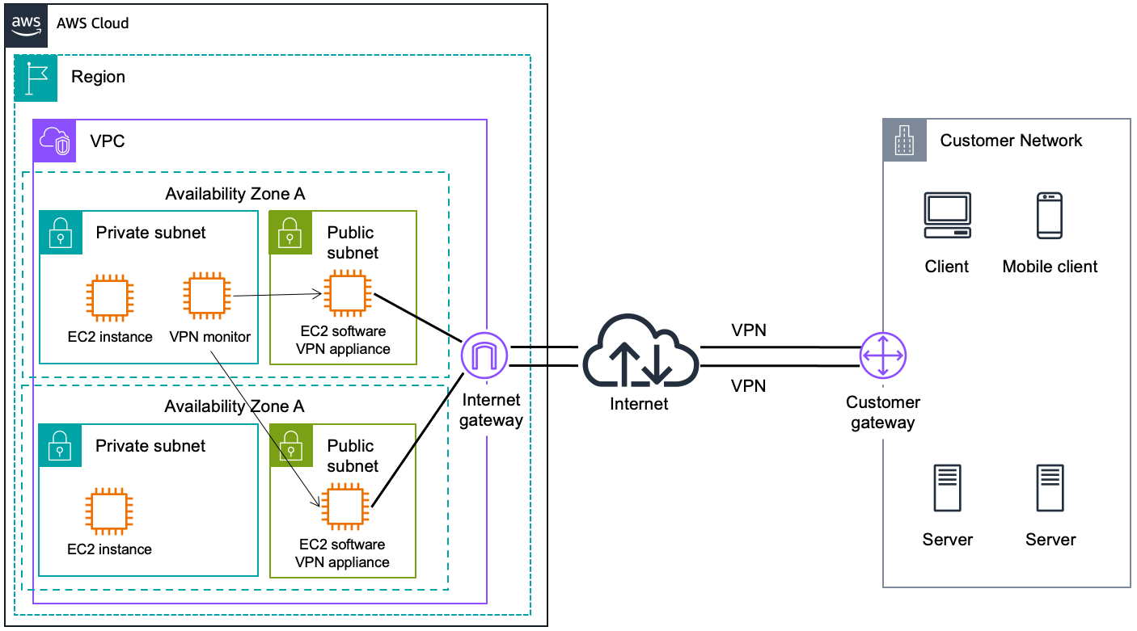
VPN + Direct Connect – Design Patterns… 14
Software VPN With High Availability

Slide 46
Summary
We have looked at 2 types of connection options offered by AWS for VPC connectivity.
Site-To-Site VPN is easy to setup but does not guarantee reliability. And it does not necessarily offers a cost-effective solution if we do not have lots of data to transfer.
Direct Connect offers more reliable way for remote sites to connect to AWS cloud resources and is a good option when you have lots of data to transfer.
Regardless of the connection option, we always need to take redundancy into account to achieve high availability.

Slide 47
References - VPN
What Is a VPN, and Why Would I Need One?
https://www.howtogeek.com/133680/htg-explains-what-is-a-vpn/
What is VPN? How It Works, Types of VPN
https://www.kaspersky.com/resource-center/definitions/what-is-a-vpn
AWS Site-to-Site VPN with strongSwan, Vasil Kosturski, November 19, 2023
https://vkontech.com/aws-site-to-site-vpn-with-strongswan/
AWS Site To Site VPN Using Terraform by Dulanjana Lakmal
https://awstip.com/aws-site-to-site-vpn-using-terraform-324b61b14cb0

Slide 48
References – Direct Connect
AWS Direct Connect - What is it and how it works? (Part 1 - For beginners) by AWS with Chetan
AWS Direct Connect Architecture pattern (Part 2 - advance level) by AWS with Chetan
Introduction to AWS Direct Connect by StormIT)
Comparison: AWS Direct Connect vs. VPN by StormIT
Introduction to AWS Direct Connect for Beginners! by Cloud Vikings
What is AWS Direct Connect? Establish a Dedicated Network between On-Premises and AWS | AWS New by Cloudemy
AWS Direct Connect - AWS Networking by Digital Cloud Training

Slide 49
Thank you for your attention!!!

