Slide 1

JMETER API PERFORMANCE TESTING – JENKINS CI INTEGRATION
Persistent Systems Quality Engineering

Slide 2
WEB API – MountSinai.org
A large non profit Network chain of Hospitals , Healthcare Solutions with focus on Medtech.
Demo API Application & Scenarios
API Application Targeted – Mountsinai.org
Demo Scenarios Targeted:
Find All Doctors of a Department (FAD)
Find Doctor
Find Location
Patient Care
PS NOTE : Docker Imaging , Containerization of solution with Pipeline is in progress
Tool Environment:
Jenkins CI with Performance Plugins
Apache Jmeter 5.5.4 with Extended Plugins
Master Single Node
Influx Time Series Database
Grafana Dashboard
Jmeter Backend Listener
Targeted Environment Parameters:
Test Data CSV,User Defined Variables and other test parameters.
Logical Handling and Enhancements incorporated for scripts on demo.

Slide 3
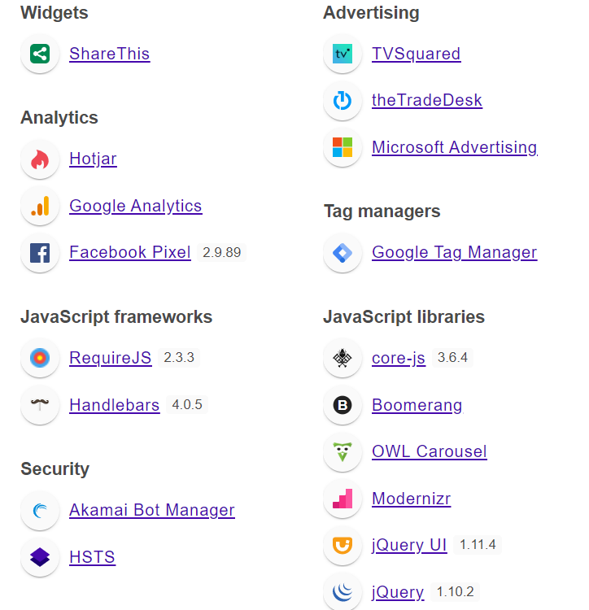
MOUNTSINAI.ORG PROD TECHNOLOGY

Slide 4



JMETER , JENKINS MASTER NODE ARCHITECTURE – Version 1
InfluxDB. Conf (Time Series DB)
Influx DB
VM Hosted Jenkins CI server with Plugins
Docker container
Jenkins Performance Plugins
Grafana on Port 3000
Grafana Customized Jmeter Dasboard
Web Application (HTTPS) API
(Responsive)
Git Hub Repository (Source Artifacts)
Archived Test Artifacts (HTML Reports)
Git Access Credentials
Apache Jmeter - IDE Script Repository

Slide 5
USAGE STEPS – HOW TO USE?
Version 1 Jenkins Master CI with UI defined Pipeline Executions
5. Ensure all steps specified in Get README is followed.
6. Kick of Jenkins Build, Monitor Console for Pass/Fail Runs
7. IF Build Fails take necessary steps to Debug the Pipeline.
8. If Job runs successfully, Check if all artifacts are archived in Workspace including HTML Reports .
9. Monitor the Real time Test Data containing Transactional data, System and Application Counters logged in Grafana
Grafana – http: <ipaddress of host>:3000
Influxdb – http: <ipadress of host>: 8086
Steps to Solution:
Download the Project Repository from GitHub. Currently individual Git Credentials are used for cloning.
Follow the Jenkins Build Steps or Create a Freestyle Jenkins Project/Copy from existing build.
Configure InfluxDB, Grafana Plugins in Manage Jenkins, Set Environment Variables and Tool Configurations.
Use appropriate Jmeter CLI command on Jenkins “Build” as per Operating System
Steps to Solution:

Slide 6
Top Jmeter Server Side Metrics of GRAFANA DASHBOARD and HTML report
Server side – KPI – Jmeter provides lot of Metrics which provide insights to Web API performance. We have mentioned which are generic and must to have.
Top Server Metrics :
Transaction Response Times
Hits/Second
Requests/Throughput
Vuser VS Response times
Total Requests/sec
Error Rate
Active Threads
8.Network Traffic
9.Failed Requests
10.Max Response

Slide 7
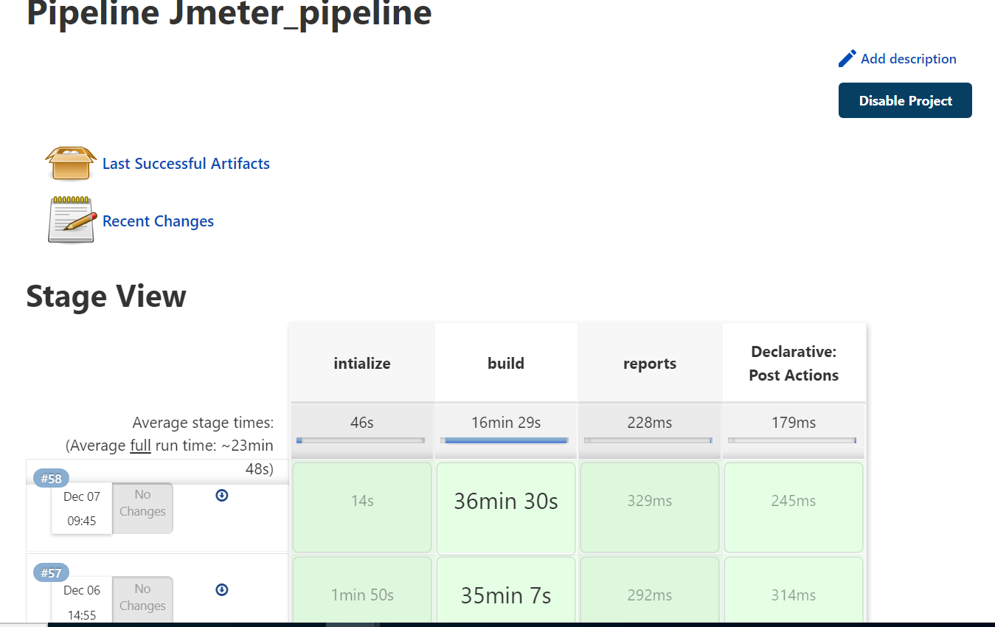
JENKINS PIPELINE

Slide 8
JENKINS PIPELINE BUILD STAGE
stage('build') {
steps {
sh 'pwd'
dir("bin") {
sh "pwd"
sh 'java -jar ApacheJMeter.jar -J jmeter.save.saveservice.output_format=${service_format} -n -t ./Mount_Sinai/MountSinai_FAD_v01.jmx -l MountSinai_FAD_reports_v04.csv -e -o MountSinai_FAD_v04_testreport_run2.html'
sh 'java -jar ApacheJMeter.jar -J jmeter.save.saveservice.output_format=${service_format} -n -t ./Mount_Sinai/Mount_Sinai_FindDoctor.jmx -l Mount_Sinai_FindDoctor_v04.csv -e -o MountSinai_FindDoctor_v04_testreport_run2.html'
sh 'java -jar ApacheJMeter.jar -J jmeter.save.saveservice.output_format=${service_format} -n -t ./Mount_Sinai/Mount_Sinai_OurLocations.jmx -l Mount_Sinai_OurLocations_v04.csv -e -o Mount_Sinai_OurLocations_v04_testreport_run2.html'
sh 'java -jar ApacheJMeter.jar -J jmeter.save.saveservice.output_format=${service_format} -n -t ./Mount_Sinai/Mount_Sinai_PatientCare.jmx -l Mount_Sinai_PatientCare_v04.csv -e -o Mount_Sinai_PatientCare_v04_testreport_run2.html'
}
}

Slide 9
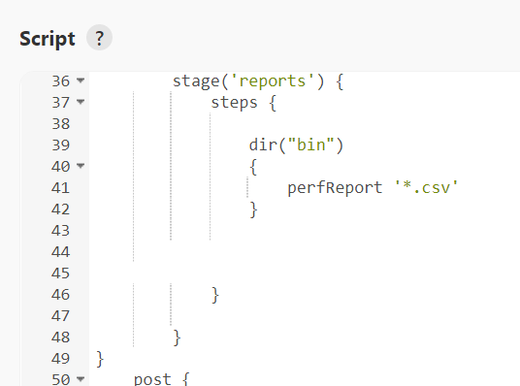
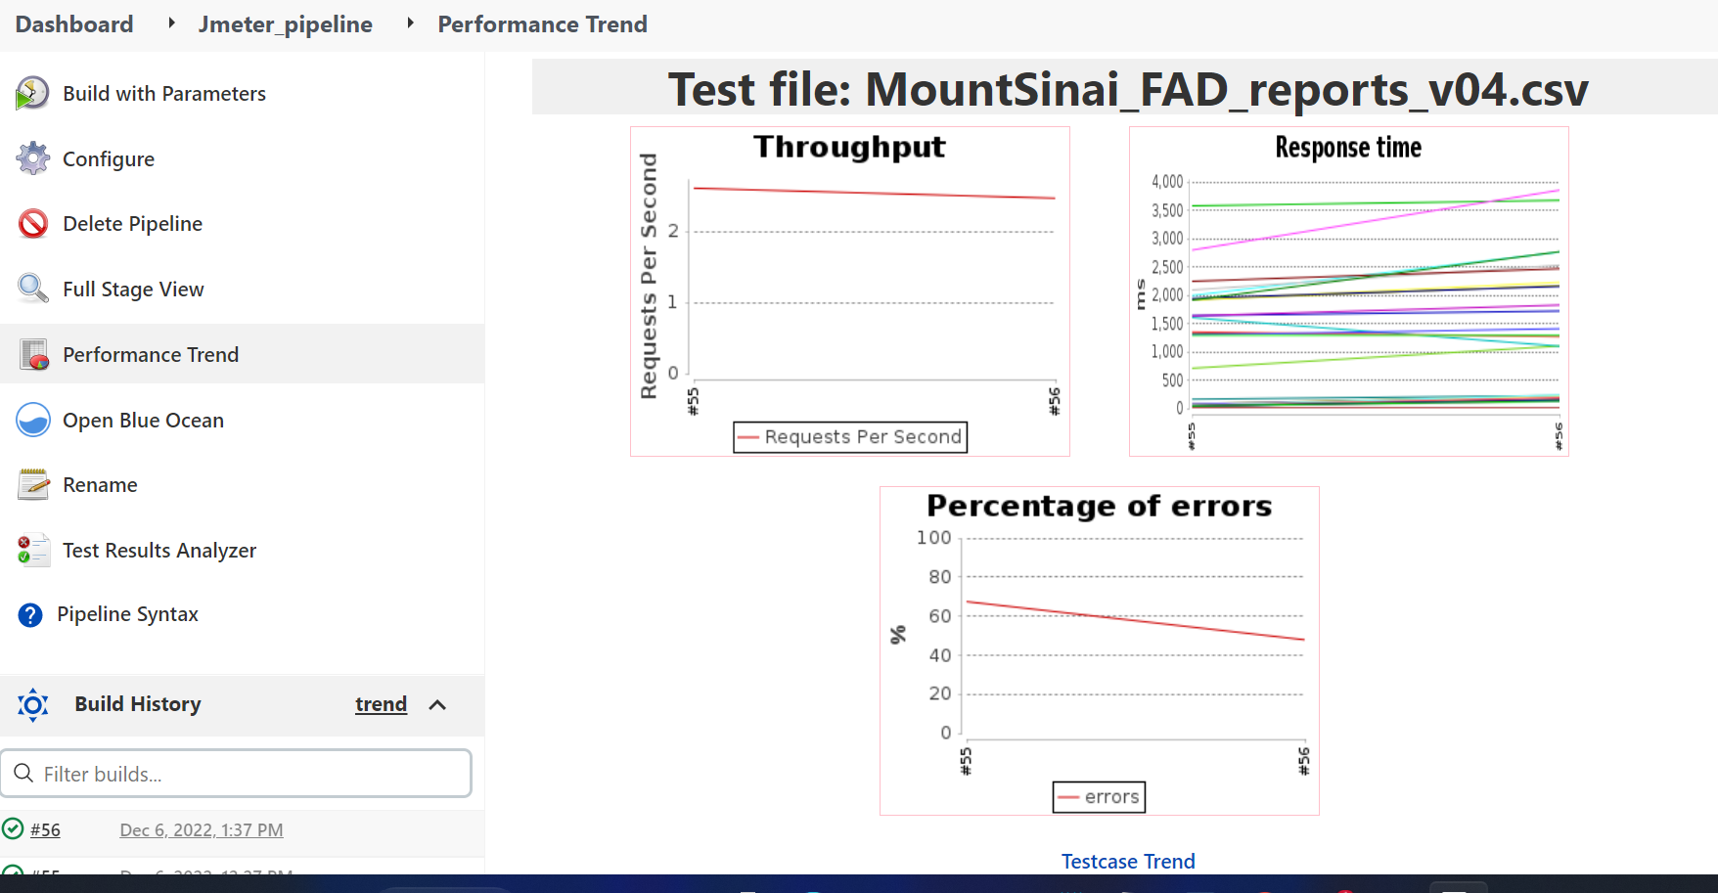
JENKINS PERFORMANCE TREND – Configuration ​

Slide 10
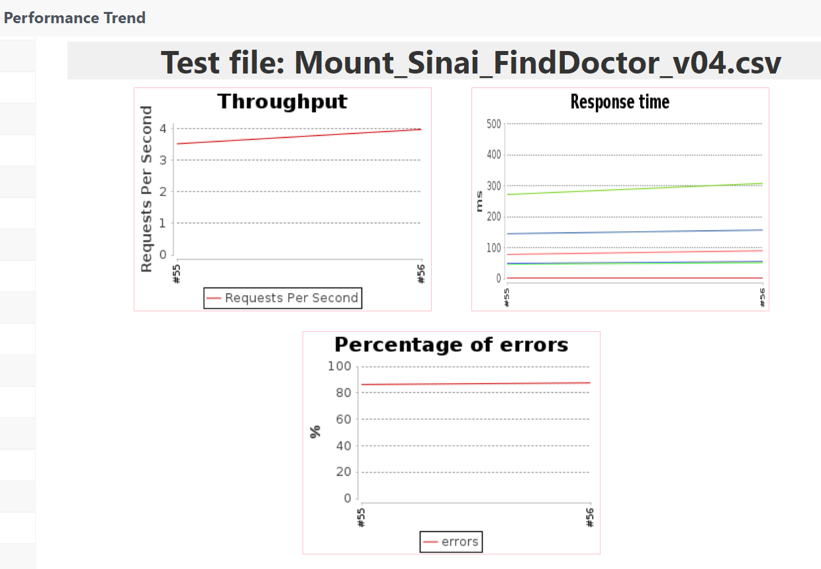
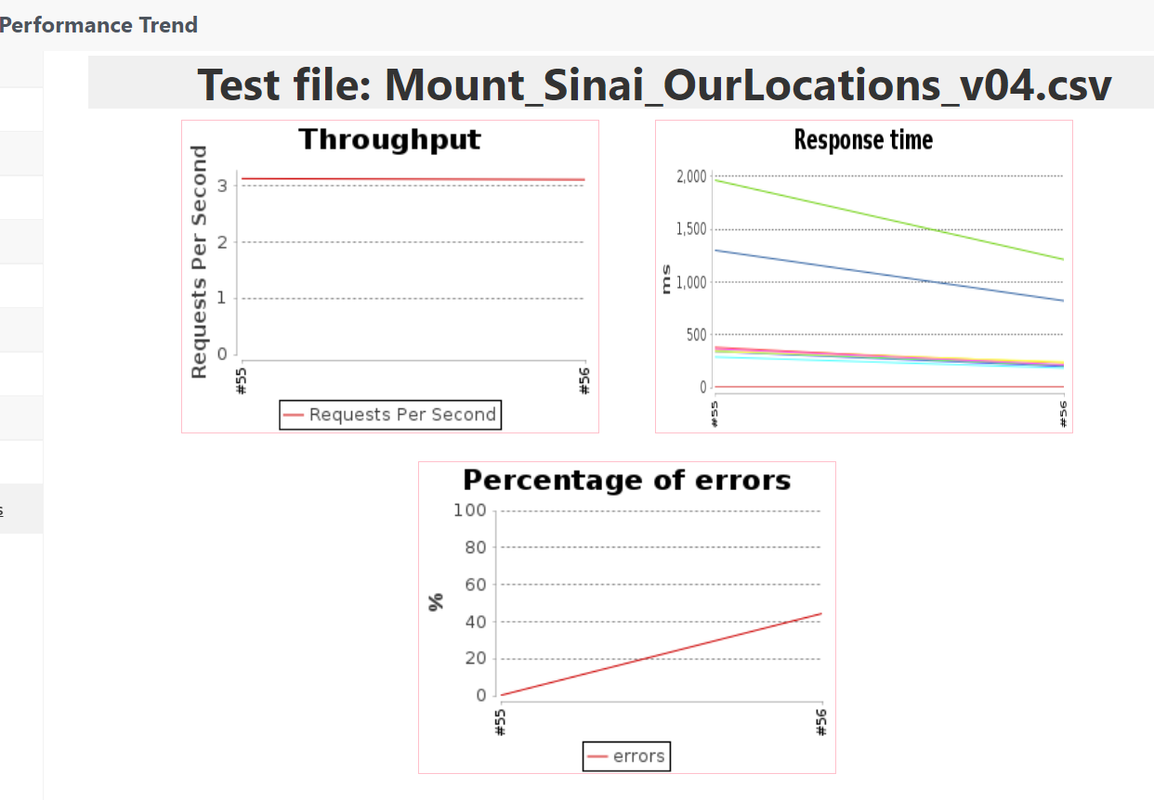
JENKINS PERFORMANCE TREND

Slide 11
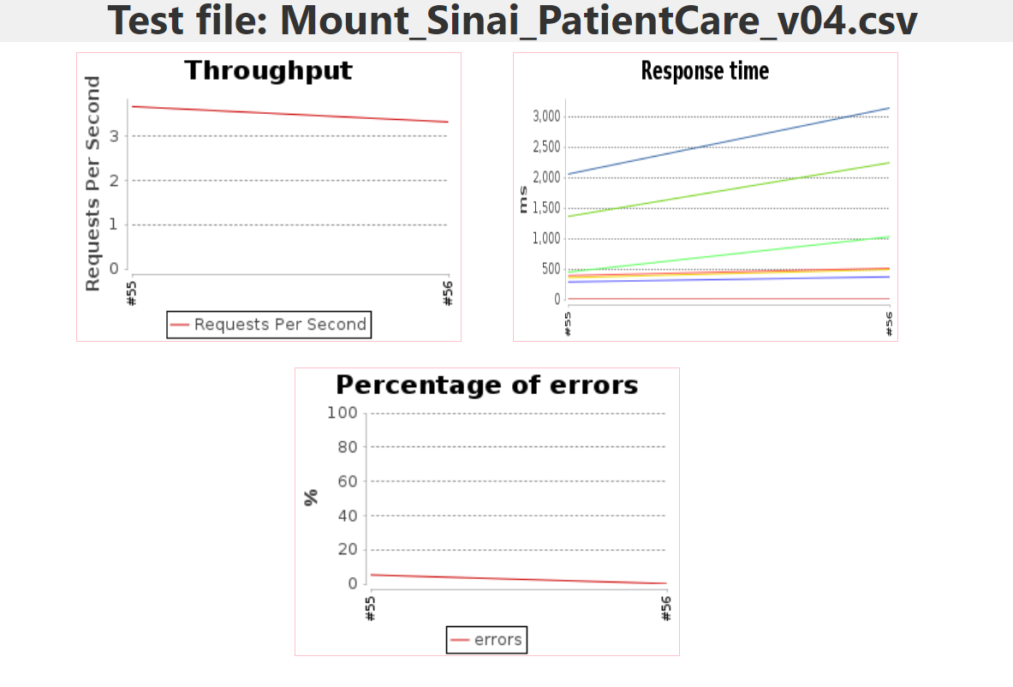
JENKINS PERFORMANCE TREND

Slide 12

Thank yoU
Pavan Magal
Performance Testing

