Slide 1

Salesforce – Performance test solutioning – Stress stimulus on lightening
Persistent Systems Quality Engineering

Slide 2
Salesforce…what and Why?
What is Salesforce and its features/products and purpose?
What is Salesforce?
Salesforce is an American cloud-based software company headquartered in San Francisco, California. It provides customer relationship management (CRM) service and also provides enterprise applications focused on customer service, marketing automation, analytics, and application development.
Features /Products :
Account and Contact Management
Opportunity Management
Salesforce Engage
Sales Collaboration
Sales Performance Management
Lead Management
Salesforce Mobile App
Workflow and Approvals
File Sync and Share
Sales Forecasting
etc
Why is Salesforce used in the current IT services?
Better Time Management Time management is a huge benefit of Salesforce and one of the best ways to allow a business to grow and thrive. ...
Ultimate Accessibility Since Salesforce is cloud software, it’s accessible anywhere and everywhere you have access to the Internet. ...
Increased Revenue ...
Greater Customer Satisfaction ...
Simple Account Planning

Slide 3
Salesforce lightening performance - StressStimulus
What is Stress Stimulus performance tool, benefits and USP?
Salesforce Lightening Demo Application
Salesforce Lightning App is a special top -level component whose markup is in a.app resource. To build Salesforce lightning application, we use many Lightning components, JavaScript, Lightning data service, CSS and HTML language.
Stress Stimulus & Benefits
StresStimulus is a load testing tool for websites, mobile and Enterprise apps. It determines the web performance and scalability of your application under the rigors of heavy traffic load. Hundreds or thousands of physical users are realistically emulated through on-premise load generators or in a cloud testing environment.
Benefits :
Ease of Use with CI/CD
Performance Analytics
Script Correlation
Salesforce Support
Performance Testing support for Dynamic CRM’s
Persistent Systems USP and Value -added Services with StressStimulus
PSL Salesforce Practice with more than 50+ Architects SME’s.
Stressstimulus Partnership for End to End performance Solution offering
Performance Salesforce COE.

Slide 4
Typical JMeter Salesforce Scripting Challenges
Heavy Async calls per HTTP Request Samplers
Too Much time spent on Correlation and Scripting challenges for Dynamic Salesforce Responses like pwid,uUID, tokens, messages etc.
Load Test Thread I/O, Interrupts and Blocking issues
System Resource Heavy based on Depth Transaction Test Elements and Data.
Lack of HTTP Response Breakup like DNS Connecting, TTFB etc.

Slide 5
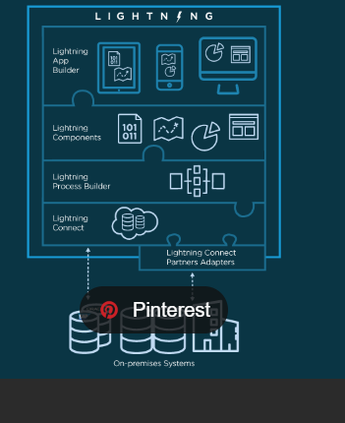
Persistent Answer to Salesforce Performance Testing - Test Architecture
StressStimulus – Onpremise/SAAS
Reporting Dashboard

Slide 6
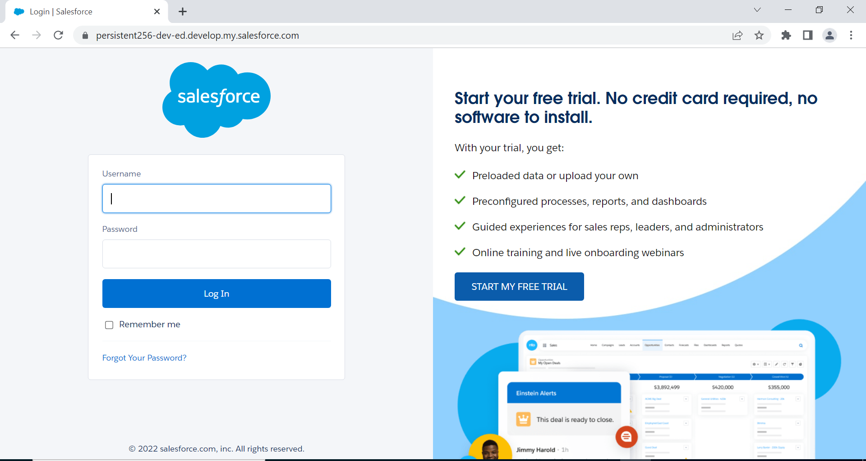
Salesforce Lightening scenario flow – StressStimuls for Create Accounts

Slide 7
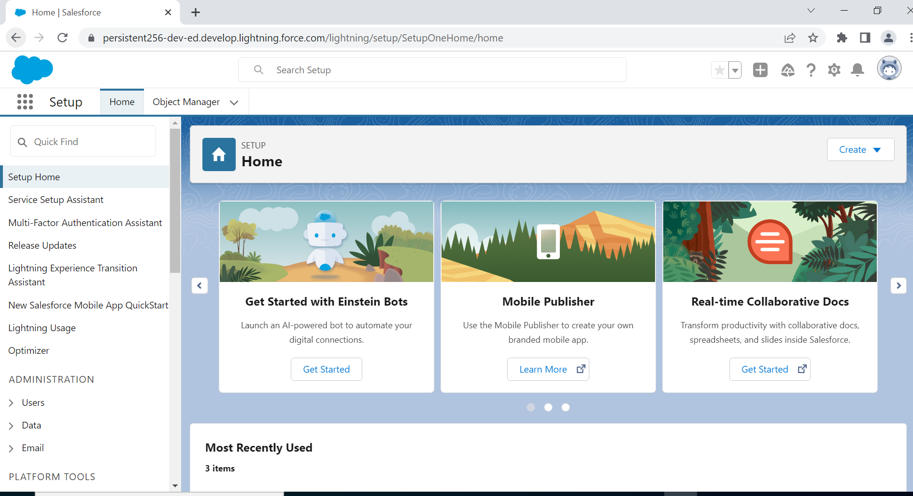
Homepage

Slide 8
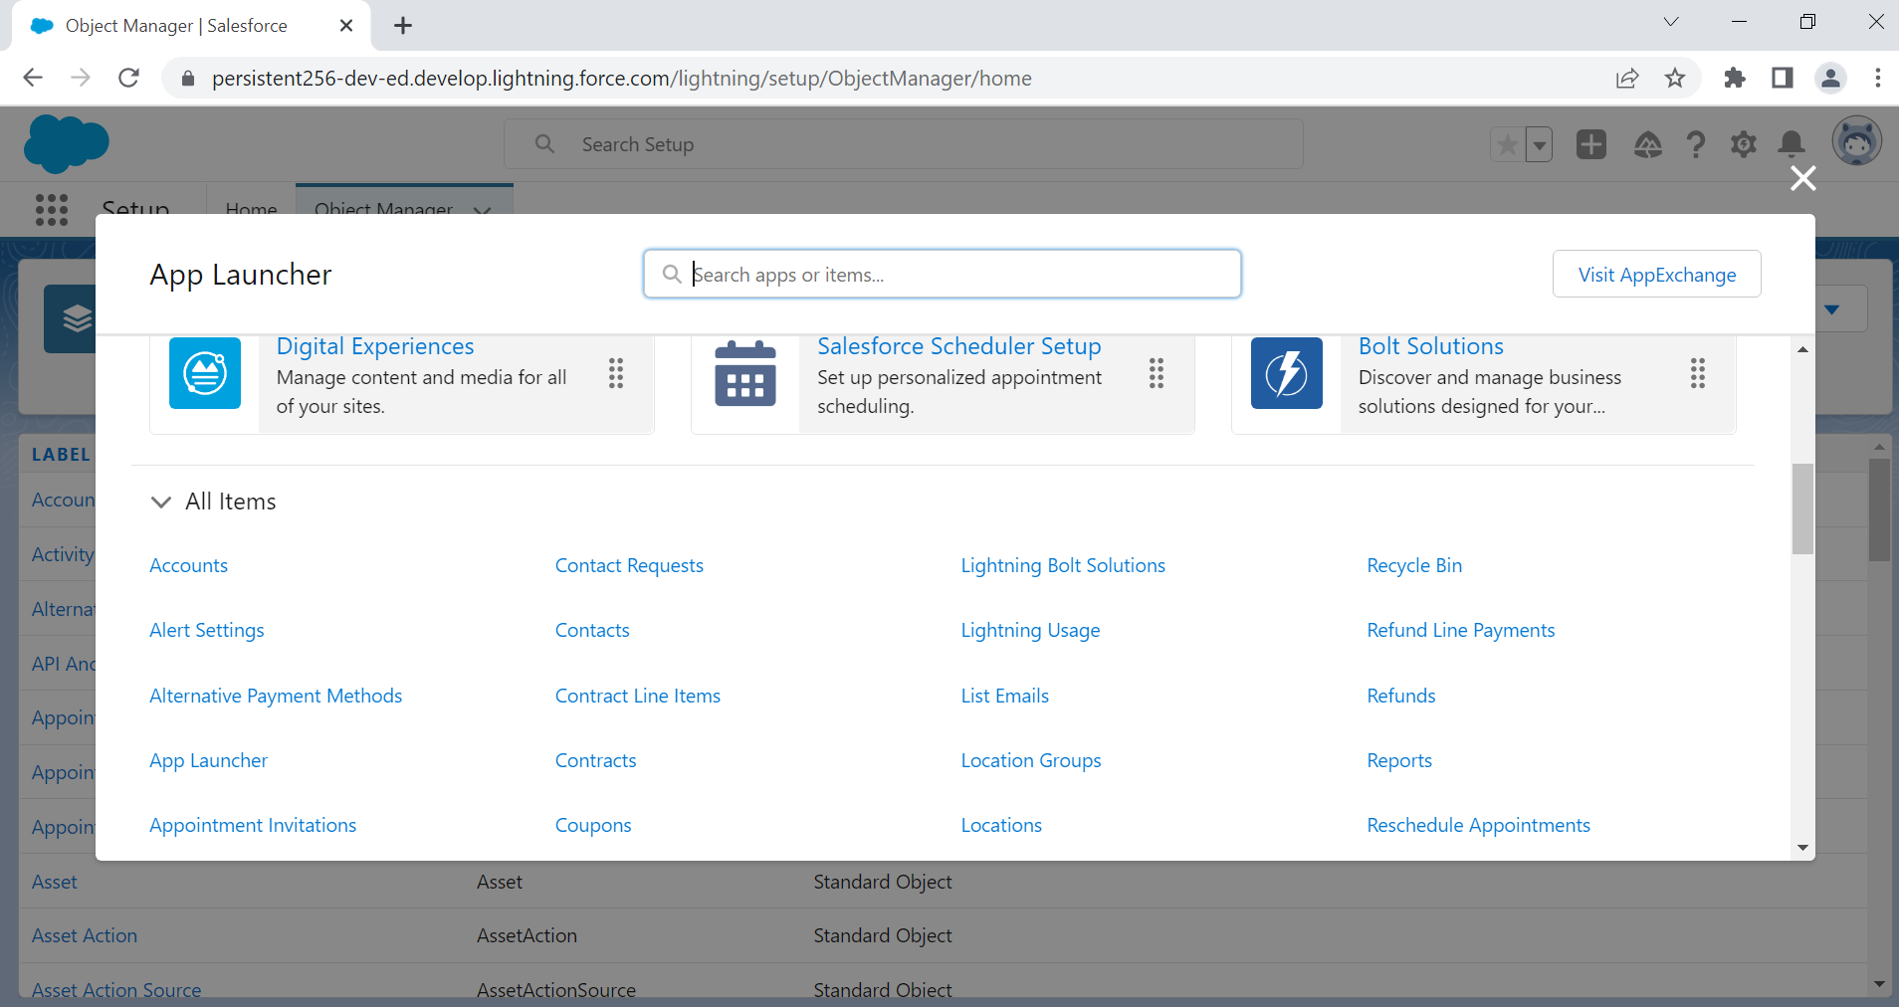
Search for accounts in App Launcher

Slide 9
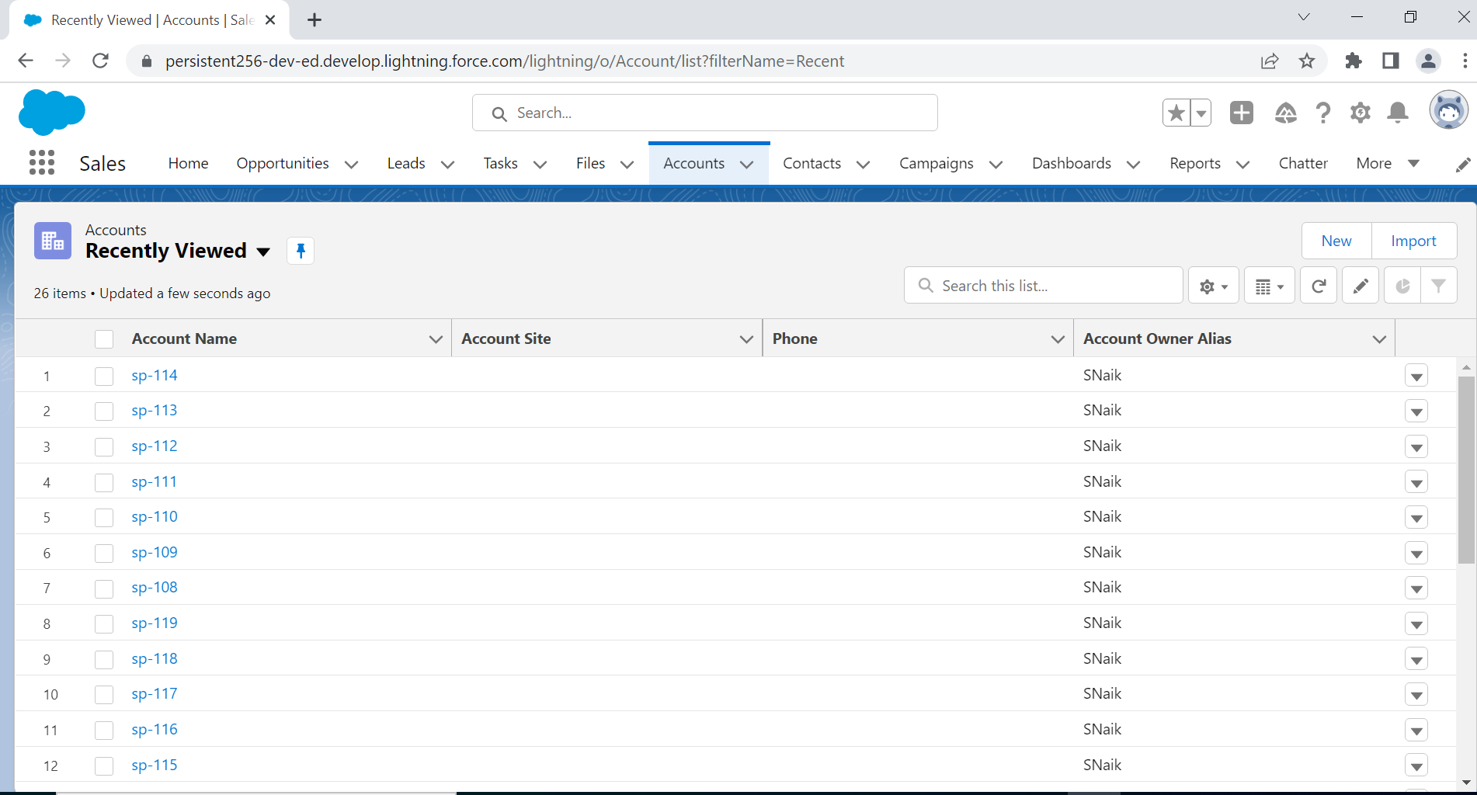
Accounts

Slide 10
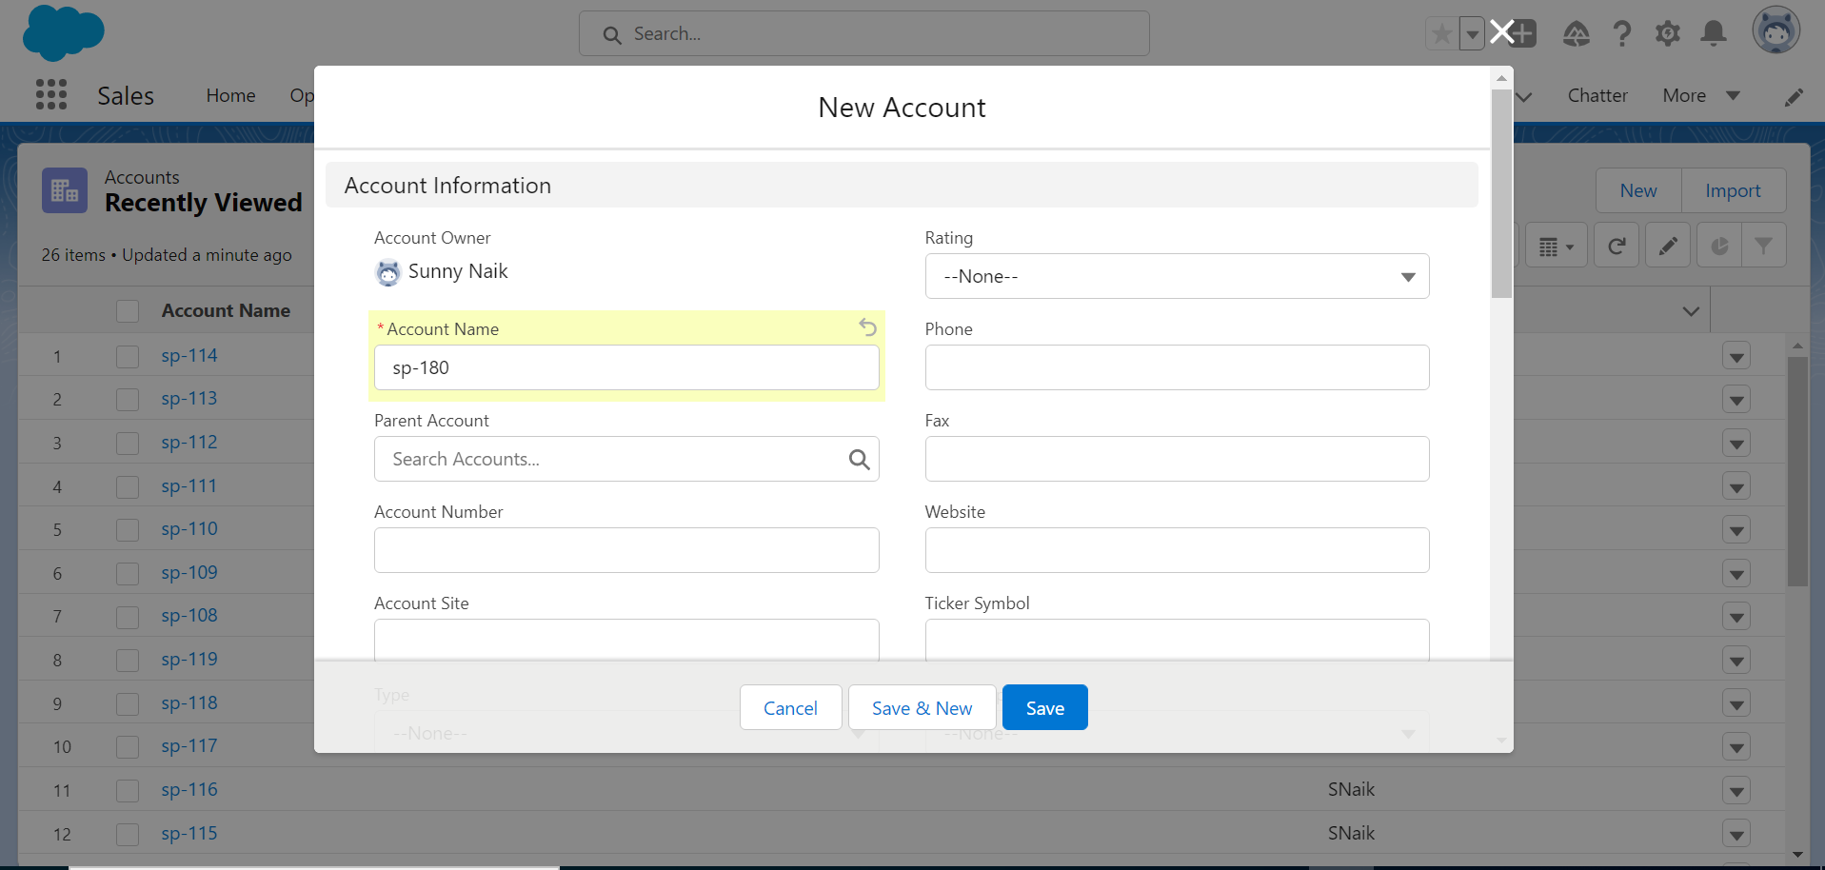
Create a new account

Slide 11
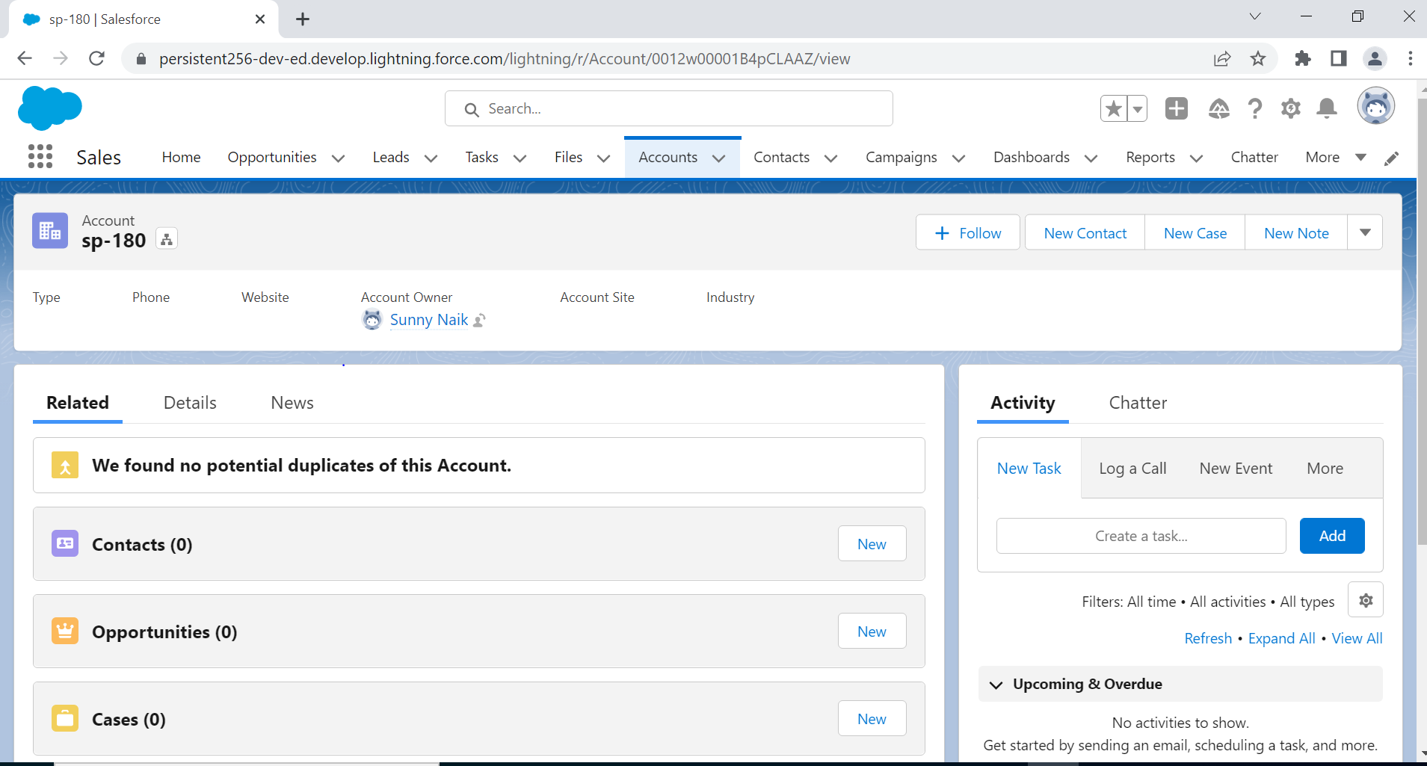
Account is created

Slide 12
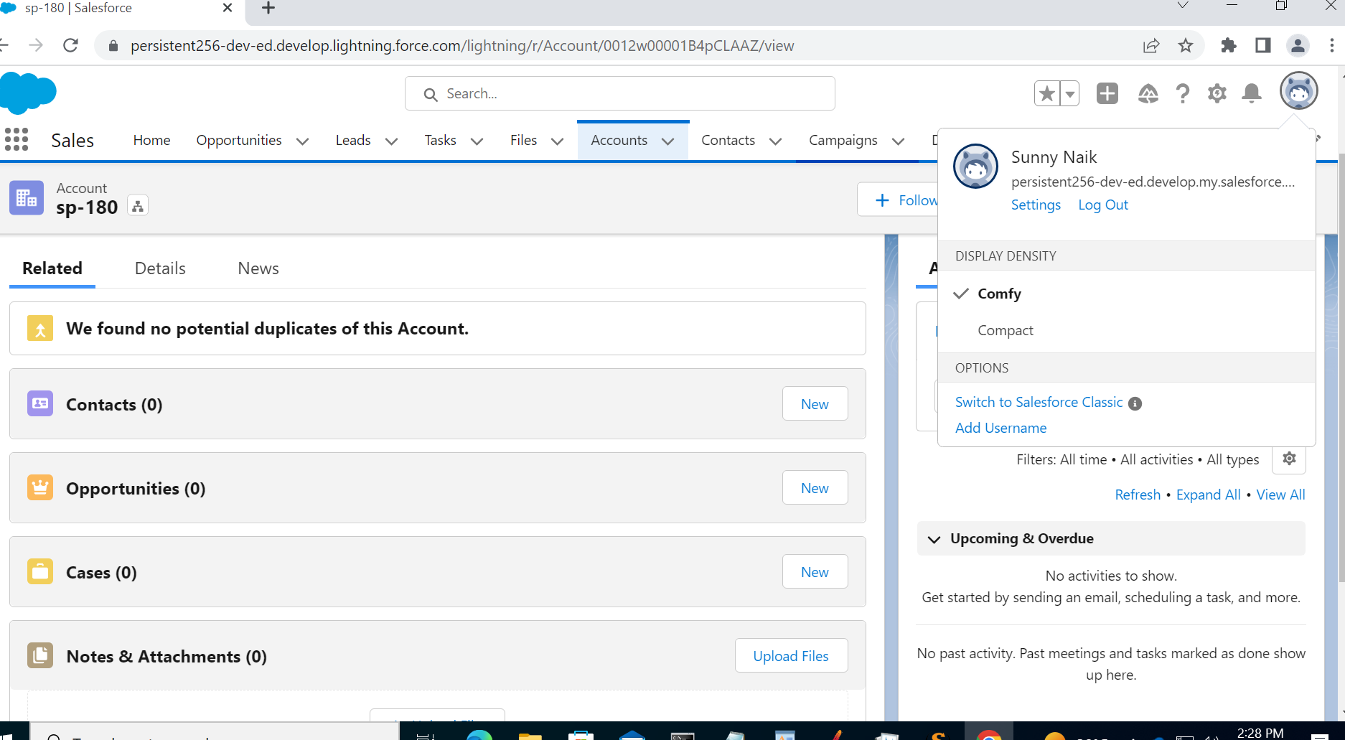
Logout

Slide 13
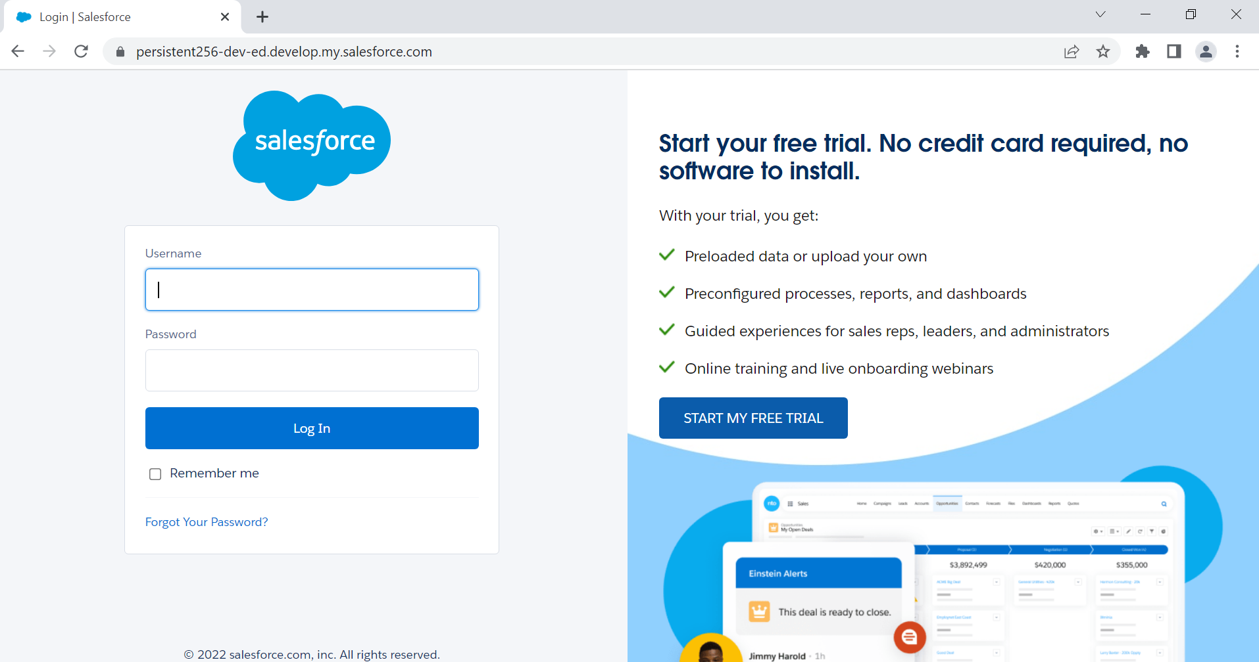

Slide 14

Thank yoU
Pavan Magal

Slide 15
Performance tool evaluation criteria
Performance Test Tool Evaluation Criteria
Wide Protocol Support.
Support to Distributed, Scalable Load Testing mechanism and Scenario Customization.
Automated Reporting.
Licensing Costs, Options and Restrictions.
Technical Support Assistance.
Shift Left CI/CD Integration support.
Observability APM Tool Integration and Customizations.

