Slide 1
Sorting!

Slide 2
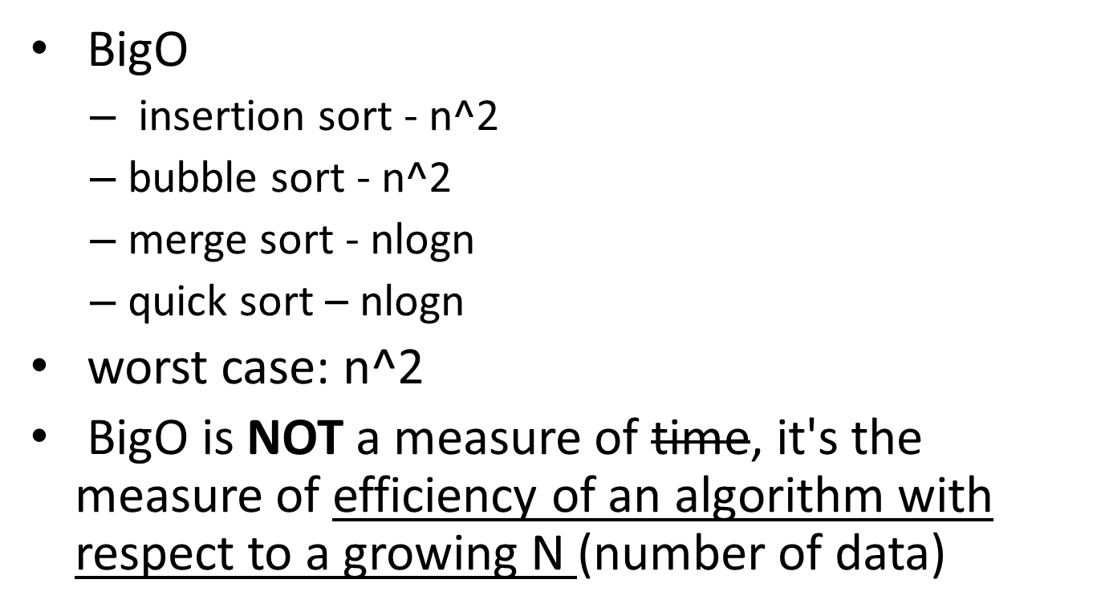
Big - O

Slide 3
Bubble Sort
Big O of N^2
Swaps terms down the row until the vector is sorted. After each pass through the vector the largest term in the so far unsorted data should now be at the end of the unsorted data.
Hint that bubble sort is being used:
  Swapping of two elements of the vector, usually by creating a variable to store the element being swapped.

Slide 4
Bubble Sort Examples
An example of Bubble Sort being carried out on a vector:
[7 3 11 8 6 5] (original)
[3 7 8 6 5 11]
[3 7 6 5 8 11]
[3 7 5 6 8 11]
The original vector
The 7 and 3 swap, then the 11 swaps all the way down, this is one pass.
Now the 8 ‘bubbles’ all the way down.
The 6 now ‘bubbles’ with the 5.
Bubble Sort Code Example:
function a = mySort(b)
N = length(b);
right = N-1;
for in = 1:(N-1)
for jn = 1:right
if (b(jn) > b(jn+1))
tmp = b(jn);
b(jn) = b(jn+1);
b(jn+1) = tmp;
end
end
right = right - 1;
end
a = b;

Slide 5
Insertion Sort
Big O is N^2
Creates a new vector, and places the data from the old vector into the new one, in order.
Hint that insertion sort is being used:
  Creation of an empty vector
  Itteration

Slide 6
Examples of Insertion Sort:
Code for Insertion Sort:
function b = sort(a)
b = []; I = 1; sz = length(a);
while i <= sz
b = sort2(b, a(i, 1) );
i = i + 1;
end
function a = sort2(a, v)
i = 1; sz = length(a); done = false;
while i <=sz
if lt(v, a(i,1))
done = true;
a = [a(1:i-1); v; a(i:end)];
return;
end
i = i +1;
end
if ~done
a(sz+1, 1) = v;
end
Insertion sort at work:
Original vector
[7 3 9 6 17 20]
New vector
[]
[7]
[3 7]
[3 7 9]
[3 6 7 9]
[3 6 7 9 17]
[3 6 7 9 17 20]

Slide 7
Merge Sort
Big O = NlogN
Breaks vector in half until it has a bunch of vectors of length 1 left. Then it compares each vector of length 1 and puts them back together in order in the exact same way they were divided.
Look for in the code where the vector is split in two halves.
Hint that merge sort is being used: Recursion.

Slide 8
Examples of Merge Sort:
Merge Sort at work:
Original vector:
[21 8 1 12 -1]
New Vector:
[21 8 1] [12 -1]
[21 8] [1] [12] [-1]
[21] [8] [1] [12] [-1]
[8 21] [1] [12] [-1]
[1 8 21] [-1 12]
[-1 1 8 12 21]*Sorted
Code for Merge Sort:
is on the next slide because it is very large.

Slide 9
function b = mySort(a)
b = a;
sz = length(a);
if sz > 1
szb2 = floor(sz / 2);
first = mySort(a(1 : szb2));
second = mySort(a(szb2+1 : sz));
b = helperSort (first, second);
end
b = b';
function b = helperSort(first, second)
i1 = 1;
i2 = 1;
out = 1;
while (i1 <= length(first)) & (i2 <= length(second))
if lt(first(i1), second(i2))
b(out,1) = first(i1); i1 = i1 + 1;
else
b(out,1) = second(i2); i2 = i2 + 1;
end
out = out + 1;
end
while i1 <= length(first)
b(out,1) = first(i1); i1 = i1 + 1; out = out + 1;
end
Merge Sort
Code

Slide 10
Quick Sort
Big O = NlogN, however, for much larger quantities of data Quick sort can switch to a Big O of N^2 (the worst case Big O)
Selects a pivot point (for example the first point) and places it in the middle. Then quick sort will place everything bigger than the pivot on the right of it, and everything smaller than the pivot to the left of the pivot. It repeats this with each created vector until a bunch of 1 element vectors are left, and these are already sorted so it puts them back together.
Indication of Quick Sort: Look for the selection of a pivot, and RECURSION!

Slide 11
Examples of Quick Sort:
Quick Sort at work:
Original Vector:
[21 8 1 12 -1]
New Vector:
[8 1 12 -1] [21]
[1 -1] [8] [12] |
[-1] [1] | [12] |
[-1 1] | | |
[-1 1 8 12] |
[-1 1 8 12 21]
as you can see to the left here, first 21 was the pivot (the first element)
next 8 was the pivot, and 21 was carried down, it is sorted already.
next 1 was a pivot, and 12 was a pivot and 8 is carried down.
next -1 is a pivot, 1 and 12 are carried down, and now the vector is ready to be put back together

Slide 12
function a = mySort(a, from, to)
if (from < to)
[a p] = helperSort(a, from, to);
a = mySort(a, from, p);
a = mySort(a, p + 1, to);
end
function [a lower] = helperSort(a, from, to)
x = a(from); ← sets up a new pivot
i = from - 1;
j = to + 1;
while (i < j)
i = i + 1;
while a(i) < x
i = i + 1;
end
j = j - 1;
while a(j) > x
j = j - 1;
end
if (i < j)
temp = a(i);
a(i) = a(j);
a(j) = temp;
end
end
lower = j;
Quick Sort Code

