Slide 1

Hedge Fund Application
By TEAM 8
Meda saikanth reddy - 001389103
Yanda yuan - 001737047

Slide 2
Overview
Building a hedge fund application that receives (real) stock price updates and makes appropriate recommendations
Functions:
Users can login to the system
Users can maintain their hedge fund profile
Users get recommendations on options

Slide 3
Program details
Language /Framework: Scala, play2 framework, Bootstrap, AkkaHttp, Slick
Github Link: https://github.com/sunnyreddy/BigDataScalaProject_Team8

Slide 4
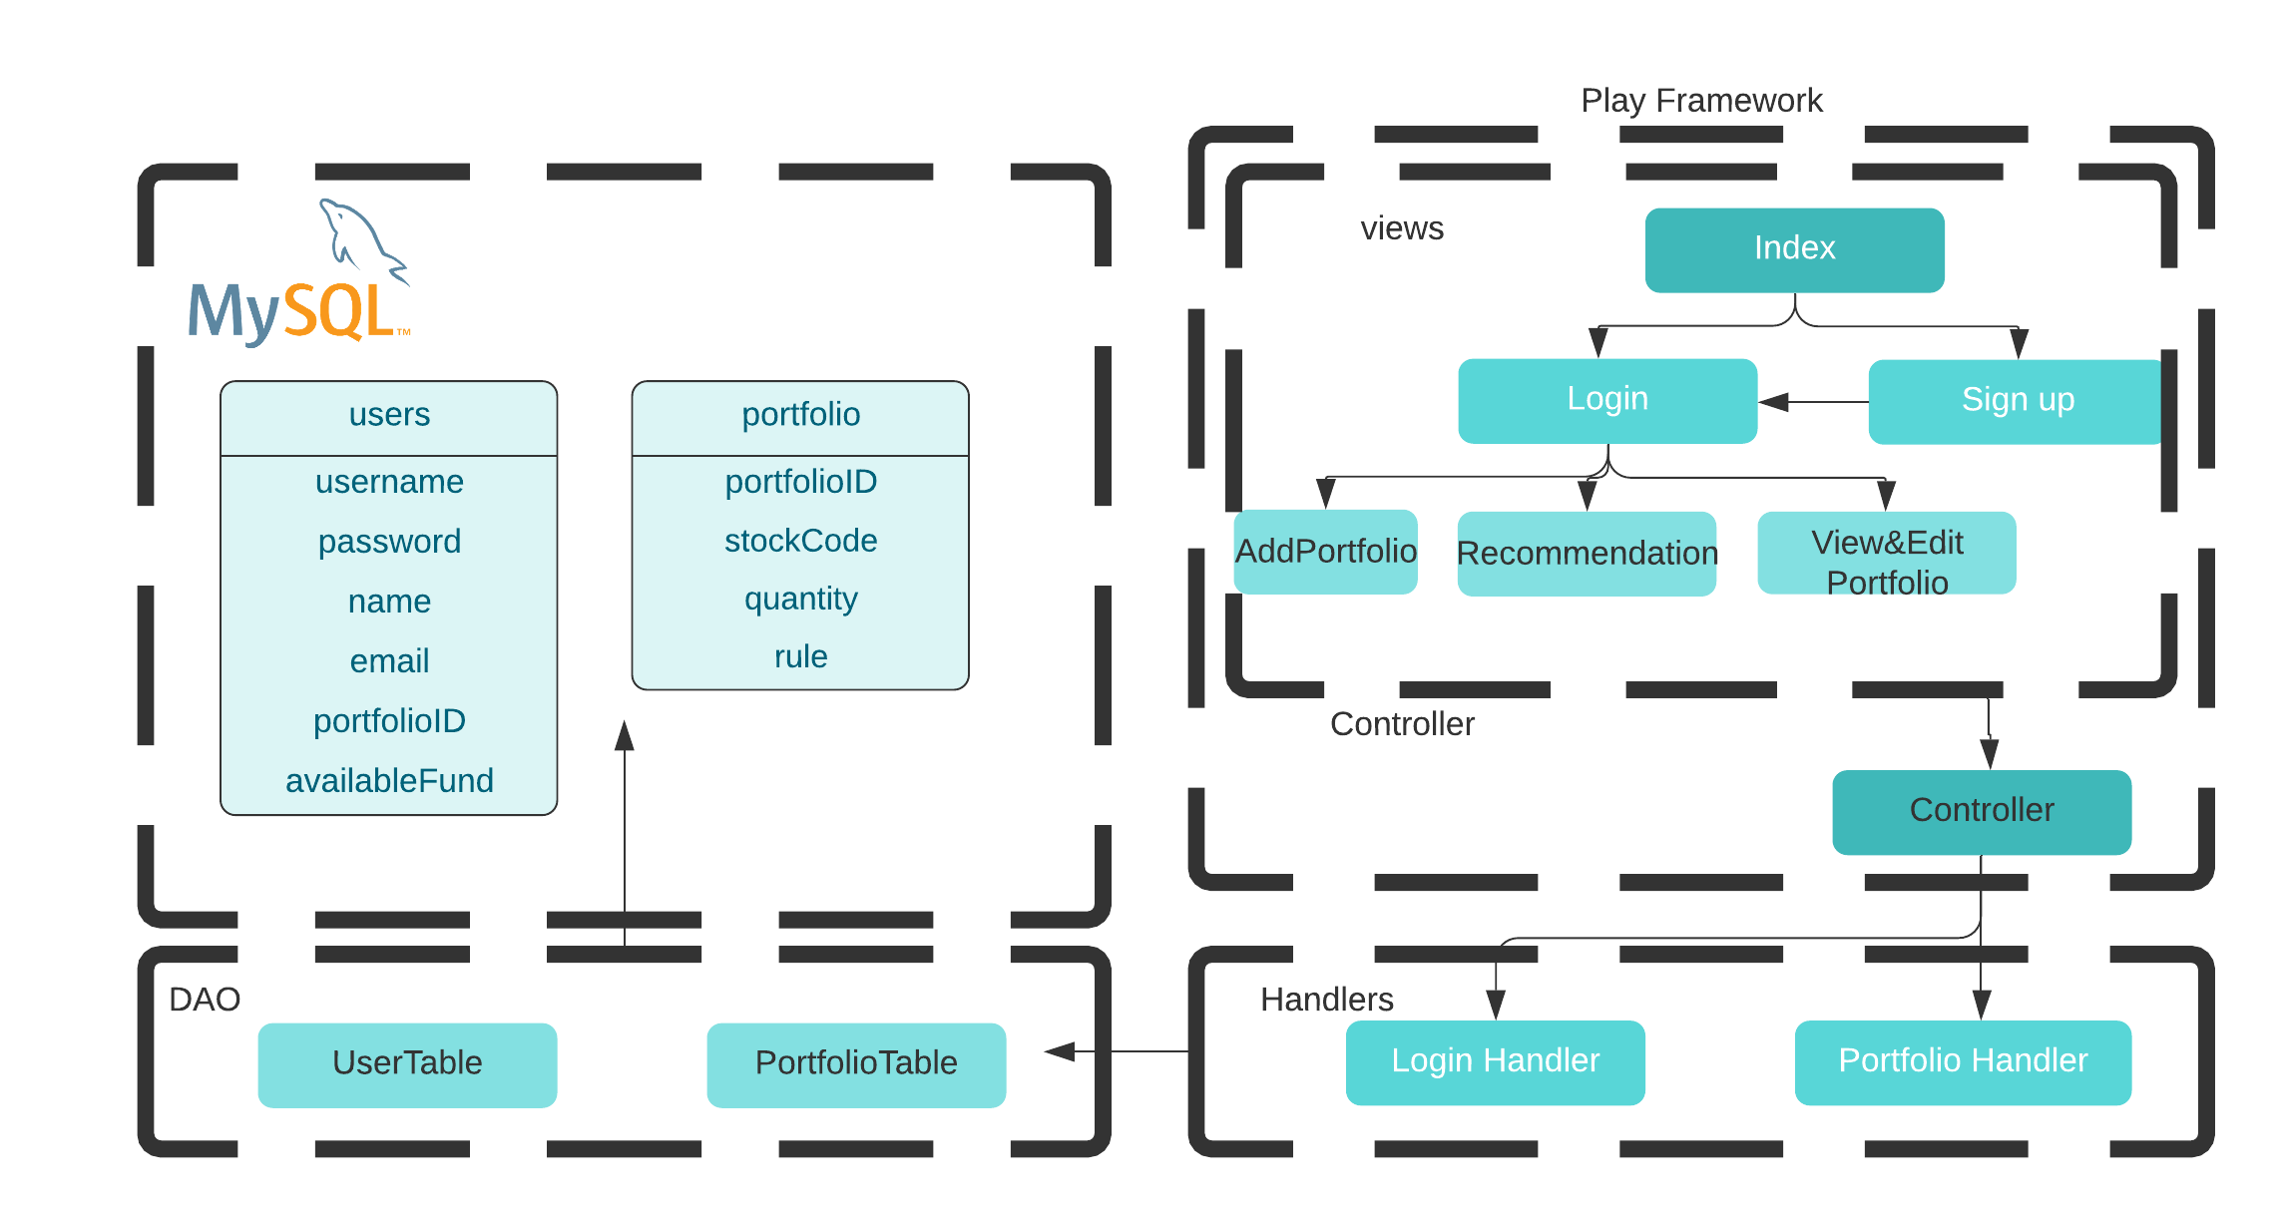
Project Implementation

Slide 5
Recommend Rule Process
Data Source (Alpha Vantage)
Predict through MLPackage(Arima)
Get Predict for Major Index ETF/ Target Stock
Combine Stock and Major Index ETF to produce a Ratio (Rule)
Transform to Spark RDD
Rule Decision
Stock Change Ratio
Increase Lower than Certain Raio
Increase Higher than Certain Raio
Major Index ETF Change Ratio
Increase Higher than Certain Raio
Increase Lower than Certain Raio
Not Recommend
No Ratio
Recommend
Give Ratio
Not Recommend
No Ratio

Slide 6
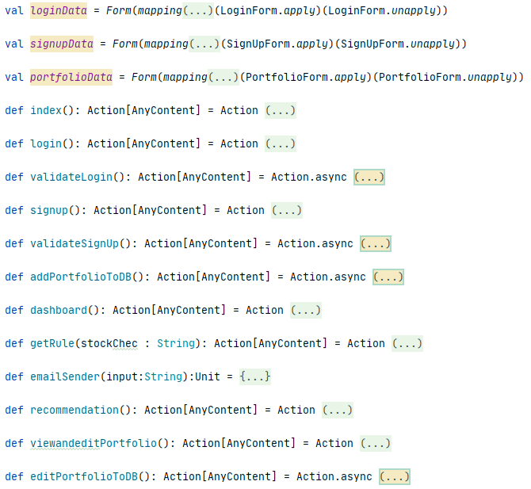
Controller

Slide 7
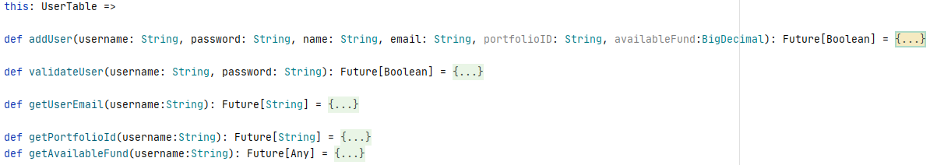
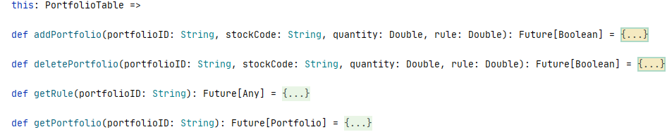
Handlers

Slide 8
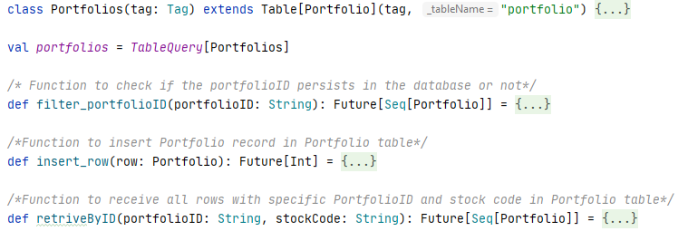
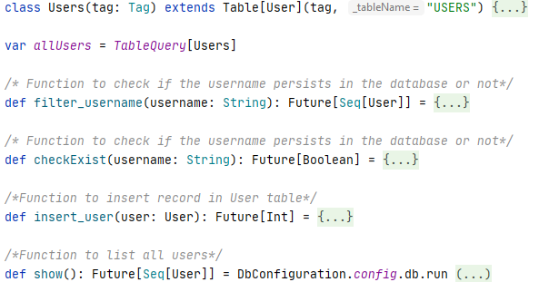
DAO

Slide 9

Use Cases:
Case1:
Actor: system
Action: retrieves user portfolio and rules from database
Result: Displays user portfolio

Slide 10

Use Cases:
Case2:
Actor: system
Action: updates value of portfolio based on current stock prices and option prices and redisplays user dashboard via websocket
Result: Re-displays user dashboard

Slide 11
Use Cases:
Case3:
Actor: user
Action: edits his/her rules
Result: rules changed in database

Slide 12
Use Cases:
Case4:
Actor: system
Action: sends recommendation to user based on current rules and current stock prices; (user is not necessarily logged in so need SMS , email, tweet or Slack;
Result: Information receive with recommendation with tweet, email, slack or SMS

Slide 13

Use Cases:
Case5:
Actor: user
Action: initiates transaction to buy/sell (mock);
Result: Confirmation

Slide 14
Use Cases:
Case6:
Actor: system
Action: simulates managing all of the contracts on the third Friday (5 p.m.)of last month of the quarter (user may not be logged in);
Result: Result of simulation

Slide 15
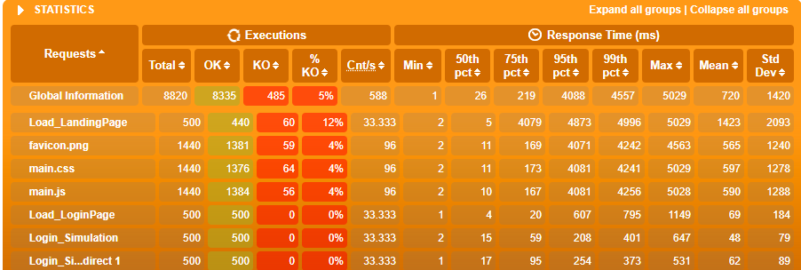
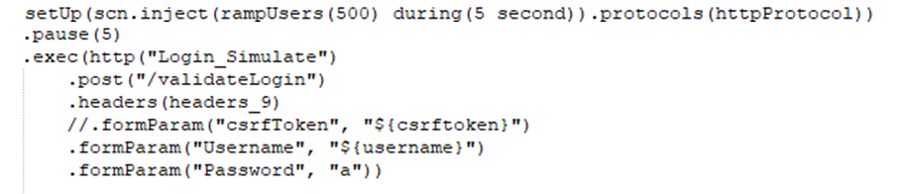
Acceptance Criteria
1. system should support at least 1000 users, of which 500 are logged in at any one

Slide 16
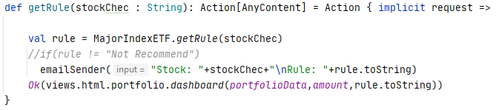
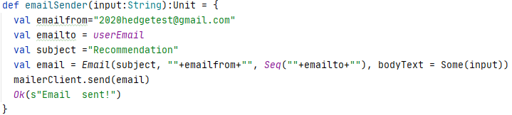

Acceptance Criteria
2. Recommendations should be sent within one minute of triggering event (price change)

Slide 17
Goals
1. Build a hedge fund application where user can manage their profiles and get recommendations whether to buy or not
2. Implement a user-friendly system to manage their profiles
3. Trigger mails for users whenever we have recommendations

Slide 18
Thank you

