Slide 1

Online Exam Analytics Dashboard: Leveraging Azure & Power BI for Real-Time Insights
A concise guide to building a scalable, secure analytics solution that turns live exam events into actionable insights for educators and administrators.

Slide 2





Why Online Exam Analytics Matter
Widespread Adoption
Common Challenges
Value of Dashboards
Over 70% of institutions adopted online exams by 2025 — analytics are essential to manage scale.
Cheating detection, real-time reliability, and meaningful performance tracking are top concerns.
Dashboards transform raw exam events into actionable insights for faster decisions and interventions.

Slide 3

Azure Cloud: The Backbone of Scalable Exam Analytics
Event Ingestion
Azure Event Hubs ingests millions of exam event data points with low latency for real-time processing.
Stream Processing
Azure Stream Analytics processes and aggregates streaming events continuously for live metrics.
Data Storage & Analytics
Azure Synapse Analytics stores large-scale exam datasets and supports complex historical queries.

Slide 4

Power BI: Visualizing Exam Data for Educators and Administrators
Interactive Dashboards
Drill-downs on student performance, question-level analytics, and cohort comparisons for deeper insight.
Real-Time Monitoring
Live visuals fed from Stream Analytics enable instructors to monitor exam progress and system health.
Custom Alerts
Power BI can surface anomalies like suspicious answer patterns or spikes in disconnects via alerts.

Slide 5
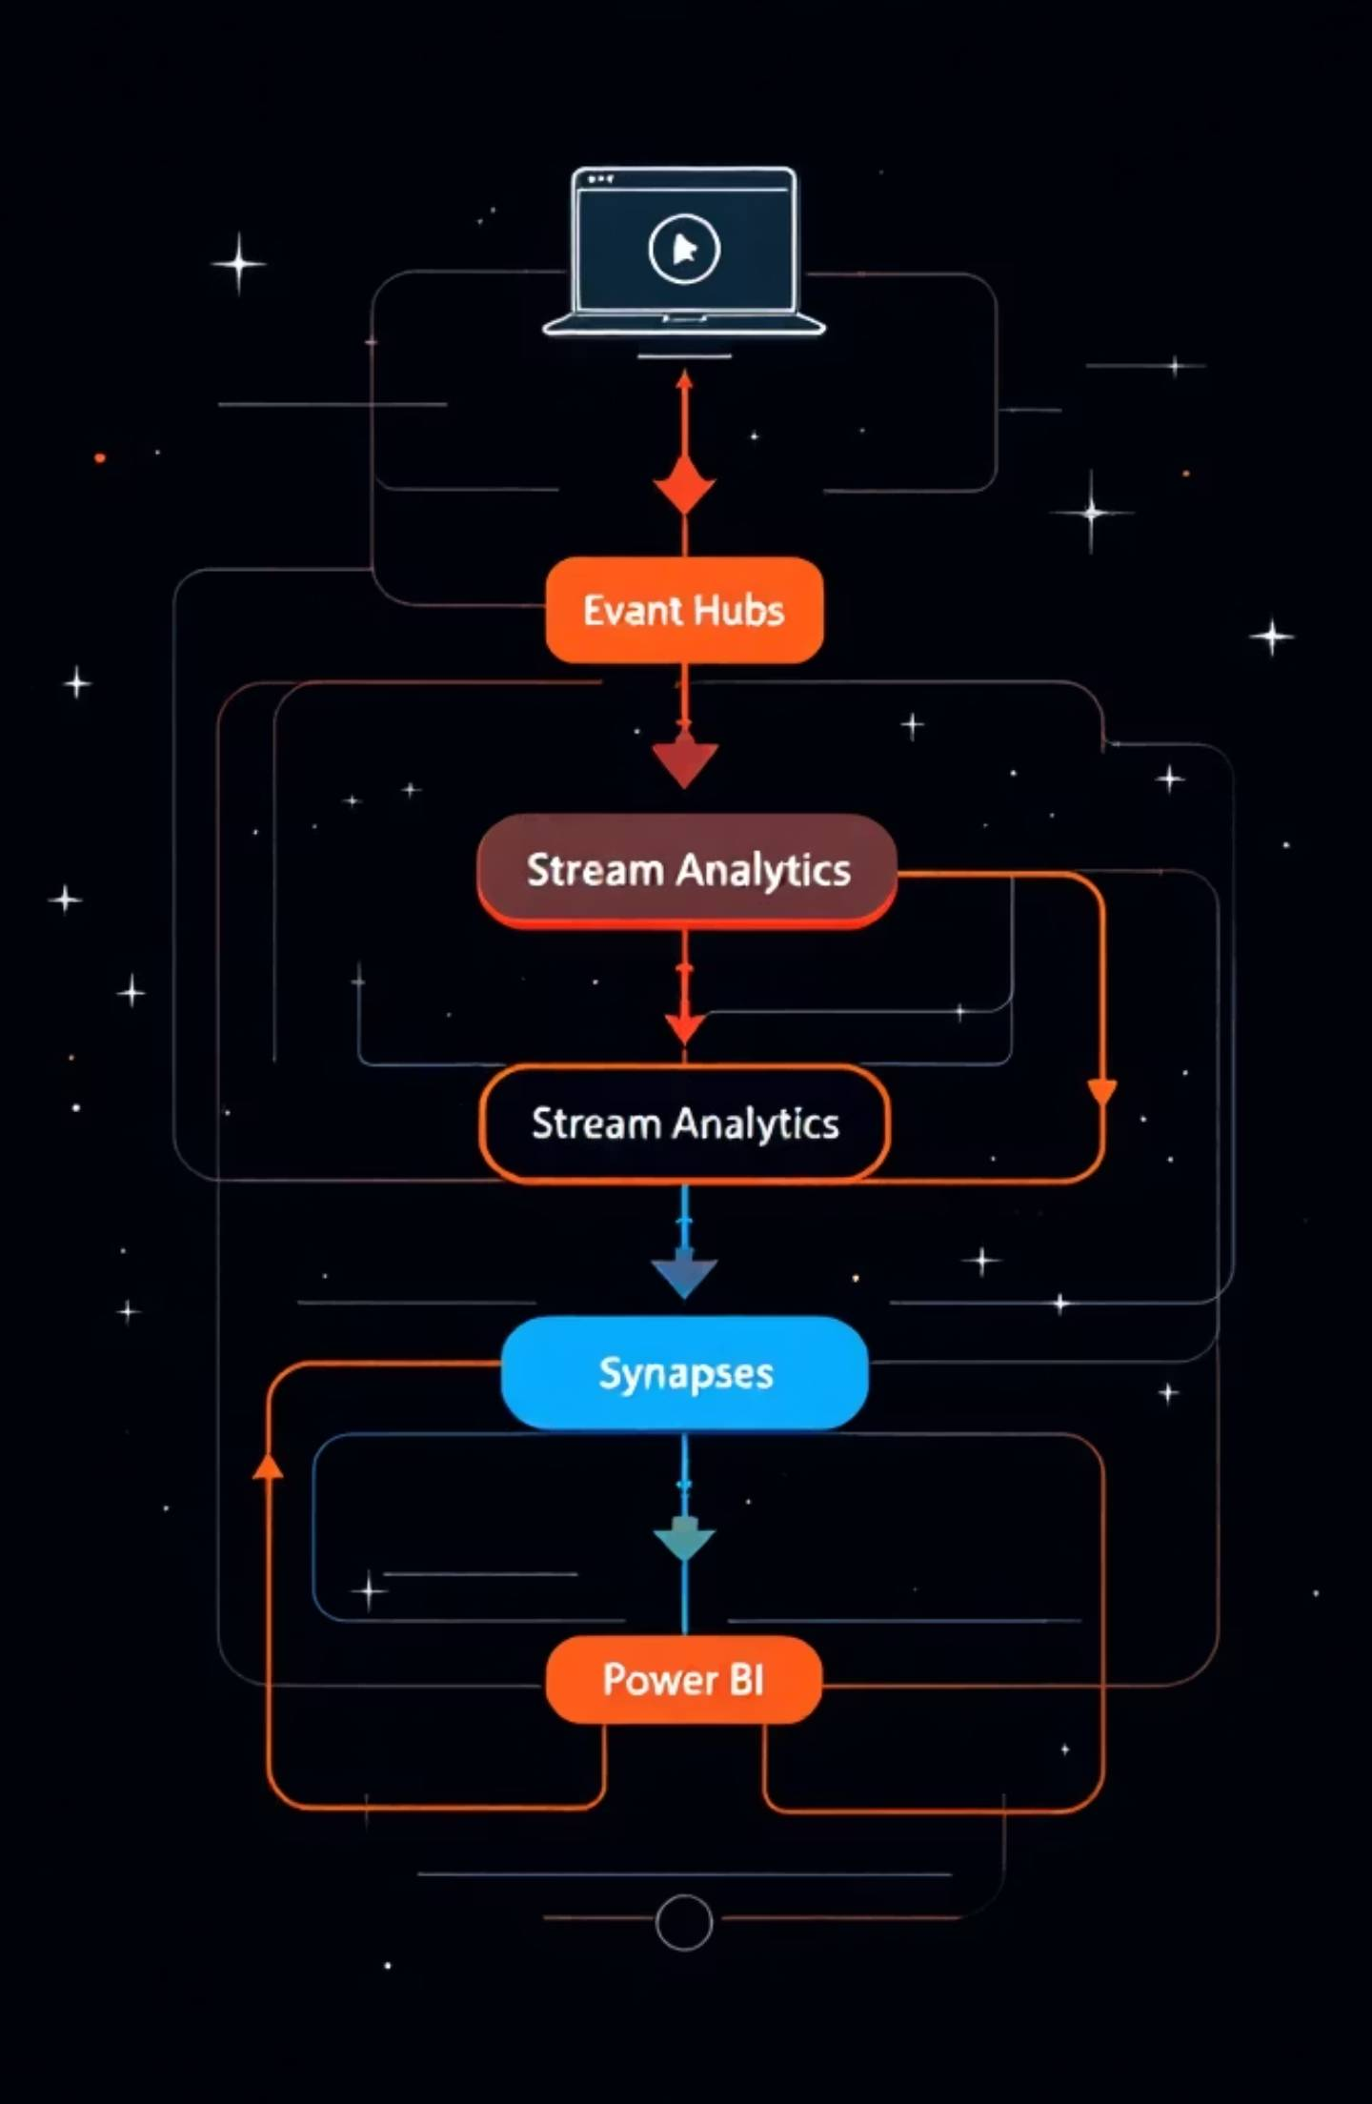

Architecture Overview: From Exam Event to Insight
Exam platform
Emits real-time exam events
Power BI
Exam events to analytics
Azure Event Hubs
Live dashboards and reports
Ingests high-volume streams
Azure Synapse
Stream Analytics
Stores historical data at scale
Aggregates avg score and time
This pipeline supports real-time alerts, historical analysis, and scalable storage — enabling rapid insights and long-term analytics.

Slide 6

Key Metrics & Visuals in the Dashboard
Student performance: pass/fail distribution, score trends, cohort comparisons.
Question analytics: difficulty index, discrimination index, median time per question.
System metrics: concurrent users, end-to-end latency, error and reconnect rates.
Use these metrics to prioritize interventions, refine assessments, and measure platform reliability.

Slide 7

Real-Time Monitoring & Alerts with Azure Monitor and Power BI
Collect Logs
Azure Log Analytics ingests platform logs, authentication events, and telemetry.
Detect Anomalies
Stream Analytics and Azure Monitor run rules to flag unusual answer patterns or traffic spikes.
Visualize & Notify
Power BI surfaces health views; automated alerts notify admins and proctors to act immediately.

Slide 8




Case Study: University XYZ’s Online Exam Transformation
Faster Results
Improved Integrity
Higher Satisfaction
Result processing moved from 3 days to real-time dashboards; instructors review outcomes immediately.
Analytics detected and prevented 15% more cheating attempts through pattern recognition and alerts.
Immediate feedback dashboards improved student satisfaction and reduced support inquiries.

Slide 9

Getting Started: Build Your Own Dashboard
Prereqs: Azure subscription, Power BI Pro, exam platform event integration.
Deploy Event Hubs → Configure Stream Analytics jobs for aggregations.
Provision Synapse for storage and connect Power BI to live outputs.
Design reports: performance, question analytics, system health, and alerts.
Use Microsoft Learn, Azure quickstart templates, and Power BI samples to accelerate deployment.

Slide 10

The Future of Online Exam Analytics: AI & Predictive Insights
Automated Proctoring
Predictive Alerts
Azure Cognitive Services can detect suspicious behavior and sentiment for richer proctoring signals.
Machine learning models identify at-risk students and predict likely question failures before exams.
Continuous Improvement
Feedback loops feed model improvements and exam design—helping educators iterate on assessments.
Let's harness Azure and Power BI with intelligent analytics to make assessments fairer, faster, and more actionable.

