Slide 1
DATA ANALYSIS FOR ENERGY CONSERVATION
BY:
S YADAVENDRA
160116737120
SANJAY BILLA
160116737321

Slide 2
INTRODUCTION
Data Analytics is defined as analysis or process of inspecting cleansing data in order to get useful output
We use the techniques of machine learning algorithm in order to provide a solution

Slide 3
What is machine learning?
Machine learning is a field of artificial intelligence that uses statistical techniques to give computer systems the ability to "learn" (e.g., progressively improve performance on a specific task) from data, without being explicitly programmed.

Slide 4
Energy Conservation:
Energy conservation is the effort made to reduce the consumption of energy by using less of an energy service. This can be achieved either by using energy more efficiently (using less energy for a constant service) or by reducing the amount of service used (for example, by driving less)

Slide 5
PREREQUISITES:
Programming languages:
- python
- R language
IDE required:
- jupyter
- Spyder
-R studio

Slide 6
CLASS DIAGRAM:
pandas
Linear model
Metrics
Acces
sing
URL
Data Frame
model
Fit()
Predict()
R2_score
Read CSV( )
Multiple Regression
SVR
Fit()
Predict()
Multiple Regression
RF
Fit()
Predict()
Multiple Regression
XGB
Fit()
Predict()

Slide 7
ACTIVITY DIAGRAM:
Dataset gathered
Dataset split into test & train
Is problem regression
NO
YES
NO
Special case
Model is trained tested & executed
terminated

Slide 8
USE CASE DIAGRAM:
SOFTWARE
DATA SETS
M!
M2
M3
M4
Accurasy is calculated and inference is given

Slide 9
MACHINE LEARNING MODELS USED:
Linear regression
SVR
RF
XGB
GBR
Multi output regression

Slide 10
FLOW CHART:
START
URL provided
DATASET retrived
TRAIN
A 1
M 1
A2
M2
A3
M3
TEST
A4
M4
Accurasy is calculated

Slide 11
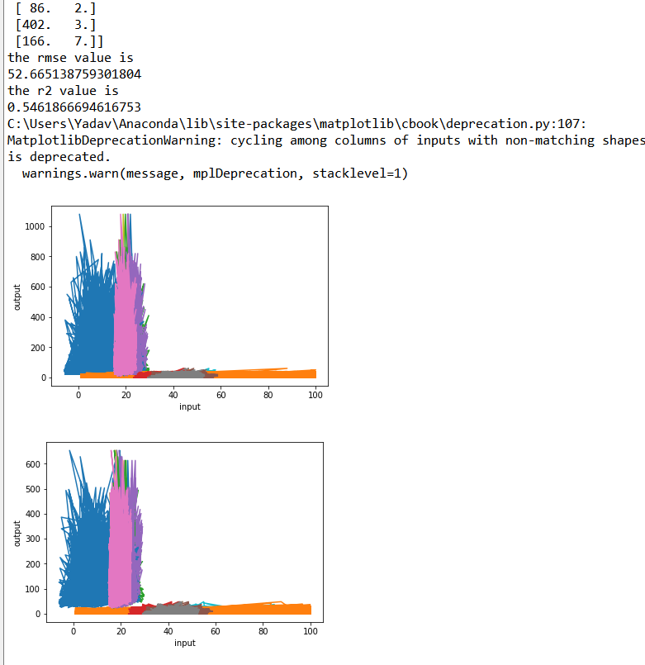
OUTPUT:

