Slide 1
Pittsburgh Tourism
Sunny P

Slide 2
Analyzing a Cities attraction for Tourism
Economy: tends to help drive a city to be a destination hotspot
Venues: a variety of different venues can help attract new tourists to a city
Education Attainment: education can help drive a cities growth with a higher attainment rates from High School to Graduates

Slide 3
Data
FourSquare Data used to find nearby venues
Number of different categories
Hotel venues for visitors
List of different attractive venues
Economic Data
Real GDP (US Census)
WalletHub ranking Job Market and SocioEconomics
Education Data
Educational attainment for Allegheny County and Philadelphia County provided by the US Census

Slide 4
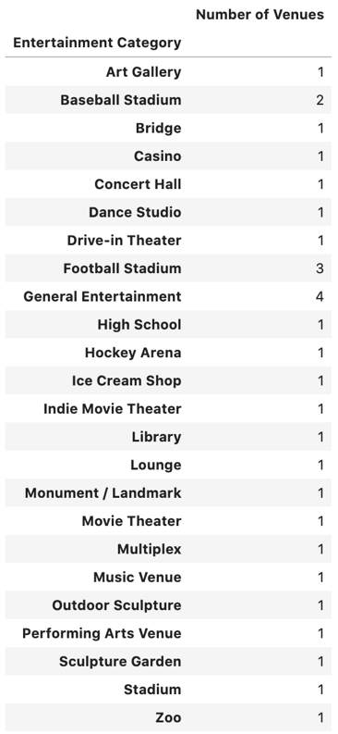
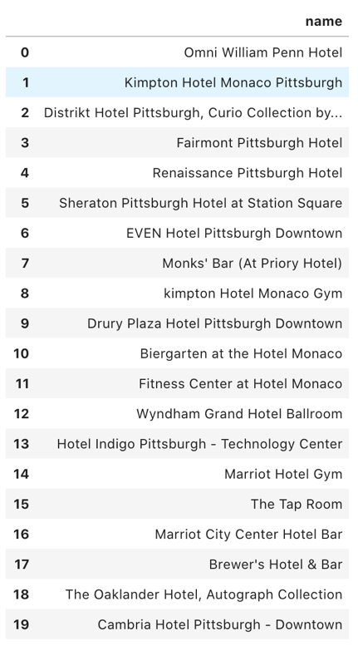
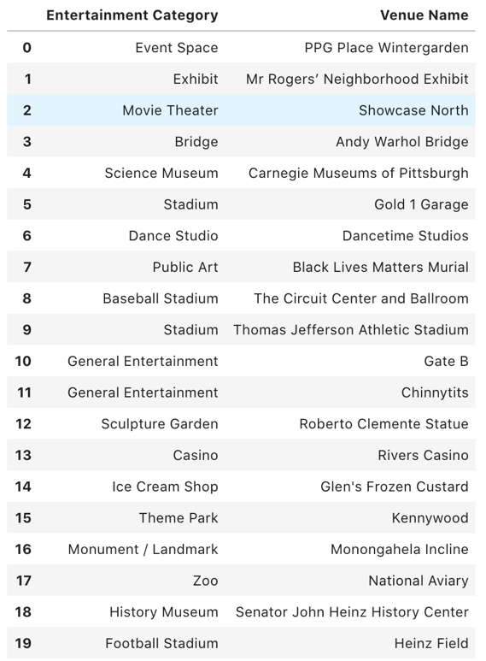
Venues in Pittsburgh

Slide 5
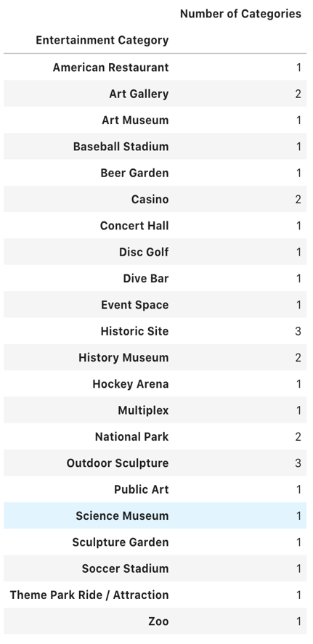
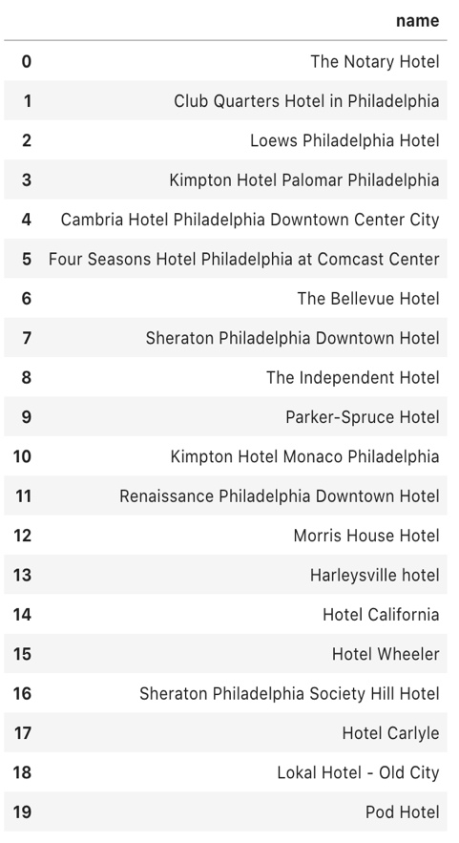
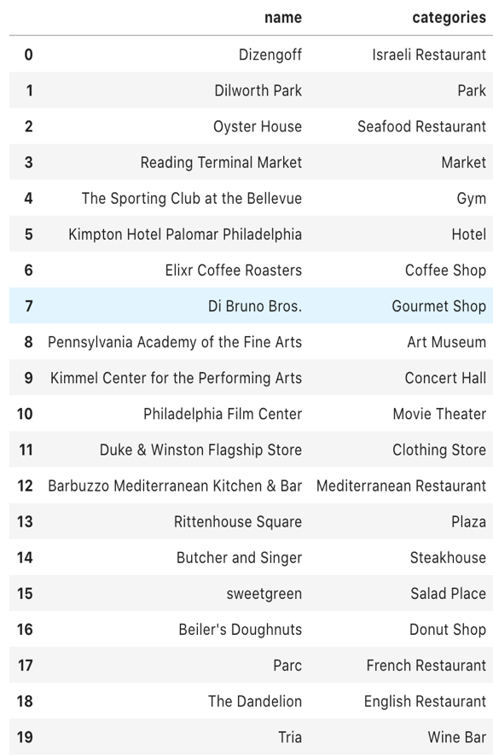
Venues in Philadelphia

Slide 6
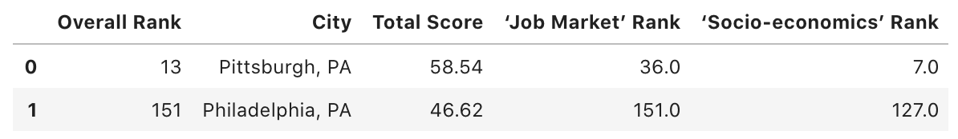
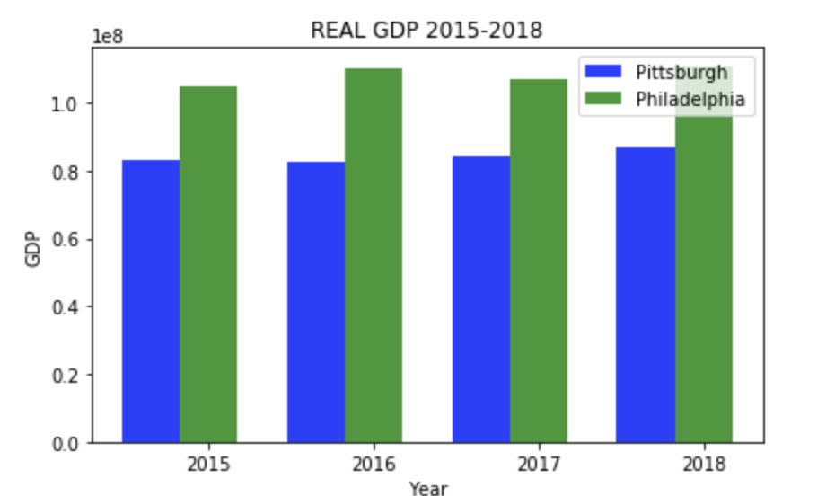
Employment Comparison
Pittsburgh has seen steady growth
over the last 3 years
Philadelphia has been up and down
but has generally progressed up

Slide 7
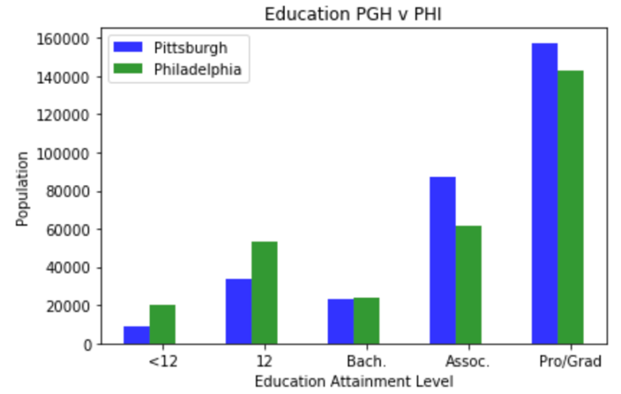
Education
Pittsburgh has more Professional graduates, associates, and students with high school diplomas
Philadelphia has more high school graduates but in respect to total population it is still behind Pittsburgh
Bachelor Degrees are roughly the same for both cities.
Pittsburgh takes the advantage due to the relation of total population

Slide 8
Conclusion
Both cities have driving economies and have been historically great at garnering tourists. Pittsburgh has a slight edge in educational attainment while Philadelphia has proved throughout the years to be a more stable economy. WalletHub has ranked Pittsburgh higher in socio economics and job markets. Pittsburgh is near identical to Philadelphia in almost all aspects but still fall behind in travelers visited.

