Slide 1

Welcome to my Website
S.Pandit

Slide 2


Slide 3
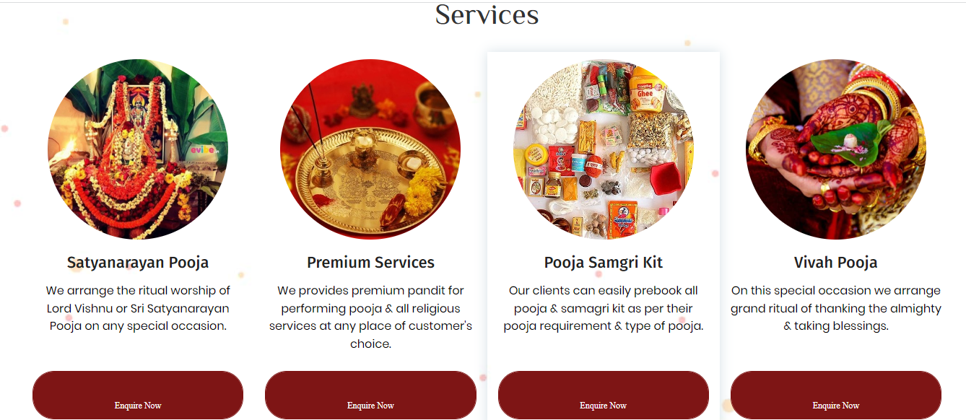

Slide 4


Slide 5


Slide 6


Slide 7
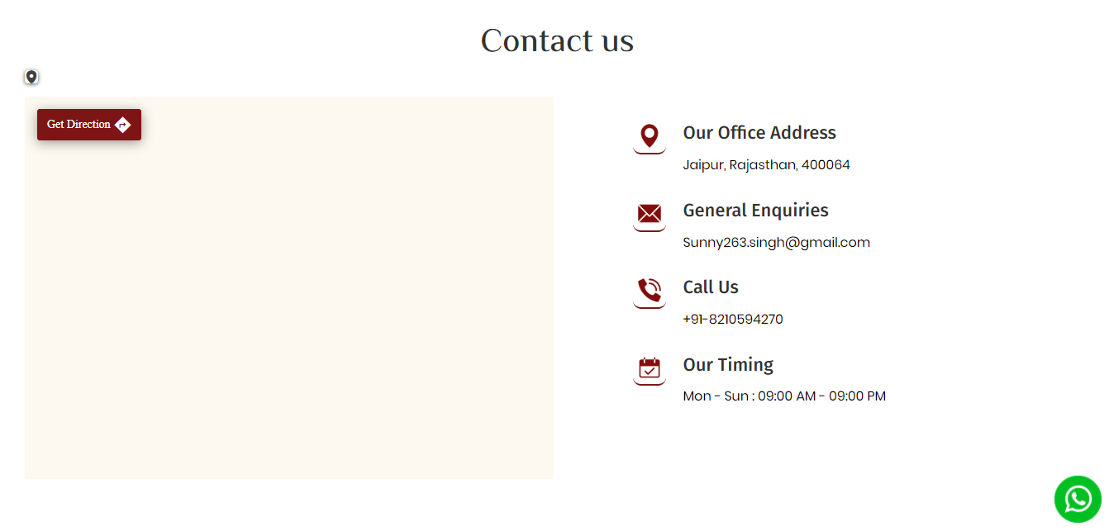

Slide 8
