Slide 1
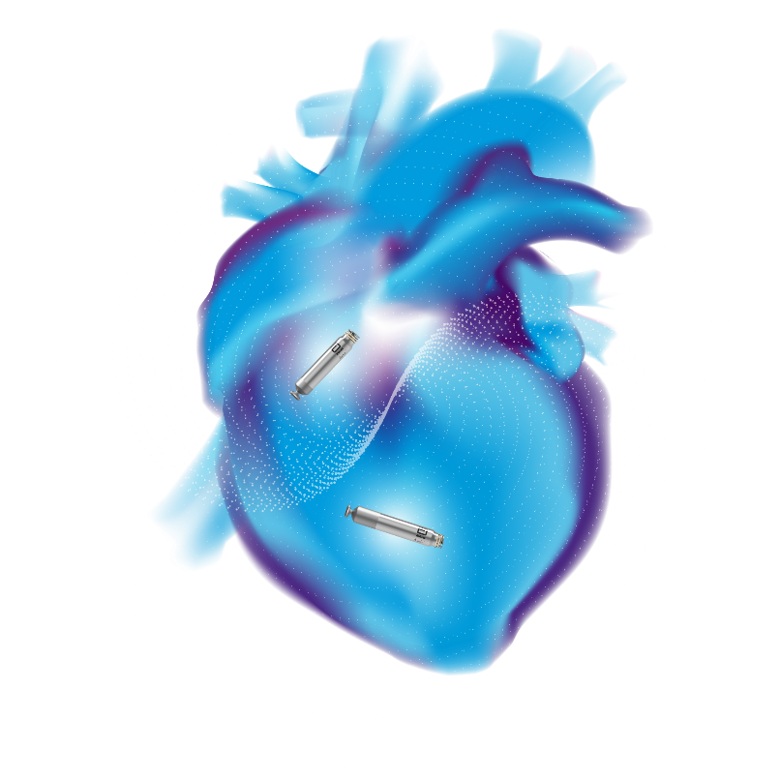






INTRODUCING
The World’s First
Dual-Chamber
Leadless Pacemaker
AVEIRTM DR
Powered by i2iTM Communication, AVEIRTM DR Offers:
Beat-to-beat synchrony
Longer life
Retrievability
Upgradability
28th & 29th
September 2025
9:00 AM - 6:00 PM
For internal use only
Aerocity

Slide 2


