Slide 1
Image Contrast Enhancement Techniques
Atif Ahmed (161114048)
atif.ahmed.1120@gmail.com
Sunny Singh (161114052)
sunny@doeity.com
Bachelor of Technology Students
Department of Electronics and Communication Engineering
Maulana Azad National Institute of Technology, Bhopal
RESEARCH PAPERS CONSULTED
1. Contrast Enhancement Algorithm for Color Images
2. Image Contrast Enhancement Using Singular Value Decomposition for Gray Level Images
3. A New Contrast Enhancement Technique by Adaptively Increasing the Value of Histogram

Slide 2
Contrast Enhancement Algorithm for Color Images
Contrast is the difference in luminance or intensity level between objects or regions in an image. If the contrast is too low, all pixels are a mid-shade of gray making the objects to fade into each other.
Hence, low contrast causes loss of information in some areas in the image, while good contrast makes objects or scenes depicted in an image distinguishable and visually interpretable.
Histogram equalization generates a grey map that changes the histogram of an image and redistribute pixel values to be as close as possible to a user-specified histogram [1, 2].
An adaptation of histogram equalization is the contrast limited adaptive histogram equalization (CLAHE). CLAHE divides input image into a number of equal size blocks and then performs contrast limited histogram equalization on each block.

Slide 3

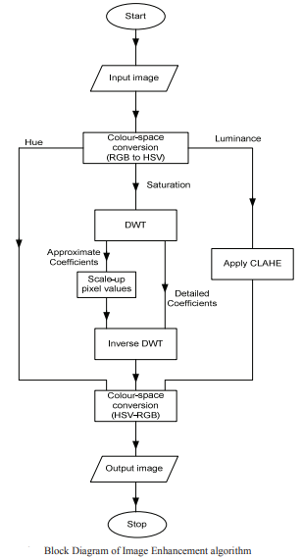
Contrast Enhancement Algorithm for Color Images
Processing Flow/Algorithm
1) Load a color image
2) Convert from RGB to HSV color space
3) Apply Discrete Wavelet Transform to saturation (S) component
4) Use a derived mapping function to modify approximate coefficients from (4).
5) Reconstruct S using Inverse Discrete Wavelet transform.
6) Enhance luminance (V) component using CLAHE.
7) Combine H, new S component, and V components to get the enhanced HSV image
8) Convert from HSV to RGB color space.

Slide 4
IMAGE CONTRAST ENHANCEMENT USING SINGULAR VALUE DECOMPOSITION FOR GRAY LEVEL IMAGES
APPLICATION
In many applications such as geosciences studies, astronomy, and geographical information systems the satellite images are used.
One of the most important quality factors in satellite images comes from its contrast.
THEORY
Contrast enhancement is frequently referred to as one of the most important issues in image processing.
Contrast is created by the difference in luminance reflected from two adjacent surfaces.
In visual perception, contrast is determined by the difference in the color and brightness of an object with other objects.
PROBLEM
If the contrast of an image is highly concentrated on a specific range, the information may be lost in those areas which are excessively and uniformly concentrated.
The problem is to optimize the contrast of an image in order to represent all the information in the input image.

Slide 5
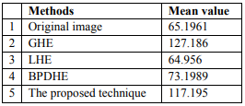
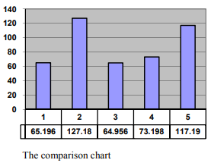
IMAGE CONTRAST ENHANCEMENT USING SINGULAR VALUE DECOMPOSITION FOR GRAY LEVEL IMAGES
There have been several techniques to overcome this issue: General Histogram Equalization (GHE),
Local Histogram equalization (LHE), and
Brightness Preserving Dynamic Histogram Equalization (BPDHE)
The GHE technique is one of the simplest and most effective primitives for contrast enhancement, which attempts to produce an output histogram that is uniform.
The stateof-the-art technique BPDHE is obtained from dynamic histogram specification which generates the specified histogram dynamically from the input image.
In this letter, the proposed method has been compared with the conventional GHE, LHE and BPDEH. The results indicate the superiority of the proposed method over the after mentioned methods.

Slide 6
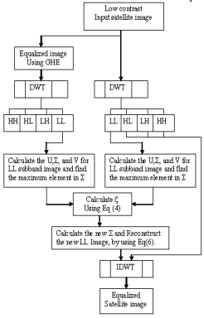


IMAGE CONTRAST ENHANCEMENT USING SINGULAR VALUE DECOMPOSITION FOR GRAY LEVEL IMAGES
The general procedure of the proposed technique is as follows. The input image A is first processed by using GHE to generate Â. Then, both of these images are transformed by DWT into four sub band images. The correction coefficient for the singular value matrix is calculated by using the following equation:
where ΣLLA is the LL singular value matrix of the input image and ΣLLAˆ is the LL singular value matrix of the output of the GHE. The new LL image is composed by
Now, the LLA, LHA, HLA, and HHA sub band images of the original image are recombined by applying IDWT to generate the resultant equalized image A.

Slide 7
A NEW CONTRAST ENHANCEMENT TECHNIQUE BY ADAPTIVELY INCREASING THE VALUE OF HISTOGRAM
Contrast enhancement is a display technology that improves the exhibition effect by increasing the dynamic range of gray intensity of the input image. We can classify the techniques of contrast enhancement into two categories: Global Enhancement and Histogram Equalization based methods.
A. Global Methods
Global Enhancement method is the most prevalent method to be utilized such as Histogram Stretching method (HS), Improved Histogram Stretching method (IHS), localized contrast manipulation method, and Automatic Video Contrast Enhancement.
B. Histogram Equalization Based Methods
Histogram Equalization (HE) is very popular for enhancing the contrast of an image. The method performs the remapping in the gray levels to produce uniform distribution in the order of input images. But it is also being criticized that it always causes unacceptable visual artifacts.

Slide 8
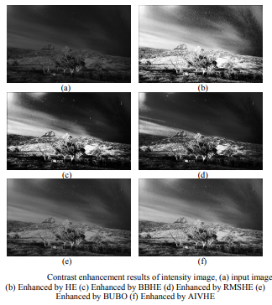


A NEW CONTRAST ENHANCEMENT TECHNIQUE BY ADAPTIVELY INCREASING THE VALUE OF HISTOGRAM
The two image contrast enhancement techniques as the basis of this research are Histogram Equalization method and BUBO method.
A. Traditional HE Method
HE obtains input-output transfer function by means of the histogram of input images. For the digital image input f(x, y) in an active area of gray level [0, L-1] with N pixels. The probability density function (PDF) P(k) of the image is defined as below, where L is the maximum gray level of image:

Slide 9
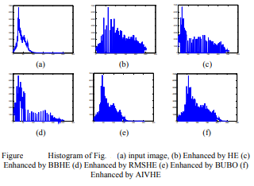

A NEW CONTRAST ENHANCEMENT TECHNIQUE BY ADAPTIVELY INCREASING THE VALUE OF HISTOGRAM
B. BUBO Method
To improve the undesirable artifacts caused by traditional HE method, the BUBO method puts constraints to avoid over enhancement, where CBU and CBO are bin underflow and bin overflow thresholds as defined below:
CBU = (1-α)/N
CBO =(1+α)/N

Slide 10
ReSULTS
In the first paper, the performance of the system was evaluated using AMBE, MSE and PSNR. The proposed method also gave the highest PSNR values, which shows that it produces the best reconstructed image of the three methods.
In the second paper, the quality of the visual results indicates that the proposed equalization technique is sharper and brighter than the one achieved by GHE, LHE, and BPDHE. Experiments have been performed on over 100 randomly selected images from various sources which confirmed the qualitative results. In order to support the qualitative conclusions on the superiority of the proposed method, a quantitative analysis is required.
In the third paper, the study tested the proposed AIVHE method on different images. Some other contrast enhancement methods, such as HE [3], BBHE [5], RMSHE [6] and BUBO [4], are simulated for comparison, too. To observe the effects of contrast enhancement achieved by these methods, the process of luminance component is done but the process of chrominance component is omitted for the completion of the image contrast enhancement processing.

Slide 11
CONCLUSIONS
In the first Paper, the modification was performed in HSV colour space, while enhancement achieved in the frequency domain. The Hue component is preserved (unchanged), luminance modified using CLAHE, while Saturation components were up-scaled using a derived mapping function on the approximate components of its discrete wavelet transform.
In the second paper, the above table shows the corresponding mean values of original image, GHE, LHE, BPDHE and the proposed method and the chart is drawn. It is clear from these distributions that the estimated Gaussian functions of the GHE and the proposed method have means which are close to the ideal mean (µ=128) for the gray level range with μ = 127.19 and 117.19 respectively.
In the third paper, an important feature of AIVHE is that the functions proposed in the study are all designed under the consideration of hardware implementation, and then use the mechanism of adjustable contrast enhancement effect. Thus, this analysis supports the qualitative observation that the proposed method over performs the conventional techniques.

Slide 12
REFERENCES
[1] Pfizer S.M, (1987), “Adaptive Histogram Equalization and its Variations,” Computer Vision,Graphics and Image Processing, 39, 355-368.
[2] Naik, S.K.and Murthy, C.A., (2003), “Hue-Preserving Color Image Enhancement without Gamut Problem”, IEEE Trans. on Image Processing, 12(12), 1591-1598.
[3] R. C. Gonzalez, R. E. Woods, Digital image processing, Prentice-Hall, Inc., 2001.
[4] S. Yang, J. Oh, and Y. Park, "Contrast Enhancement Using Histogram with Bin Underflow and Bin Overflow", in 2003 Proc. of ICIP, Vol. 1, pp.881 - 884, Sep. 2003.
[5] Y. T. Kim, "Contrast enhancement using brightness preserving bihistogram equalization," IEEE Trans. on Consumer Electronics, Vol.43, No.1, pp.1-8, Feb. 1997.
[6] S-D Chen, and A. R. Ramli, "Contrast enhancement using recursive mean-separate histogram equalization for scalable brightness preservation", IEEE Trans. Consumer Electronics, vol. 49, no. 4, pp. 1301-1309, Nov. 2003.

