Slide 1
Introduction to Statistical Learning Human Activity Recognition With Smart Phones
Submitted by:
Vineeth Reddy Kottam
Student ID:16261474

Slide 2
Dataset Description
The experiments have been carried out with a group of 30 volunteers within an age bracket of 19-48 years. Each person performed six activities (WALKING, WALKING_UPSTAIRS, WALKING_DOWNSTAIRS, SITTING, STANDING, LAYING) wearing a smartphone (Samsung Galaxy S II) on the waist.
Point of Interest:
Interested in finding out the activity of person

Slide 3
For each record it is provided:-
Triaxial acceleration from the accelerometer (total acceleration) and the estimated body acceleration.
Triaxial Angular velocity from the gyroscope.
A 561-feature vector with time and frequency domain variables.
Its activity label.
An identifier of the subject who carried out the experiment.

Slide 4
Approaches tried:
Used logistic regression but the logic didn't work out well as our problem is a multiclass classification problem.
Final Approach
random Forest is a ensemble model. It takes multiple trees together to build final model

Slide 5
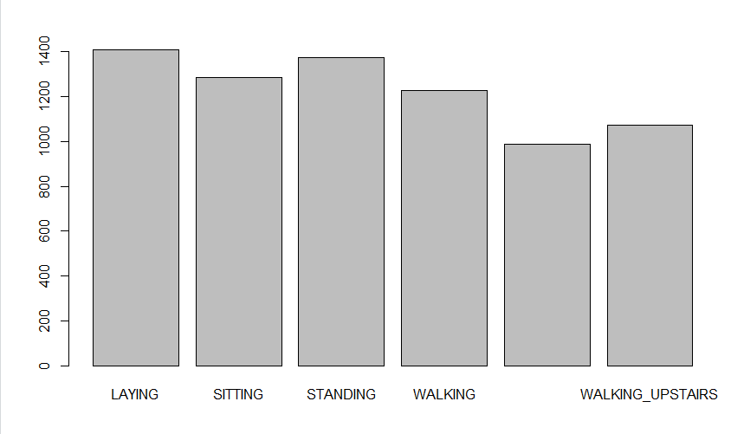
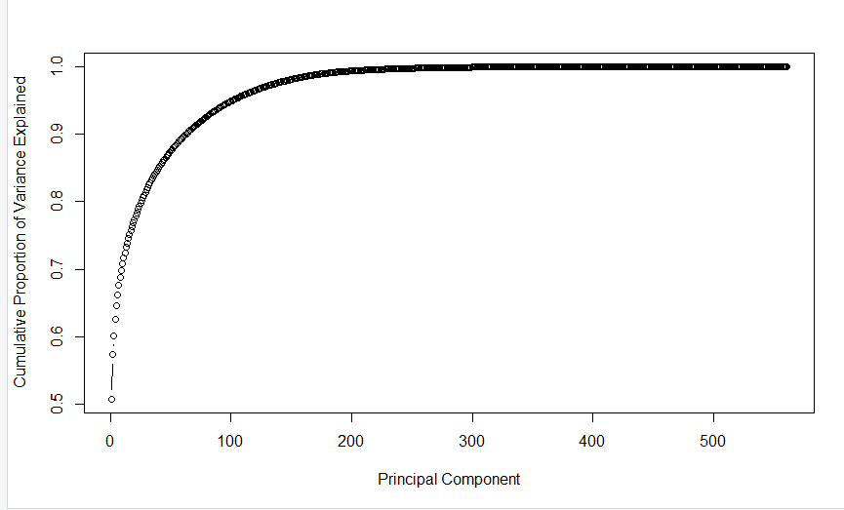
Summary :
by taking 179 principal components I can explain 0.9901927, it means I can explain 99% variation in the data by 179 principal components
Checked for class imbalance :

Slide 6
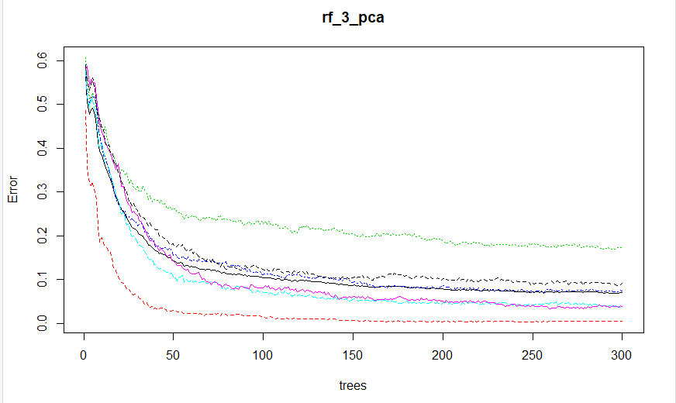
Principle Component Analysis graph:

Slide 7


Applied PCA and extracted 179 principal components from the total data.
By taking 179 principal components i can explain 0.9901927 it means I can explain 99% variation in the data by 179 principal components
Now that the compressed data is ready. Let’s build a randome forest on the compressed data

Slide 8
The accuracy of the test data is 90%
Conclusions:
The algorithm is working well on the test data with a 90% of accuracy rate

Slide 9
Thank You

