Slide 1



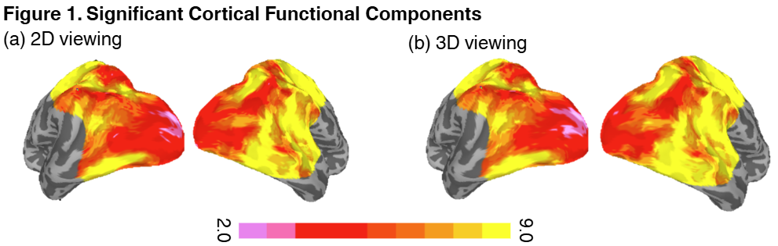
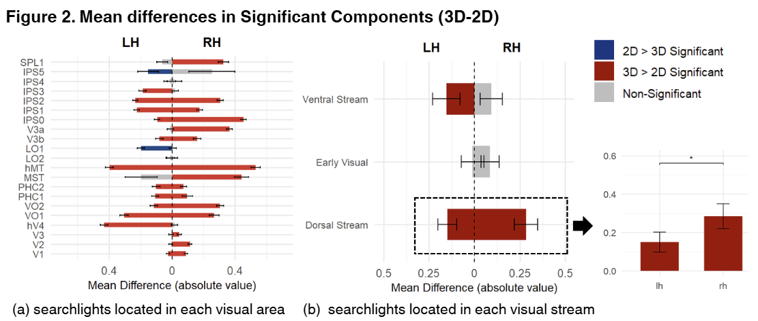


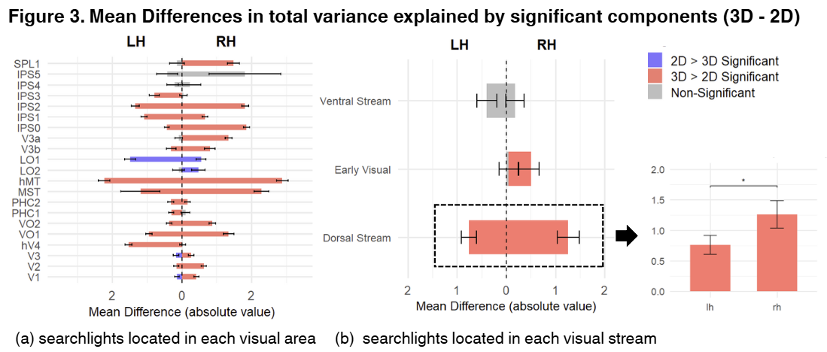
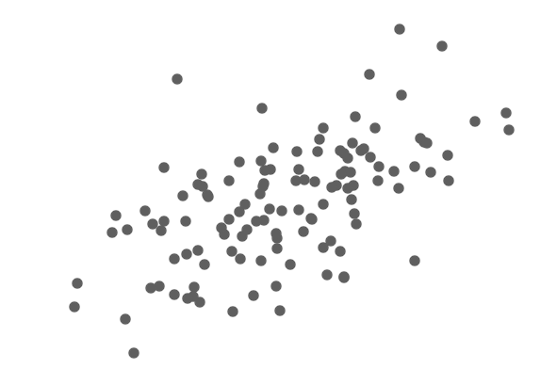
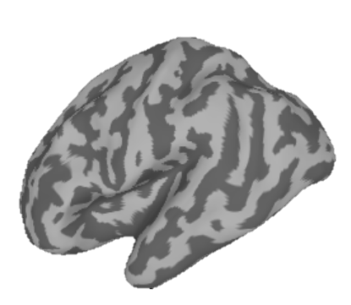
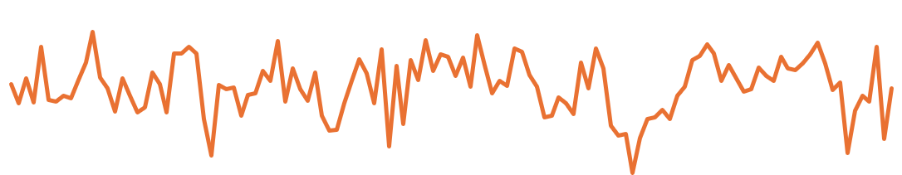
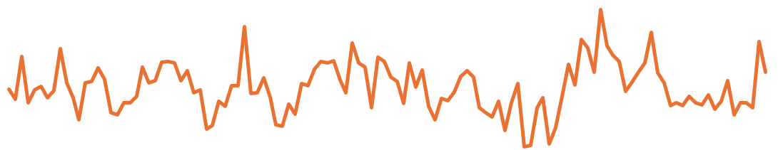
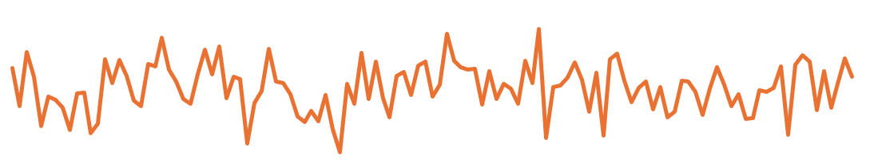
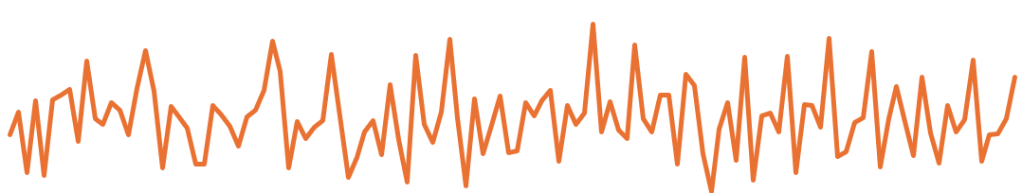


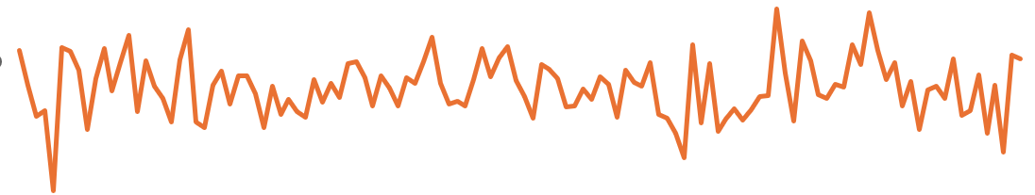
Unbiased Estimation of Cortical Functional Components in
Stereoscopic (3D) and Monoscopic (2D) Movie Viewing
Linshan (Sunny) Wang¹, Reza Farivar-Mohseni²
1. Department of Psychology, McGill University, Montréal, Canada 2. Department of Ophthalmology and Visual Science, McGill University, Montréal, Canada
Background
Result
Stereoscopic (3D) vision integrates features absent in flat stimuli, including true binocular depth using disparity between left and right eye views, creating a sense of depth volume, and enables perception of motion-in-depth (coming toward or moving away)
Previous findings about 3D vision
3D information is encoded as early as the primary visual cortex (V1), explained by the famous disparity energy.
Regions like V3A, V7, MT+, IPS (dorsal) and V4, LO (ventral) show stronger activation and selectivity during stereoscopic view
When watching movie, 3D increases inter-subject temporal & spatial correlation
Limitations of previous findings:
many used artificial stimuli such as random dot stereogram
used pre-defined parcellation
relied on methods(activation, FC, MVPA) may not capture complexity of underlying representations
With naturalistic stimuli, how does stereoscopic (3D) vs monoscopic (2D), modulate how richly and how complex the information coding is, within visual cortical regions.
Methods
fMRI data
*collected between 2018 to 2019, by Angela Zhang, as part of her doctoral research
55 subjects
Movie clip from “Under the Sea 3-D: IMAX” during an fMRI scan.
5 min in length; subtended 17° × 9.4°
presented in 2D and 3D in two different sessions
participants fixate on the cross
full-body 3T Siemens TIM Trio with a 32-channel head coil for anatomical images and 20-channel posterior coil for functional images
Under the Sea 3-D: IMAX
Computational Analysis
Principal Component Analysis (PCA) transforms high-dimensional data into a set of orthogonal components.
Timeseries A
Dependent variables:
Functional Components - number of statistically significant principal components in each searchlight, infers unique source of variance in the fMRI signal.
Functional Engagement total variance explained by significant components, infers the meaningful signals that cannot be simply explained by noise.
Principal component 2
Principal component1
Eigenvalue variance explained by each component
Total variance =
Variance explained by PC1+
Variance explained by PC2
Timeseries B
PC1
PC2
Findings
Each node is the center of a circular “searchlight” that includes itself and its local neighboring nodes.
Time Series Matrix
Identify functional components through PCA
Hierarchal Visual Processing
Regardless of viewing condition, high level regions exhibit higher local functional complexity than early visual areas.
Stereoscopic (3D) vs Monoscopic (2D) Movie Viewing
Stereoscopic vision enhances local functional complexity and engagement than monoscopic vision across almost every region on visual cortex; however, magnitude of enhancement is region-dependent.
Dorsal stream, especially motion-sensitive areas hMT+ and MST shows large unidirectional differentiation between 2D and 3D
Ventral stream shows small unidirectional differentiation between 2D and 3D, especially V4, with the notable exception of the LO area, a possible suppression of LO for 3D cues.
fMRI analysis Technique Advancemesuggestingnt
model-free, naturalistic movie creates ecologically valid conditions
geometrically interpretable framework for understanding fMRI activity patterns
Noise control technique - rigorous statistical testing of fMRI signals using Fourier phase randomization
5mm radius searchlight
120 TRs
PC1
PC2
PC3
PC4
……
PCN
Count significant
components
Establish threshold
.
.
.
N
nodes
(~60-100
number varying by topology)
Fourier Scramble time series and conduct PCA (repeated 1100 times) generates null distributions of eigenvalues, the 95th percentile set as the significance threshold
PC1
PC2
PC3
PC4
120 cols * N rows
……
Number of
Significant components = 3
PC1
PC2
PC3
PC4
PCN
Repeats the procedure for every searchlight on cortex
Visual area atlas
*defined by the Wang et al. (2015) probabilistic atlas
Early - V1, V2, V3
Ventral - hV4, LO1, LO2, VO1, VO2, PHC1, PHC2
Dorsal - V3a, V3b, hMT, MST, IPS0, IPS1, IPS2, IPS3, IPS4, IPS5, SPL1

