Slide 1
EDES 301
Pneumatic Haptic Feedback Glove Proposal
2026.10.04
Sunny Yu

Slide 2
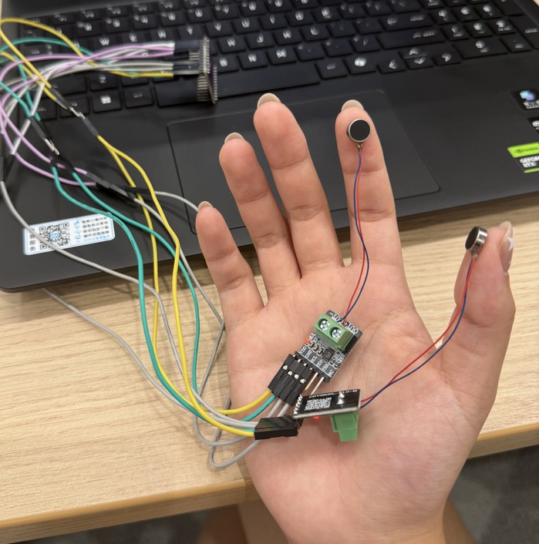
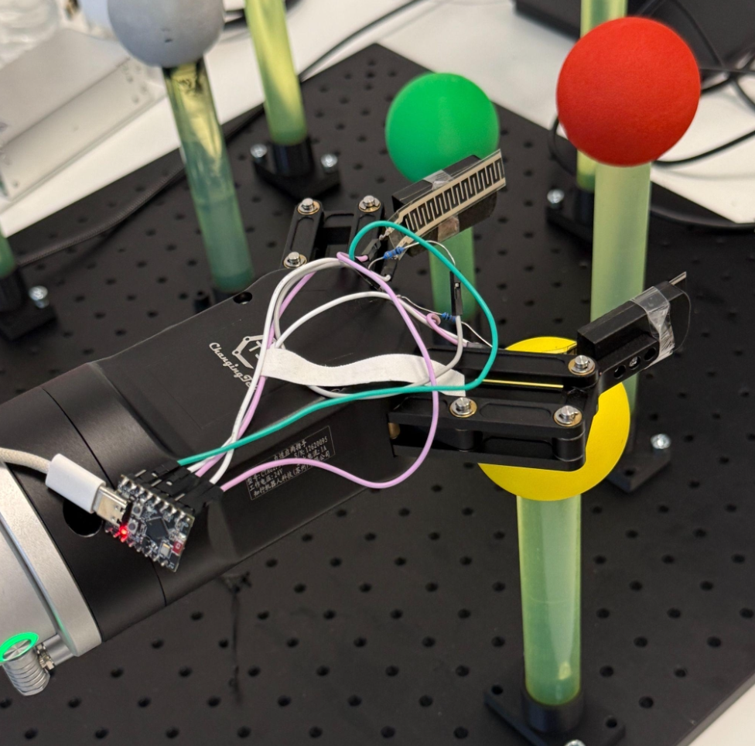
Background Information
Project Idea and Motivation
  During my summer internship, I developed a tactile feedback system that used two vibration motors to convey contact information from a BCI-controlled robotic arm. This experience motivated me to explore pressure-based feedback that may better represent the sensation of contact during grasping.
  For this project, I propose a PocketBeagle-controlled glove with two small inflatable air bladders. Two external force-sensitive resistors (FSRs) will simulate contact sensors on a robotic hand. Pressing either sensor will inflate the corresponding bladder by an amount that scales with the applied force (open-loop control), producing localized pressure feedback on the glove. Releasing the sensor vents the bladder.

Slide 3
Background Information
Improvements over the Previous
  Hardware: Replace vibration motors with pneumatic actuators and integrate two feedback points into a wearable glove.
  Software: Replace direct vibration commands with an open-loop force-to-inflation mapping: FSR readings are quantized into levels (none / light / medium / firm), each mapped to a pump on-time / PWM duty cycle; the valve vents the bladder on release.
  Evaluation: Log FSR readings, commanded levels, and actuation timestamps to measure input-to-actuation latency; run a simple user test to check whether a wearer can distinguish the pressure levels on each finger.
Related Projects
  HaptX: commercial microfluidic haptic glove that inspired this project. This project is a low-cost, open-source, two-channel pneumatic version built from off-the-shelf parts on a PocketBeagle.

Slide 4
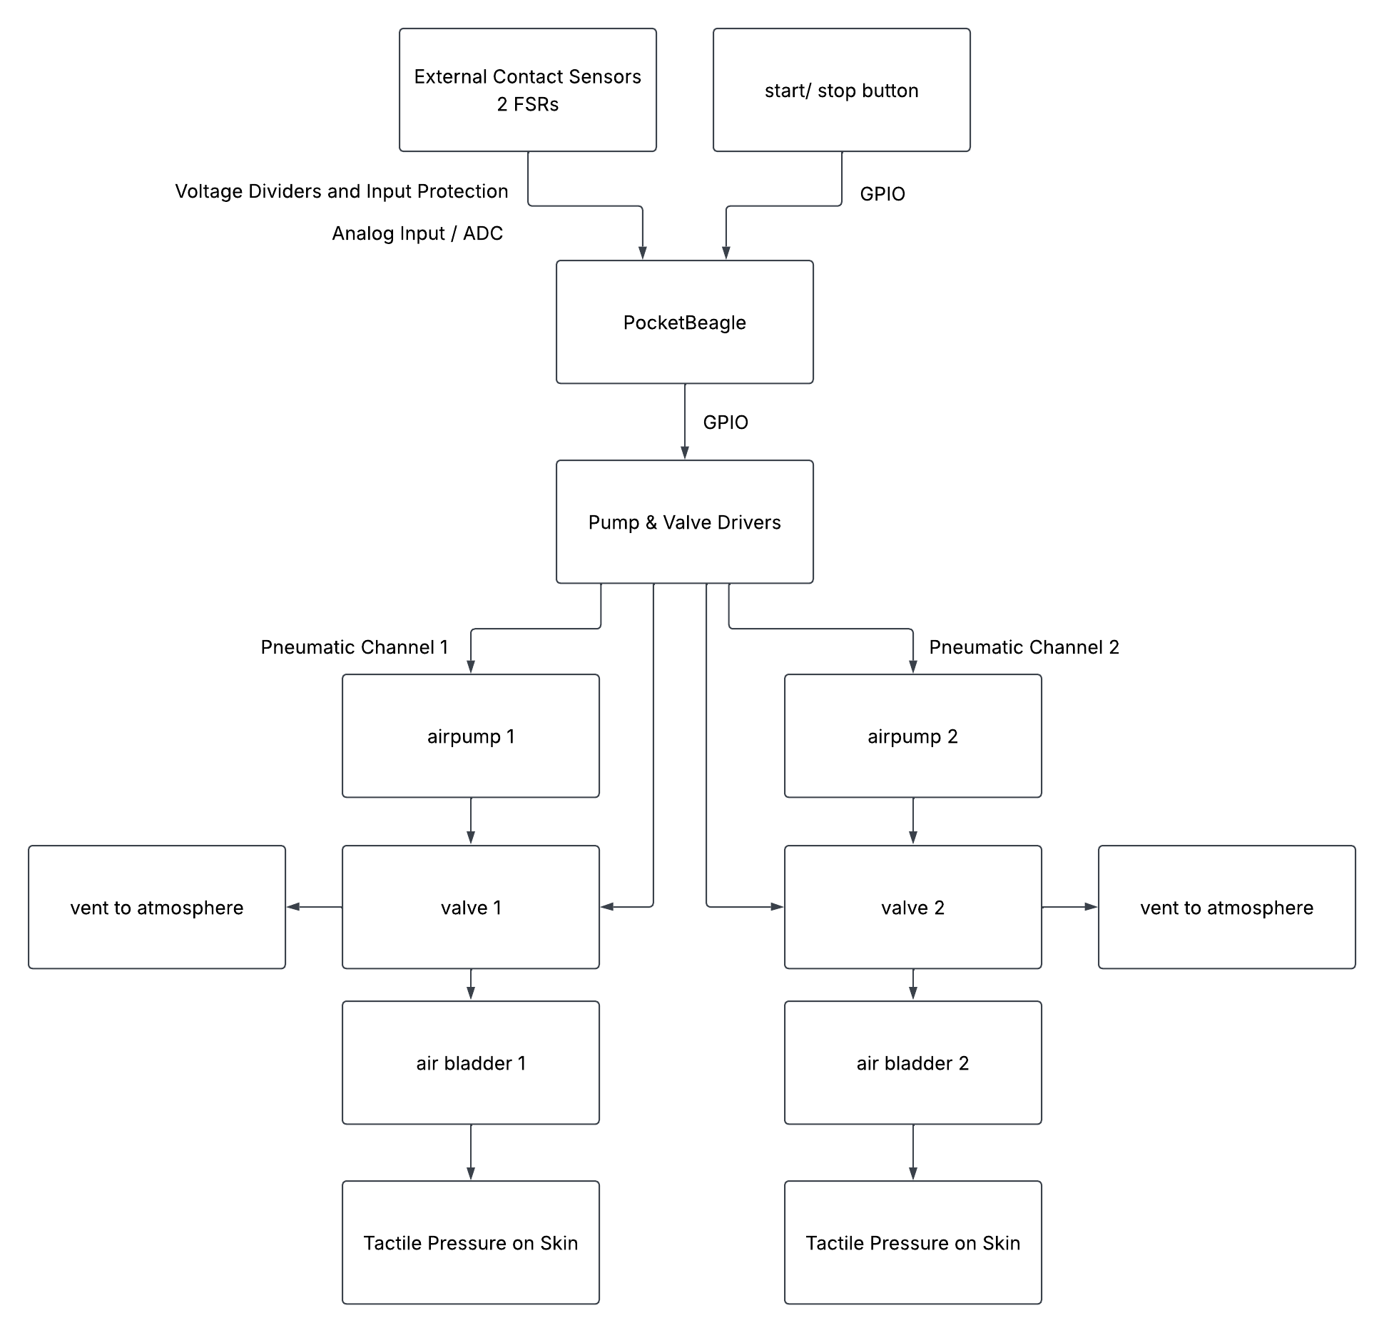
System Block Diagram

Slide 5
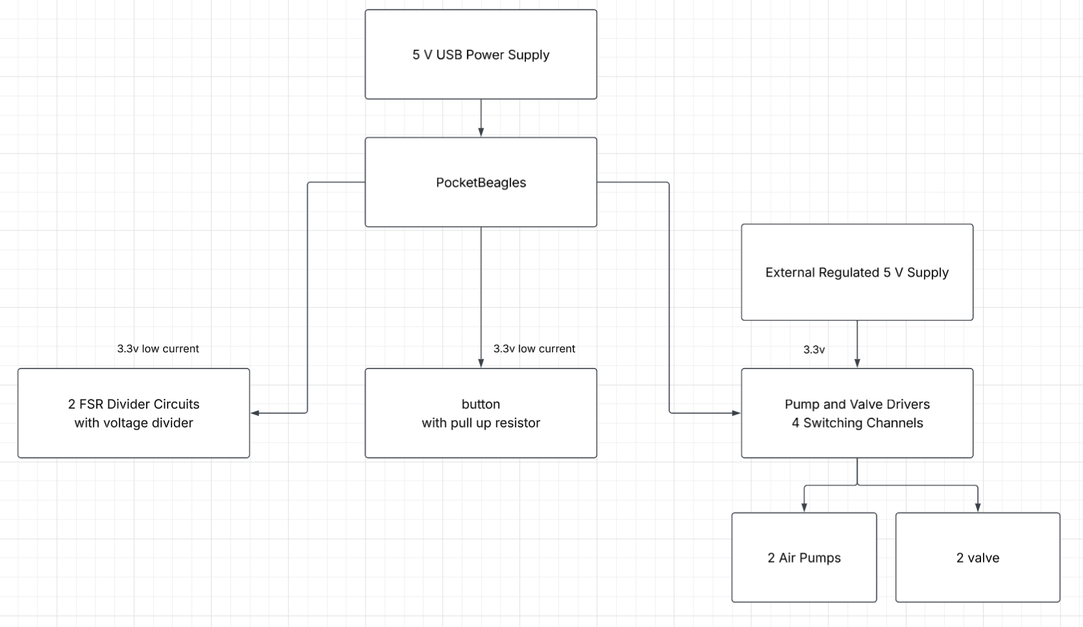
Power Block Diagram

Slide 6
Components / Budget
Component | Qty | EDES301 to Buy? | Cost
Air Pump — Adafruit #4699 | 2 | Yes | $15.90
3-Way Air Valve — Adafruit #4663 | 2 | Yes | $5.90
FSR — Adafruit #166 | 2 | Yes | $7.90
MOSFET Driver — Adafruit #5648 (1 per pump / valve) | 4 | Yes | $15.80
5 V 2 A Adjustable Voltage Adapter (EDES301 parts list) | 1
Silicone air tubing (3–4 mm ID) | 1 | No | TBD
Small air bladders | 2 | No | TBD
Glove | 1 | No | TBD
Start / stop button + 10 kΩ pull-up resistor | 1 | No (parts kit) | $0.00
Total (known items) |  |  | $61.48
Known items total $61.48, above the $25–35 EDES301 supplement; the amount over the supplement will be self-funded or sourced from the OEDK (to be discussed in the project meeting).

