Slide 1
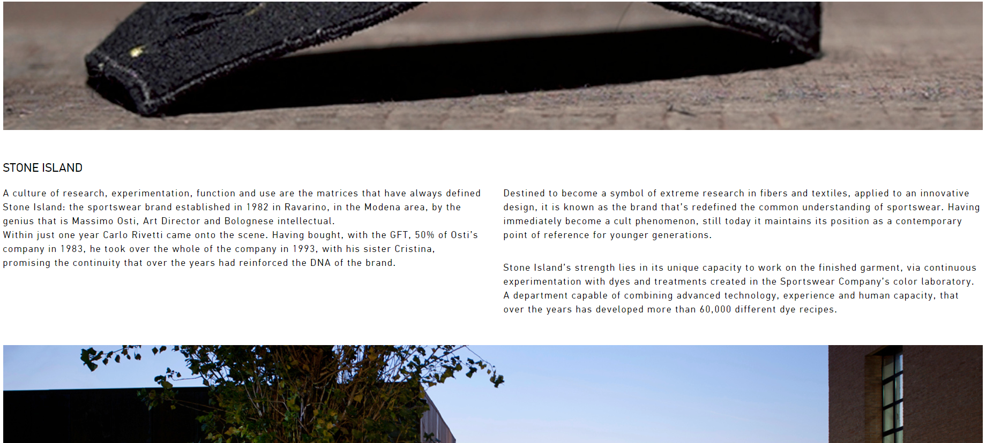
About Us 1

Slide 2

About Us 2

Slide 3

Partners 1 下拉式捲軸

Slide 4

Partners 2 橫向式捲軸

Slide 5

What’s New 1 Exhibitions

Slide 6
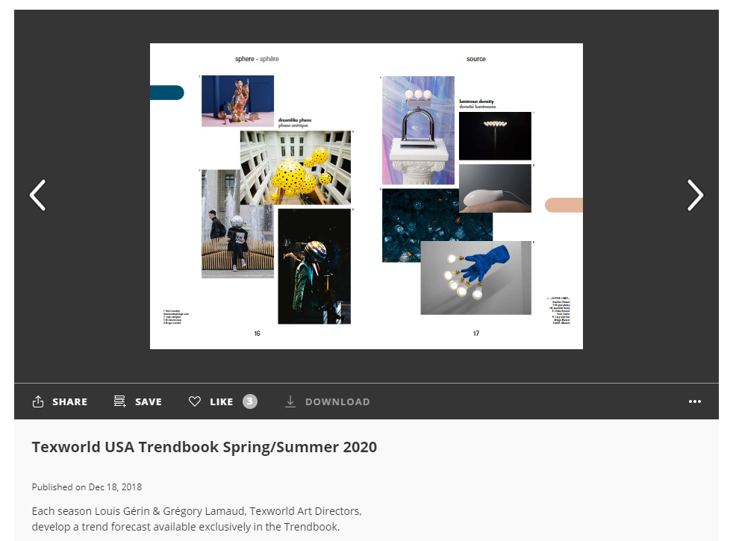
What’s New 2 Trendbooks

Slide 7
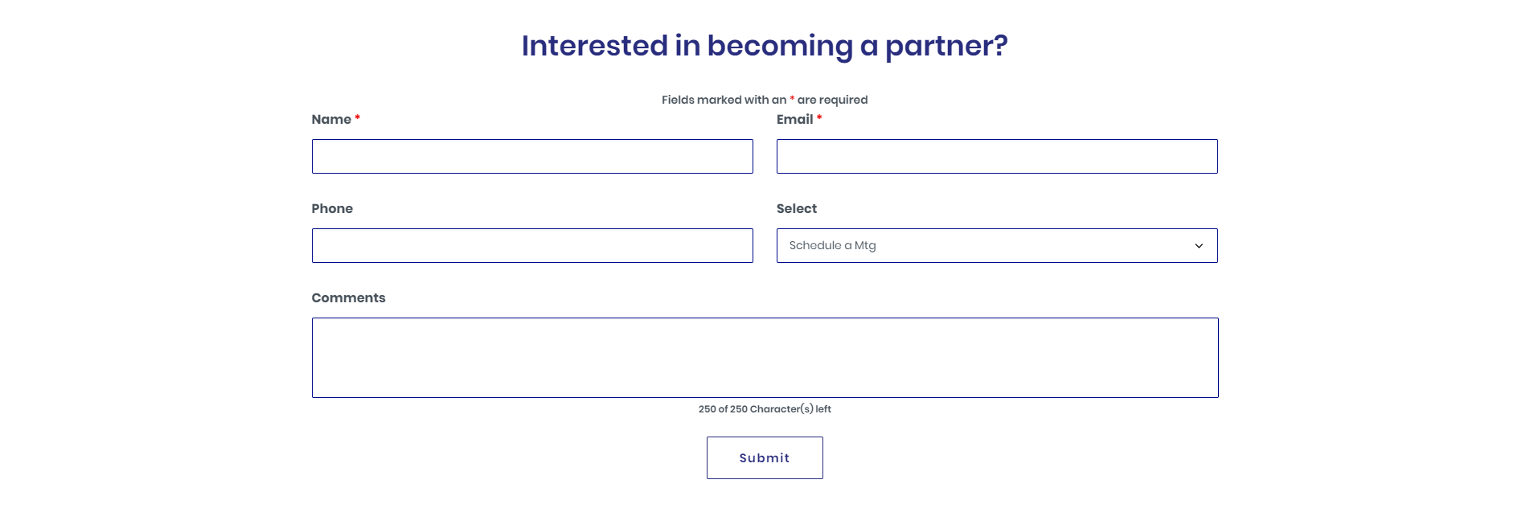
Get In Touch

