Slide 1


Data Analysis
Sprocket Central Pvt Lmt

Slide 2
Today's Agenda
Data Exploration
Model Development
Interpretation

Slide 3
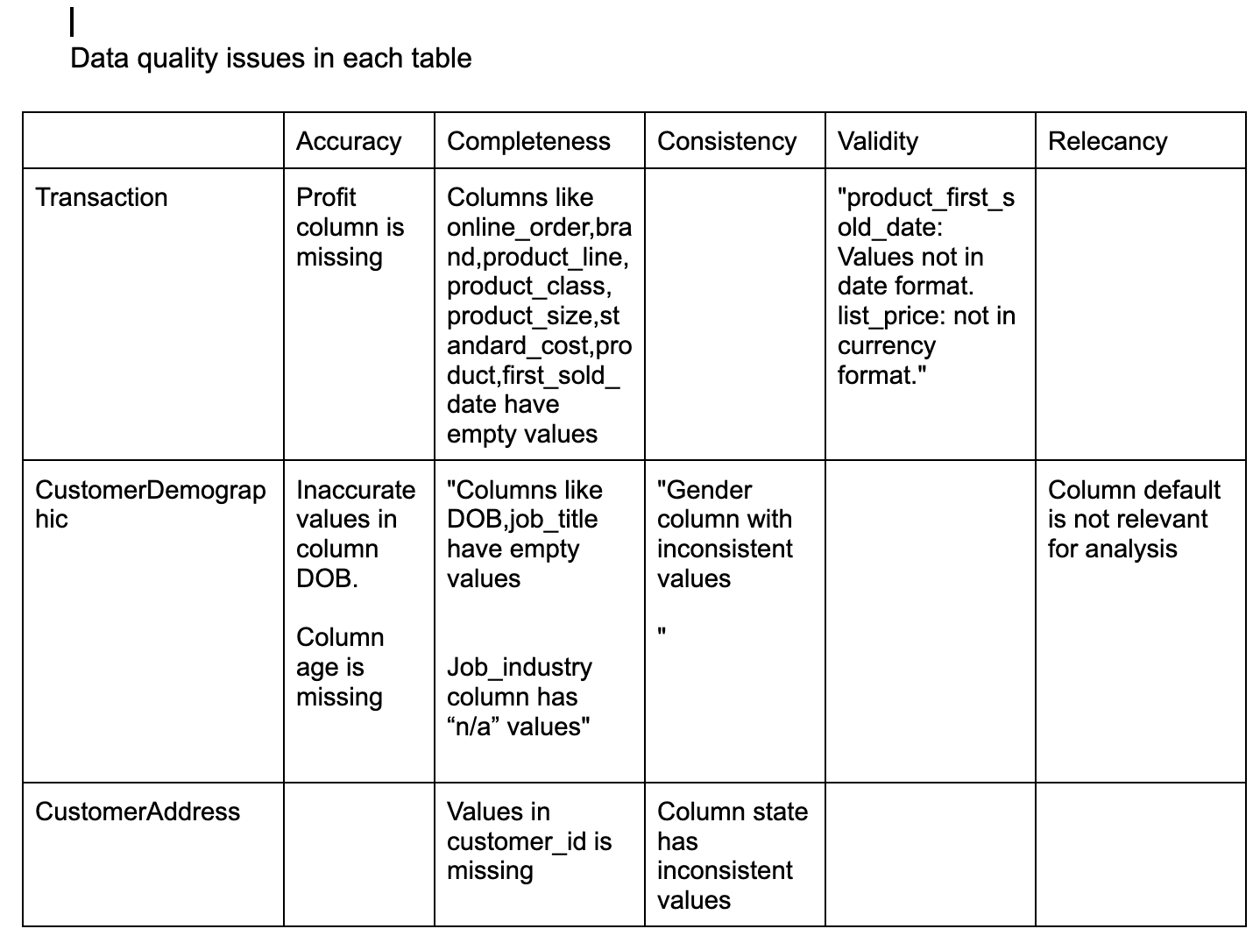
Data exploration
Data exploration is the first step of data analysis. A major part of this involves giving a detailed analysis of the data. Several valuable insights are gained from quality datasets. After examining the given dataset, we noticed some quality issues within the tables. We suggested some methods to rectify this issue (Clearly mentioned din the mail that have send before).Primary issues can be rectify in analysis process.

Slide 4
As a part of this adding few columns to the table really help the analysis, columns like:
Profit in transaction table– by calculating the fields list_price and standard_cost.
Age in CustomerDemographic table – calculating the current age of each customer
Some columns need to be in consistent like:
Gender column in CustomerDemographic table and state column in CustomerAddress table.
Some of the blank fields can be eliminated as it really affect the outcome of the analysis.

Slide 5
Model development
Developing a model is the next step in analysis process.
After cleaning the data now it's time to get into developing a model for our analysis.
To begin with modelling as a first step lets create some calculated field in the tables like age in CustomerDemographic table, by which we can categorize the users according to their age group. Also adding column called profit in transaction table which helps our analysis to find which product leads the company to profit or loss.
Then lets let's create a hypothesis related to the client requirement and perform a statistical test to check whether the hypothesis is correct.

Slide 6
Interpretation
After finding all the insights from the dataset, Visualizing is the best way to present the findings.
This may involve interpreting the significant variables and co-efficient from a business perspective.
With the help of an interactive dashboard, users can explore the data on a deeper level and make well-informed, data-driven business decisions.

Slide 7
Thank you
Please feel free to raise any question...
Sunooja

