Slide 1

DAV 5400 Final Project Proposal - Bike Sharing Service
Team members: Sun Hee Park, Manling Yang

Slide 2
Motivation
Today, there are many ride-sharing companies that offer users to share car rides, or ride electric scooters or bikes. However, bike sharing is the worthiest of notice to be analyzed now and even for the future. It is because people face practical and realistic problems when sharing and cars and electric scooters which do not exist when people share bikes, about insurance or driver’s license.
This is why people would like to use bike-sharing. There are some companies offer the bike-sharing in the city. Understand the bike-sharing situation is beneficial for people to find the best station to begin and end of bike-sharing usage.
In addition, our major is Data Analyze and Virtualization. I may work for the bike-sharing company in the future. Practices more.

Slide 3
Research Questions
Along with increasing number of Bike-Sharing users, companies want to analyze their customer's data. They want to conduct marketing based on users who are mostly using the service. We expected that the companies assume main factors as ‘location’, 'time', 'age', and 'gender' for analyzing their data.
In addition, we are also going to compare popularity in using this service in two cities - Chicago and New York. Thus, the questions that we take into account are:
When (specific time) do people mostly use bike-sharing service, such as month, weekday and day?
Which age range of is mostly using bike-sharing service?
Which gender is the main users in both city?
Which station is the most popular one?
Which city is more popular to use the bike sharing services?

Slide 4
Used Data
The first data set('Chicago-Divvy-2016') is a SQL file.
The second data ('NYC-BikeShare-2016') is a CSV file
Both files are from Kaggle.

Slide 5
Approach
In this project, we are going to investigate the ride-sharing market first to understand our data well. Then we will start analyzing the data from Kaggle to understand what are considered to be influential factors for the bike-sharing service.
After the investigation, we are going to cleanse NYC-Bike Share data because it includes data from 2016. We are going to use only data from 2016 to compare with Chicago data from 2016. After that, we will also cleanse both data because these data should have the same column names or the same types of attributes to be compared. Then we will store our data as CSV format on Github.
To analyze our data, we would apply a histogram and a box plot to figure out time and age range that the bike-sharing service is mostly used from. After than, we are going to use bar, histogram, scatter, line graphs to figure out the third and the last question.

Slide 6
Attributes of two data sources (sql and csv)
Trip duration: Time in sec
Start time: Time to start to use bike sharing services
Stop time: Time to stop to use bike sharing services
Bike id: the id of bike
From station id: The id of the bike station for people star to use bike sahring services
From station name: The name of the bike station for people star to use bike sahring services
To station id: The id of the bike station for people stop to use bike sahring services
To station name: The name of the bike station for people stop to use bike sahring seszrvices
User type:the type of bike users
Gender: the gender of bike users
Birth_year: the birth year of bike users

Slide 7
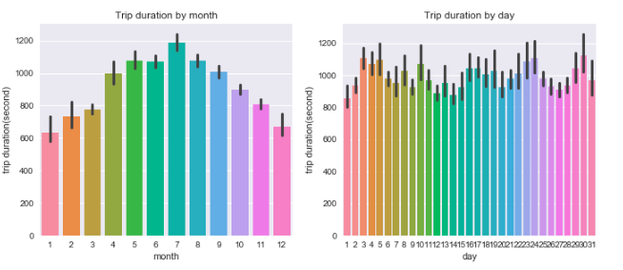
Bike data from Chicago

Slide 8
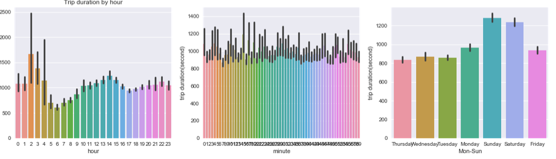
Bike data from Chicago

Slide 9
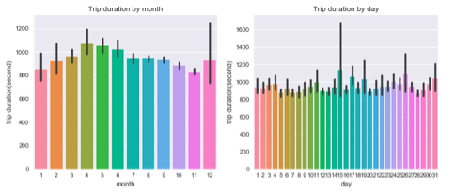
Bike data from New York City

Slide 10
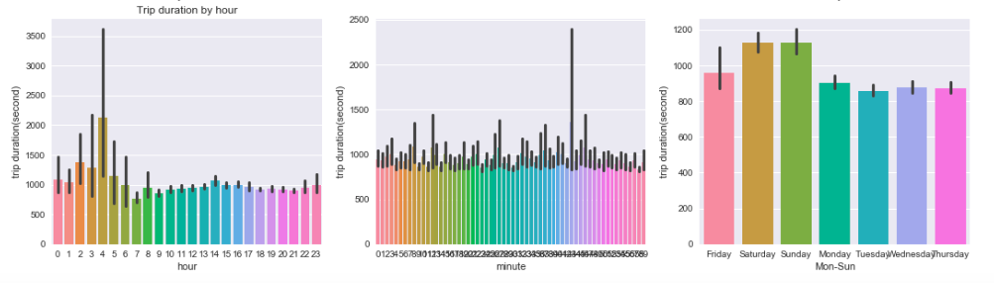
Bike data from New York City

Slide 11
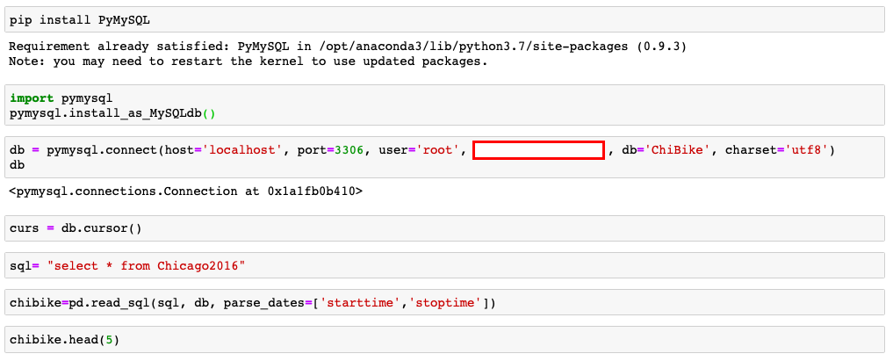
The most hard part we encountered with the final project was

Slide 12
References
https://www.kaggle.com/samratp/bikeshare-analysis#Chicago-Divvy-2016.csv
https://www.bbc.com/news/uk-48106617
https://www.walkuplawoffice.com/2019/06/19/2019-electric-scooter-helmet-laws-in-california/
https://www.washingtonpost.com/technology/2019/01/25/electric-scooters-send-more-people-hospital-than-bicycles-walking-new-study-finds/

Slide 13
Thank you for watching our presentation

