Slide 1
Welcome to Gatik Otto India Private Limited -Precision in Every Ride With a Brand name Stromax
Backed by an experienced team of engineers, technicians, and industry experts, we combine deep technical knowledge with cutting-edge manufacturing to deliver reliable, top-quality products. Our team’s expertise ensures that every shock absorber meets the highest standards of safety, performance, and innovation.
At GOIPL , we specialize in high-performance shock absorbers engineered specifically for 2W, 3W & 4 Wheeler. With a commitment to innovation, durability, and rider comfort, our products are designed to handle the toughest roads while delivering a smooth, stable ride. Whether you're a commuter, enthusiast, or professional rider, our advanced suspension solutions ensure enhanced control, superior safety, and unmatched riding pleasure. Trusted by manufacturers and riders alike, we stand for quality that lasts and performance you can feel.
Ride smoother. Ride safer. Ride with Stromax .

Slide 2
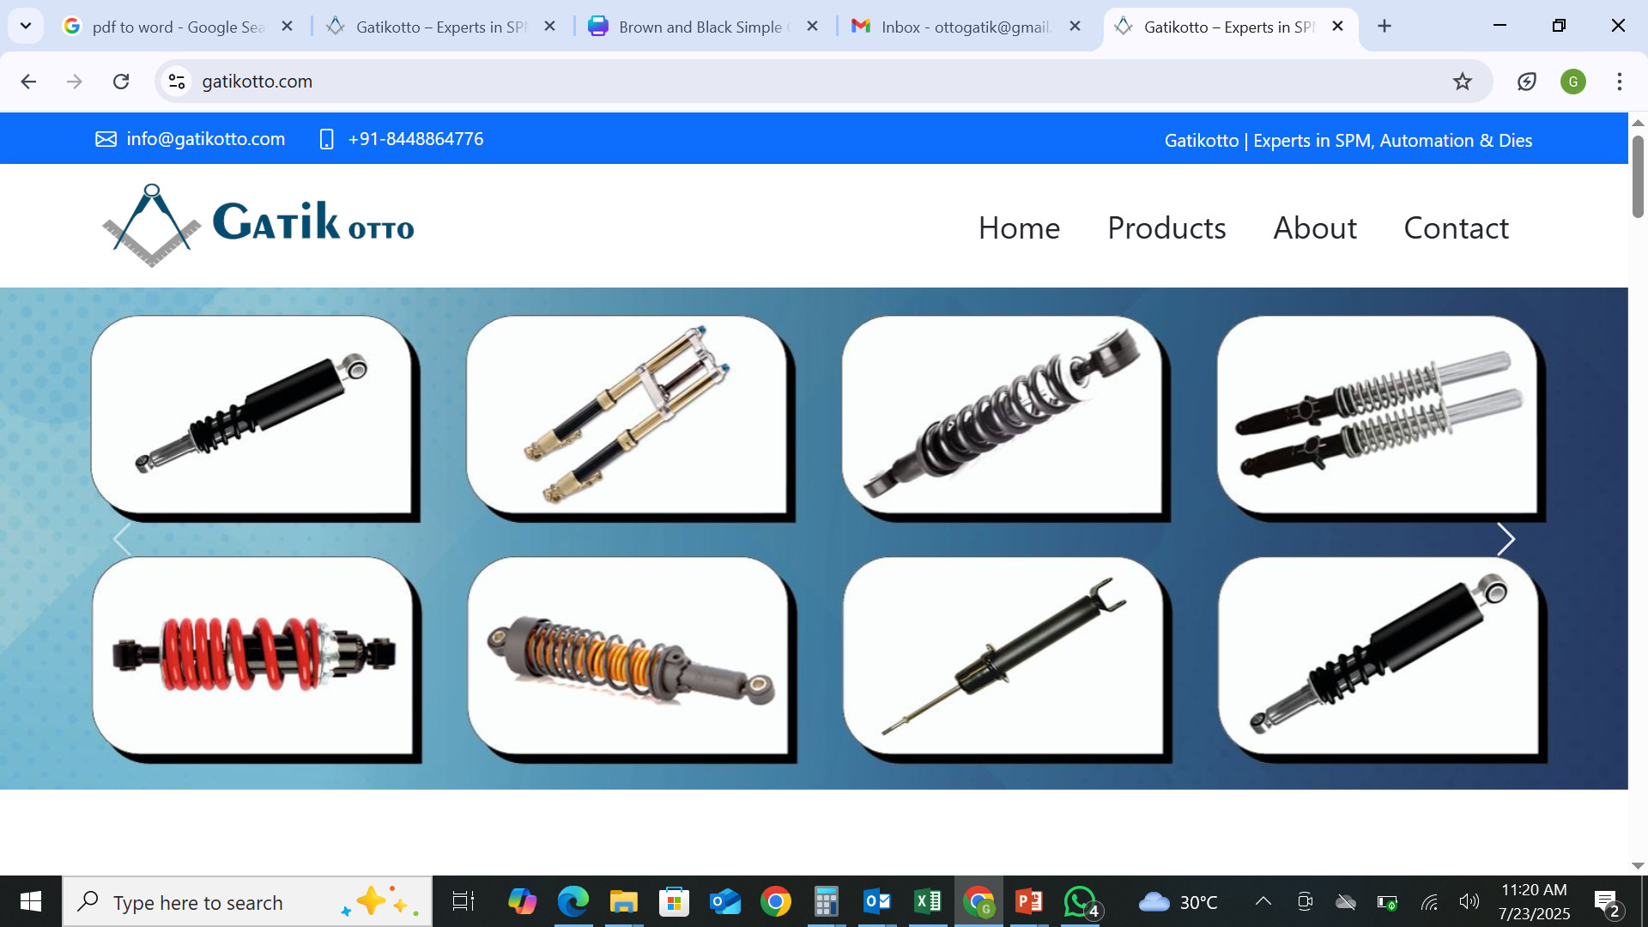

Slide 3
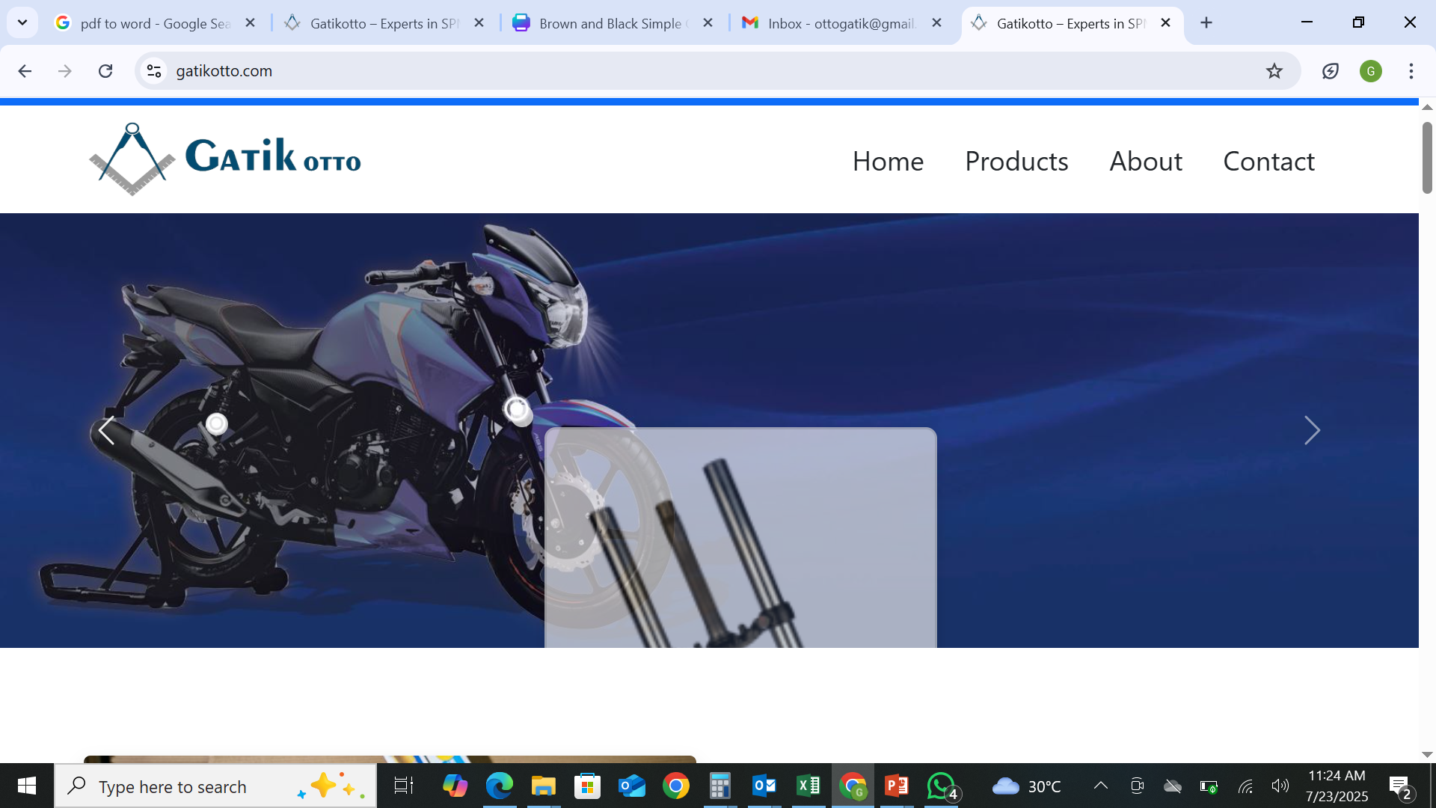

Slide 4
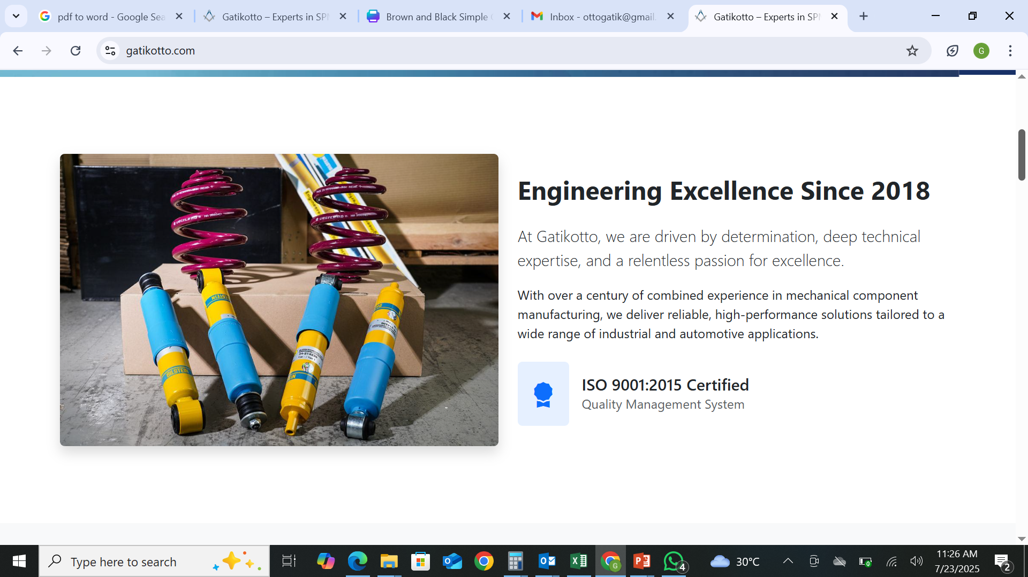

Slide 5
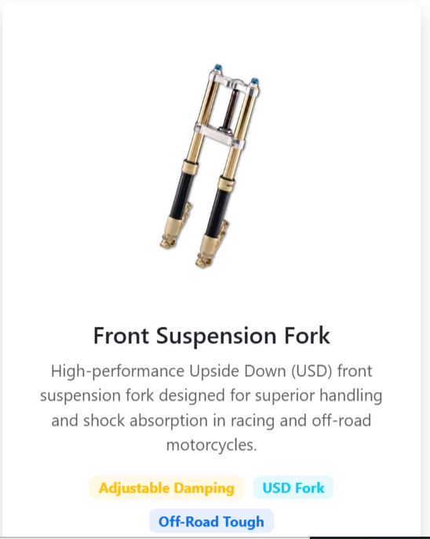
UP side down Fork
HIGH- Performance Upside Down Fork Design for Superior Comfort, Sports Look , Ride Control ,Superior Handling in Off Road & Racing & Sports Motorcycle

Slide 6
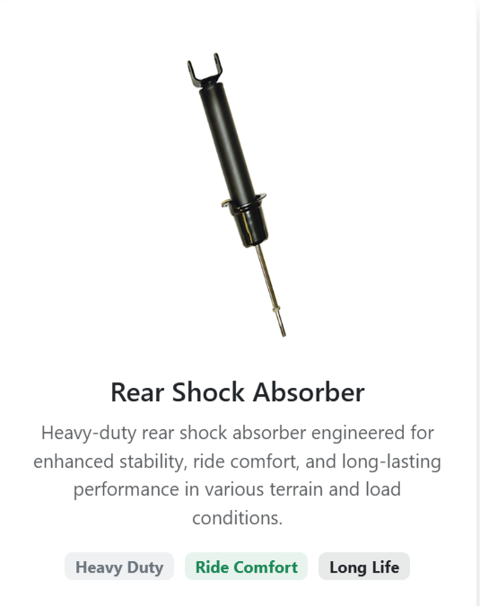
Stud Type Shock Absorber
Only Rear Word to Remove

Slide 7
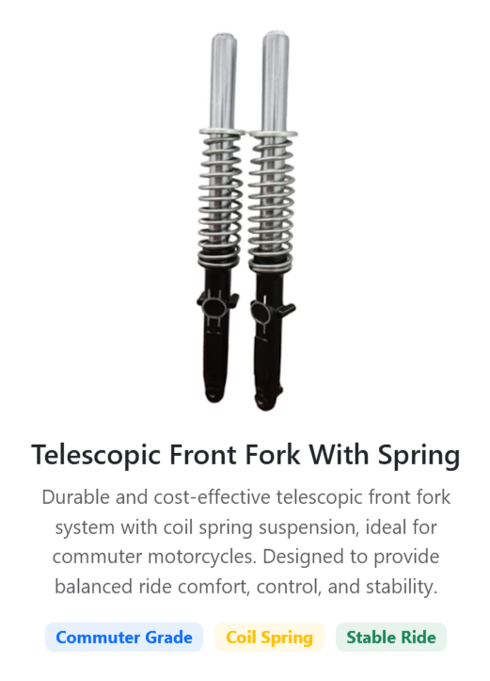
Heavy Duty Telescopic Front Fork With Outer Spring
Heavy Duty Front Fork System With Outer Coil Spring , Ideal for Off Road , Heay Duty L3, & L5 Vehicle System Designed to Provide Balance Ride comfort , Control & Stability

Slide 8
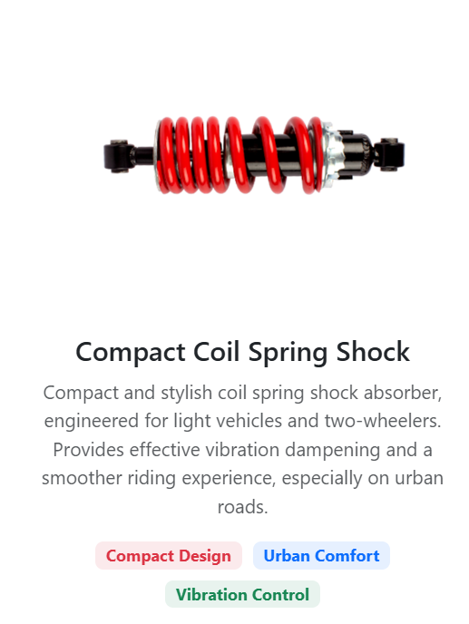

A high – Performance Shock Designed for optimal damping and modern aesthetic . Its compact design and durable body make it perfect for sporty commuter and premium bikes

Slide 9
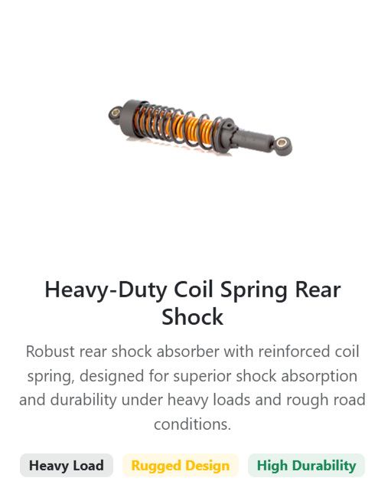
Dual Spring Shock absorber

Slide 10
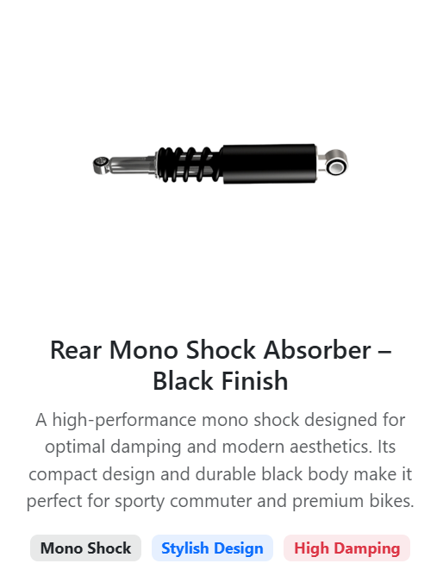
Rear Shock Absorber
High Performance Rear Shock absorber specifically designed for daily commuters to provide Enhance comfort & Long lasting Performance

Slide 11
1. Face book Page Link
https://www.facebook.com/profile.php?id=61578274814383
2. Add this Phone Number in Another adrees
+13657220618
3. Also add Ontario Canada in the last of address
4.

