Slide 1


Hybrid RAG
with Re-Ranker
Building Smarter Retrieval for Conversational AI
DataHour • Analytics Vidhya
Presentation By
Katiki Ravindra Babu
Strategic Technology Advisor, Vriksha.ai
CTO | 27+ Years Building Scalable Systems
M. Tech in AI/ML, BITS Pilani
Code & slides: github.com/sunrise197605/Datahour_HybridRAG

Slide 2
About Me
▸ Strategic Technology Advisor at Vriksha.ai — focus on platform reliability and applied AI
▸ 27+ years in gaming and large-scale platform engineering
▸ Operated systems handling 4B+ daily service calls at 125K+ concurrent users
▸ Managed product portfolios exceeding $1B in revenue impact
▸ Top 10 Tech Leader in India (2025) by TradeFlock
▸ Areas of work: Hybrid RAG, Conversational AI, Multi-Agent systems, Observability
▸ Today's session: walking through Hybrid RAG end-to-end — theory, code, and a live demo
DataHour • Hybrid RAG with Re-Ranker • Ravindra Babu Katiki
2

Slide 3
What We Will Cover Today
▸ Conversational AI — what it is and the problem it tries to solve
▸ Request–Response Pipeline — how a query becomes a grounded answer
▸ RAG Architecture — grounding LLMs in real documents
▸ Hybrid RAG — Dense retrieval + BM25 fused with Reciprocal Rank Fusion
▸ The Re-Ranker stage — why a cross-encoder is the cheapest big quality win
▸ Code walkthrough — pipeline, retrievers, RRF, reranker, prompts
▸ Evaluation — MRR, HitRate, plus our custom CUS and ACS metrics
▸ Production realities — failure modes, observability, what to watch for
▸ Live Demo — Streamlit UI with reranker toggle and source explainability
DataHour • Hybrid RAG with Re-Ranker • Ravindra Babu Katiki
3

Slide 4
What is a Conversational AI System?
▸ A system that holds a natural-language conversation with a user and helps them complete tasks
▸ Classical pipeline: NLU → Dialogue State → Knowledge Lookup → NLG
▸ Modern systems collapse most of this into a Large Language Model with tools and retrieval
▸ Inputs are messy: paraphrases, typos, follow-ups, ambiguity, multi-part questions
▸ Output expectation has shifted from 'plausible reply' to 'verified, grounded answer'
▸ The bar is now: be correct, cite sources, stay current, and admit when you don't know
▸ Conversational AI is no longer a chat window — it is the front door to enterprise knowledge
Conversation is the interface. Retrieval is the substance.
DataHour • Hybrid RAG with Re-Ranker • Ravindra Babu Katiki
4

Slide 5
Why an LLM Alone is Not Enough
▸ Knowledge cutoff — the model has no idea what happened after training
▸ No access to private data — your wikis, tickets, product docs, customer history
▸ Hallucinations — the model fabricates confident, plausible, and wrong answers
▸ No source attribution — the user cannot verify or audit the answer
▸ Stale facts decay silently — yesterday's correct answer becomes today's incident
▸ Re-training is expensive — you cannot fine-tune your way out of every fact change
▸ Compliance risk — regulated domains demand traceable, citable evidence
Don't ask the LLM to remember. Let it look things up.
DataHour • Hybrid RAG with Re-Ranker • Ravindra Babu Katiki
5

Slide 6
Agentic Conversational AI — Request → Response Pipeline
How a modern conversational agent processes user input — Hybrid RAG sits inside steps 3–5, Credits : BITS Pilani MTech AI / ML program
1
REQUEST
2
ROUTING
3
REASONING
4
TOOL INVOCATION
• User input received & validated
• Parse user intent
• Extract entities
• Input sanitization (security)
• Intent classification
• Task decomposition
• Determine required tools
• Route to appropriate sub-agent
• Planning & decisions with LLM
• Break down into steps
• Identify information gaps
• Plan tool call sequence
• External API calls & actions
• Database & vector-store queries
• Full-text / graph search
• Code execution
5
MEMORY
6
SAFETY
7
RESPONSE
• Context storage & retrieval
• Store conversation history
• Update user preferences
• Maintain session state
• Guardrails & output validation
• Check for toxic content
• Verify factual accuracy
• PII redaction
• Final output delivered to user
• Natural language generation
• Format for channel (text/voice/UI)
• Send to user
Retrieval (Hybrid RAG) is one slice — steps 3–5 of a larger agent loop
DataHour • Hybrid RAG with Re-Ranker • Ravindra Babu Katiki
6

Slide 7
Inside RAG — The Query-to-Answer Flow
User Query
Retriever
Context
LLM
Answer
Each stage adds latency and is independently optimizable
▸ Query understanding — the same question asked five different ways must reach the same docs
▸ Retrieval — the recall ceiling for the entire system. If the doc isn't fetched, no LLM can save you
▸ Ranking and filtering — too much context distracts the model and inflates token cost
▸ Generation — small models are fast and shallow; large models are slow and thorough
▸ Citation — every claim should map back to a chunk the user can click on
Optimize the bottleneck stage, not the slowest one.
DataHour • Hybrid RAG with Re-Ranker • Ravindra Babu Katiki
7

Slide 8
RAG: Retrieval-Augmented Generation
Idea: Treat the LLM like an open-book exam, not a memory test.
▸ Step 1 — Index: chunk your documents and embed them into a vector store
▸ Step 2 — Retrieve: at query time, fetch the top-K most relevant chunks
▸ Step 3 — Augment: pass the chunks alongside the question into the prompt
▸ Step 4 — Generate: the LLM produces an answer grounded in the retrieved text
▸ Step 5 — Cite: return the chunks that supported each statement
What this buys you
▸ Update knowledge by re-indexing, not retraining
▸ Source citations for every answer — auditability built in
▸ Hallucination drops dramatically when the LLM has the right text in front of it
DataHour • Hybrid RAG with Re-Ranker • Ravindra Babu Katiki
8

Slide 9
The Real Problem in RAG is Retrieval
▸ RAG is only as good as the chunks you send to the LLM
▸ Garbage in, garbage out — irrelevant context = confident wrong answers
▸ Two failure modes dominate retrieval:
▸ — Recall failure: the right chunk was never fetched
▸ — Ranking failure: the right chunk was fetched but buried below noise
▸ Most teams blame the LLM when the bug is upstream in the retriever
▸ The retriever is the highest-leverage component to optimize in any RAG system
▸ Two complementary approaches: dense (semantic) and sparse (lexical) retrieval
Fix retrieval first. Everything downstream gets cheaper.
DataHour • Hybrid RAG with Re-Ranker • Ravindra Babu Katiki
9

Slide 10
Dense (Semantic) Retrieval
▸ Encode query and documents into dense vectors in the same embedding space
▸ Similarity = cosine distance between query vector and chunk vectors
▸ Powered by sentence-transformer models like all-mpnet-base-v2
▸ Strengths: captures meaning, paraphrase, synonyms, and conceptual similarity
▸ Handles queries like "affordable smartphones for elderly" matching docs about "senior-friendly budget phones"
▸ Weaknesses: misses rare exact terms, proper nouns, identifiers, codes, and acronyms
▸ Indexed once, served fast via FAISS or similar approximate-nearest-neighbor library
▸ Scales to millions of chunks with sub-100ms retrieval on a single CPU
Dense retrieval understands meaning — but it forgets exact words.
DataHour • Hybrid RAG with Re-Ranker • Ravindra Babu Katiki
10

Slide 11
Sparse (Lexical) Retrieval — BM25
▸ BM25 is a ranking function based on term frequency and inverse document frequency
▸ Measures how rare and how concentrated a query term is in a document
▸ No training, no embeddings — pure statistics over tokenized text
▸ Strengths: exact-keyword match, proper nouns, IDs, codes, error messages, version numbers
▸ Handles queries like "ORA-04031 fix" or "iPhone 15 Pro Max specs" with surgical precision
▸ Weaknesses: misses synonyms ("car" vs "automobile") and reformulated queries
▸ Battle-tested for decades — powers Elasticsearch, Lucene, Solr
▸ Almost free to compute, easy to debug, easy to explain to stakeholders
BM25 remembers the words. mpnet remembers the meaning. We need both.
DataHour • Hybrid RAG with Re-Ranker • Ravindra Babu Katiki
11

Slide 12
Hybrid RAG — Dense + Sparse Together
Dense and sparse fail in different ways. So combine them.
Dense (Semantic)
Sparse (Lexical)
▸ all-mpnet-base-v2 embeddings
▸ FAISS cosine similarity
▸ Wins on paraphrase and concept
▸ Loses on rare exact terms
▸ BM25 Okapi over tokens
▸ Term frequency × IDF
▸ Wins on names, IDs, exact matches
▸ Loses on synonyms
▸ Pull top-50 from each retriever in parallel
▸ Fuse the two ranked lists with Reciprocal Rank Fusion (RRF)
▸ The fused list is more robust than either retriever alone — complementary failure modes
Hybrid retrieval is robust because dense and sparse fail differently.
DataHour • Hybrid RAG with Re-Ranker • Ravindra Babu Katiki
12

Slide 13
Reciprocal Rank Fusion (RRF)
A rank-based fusion method — no score normalization needed.
score(d) = Σ 1 / (k + rank_i(d))
over each retriever i
k = 60 (a constant that dampens top-rank dominance)
▸ Each document gets a contribution from every retriever it appears in
▸ Rank, not score — solves the calibration problem between heterogeneous retrievers
▸ Robust: works without normalizing cosine similarity vs BM25 raw scores
▸ Tunable: k controls how harshly we discount lower ranks (60 is the published default)
▸ Documents that appear high in both lists rise to the top — that's the magic
▸ If a doc appears at rank 1 in one list and rank 50 in the other, it still beats most singletons
DataHour • Hybrid RAG with Re-Ranker • Ravindra Babu Katiki
13

Slide 14
The Re-Ranker — A Smarter Second Look
▸ Hybrid RAG gives us a good candidate pool of ~25 chunks — but ranking is still imperfect
▸ The top-3 of that pool may not be the best 3 for the actual question
▸ A re-ranker takes the fused candidate list and rescores each (query, chunk) pair
▸ It uses a stronger but slower model that we can afford to run on a small batch
▸ Two-stage retrieval: fast bi-encoder narrows the field → slow cross-encoder picks winners
▸ This pattern is borrowed from classical information retrieval and web search
▸ It is the single highest-ROI improvement you can add to a working RAG system
The re-ranker rescues the right chunks that hybrid retrieval ranks low.
DataHour • Hybrid RAG with Re-Ranker • Ravindra Babu Katiki
14

Slide 15
Bi-Encoder vs Cross-Encoder
Bi-Encoder (Stage 1)
Cross-Encoder (Stage 2)
▸ Encodes query and document separately
▸ Compares with cosine similarity
▸ Document vectors are pre-computed at index time
▸ Very fast at query time — pure lookup
▸ Less accurate on subtle relevance
▸ Used for fast first-stage retrieval
▸ Encodes query and document jointly
▸ Full attention between every query and passage token
▸ Cannot pre-compute — slower per pair
▸ Much higher precision on fine-grained relevance
▸ Trained on relevance datasets like MS MARCO
▸ Used for second-stage rescoring of small pools
Bi-encoders go wide. Cross-encoders go deep. Use both.
DataHour • Hybrid RAG with Re-Ranker • Ravindra Babu Katiki
15

Slide 16
Our Hybrid RAG + Re-Ranker Pipeline
Query
├──▶ Dense Index (mpnet + FAISS) ──▶ Top 50
└──▶ BM25 Index (Okapi) ──▶ Top 50
│
▼
Reciprocal Rank Fusion (k = 60)
│
▼
Top 25 candidate pool
│
▼
Cross-Encoder Re-Rank
(cross-encoder/ms-marco-MiniLM-L-6-v2)
│
▼
Top 6 chunks → Flan-T5 → Grounded Answer + Citations
DataHour • Hybrid RAG with Re-Ranker • Ravindra Babu Katiki
16

Slide 17
Code: HybridRAG.retrieve()
def retrieve(self, query, top_k=50, context_size=6,
use_reranker=False, rerank_pool=25):
dense_idx, dense_sc = self.dense_index.search(query, top_k)
bm25_idx, bm25_sc = self.bm25_index.search(query, top_k)
fused = reciprocal_rank_fusion(
dense_idx, bm25_idx, fusion_constant=self.rrf_constant)
first_n = max(rerank_pool, context_size) \
if use_reranker else context_size
candidates = build_retrieved(top_n_by_score(fused, first_n))
if use_reranker:
candidates = self.reranker.rerank(
query, candidates, top_n=context_size)
return candidates
DataHour • Hybrid RAG with Re-Ranker • Ravindra Babu Katiki
17

Slide 18
Dataset and Tech Stack
Corpus
▸ 500 Wikipedia URLs — 200 fixed travel articles + 300 random
▸ 9,083 chunks of 200–400 tokens each, with 50-token overlap
▸ 100 evaluation questions across factual, descriptive, comparative, inferential, and multi-hop categories
Open-Source Stack — runs on CPU, no API keys
▸ Dense: sentence-transformers / all-mpnet-base-v2 + FAISS
▸ Sparse: rank-bm25 (Okapi)
▸ Reranker: cross-encoder / ms-marco-MiniLM-L-6-v2
▸ Generator: google / flan-t5-base
▸ UI: Streamlit • end-to-end latency ~1.5–2s on CPU
DataHour • Hybrid RAG with Re-Ranker • Ravindra Babu Katiki
18

Slide 19
Evaluation — Standard + Custom Metrics
Standard retrieval and faithfulness metrics
▸ MRR (Mean Reciprocal Rank) — where the correct source ranks in retrieval
▸ HitRate@K — was the correct doc in the top-K? Coarse but useful
▸ CSFS (Claim-Level Faithfulness) — does each claim trace back to context? Hallucination check
Our custom metrics — answer-quality, not just retrieval
▸ CUS — Context Utilization Score: did the answer actually use the retrieved context? 0.4 × keyword_overlap + 0.6 × semantic_similarity
▸ ACS — Answer Completeness Score: does the answer address the question? Penalizes evasive non-answers, tolerates short factual replies
▸ Why both: MRR and HitRate measure retrieval. CSFS measures honesty. CUS and ACS measure whether the LLM is using what we worked so hard to retrieve.
DataHour • Hybrid RAG with Re-Ranker • Ravindra Babu Katiki
19

Slide 20
Results — 100 Questions
Metric
Value
Notes
MRR (URL-level)
0.7978
Good retrieval ranking
HitRate@5
0.9300
93% correct source in top-5
HitRate@10
0.9300
Same as @5 — top-5 is enough here
CSFS
0.0122
Low — short answers are hard to verify
CUS
0.7208
Answers genuinely use the context
ACS
0.6368
Answers properly address the question
Avg Latency
1600 ms
End-to-end (without reranker)
▸ 93% HitRate@5 means the right document is in the top-5 for almost every question
▸ CUS 0.72 confirms the LLM is leaning on the retrieved chunks, not its own memory
▸ CSFS is low because Flan-T5-base gives short answers — fewer claims to verify, not less faithful
DataHour • Hybrid RAG with Re-Ranker • Ravindra Babu Katiki
20

Slide 21
Ablation Study — Hybrid vs Single Retrievers
Method
MRR
HitRate@5
Hybrid (Dense + BM25 + RRF)
0.80
0.93
Dense only
0.85
0.93
Sparse only
0.74
0.92
What this tells us
▸ Dense beat hybrid here — travel queries are mostly conceptual, mpnet handles proper nouns well
▸ Sparse-only is the floor — BM25 alone misses paraphrased questions
▸ Hybrid is the safer default across diverse query mixes — and it's the best base for the reranker
▸ The reranker is what makes hybrid pay off — it cleans up the noise BM25 introduces
DataHour • Hybrid RAG with Re-Ranker • Ravindra Babu Katiki
21

Slide 22
When to Use What — Decision Guide
Different query types deserve different retrieval stacks.
Your situation
Best stack
Why
Small corpus (<1k docs), conceptual questions
Dense only
Simpler, faster, recall is easy
Exact-match queries (IDs, codes, product SKUs)
BM25 only
Keyword precision beats semantic blur
Mixed query styles (most real systems)
Hybrid (Dense + BM25 + RRF)
Robust across paraphrases and exact terms
Quality matters more than latency
Hybrid + Cross-Encoder Re-Ranker
Highest precision per millisecond
Highly structured data (relational records)
SQL / SPARQL, not RAG
Structured query beats vector search
Sub-100ms p99 latency budget
Dense only, no reranker
Reranker adds 300–800ms
Start with hybrid + reranker. Drop pieces only when latency or simplicity forces it.

Slide 23
Re-Ranker Impact — A Real Example
Query: "Where is the Burj Khalifa and when was it built?"
▸ Without rerank — the correct Burj Khalifa article was BM25 rank 12 → likely missed top-6 context
▸ Dense retrieval ranked it #1, but RRF averaged the two and pushed it to RRF rank ~5
▸ With rerank — the cross-encoder rescored every (query, chunk) pair jointly
▸ It promoted Burj Khalifa to position 1 with a rerank score of 3.41
▸ Source 2 (Burj Al Arab) was a noisy near-match — reranker kept it but ranked it second
▸ Latency cost — about 300–800 ms per query on CPU after model warm-up
▸ Result: the LLM got the right context and produced a grounded answer with citations
Cross-encoder reranking is the cheapest big quality win in RAG.
DataHour • Hybrid RAG with Re-Ranker • Ravindra Babu Katiki
23

Slide 24
A Real-World Lesson — When Dense Alone Fails
Scenario: A customer-support team ships a dense-only RAG over their product docs. Three weeks in, users search "ORA-04031 fix" and get an article about Oracle licensing instead of the one that actually debugs the error. Ticket volume climbs; trust tanks.
What went wrong
▸ Embeddings smooth over exact tokens. "ORA-04031" is rare; the model finds docs with similar prose, not the exact code.
▸ Recall ceiling hit. The right doc wasn't in the top-50 at all — no amount of prompt tuning could save the generator.
▸ The generator looked confident. The LLM answered from the wrong doc rather than saying "I don't know".
What fixed it (one afternoon of work)
▸ Added BM25 alongside dense; fused with RRF — exact-code match jumped to rank 1. Added a cross-encoder reranker to keep noisy matches out of the prompt. Ticket deflection went back above baseline.

Slide 25
Why RAG Systems Fail in Production
▸ Bad chunking — chunks too big lose precision, too small lose context
▸ Embedding drift — your domain vocabulary doesn't match the embedding model's training
▸ Stale indexes — documents change but the vector store doesn't
▸ Single-retriever blind spots — dense misses exact terms; sparse misses paraphrases
▸ Retrieval shows the right doc but the wrong chunk of it — segmentation matters
▸ Token budget overflow — too many context chunks crowd out the question
▸ Hallucinations from sparse context — the LLM fills gaps confidently
▸ No observability — you can't fix what you can't see
▸ No evaluation harness — every change is a gamble
RAG is easy to demo, hard to operate. Plan for both.
DataHour • Hybrid RAG with Re-Ranker • Ravindra Babu Katiki
25

Slide 26
Productionizing Hybrid RAG
▸ Hybrid retrieval as the default — dense + sparse, fused with RRF
▸ Cross-encoder reranking on a small candidate pool — best precision per millisecond
▸ Chunking strategy tuned per corpus — try 200–400 tokens with 50-token overlap as a starting point
▸ Reindex on a schedule — embedding-model upgrades and content updates are routine, not exceptional
▸ Caching — embed-once, cache reranker scores for common queries
▸ Fallbacks — when retrieval confidence is low, return "I don't know" instead of guessing
▸ Cite everything — every claim should map to a chunk the user can click
▸ Evaluation harness in CI — run MRR / CUS / ACS on every change before merging
Reliability is a feature, not a phase.
DataHour • Hybrid RAG with Re-Ranker • Ravindra Babu Katiki
26

Slide 27
Observability for RAG
▸ Log every stage — query, dense IDs, sparse IDs, fused order, rerank order, final context
▸ Per-query latency breakdown — retrieve, rerank, generate, total
▸ Per-chunk attribution — which chunks supported which sentences in the answer
▸ User feedback loop — thumbs up/down feeds back into eval set and retrieval tuning
▸ Drift monitoring — track CUS / ACS over time, alert when they sag
▸ Replay debugging — given a bad answer, replay the exact retrieval and prompt
▸ Cost tracking — tokens per query, reranker calls, embeddings per day
▸ Eval-on-CI — block regressions before they ship
If you can't trace it, you can't trust it.
DataHour • Hybrid RAG with Re-Ranker • Ravindra Babu Katiki
27

Slide 28
Live Demo — Streamlit UI
What you will see
▸ Toggle the cross-encoder reranker on and off — same query, see the difference
▸ Tune retrieval top-K, rerank pool size, context chunks, max tokens live
▸ Per-source explainability: Dense Rank, BM25 Rank, RRF Score, Rerank Score
▸ Latency breakdown: retrieval vs generation vs total
Demo queries
▸ "When was the Eiffel Tower built?"
▸ "What is the height of Burj Khalifa?"
▸ "Which country is Machu Picchu located in?"
▸ "Where is the Burj Khalifa and when was it built?" (compound query)
DataHour • Hybrid RAG with Re-Ranker • Ravindra Babu Katiki
28

Slide 29
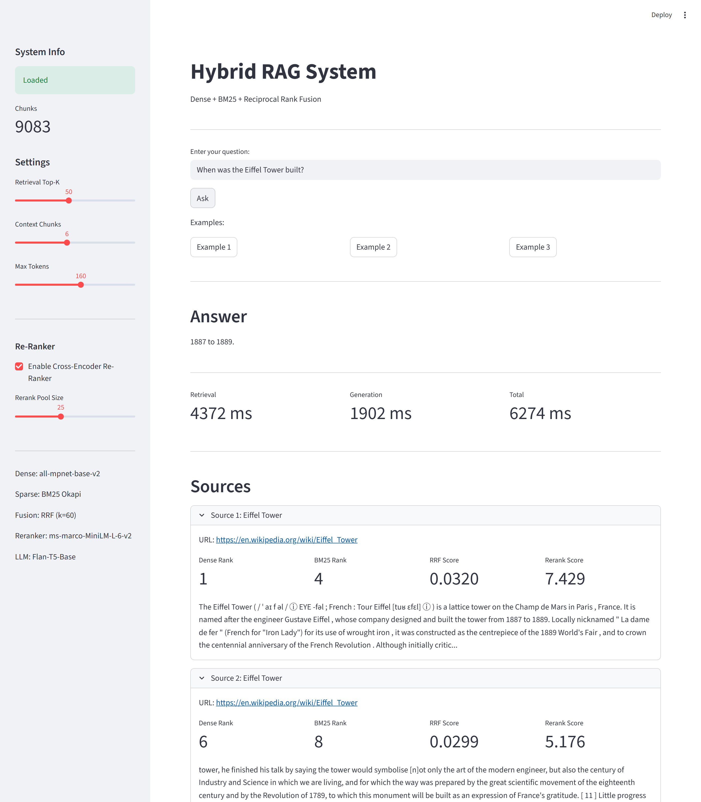
Live Demo — Example 1
Query: "When was the Eiffel Tower built?" → Answer: 1887 to 1889
DataHour • Hybrid RAG with Re-Ranker • Ravindra Babu Katiki
29

Slide 30
Key Takeaways
▸ RAG grounds LLMs and kills hallucinations — but only if retrieval is good
▸ Hybrid retrieval (Dense + BM25 + RRF) is robust because dense and sparse fail differently
▸ Reciprocal Rank Fusion needs no score calibration and is trivially extensible
▸ A cross-encoder re-ranker is the cheapest big quality win you can add to a working RAG system
▸ Two-stage retrieval = fast recall (bi-encoder) + sharp precision (cross-encoder)
▸ Custom metrics (CUS, ACS) reveal answer-quality issues that MRR alone hides
▸ All of this runs on CPU with open models — no API keys, no vendor lock-in
▸ Plan for production from day one — observability, evaluation harness, fallbacks
DataHour • Hybrid RAG with Re-Ranker • Ravindra Babu Katiki
30

Slide 31
Closing Statement
▸ The Core Shift: RAG is no longer optional. Conversational AI without grounding is a hallucination machine in production.
▸ Retrieval is the bottleneck: the model is rarely the problem. The retriever almost always is. Fix retrieval first and everything downstream gets cheaper.
▸ Hybrid + Re-Rank as the new default: combine dense and sparse for recall, fuse with RRF, then let a cross-encoder pick the winners. Simple, robust, fast.
▸ The Final Takeaway: the next generation of conversational AI will be built on reliable retrieval, not bigger models.
DataHour • Hybrid RAG with Re-Ranker • Ravindra Babu Katiki
31

