Slide 1

Use QR Code with WeChat Pay
Case study from perspective of software engineering
MARCH 2024
Notes:
微信支付 - 中国领先的第三方支付平台 ｜ 微信支付提供安全快捷的支付方式 (qq.com)

Slide 2
Contents
01
Introduction to WeChat Pay
02
QR code Pay Example Case
03
Example Case Analysis
04
Example Case Implementation
05
Other approaches to use WeChat Pay

Slide 3
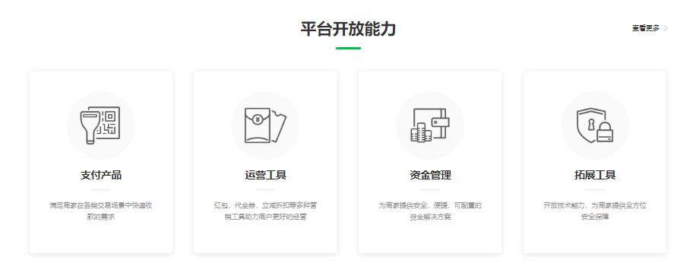
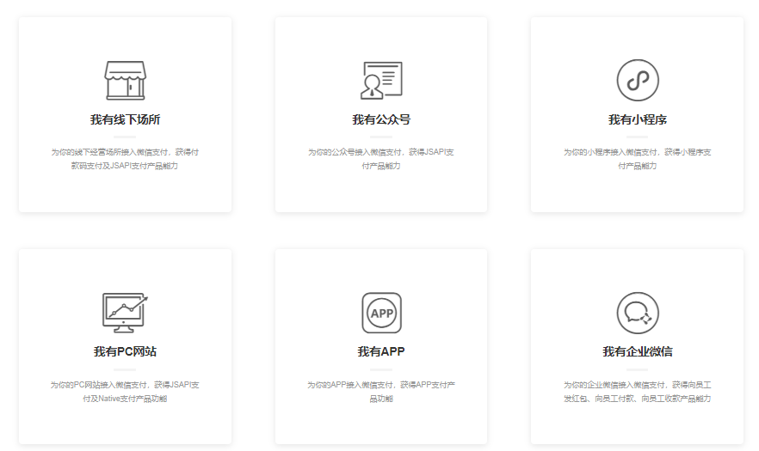
What is WeChat Pay
01
Introduction to WeChat Pay
微信支付 - 中国领先的第三方支付平台 ｜ 微信支付提供安全快捷的支付方式 (qq.com)
Multiple channels for business to charge customers

Slide 4
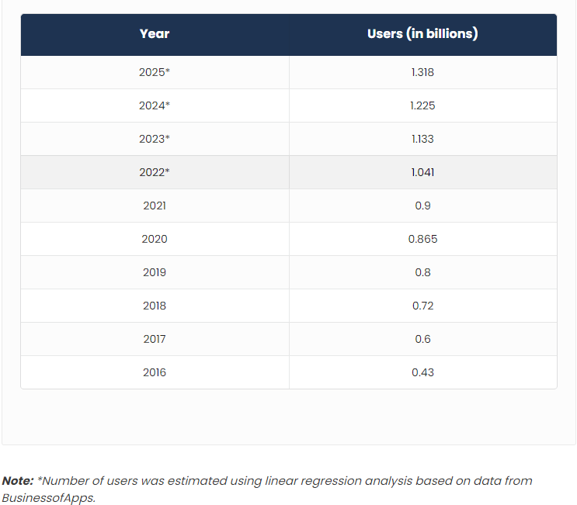
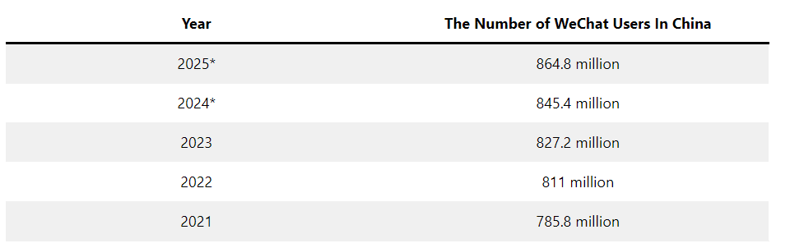
Why WeChat Pay
01
Introduction to WeChat Pay
With most WeChat Pay users living in China, business will be able to reach out for a large user base easily in this market.
A large user base around the global.

Slide 5
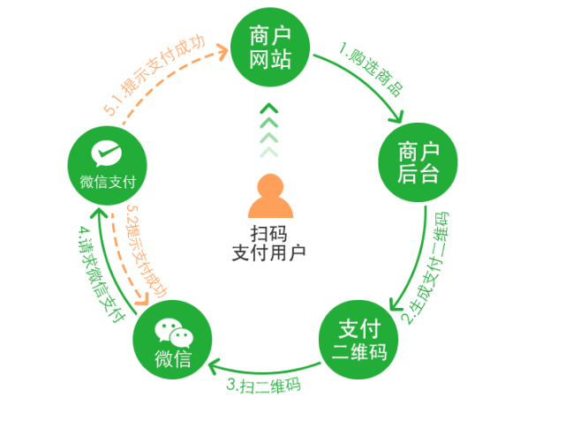
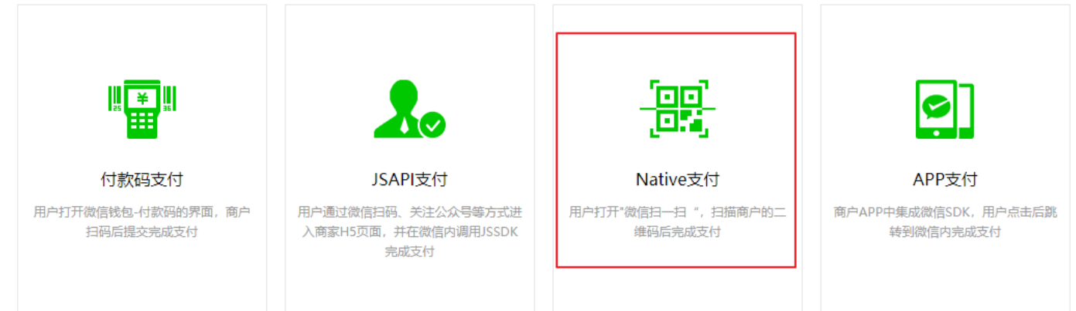
03
QR code pay example
Implemented with WeChat native Pay

Slide 6
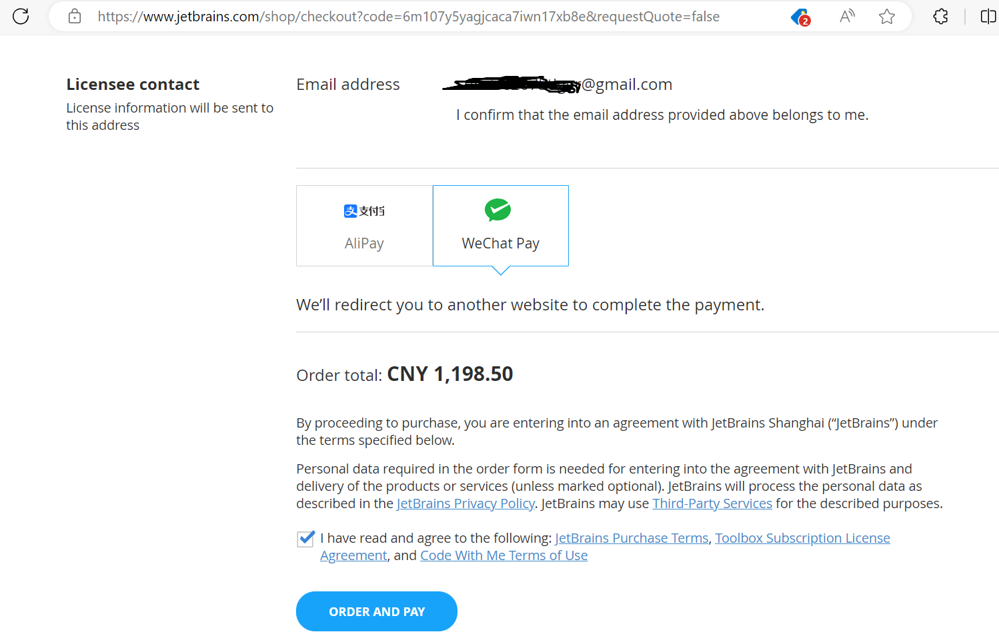
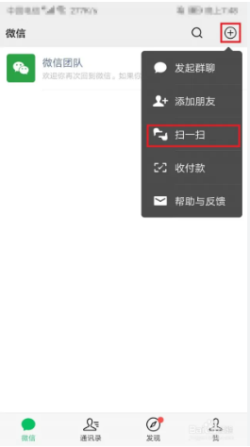
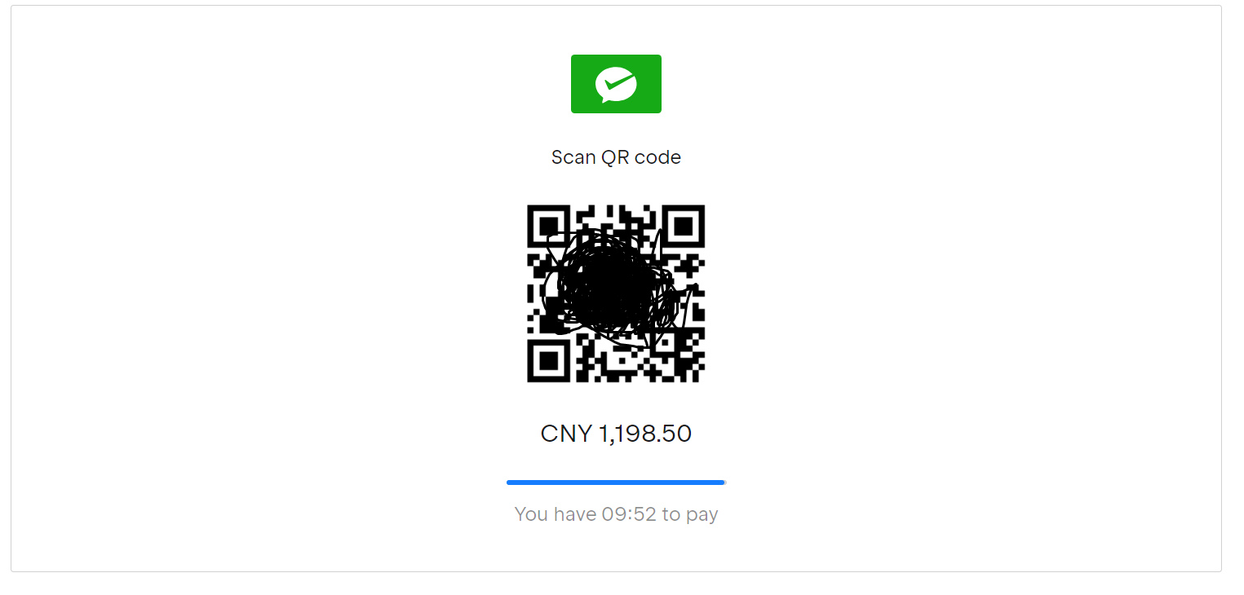
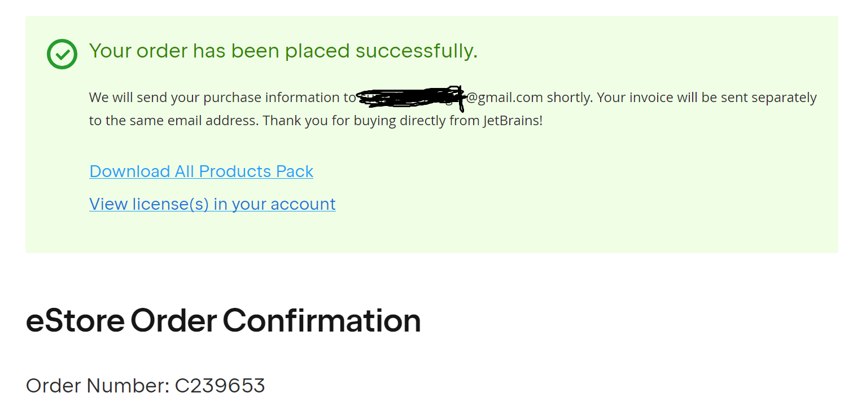
Use QR code to charge customer
02
QR code Pay example Case
After clicking the blue “order and Pay” button, you’ll be shown the QR pay code on web page. Then it’s your turn to open WeChat app on mobile device, and then scan the QR code to complete the order.
Placing an order in JetBrains’ website on PC

Slide 7
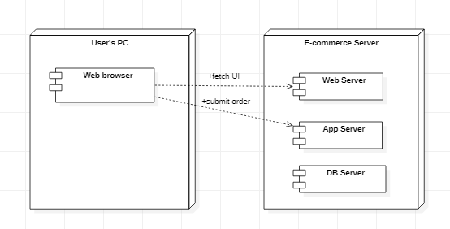
System breakdown
03
Example Case analysis
Structure and activities

Slide 8
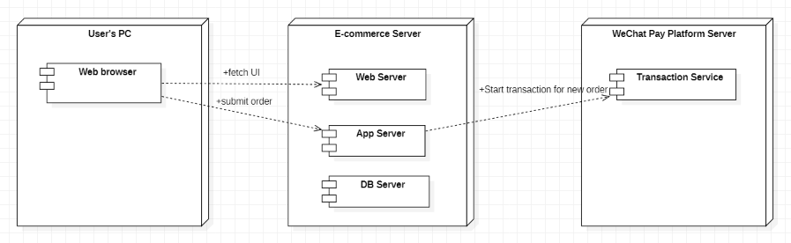
System breakdown
03
Example Case analysis
A request for WeChat Pay transaction is required

Slide 9
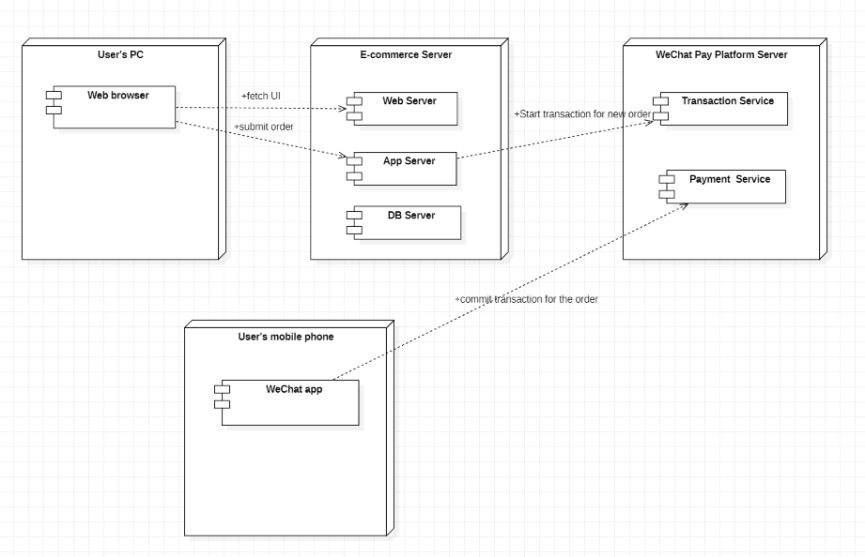
System breakdown
03
Example Case analysis
After WeChat Pay transaction is created for new order,
it’s customer’s turn to pay money.

Slide 10
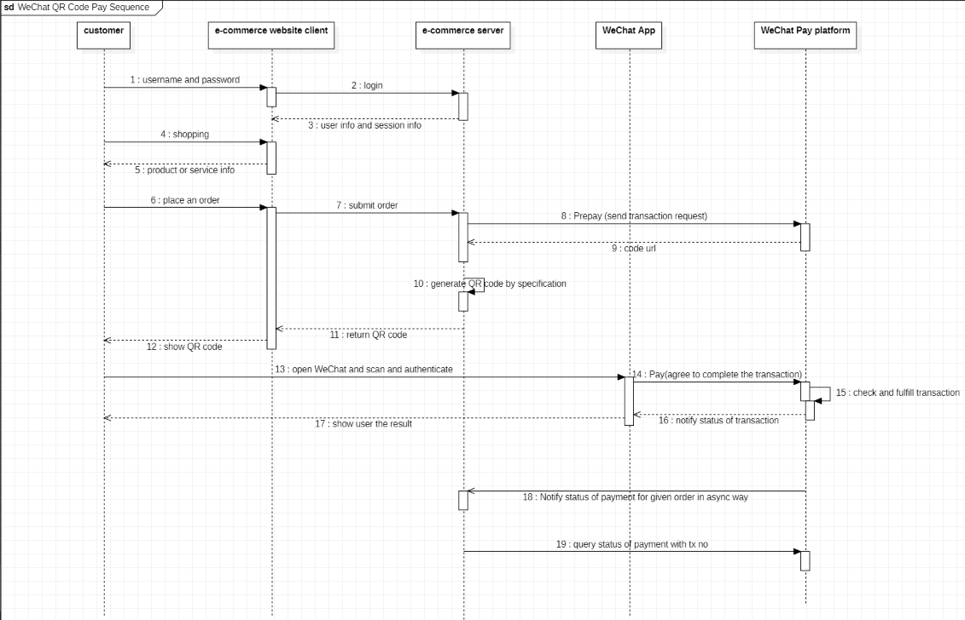
Big picture
03
Example Case analysis
The sequence diagram

Slide 11

Start with WeChat Pay platform
04
Example Case implementation
Preparation for native Pay
WeChat Pay platform : mchid
WeChat Official Accounts platform: AppID (Service Account)
API v3 secure key in console
https certificate generation in console

Slide 12
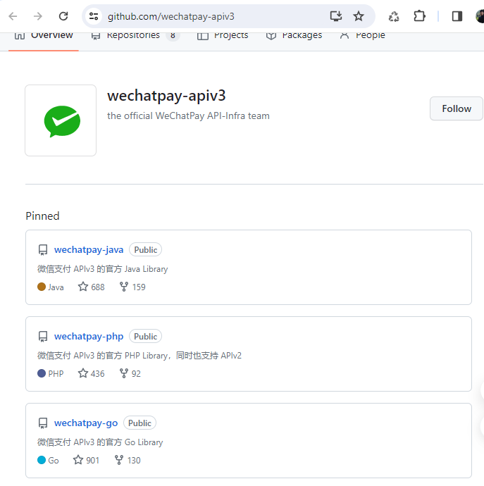
Create WeChat Pay transaction
04
Example Case implementation
Work with WeChat API-v3 SDK
Java/Go/PHP support
Config initialization in simple way
Transaction request for native pay in one line

Slide 13
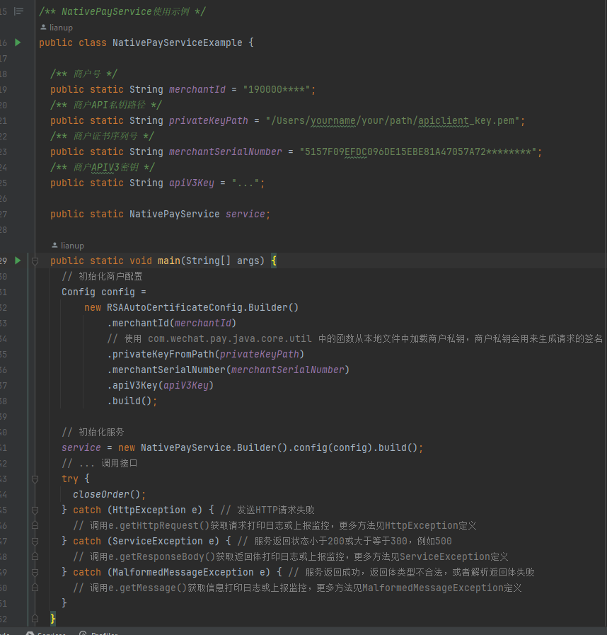
Create WeChat Pay transaction
04
Example Case implementation
Work with WeChat API-v3 SDK
Java/Go/PHP support
Config initialization in simple way
Transaction request for native pay in one line

Slide 14
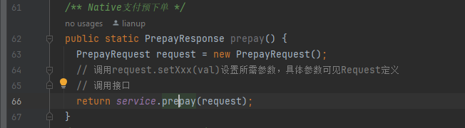
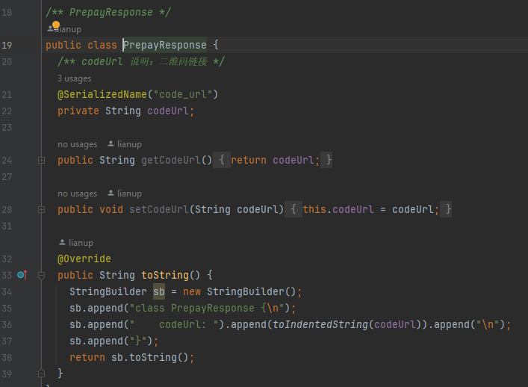
Create WeChat Pay transaction
04
Example Case implementation
Work with WeChat API-v3 SDK
Java/Go/PHP support
Config initialization in simple way
Transaction request for native pay in one line

Slide 15
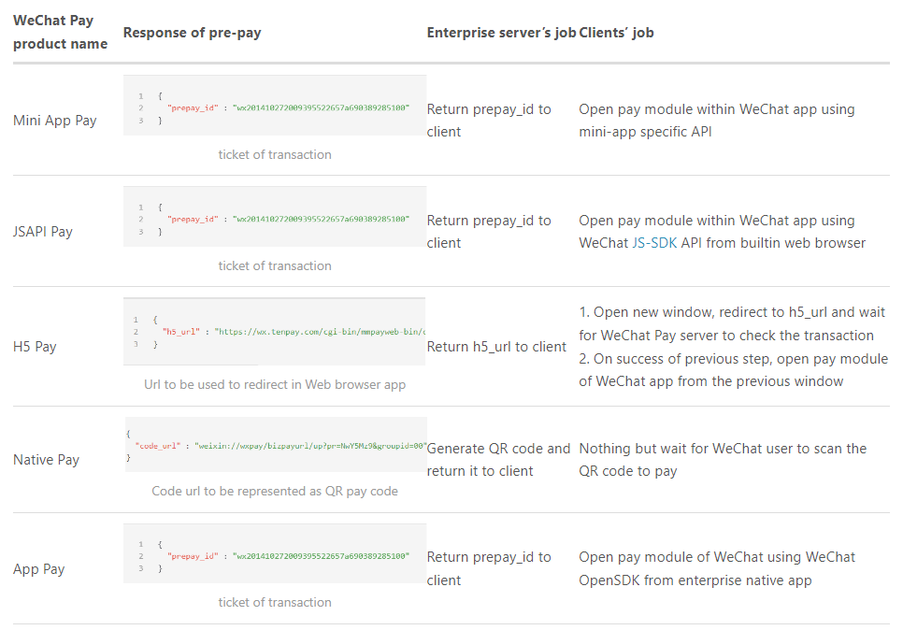
Process result of pay transaction
04
Example Case implementation
Your server is responsible for issuing the request for pay transaction and get the result of code URL and then generate QR code from it which is to be displayed in web page. How to generate and read QR code with Java using ZXing Library

Slide 16
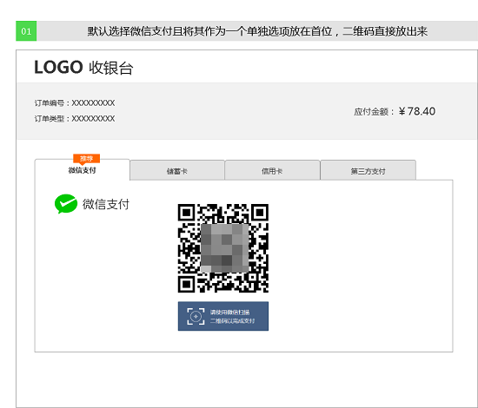
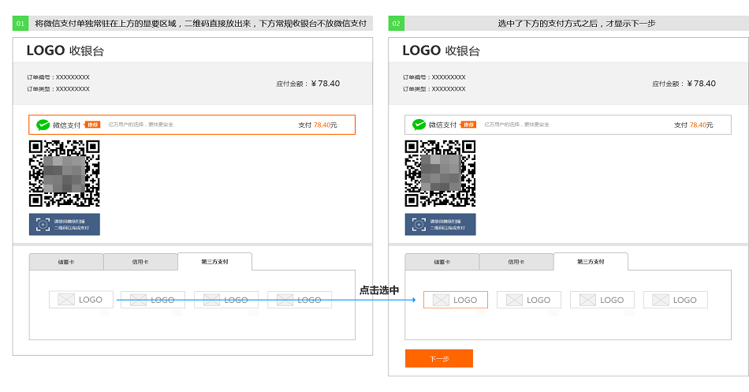
Display QR Code
04
Example Case implementation
Design checkout page for the pay transaction
Display QR code in web page
Allow customer to refresh QR code after 2 hours

Slide 17
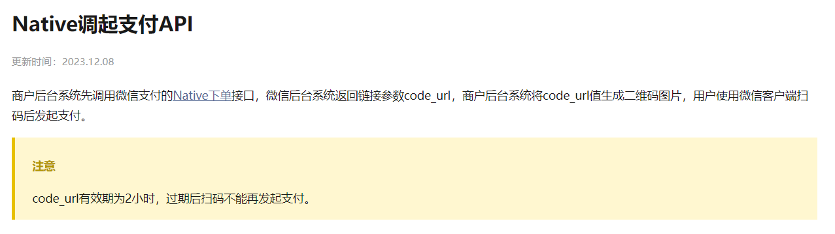
Display QR Code
04
Example Case implementation
Design checkout page for the pay transaction
Display QR code in web page
Allow customer to refresh QR code after 2 hours

Slide 18
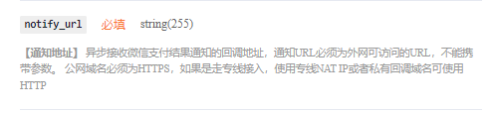
Payment result synchronization
04
Example Case implementation
Process notification from WeChat Pay platform
Attach notify_url when creating transaction
Define your logic to process notification

Slide 19
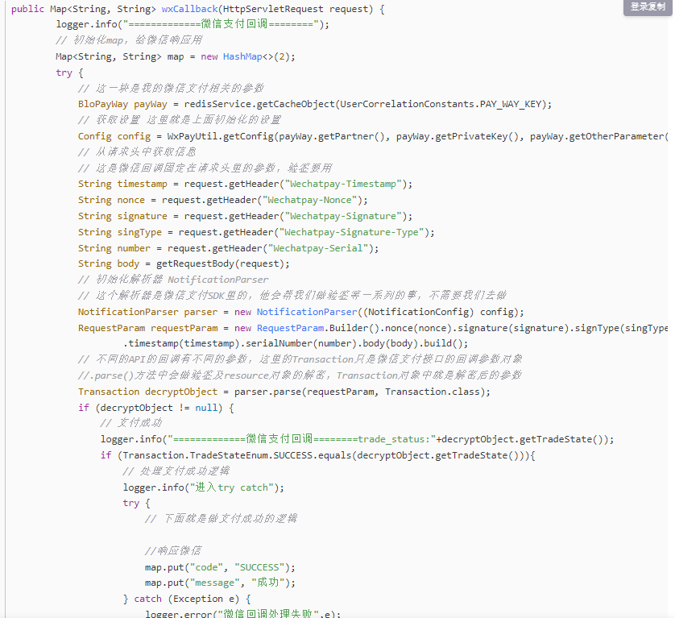
Payment result synchronization
04
Example Case implementation
Process notification from WeChat Pay platform
API v3 example:
Attach notify_url when creating transaction
Define your logic to process notification

Slide 20
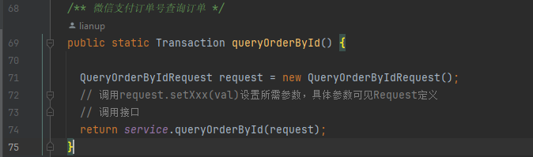
Payment result synchronization
04
Example Case implementation
Query result against WeChat Pay with API v3 SDK
Query with transaction no/id
Query with your custom order no

Slide 21
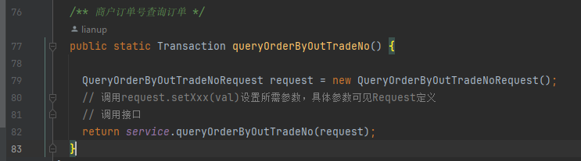
Payment result synchronization
04
Example Case implementation
Query result against WeChat Pay with API v3 SDK
Query with transaction no
Query with your custom order no

Slide 22

Afterthoughts
04
Example Case implementation
Thinking about quality attributes
Communication security
Data confidentiality and integrity
Timeout and retry

Slide 23
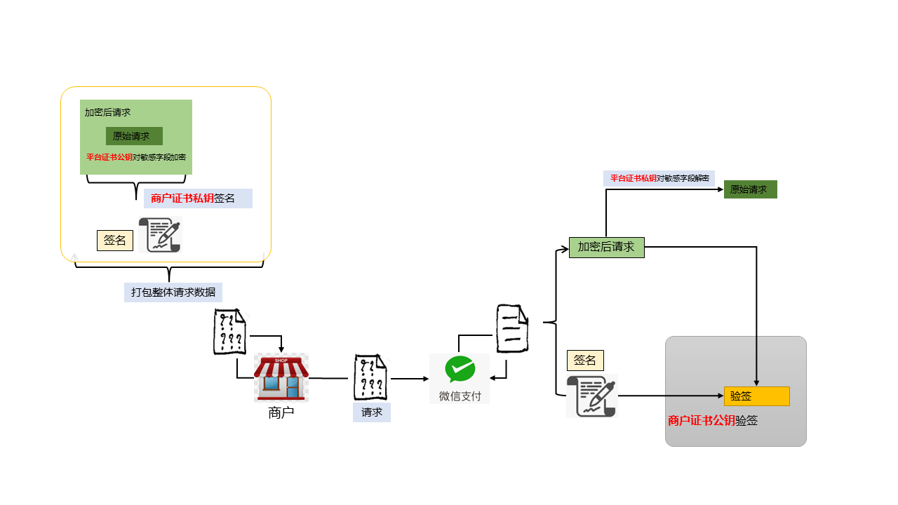
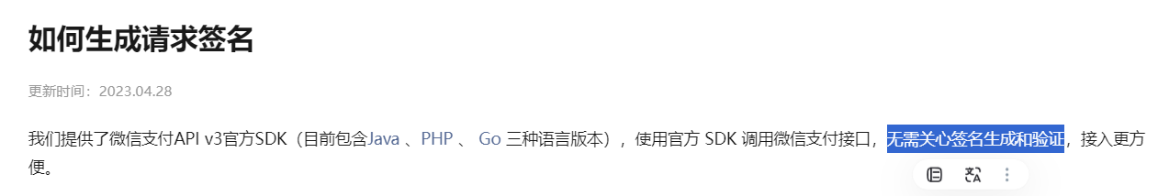
Afterthoughts
04
Example Case implementation
Thinking about quality attributes
Communication security
Data confidentiality and integrity
Timeout and retry

Slide 24
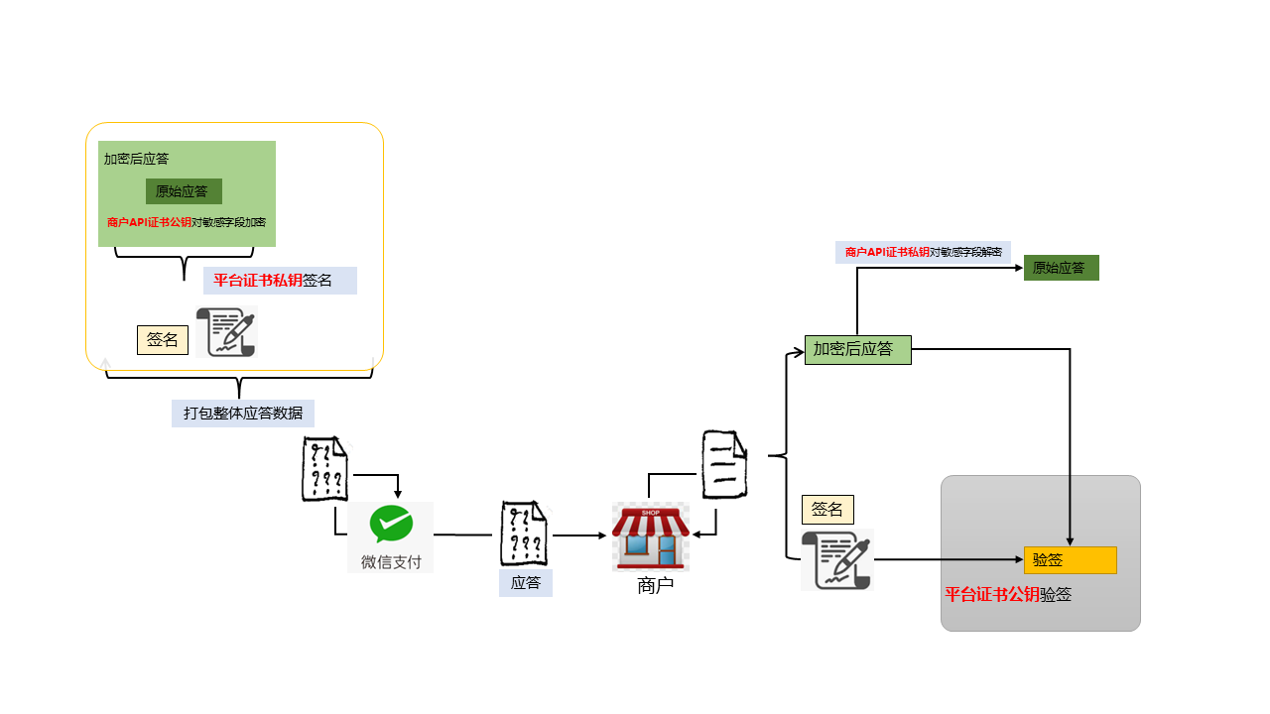
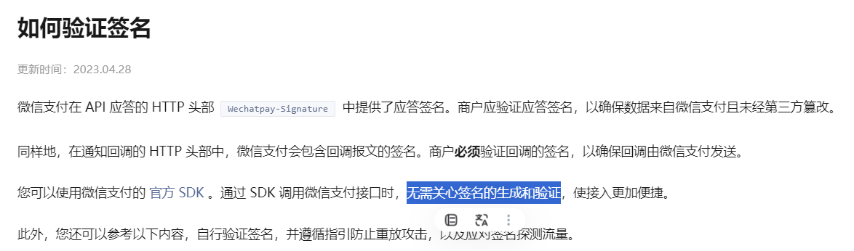
Afterthoughts
04
Example Case implementation
Thinking about quality attributes
Communication security
Data confidentiality and integrity
Timeout and retry

Slide 25
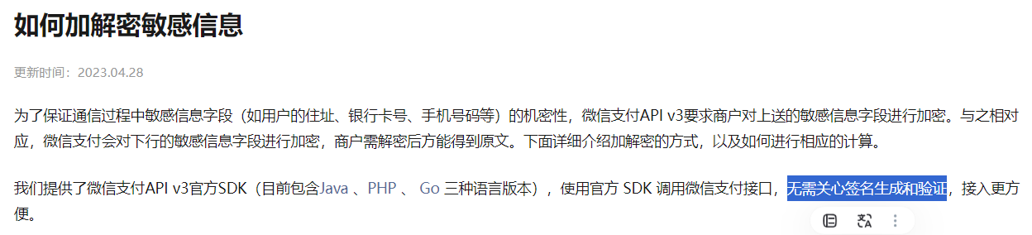
Afterthoughts
04
Example Case implementation
AbstractPrivacyDecryptor
AbstractPrivacyEncryptor
Thinking about quality attributes
Communication security
Data confidentiality and integrity
Timeout and retry

Slide 26
Afterthoughts
04
Example Case implementation
Thinking about quality attributes
Communication security
Data confidentiality and integrity
Timeout and retry

Slide 27
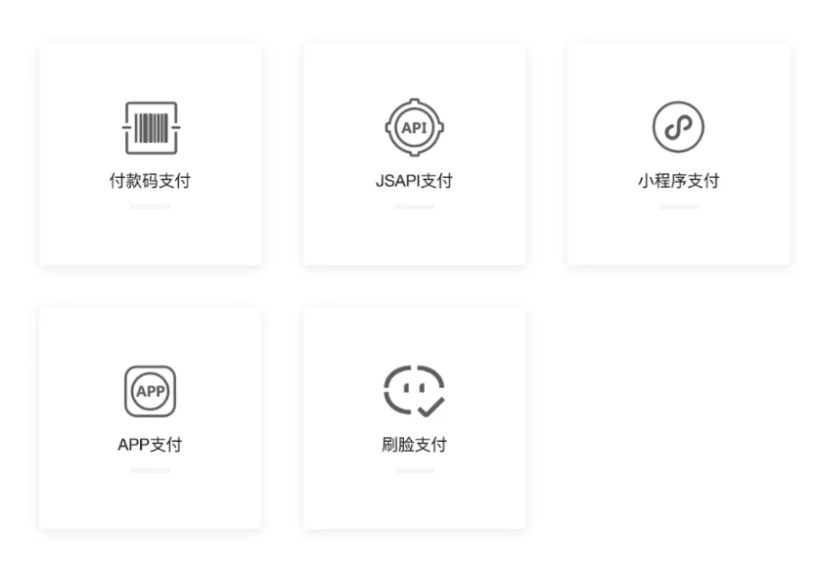
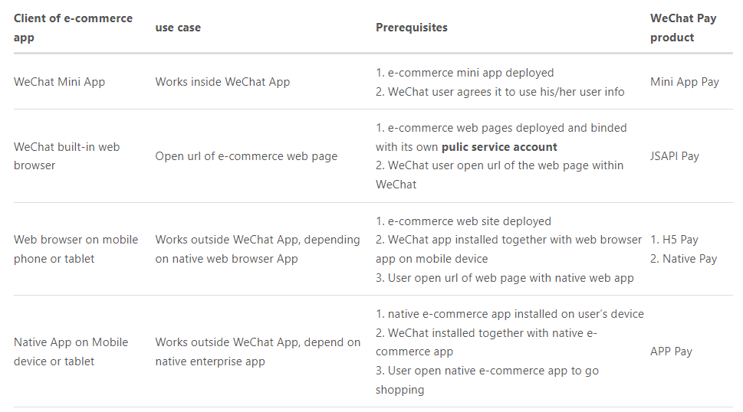
Go beyond QR code pay
05
Other approaches to use WeChat Pay
More details...

Slide 28

Thank you!
For more information, contact
Tiger Cao
Senior software engineer
Tiger_cao@epam.com
+86 135 3825 7831
Address line 1 Address line 2 Address line 3 Zip code Country

