Slide 1









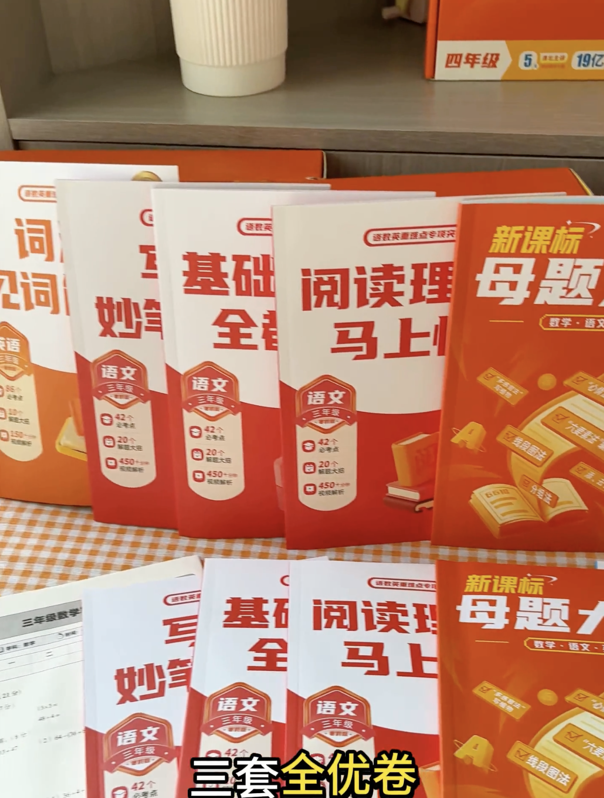




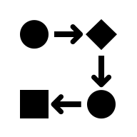











$$S_{0}$$
Our Method
Controller
$A_{text1}$,
$A_{text2}$,
$$… A_{textn}$$
Train
Pipeline
🔥
Training-free GRPO
Pass
-
✅
Experience
&
$$S_{0}$$
$$M_{1}$$
Pass
Reward Model
Low Cost
Pass
✅
$$S_{0}$$
$$M_{1}$$
&
LLM
Fail
…
Pass
High Cost
LLM
Extract Advantage
Rule Cases
审核细则
Cost Calculate
Pass
…
✅
Policy
$$S_{0}$$
Fail
&
High Cost
legal
the best products
Experience
Json Format
relatively good products
Text Match
LLM
Format
Refine
LLM
the best products
Policy
Format Check
Video STT
Single Generation
illegal, retry <= 3
illegal, retry > 3
relatively good products
…
…
Reward Model
…
Select
Less
modifications
Data Generation
Compliance
Modifications
the best products
relatively good products

