Slide 1


Interpretable Dictionary Prior for Controlled Text Generation
Xianghong Fang, Jian Li, Lifeng Shang, Xin Jiang, Qun Liu, Dit-Yan Yeung
The Hong Kong University of Science and Technology
Hua Wei Noah’s Ark Lab

Slide 2






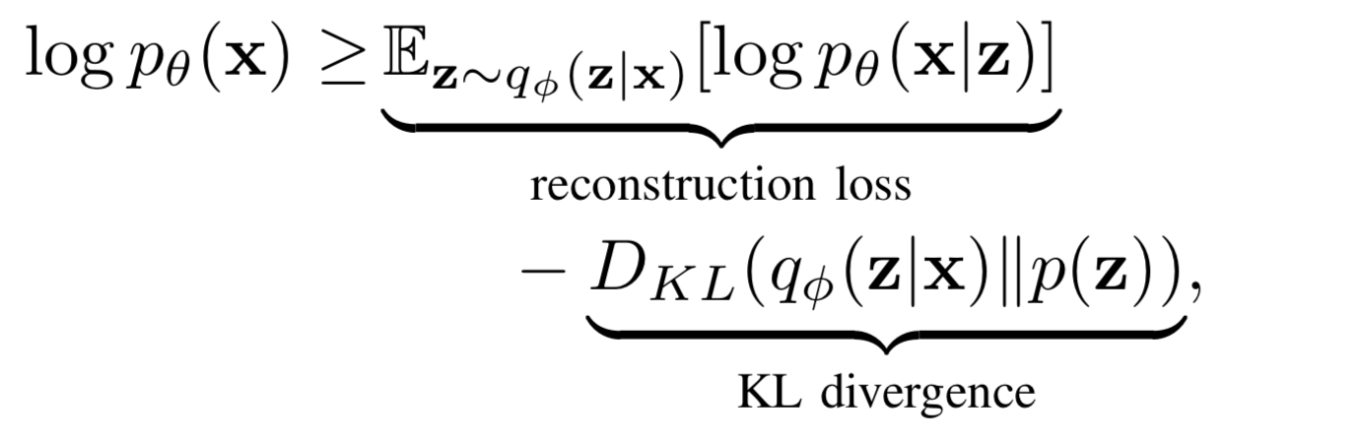
Background
Variational Auto-encoder (VAE):
Given sentences
Find the true posterior that explains the data
The encoder parameterized by
The decoder parameterized by
Training objective: maximize the Evidence Lower Bound (ELBO) as:

Slide 3


Background
Challenges
Bad Interpretability
VAEs adopt continuous distribution like Gaussian Distribution as prior, it would be hard to interpret the continuous latent variable against natural language attributes such as sentiments and topics
Posterior Collapse
The KL divergence diminishes to zero:
Leading to uninformative posterior
A common issue in VAE-based generative models

Slide 4
Methodology
Deep Generative Models (VAEs)
+ Adversarial Learning for Discrete Dictionary Representation
Dictionary Prior (DPrior)
+ Contrastive Learning for Dictionary Subsets
Interpretable Dictionary Prior (IDPrior)

Slide 5


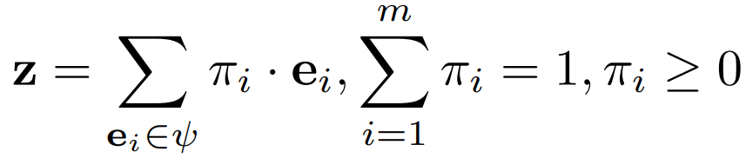

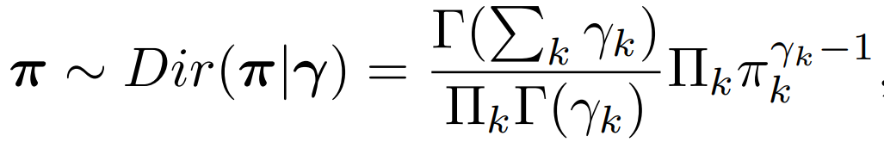


Methodology
Dictionary Prior (DPrior)
Learn prior space via learnable vectors (dictionary atoms):
Interpolate all dictionary atoms with coefficients to form latent variables:
Generation capacity is restricted when feed atoms into decoder
Adopt Dirichlet distribution to sample random interpolation coefficients
Whe , dirichlet distribution approximate one-hot distribution, approximate uniform categorical distribution when

Slide 6




Methodology
Adversarial Learning for DPrior
It’s intractable to deploy KL divergence as VAEs
Employ adversarial learning to learn discrete representations to narrow the distribution gap between prior and posterior
Latent variables z from encoder constitute real samples
Latent variables z from DPrior constitute fake samples
A discriminator parameterized by
Deploy LSGAN as our adversarial learning objective, where 1 and 0 are the labels for real and fake samples respectively:

Slide 7
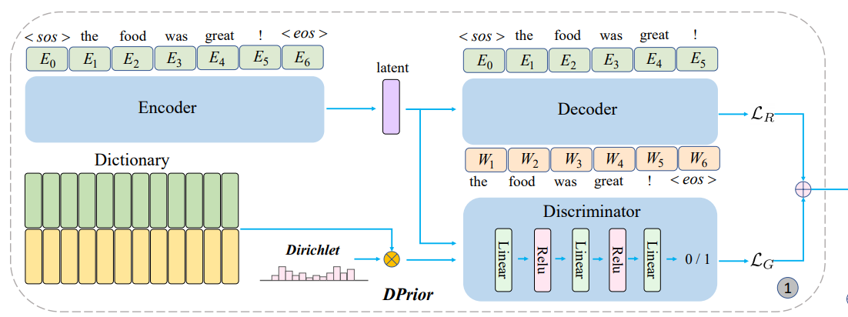

Methodology
DPrior Framework:
DPrior is a form of data-dependent prior as the dictionary is learnable
Our learnable prior could update its prior knowledge during training as Empirical Bayes method, would be flexible and powerful

Slide 8



Methodology
Interpretable Dictionary Prior (IDPrior)
Separate the dictionary into subsets: , given different attribute values in the data (positive and negative sentiments)
Problem: how to incorporate the attribute information into dictionary subsets
Solution: employ contrastive learning to separate the semantic space of the dictionary subsets according to natural language attribute
Task: sentences generated from a certain subset accurately correspond to one attribute

Slide 9





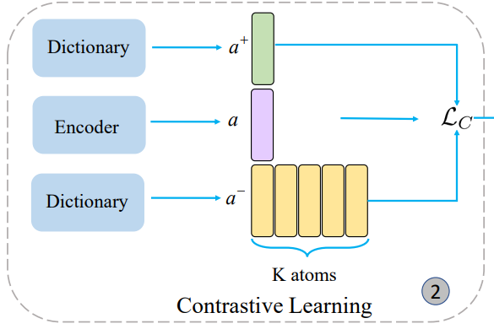
Methodology
Contrastive Learning for IDPrior
Latent variables z (anchor ) from encoder with attribute label
Dictionary atoms in subset r ) with same attribute (positive samples )
Dictionary atoms in other subsets (negative samples )
Employ InfoNCE loss as our objective:
Contrastive loss is a distance metric to enforce the anchor to be similar to positive samples and dissimilar to negative samples

Slide 10

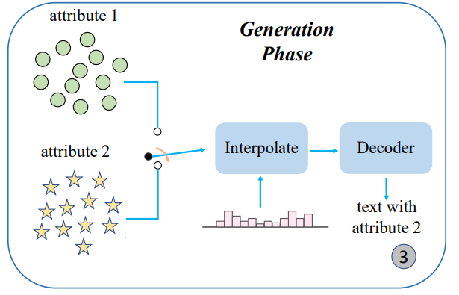
Methodology
IDPrior for Controlled Text Generation
Select the corresponding dictionary subset according to attribute label
Sample random in interpolation coefficients from dirichlet distribution
Produce latent variables z from dictionary subset and interpolation coefficients
Feed latent variables z to decoder for text generation

Slide 11
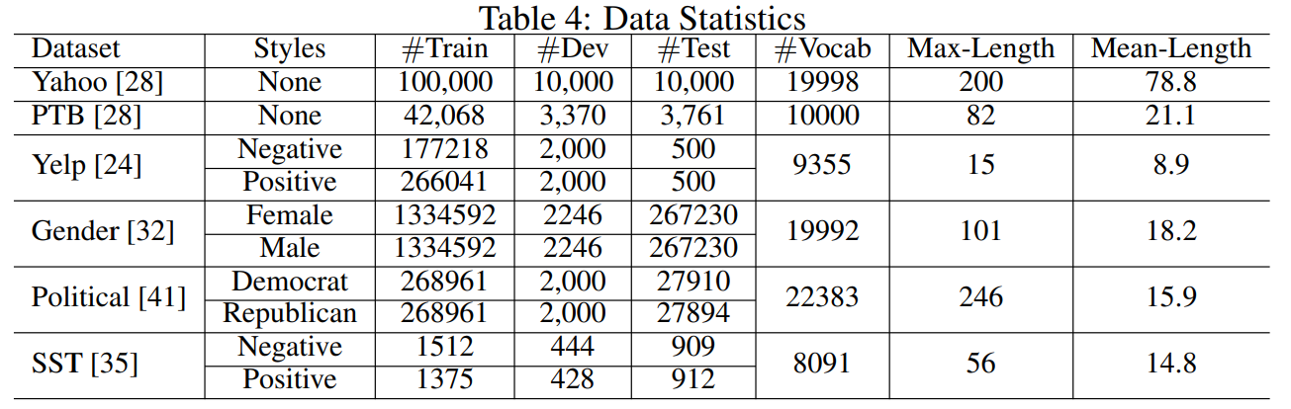
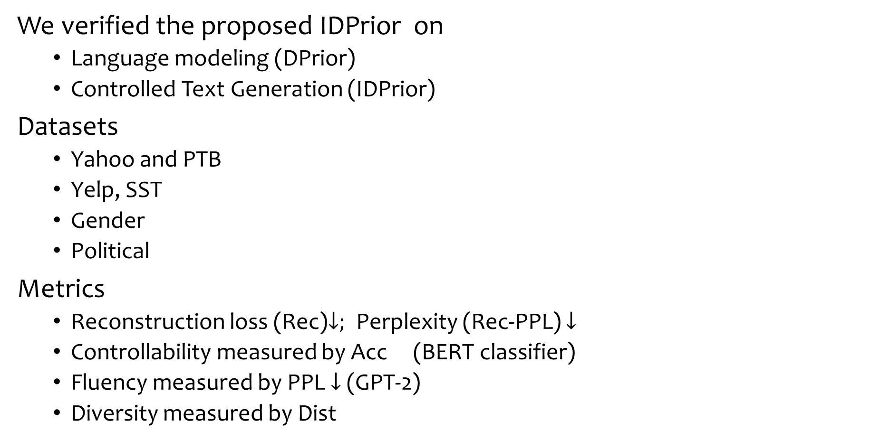
Experiments
We verified the proposed IDPrior on
Language modeling (DPrior)
Controlled Text Generation (IDPrior)
Datasets
Yahoo and PTB
Yelp, SST
Gender
Political
Metrics
Reconstruction loss (Rec)$↓;$Perplexity (Rec-PPL) $↓$
Controllability measured by Acc (BERT classifier)
Fluency measured by PPL $↓$ (GPT-2)
Diversity measured by Dist

Slide 12
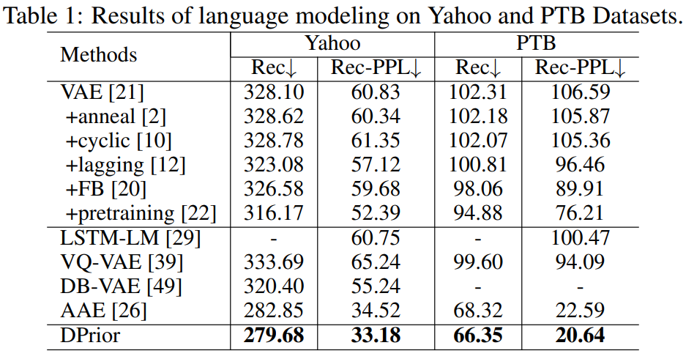
Experiments
Main results on language modeling over Yahoo, PTB
Adversarial learning (AAE and DPrior) is better than ELBO optimization (VAEs variants) for generative text modeling
ELBO optimization is prone to posterior collapse in an auto-regressive decoder

Slide 13
Experiments
Main results on language modeling over Yahoo, PTB
DPrior achieves further improvements upon AAE, which attributes to flexible prior
AAE cannot be adopted for controlled generation

Slide 14
Experiments
Main results on language modeling over Yahoo, PTB
Comparing to VQ-VAE and DB-VAE, DPrior achieve impressive result as STE employed in VQ-VAE and DB-VAE for updating discrete representations is not stable

Slide 15
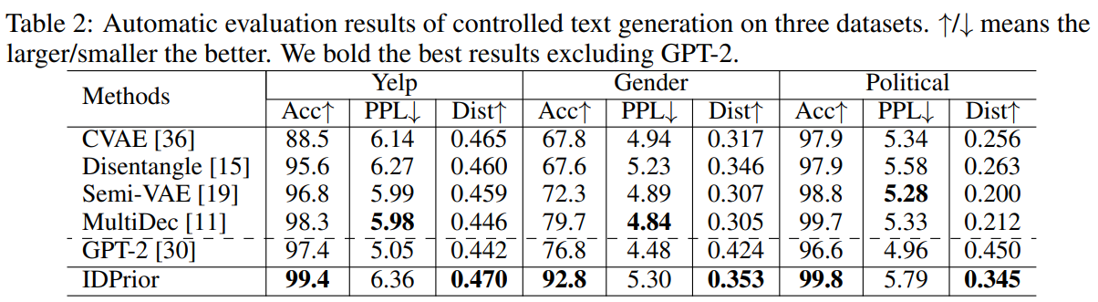
Experiments
Main results on Controlled Text Generation over Yelp, Gender and Political
In terms of controllability, IDPrior consistently achieves the best generation accuracies and outperforms the GPT-2 model, indicating discrete representations may better capture the text attributes than pre-trained language models under limited training data
In terms of diversity, excluding GPT-2, IDPrior also achieves the best distinct metrics (Dist) on all datasets

Slide 16
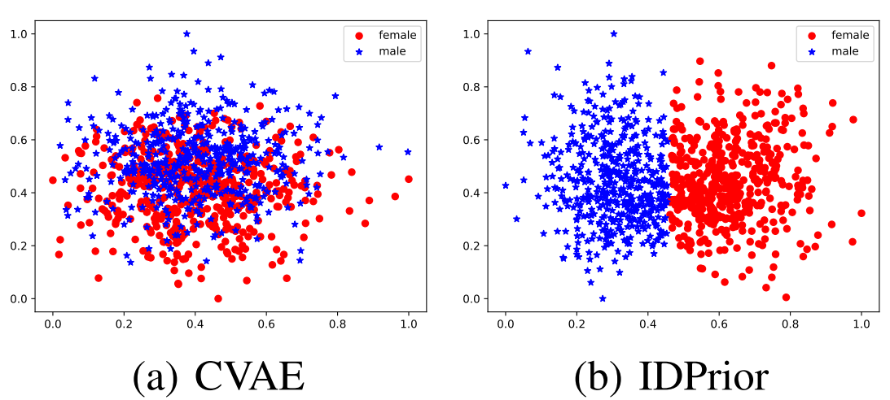

Experiments
Visualizations
To gain understanding of prior space separations, we visualize dictionary atoms via PCA (Gender dataset)
The prior in CVAE is highly overlapped, indicating serious mode-collapse problem (explain the poor controllability in table 2)
IDPrior clearly separates the prior space into the female and male parts

Slide 17
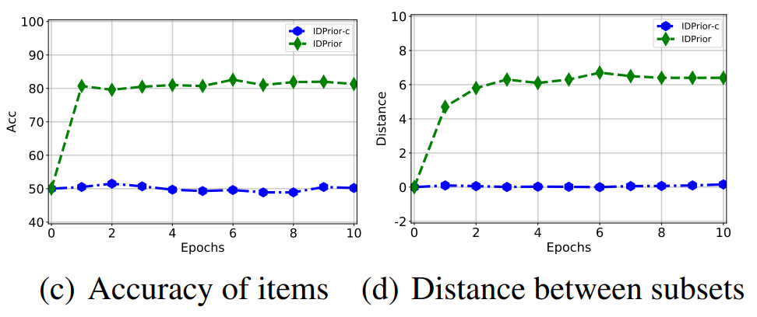
Experiments
Further Analysis
We remove contrastive loss from IDPrior, that is IDPrior-c
When contrastive learning is deployed, the atom accuracy quickly increases to 80%, and the subset distance gradually enlarges during the model training
when no contrastive loss is applied, the atom accuracy and subset distance keep almost unchanged, i.e., 50% and 0 respectively

Slide 18
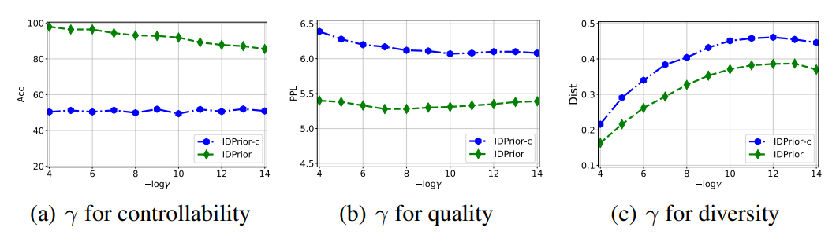

Experiments
Discussion on Dirichlet Distribution
determines the density of the Dirichlet distribution or interpolation coefficients, we analyze its influences from controllability, quality, and diversity
Larger would achieve better controllability, smaller diversity. While the PPL score fluctuates in a small range when varies

Slide 19
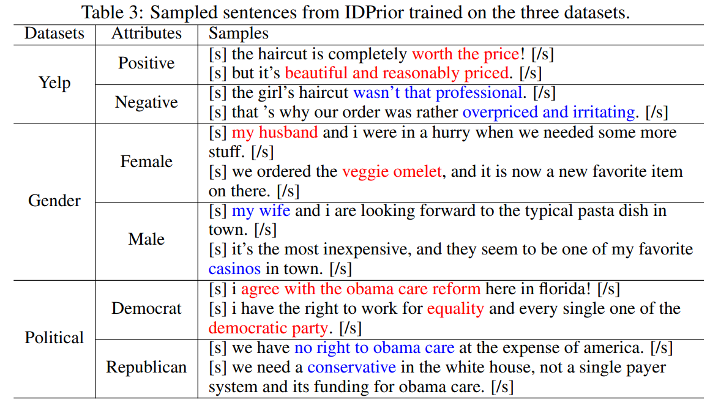
Experiments
Case Study

Slide 20
Conclusion
In this paper, we:
propose Dictionary Prior (DPrior) within deep generative models, which consists of learnable dictionary atoms and interpolates the atoms as latent variables. Adversarial learning is employed to make DPrior approximate the posterior distribution.
further extend DPrior to Interpretable Dictionary Prior (IDPrior) for controlled text generation, which separates DPrior into subsets according to the natural language attribute. We apply contrastive learning on IDPrior to incorporate the attribute information
IDPrior achieves very competitive controlled generation performance on three datasets with different attributes, even outperforms the GPT-2 finetune-based approach

Slide 21
Thanks & QA

