Slide 1
Part 7
US10049272B2
Notes:
https://patents.google.com/patent/US10515283B2
https://patents.google.com/patent/US10515283B2

Slide 2
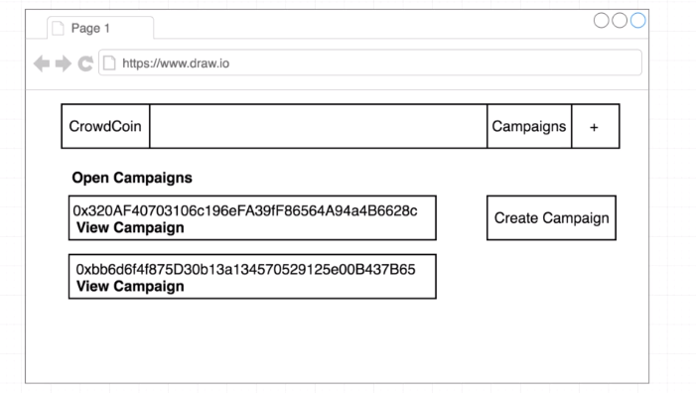
Notes:
Create campaign, open campaign, contribute, create request

Slide 3
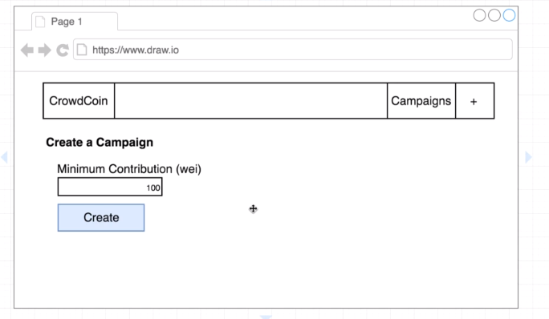

Slide 4
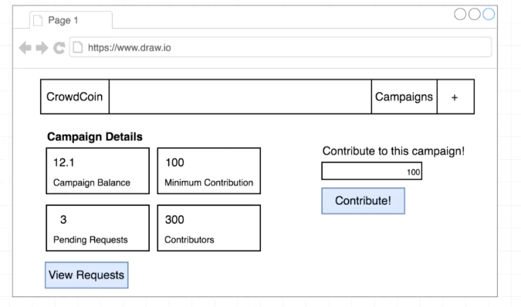

Slide 5
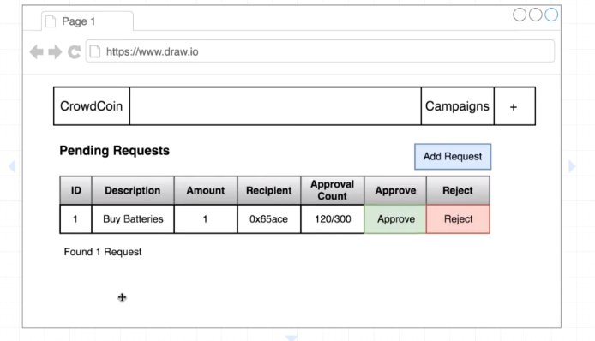

Slide 6
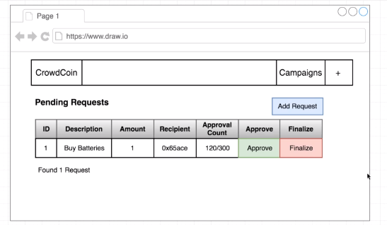

Slide 7
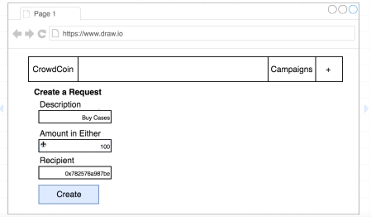

Slide 8
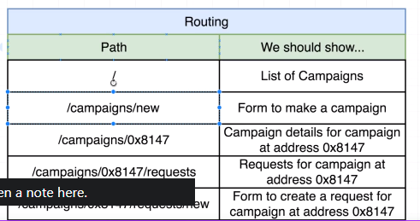
Notes:
Crowdcoin.com

Slide 9
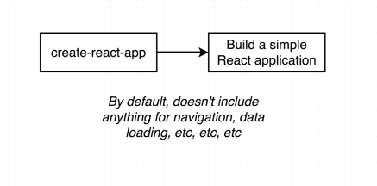
Notes:
Tạo app đơn giản

Slide 10
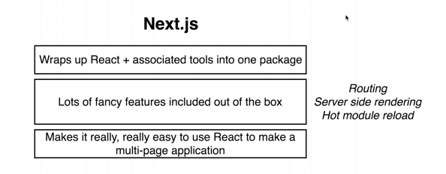
Notes:
Next js là framework wrap up reactjs

Slide 11
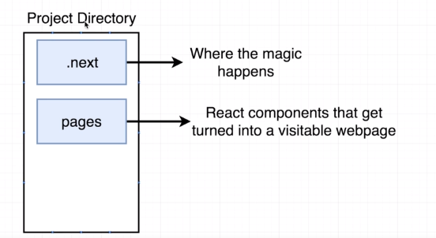

Slide 12
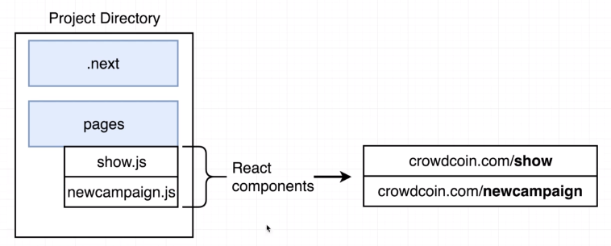

Slide 13
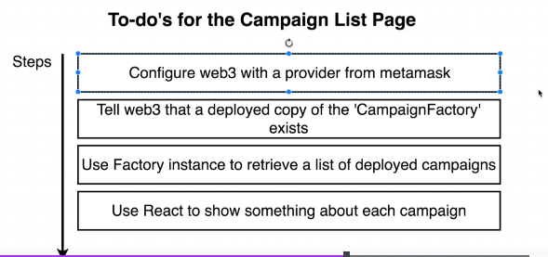

Slide 14
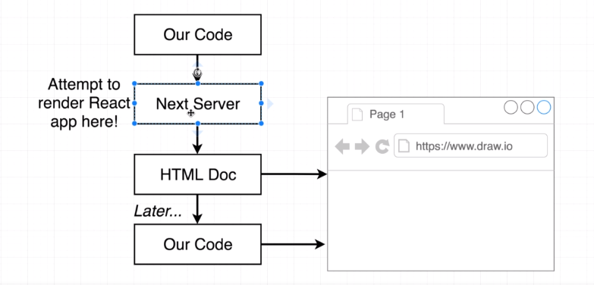

Slide 15
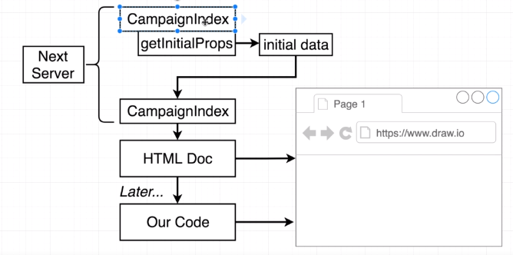

Slide 16
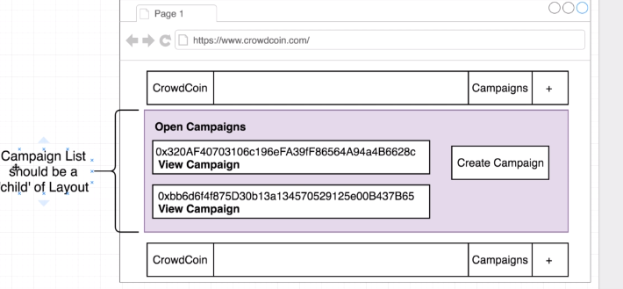

Slide 22
Thank you

