Slide 1
blockchain
Notes:
https://cryptoviet.com/proof-of-stake-la-gi

Slide 2
When a Bitcoin transaction is transmitted to the network, it first gets verified by all of the Bitcoin nodes available
After it successfully passes verification by a node, it sits inside that node’s “Unconfirmed Transactions” area called the “Mempool” (short for Memory Pool). The transaction patiently waits until a miner picks it up and includes it in the next block. The Mempool is basically the node’s holding area for all the pending transactions.

Slide 3
Once the Mempool reaches full capacity, the nodes start prioritizing transactions by setting up a minimal transaction fee threshold. Transactions with a fee-rate lower than the threshold are immediately removed from the Mempool and only new transactions with a large enough fee are allowed access to the Mempool
Notes:
48h unconfirm transaction remove from mempool
if you wait long enough (usually around 48 hours) your transaction will drop from all of the Bitcoin mempools and the funds will be returned to your wallet.

Slide 4
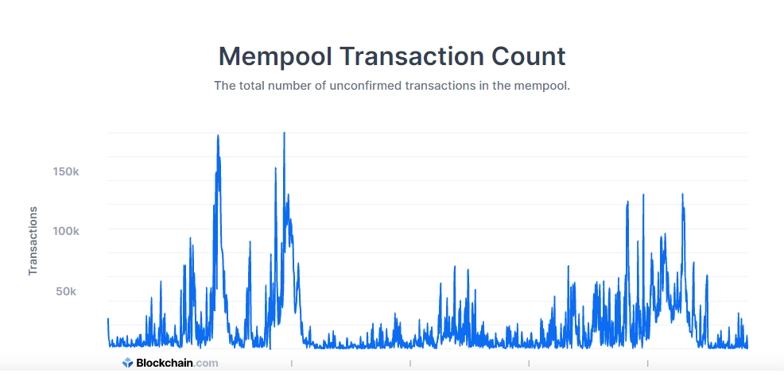

Slide 5
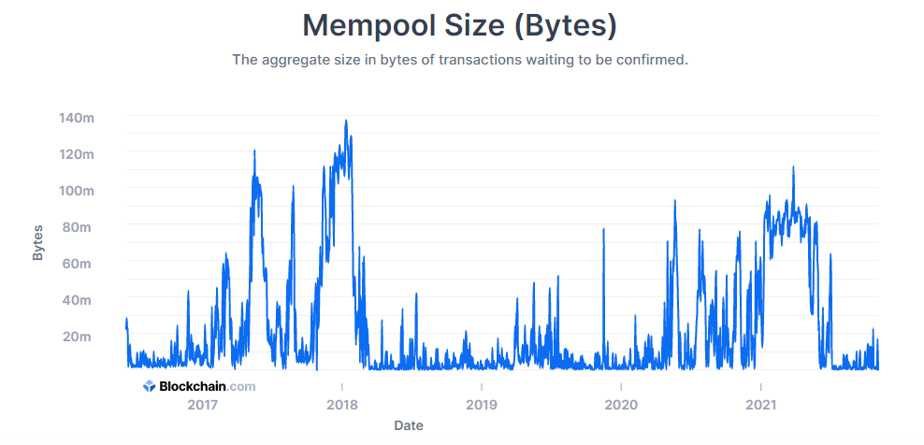

Slide 6
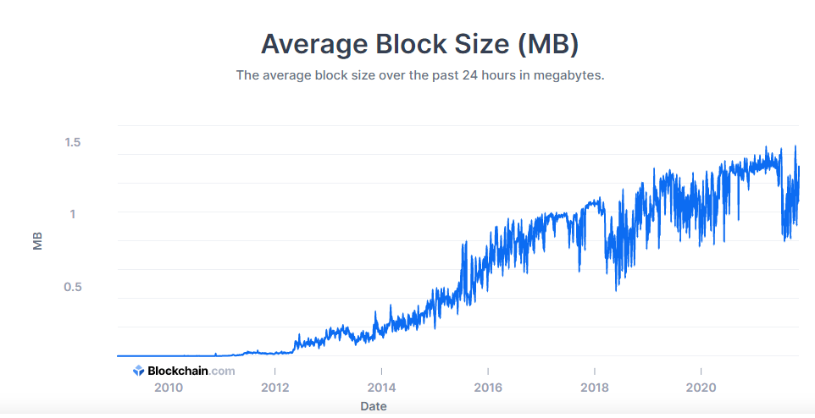

Slide 7
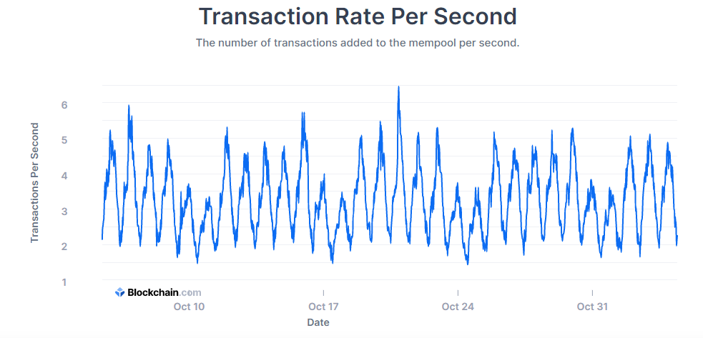

Slide 8

Với công thức trên, TPS tối đa của bất kỳ nào đều có thể được tính toán một cách chính xác.
Chẳng hạn, thời gian tạo khối Bitcoin hiện tại là 10 phút; tức là cứ sau 10 phút, một khối mới được khai thác. Trong 10 phút (600 giây), và khối Bitcoin hiện tại có kích thước tối đa là 1MB. Vậy trung bình Bitcoin có thể có khoảng 2.759,12 giao dịch dựa trên các giả định trước đó.
Nói cách khác, chuỗi khối Bitcoin hiện chỉ có thể đảm bảo (2759.12 / 600) = 4,6 giao dịch mỗi giây.
Tuy nhiên theo lý thuyết thì TPS của Bitcoin rơi vào khoảng 7 TPS, sở dĩ có sự chênh lệch này là vì nó phụ thuộc vào số lượng giao dịch trong 1 khối. Bạn có thể cập nhật TPS của Bitcoin chính xác nhất trong thời điểm hiện tại, cũng như quá khứ tại https://www.blockchain.com/charts/transactions-per-second

Slide 9
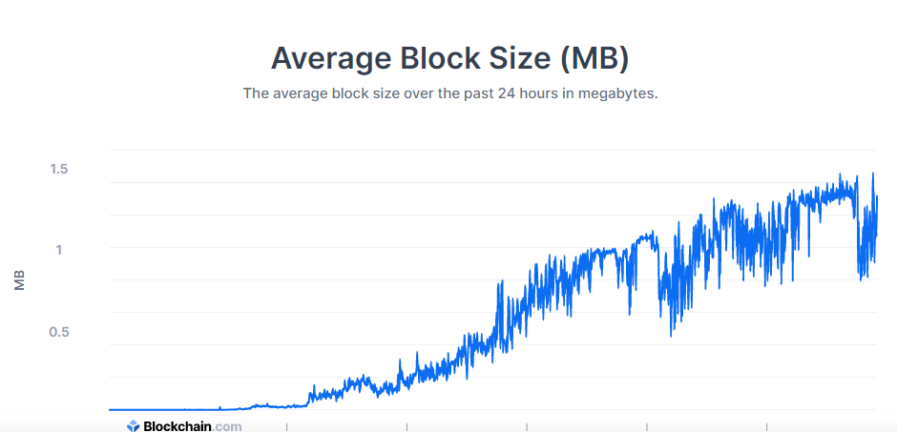

Slide 10
An orphan block is a block whose parent block is unknown or inexistent. These types of blocks were formed in older versions of the Bitcoin Core software, where network nodes could receive blocks despite the lack of data about their ancestry. Since the release of Bitcoin Core v.0.10, in early 2015, Bitcoin orphan blocks (in the literal sense) are no longer possible.
However, the term orphan block is still widely used in the cryptocurrency space when referring to valid mined blocks that have been discarded. Technically, these blocks should be called “stale blocks” or “extinct blocks,” but because the client denotes their block rewards as “orphaned,” most people call them orphan blocks. So despite having a known parent block, most people refer to those blocks as orphan blocks rather than stale blocks.
Stale blocks are generated when two different miners relay their valid blocks almost at the same time. This causes the network to split into two competing versions of the blockchain until one of the blocks is discarded (the longest chain prevails while the other is abandoned). Note that both blocks are verified and valid, but only one is attached to the main chain.
Because miners are constantly generating new blocks, some of these may be broadcasted to the network almost simultaneously. And since the network is distributed, the transmission of information between nodes takes some time. For this reason, there is a possibility that a group of nodes will choose to validate one block, while another group will choose to validate the other. Finally, this would cause one of the blocks to be “orphaned”.
The generation of stale blocks is completely natural and, in most cases, occurs by chance. However, they may also be produced when malicious actors try to create an alternate valid chain (see 51% attacks).
Notes:
https://academy.binance.com/en/glossary/orphan-block

