Slide 1
Runner
Mobile Game Development

Slide 2
User Experience Goals
Replayability
Competitiveness

Slide 3

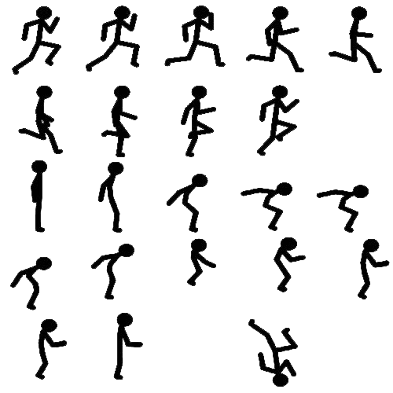
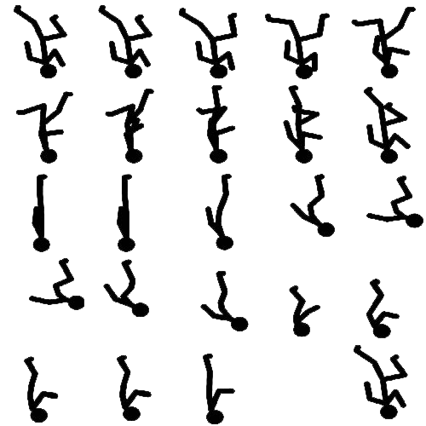
Animation

Slide 4

Animation
Run
Jump
PlayerState = 0
PlayerState = 2
Press Jump Button

Slide 5
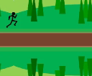
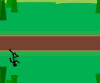
Animation
Press Flip Button
Flip down
Run
Flip down
Press Flip Button
Flip up
PlayerState = 0
PlayerState = 1

Slide 6

Animation
Flip Run
Flip Jump
PlayerState = 1
PlayerState = 2
Press Jump Button

Slide 7
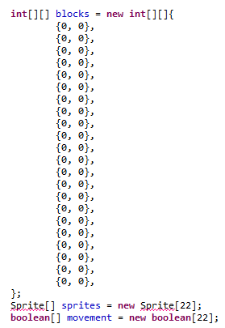
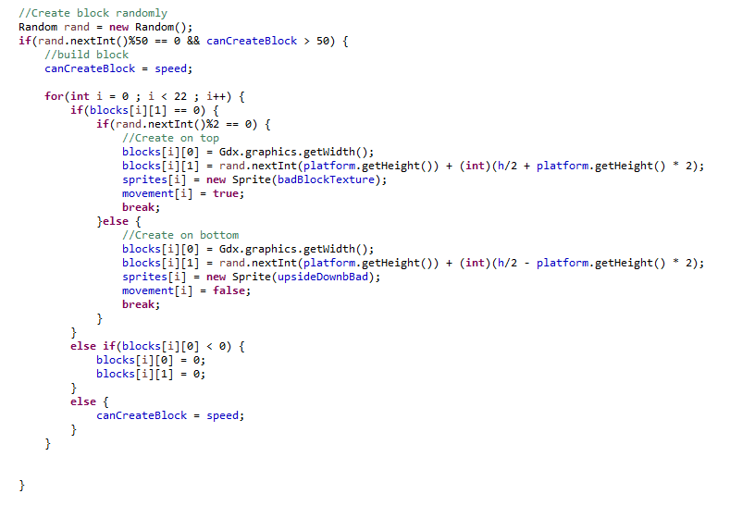
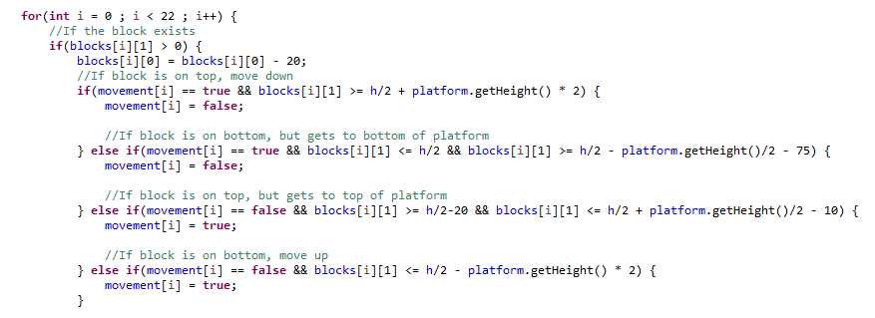
Bad blocks
This code declares and instantiates the arrays which store the bad blocks
This code places data into the arrays which is later used to create bad blocks
This code moves the blocks up and down on the ‘x’ axis. In relation to the top of the screen and the platform

Slide 8
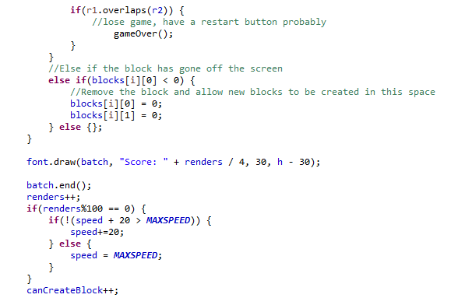
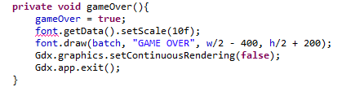
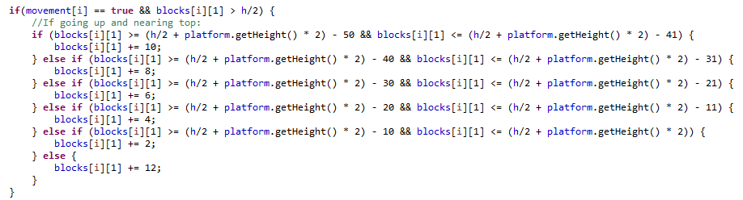
Bad blocks
This code checks whether or not the game is over.. Completely unrelated to bad blocks
This code draws the bad block sprites on the screen at their updated position
This code increases the speed at which blocks are created based upon the amount of renders, also seen above that, I clean up the arrays whenever a block goes off the screen
This code gives the blocks a realistic feel as they move up and down the screen, and makes it seem as if they’re bouncing. (I repeated this for each four possible directions)

Slide 9
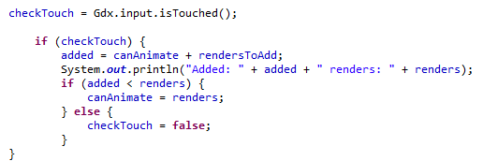
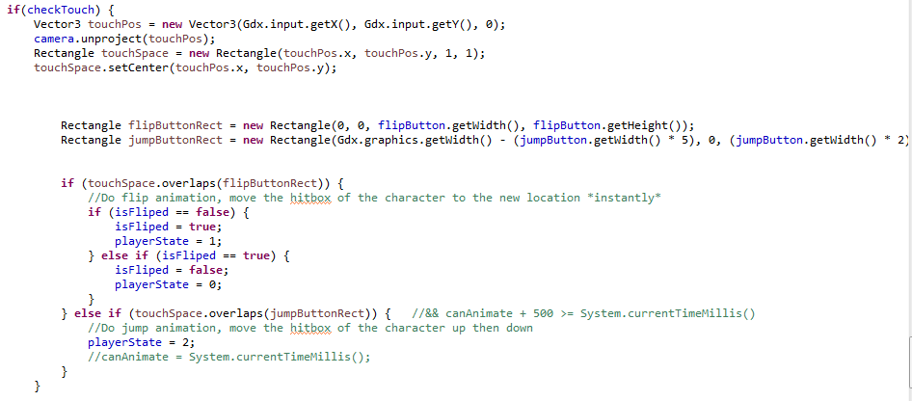
Touch detection
In this code I made sure that the user can only flip or jump by a user defined increment based on an amount of renders. In the example of this assignment, I set it to 20 as this felt nice. Doing this stopped the game from continuously flipping or jumping when you tap the button.
This code first checks whether the screen has been touched, if it has then it will create rectangles around where the flip button and jump button sprites are. If the space which was touched was the same as the space occupied by either of these rectangles, then the user has touched a button.

Slide 10

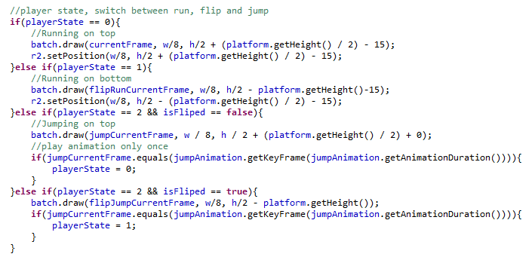
Collision detection
This code creates the rectangle which is used for the collision detection of the player
This code checks whether there’s been a collision, and if there has then the game will end
This code was written mostly by Toby, but I included it because I changed the position of the rectangle when the user flips, which means the players hitbox moves when you flip rather than staying above the platform all the time.

Slide 11
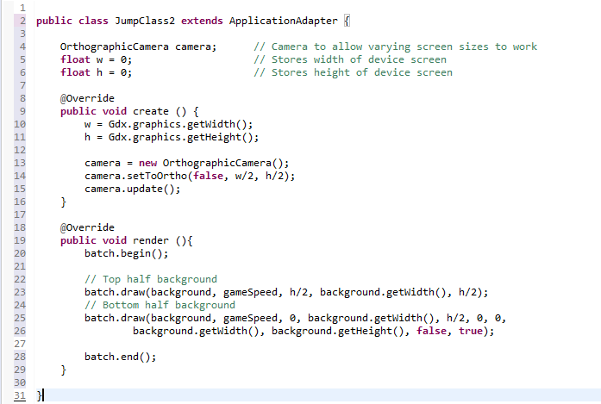
Camera

Slide 12
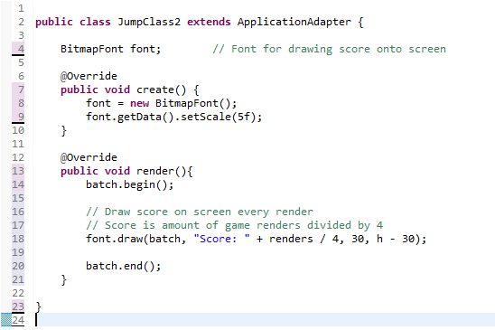
GAME Score

Slide 13
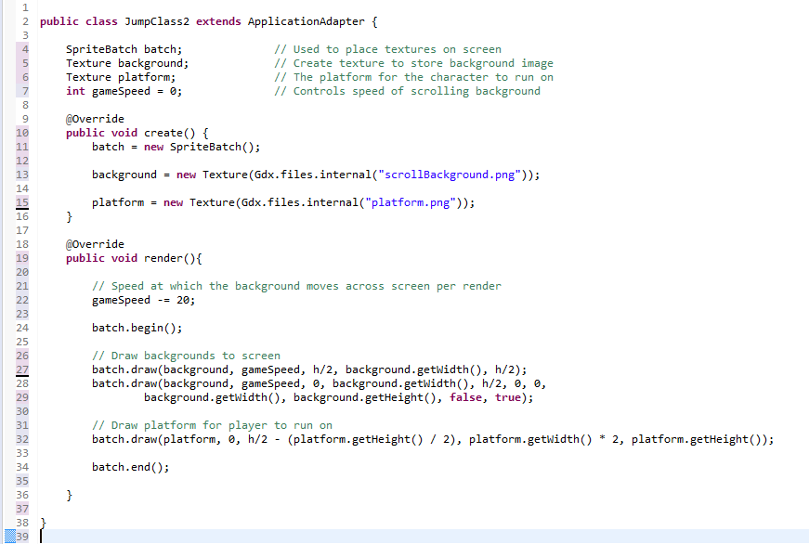
Backgrounds & platform

Slide 14
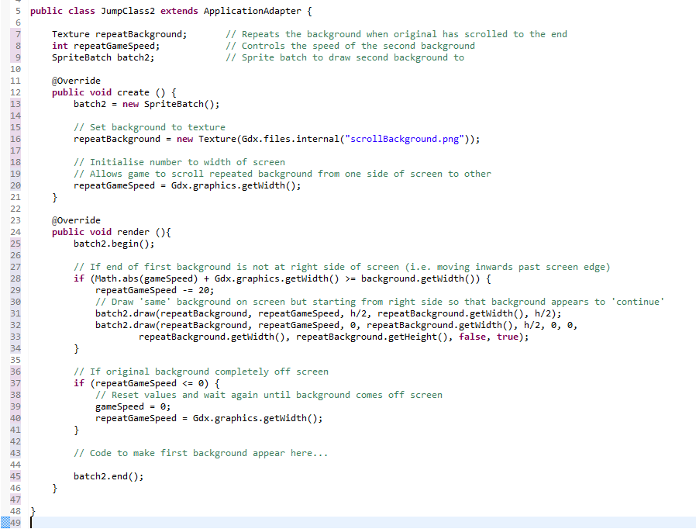
BACKGROUNDs (repeating)

Slide 15
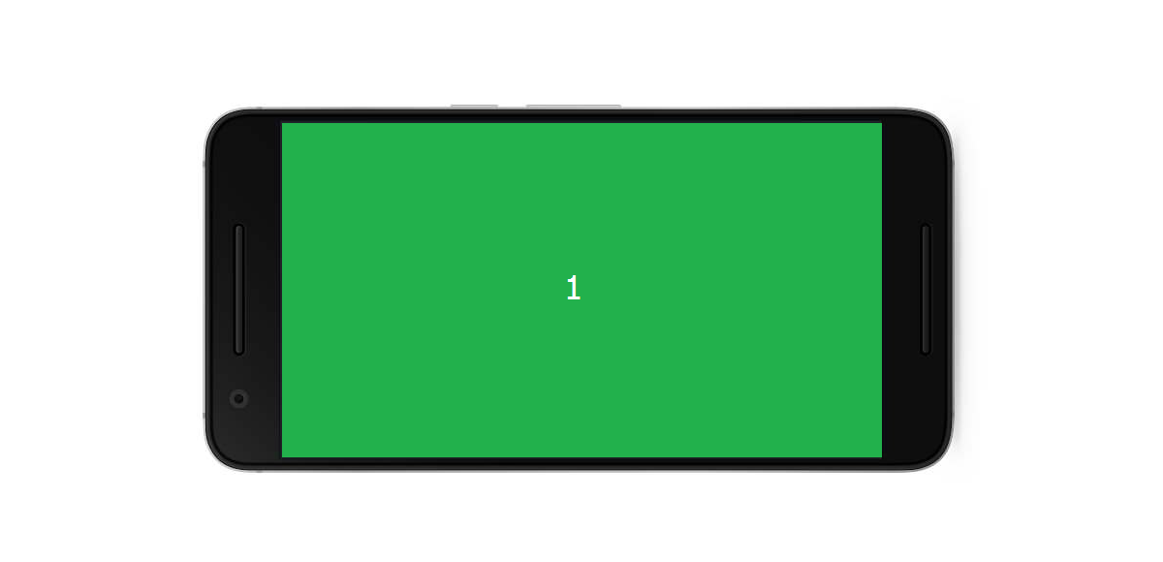

Slide 16
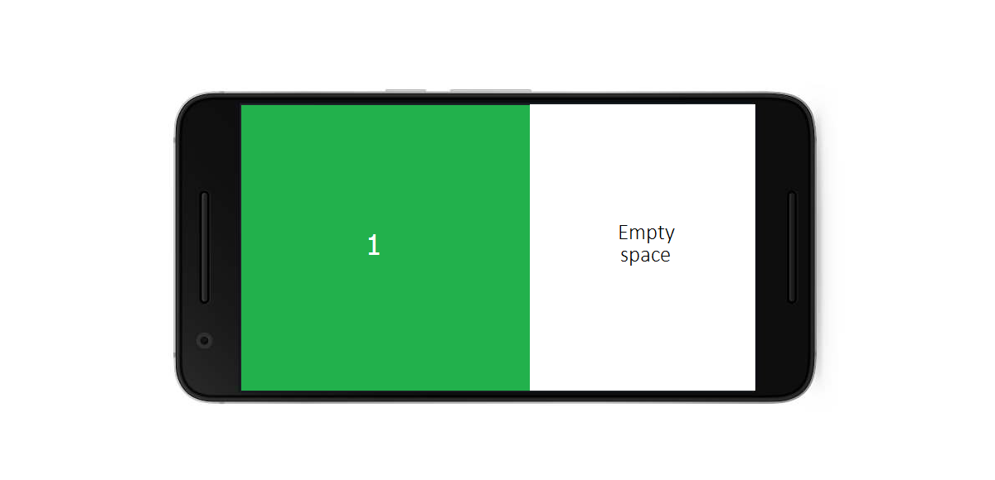

Slide 18
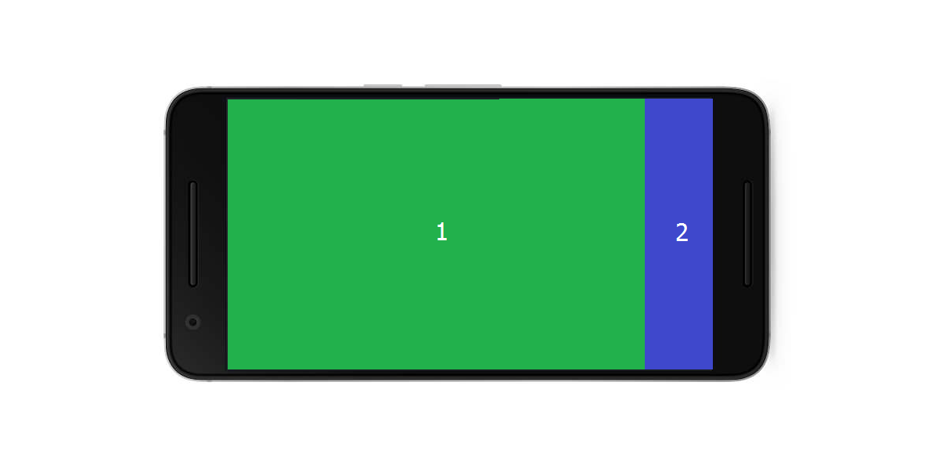

Slide 19
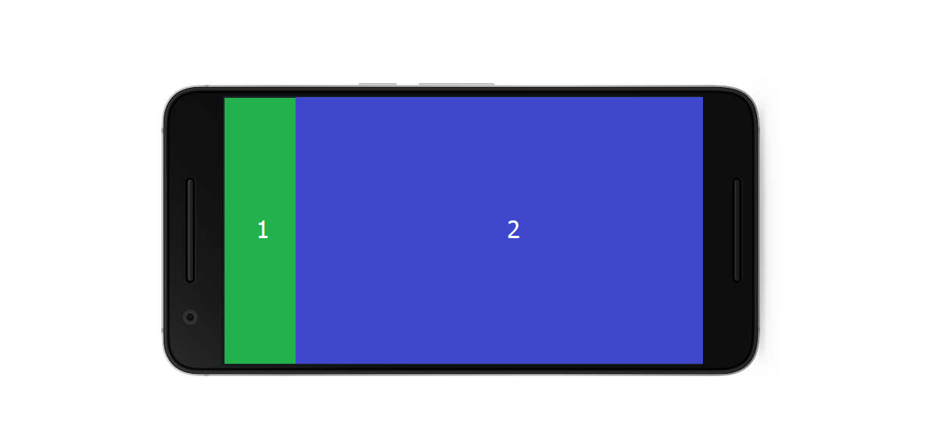

Slide 20
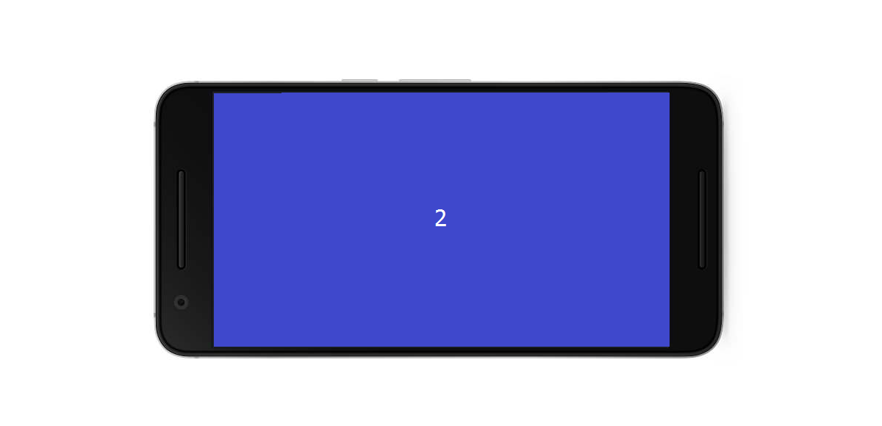

Slide 22
