Slide 1
Data Analytics
Water Quality Analysis
Name : Sai Sailaja Policharla SRN:PES1UG20CS671
Name : Nidhi S Sheth SRN:PES1UG20CS666
Name : Baddela Divya Malika SRN:PES1UG20CS540

Slide 2
Abstract and Scope
For humans to thrive and function, water is crucial.
Compounds like cadmium, mercury, arsenic, lead, fluorine, zinc, barium, nitrates, chlorine, etc. are the main contaminants of water.
Mineral concentrations in water can be tolerated up to a certain amount, but once that point is reached, it becomes extremely harmful and can disrupt the ecosystem that depends on these bodies of water.
The study focuses on determining whether or not water is fit for ingestion based on various compositions by employing a few machine learning models.

Slide 3
Implementation Details
Pseudo code
//Import the dataset
df = pd.read_csv('WaterQuality.csv',na_values = missing_value)
//EDA
Exploring the dataset
df = df.astype({'is_safe':'int’})
df.shape
df.isna().sum()
df = df.dropna()
df.isna().sum()
Transforming values
df["ammonia"] = df["ammonia"].apply(pd.to_numeric)

Slide 4
Implementation Details
//Feature Extraction
Pearson correlation
feature_correlation(X, y, method='mutual_info-classification')
//balancing the classes by performing PCA and then SMOTE
pca = decomposition.PCA(0.95)
print("Before PCA-",X1.shape)
X1 = pca.fit_transform(X1)
print("After PCA-",X1.shape)
//Using various Pre-defined ML model acts of training the and obtaining the performance metrics for all the models in similar fashion
model_lr1 = LogisticRegression()
model_lr1.fit(X_train, y_train)
predictions1 = model_lr1.predict(X_test)
cm = metrics.confusion_matrix(y_test,predictions1)
cm_display = metrics.ConfusionMatrixDisplay(confusion_matrix = cm, display_labels = [False, True])
cm_display.plot()
plt.savefig("confusion_matrix_no_pca.png")

Slide 5
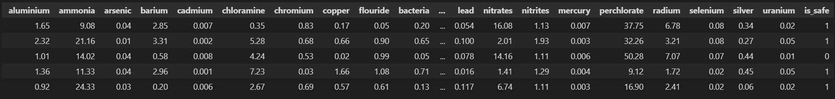
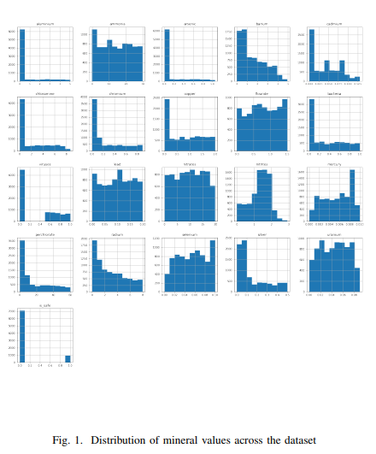
Project Demonstration
EDA
Data set contents
Distribution of mineral values across the dataset

Slide 6
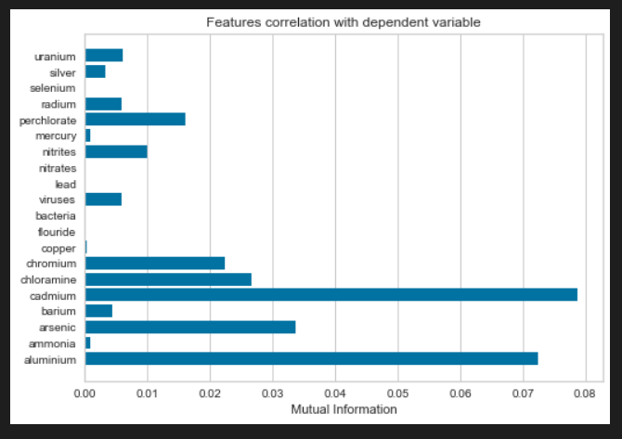
Project Demonstration
Feature Extraction
Pearson coefficient

Slide 7
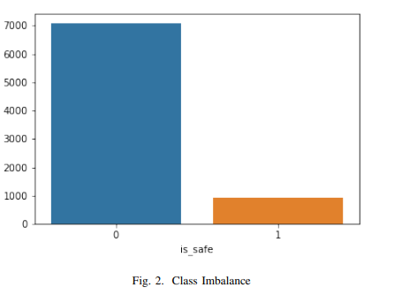
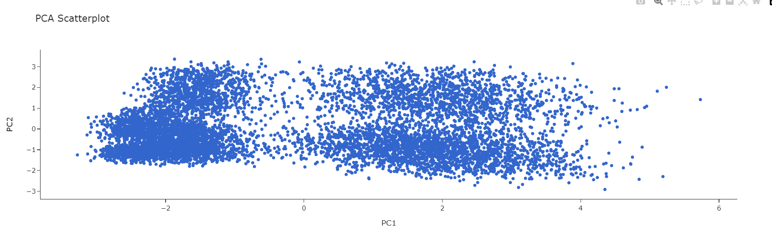
Project Demonstration
Class Balancing using PCA and SMOTE

Slide 8
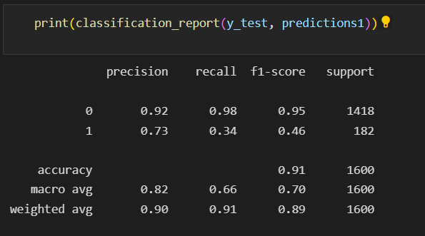
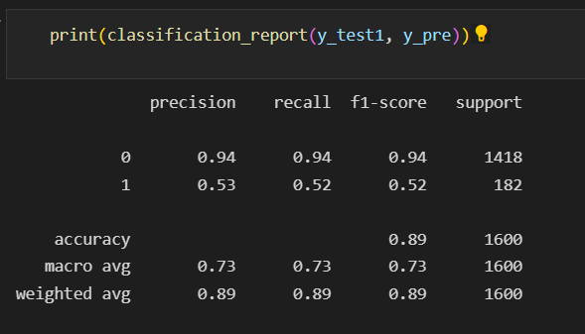
Project Demonstration
Performance Metrics for the models used.
Logistic Regression with only PCA Logistic Regression with SOMTE

Slide 9
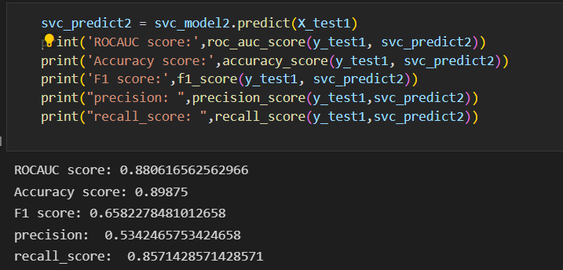
Project Demonstration
SVM

Slide 10
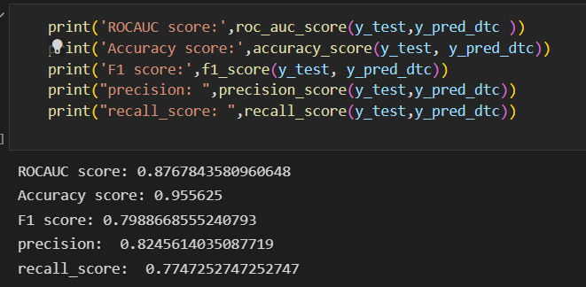
Project Demonstration
Desicion Tree

Slide 11
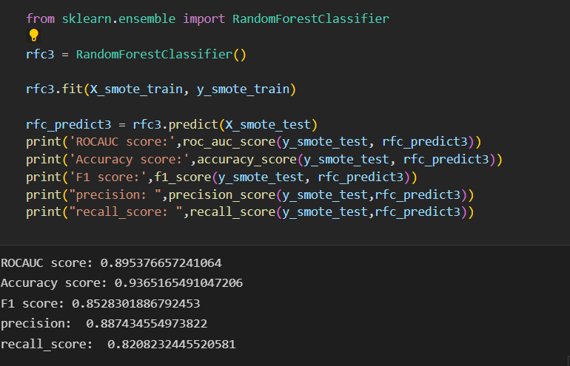
Project Demonstration
Random Forest

Slide 12
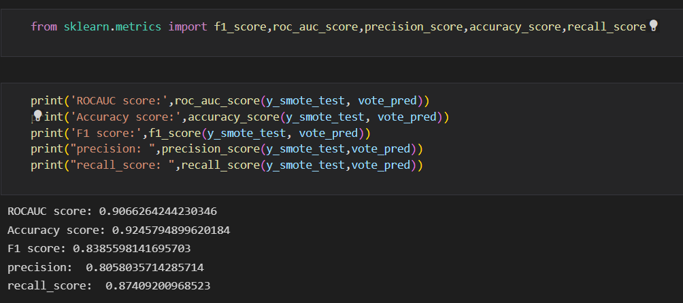
Project Demonstration
Ensemble Model

Slide 13
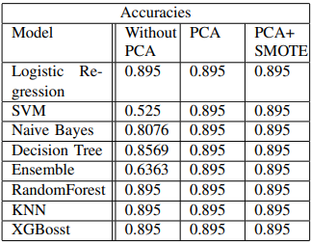
Results and Discussion
Results
After comparing different models with respect to the accuracies and metrics,
it can be observed that the metrics for models which were trained on PCA+SMOTE have an overall high accuracies.

Slide 14
Conclusion and Future work
We would like to extend the problem as to find better methods to deal with the data imbalance as SMOTE still synthetically oversampling which will add to the variance. Exploring or training models that perform better in presence of class imbalance.

Slide 15
References
[1] Naseriparsa, Mehdi and Kashani, Mohammad Mansour Riahi ”Combination of PCA with SMOTE resampling to boost the prediction rate in lung cancer dataset” , 2014.
[2] https://www.epa.gov/ccl/types-drinking-water-contaminants
[3] Y. Khan and C. S. See, ”Predicting and analyzing water quality using Machine Learning: A comprehensive model,” 2016 IEEE Long Island Systems, Applications and Technology Conference (LISAT), 2016, pp. 1-6, doi: 10.1109/LISAT.2016.7494106.
[4] Mozo, A., Moron-L ´ opez, J., Vakaruk, S. et al. Chlorophyll soft-sensor ´ based on machine learning models for algal bloom predictions. Sci Rep 12, 13529 (2022). https://doi.org/10.1038/s41598-022-17299-5
[5] Fitore Muharemi, Doina Logofatu, Florin Leon (2019) Machine learning ˘ approaches for anomaly detection of water quality on a real-world data set, Journal of Information and Telecommunication, 3:3, 294-307, DOI: 10.1080/24751839.2019.1565653
[6] T. Maruthi Padmaja, Bapi S. Raju, Rudra N. Hota, and P. Radha Krishna. 2014. Class imbalance and its effect on PCA preprocessing. Int. J. Knowl. Eng. Soft Data Paradigm. 4, 3 (August 2014), 272–294. https://doi.org/10.1504/IJKESDP.2014.064265

Slide 16
IEEE Draft
Display the draft of your project work in an IEEE template if you have prepared to submit it in a Conference/Journal.
Indicate the status of completion as well.
Download the IEEE conference template from the given link below,
https://www.ieee.org/content/dam/ieee-org/ieee/web/org/conferences/Conference-template-A4.doc
Mention the list of conferences/journals you are targeting for.

Slide 17
Thank You

