Slide 1
Activity Manager Analysis
Author: Gao, Carol
2012.05.10

Slide 2
Agenda
Profiling
Example

Slide 3
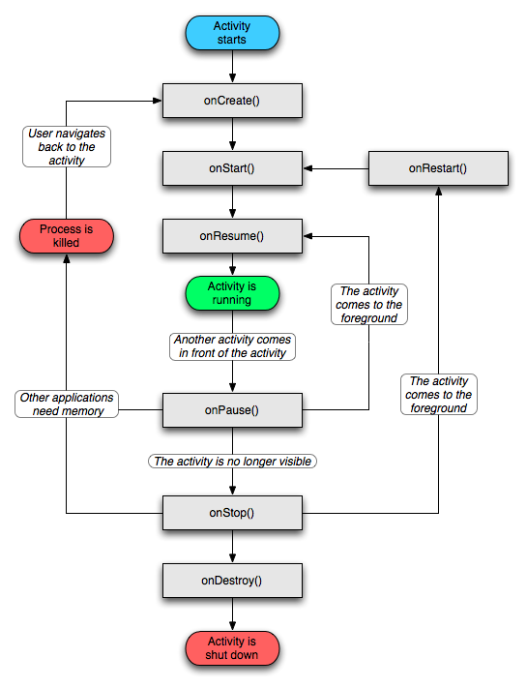
Activity Lifecycle

Slide 4
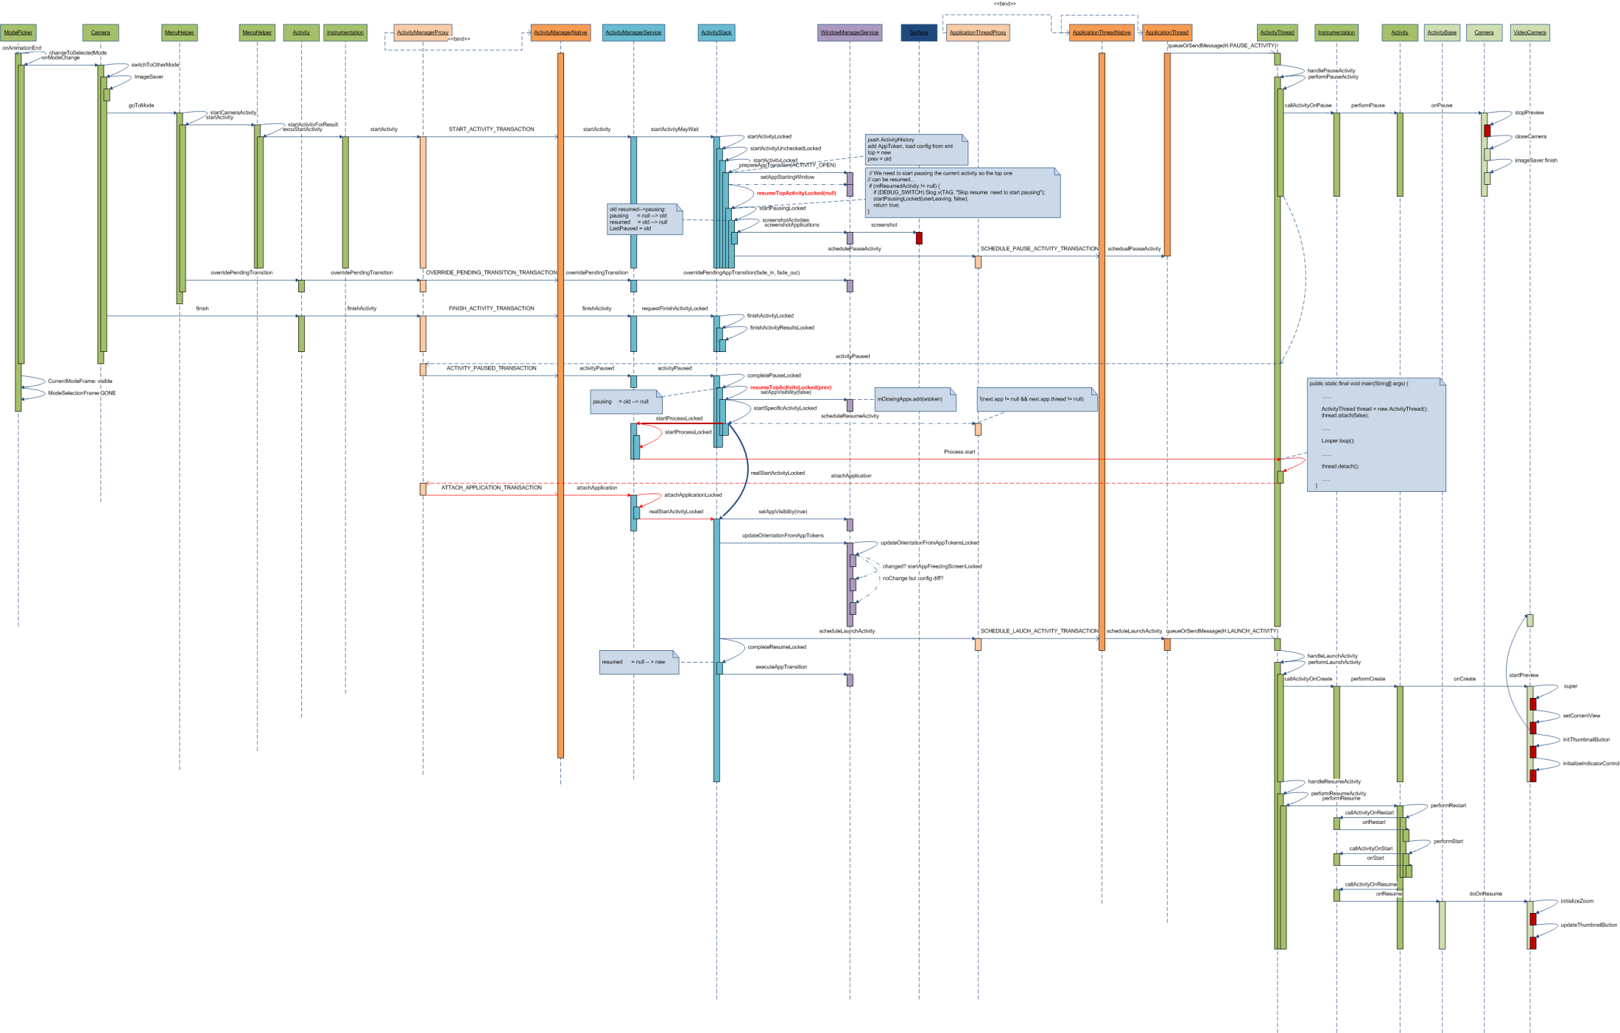
Profiling—Activity Manager

Slide 5
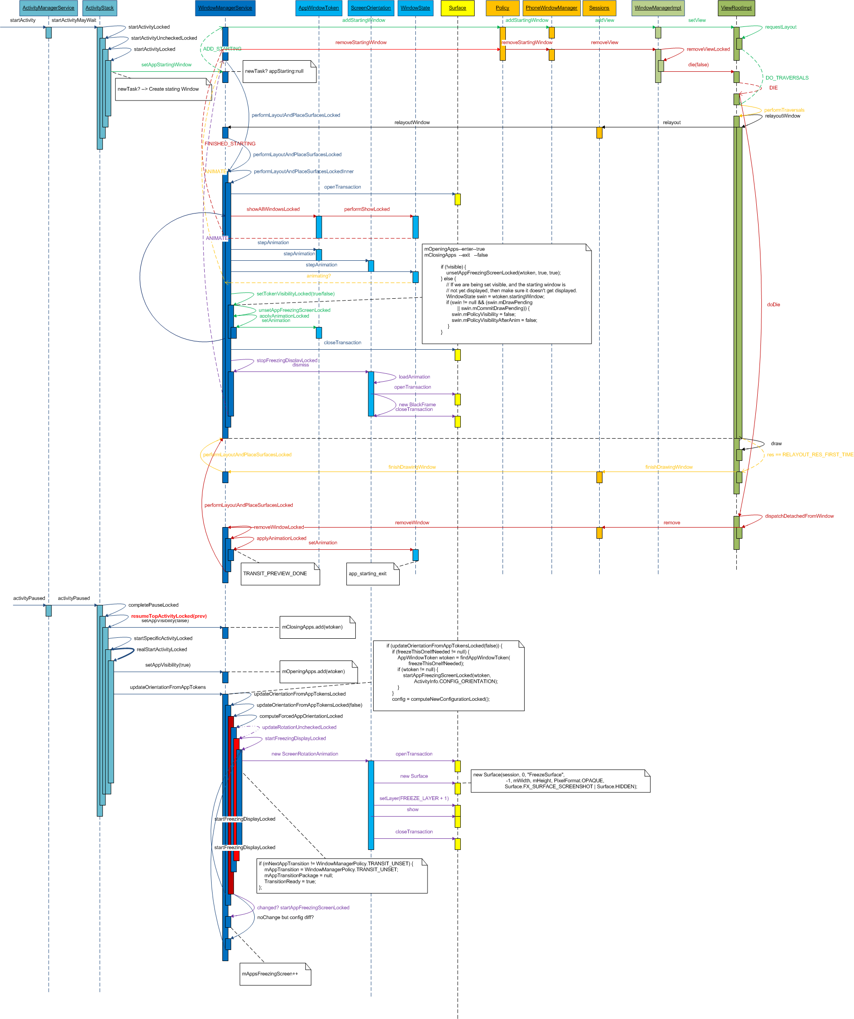
AM-WM animation

Slide 6
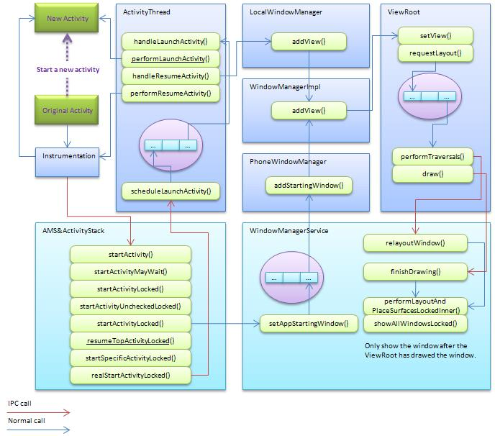
profiling

Slide 7
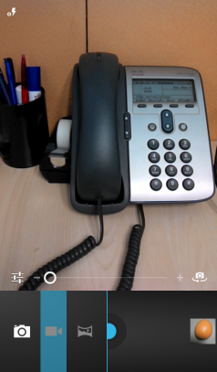
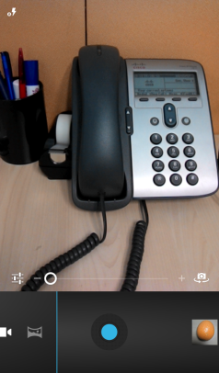
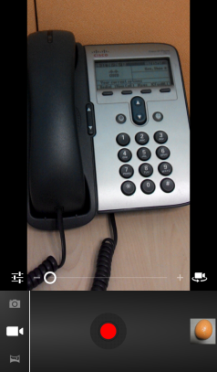
Example—camera mode picker
binder
message
animation
Input
Fadeout
StartActivity
HandlePauseActivity
Draw
HandleLaunchActivity
Draw
Animation
Image
Activity
startActivity
onPause
draw
pause
ActivityManager Service
Screen Shot
activityPaused
Orientation update
launch
update Landscape from AndoridManifest.xml
Video
Activity
onCreate
onResume
draw
Orientation update
Set as Portrait
Window
Manager
Service
Display freeze
alpha

Slide 8
Example—settings launch
Input
startActivity
Pause & Launch
animation
Launcher
startActivity
handlePauseActivity
pause
ActivityManager Service
Screen Shot
activityPaused
Settings
handleLaunchActivity
draw
next
Window
Manager
Service
ADD_STARTING
FINISHED_STARTING
AppStartingWindow
app_starting_exit
draw
Wallpapaer_close_exit/enter
alpha
scale
scale
alpha
alpha
alpha
binder
message
exit
animation
enter

Slide 9
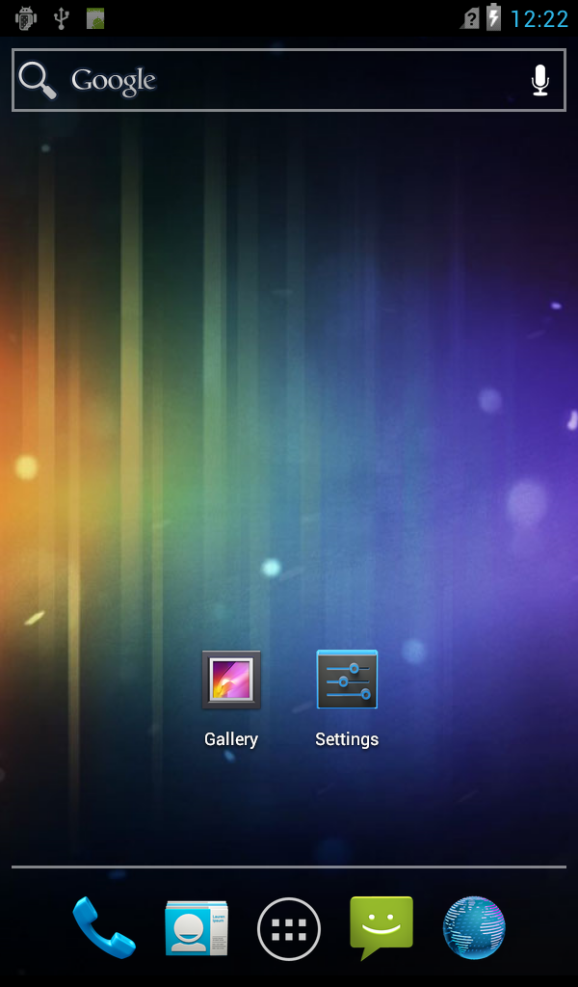
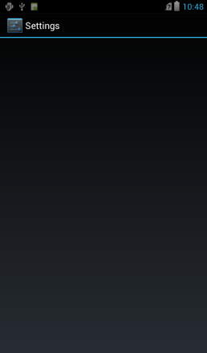
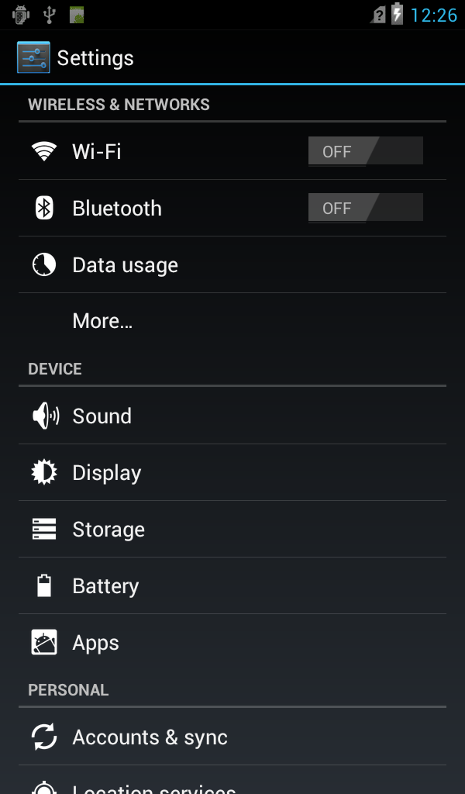
Example—animation of settings launch
Animations
wallpaper_close_exit alpha
200 ms
wallpaper_close_exit scale
300 ms
wallpaper_close_exit alpha
600 ms
wallpaper_close_enter alpha
300 ms
wallpaper_close_enter scale
240 ms
app_starting_exit alpha
160 ms

300*4 ms

Hide Scrollbar Indicator
250 ms
0
179
249
330
479
642
807
1449
Time (ms)
Hide scrollbar indicator in ListView after 1200ms
Notes:
9
Animation detailed in backup
Scrollbar in ListView would hide after 300*4ms

Slide 10
Thanks

