Slide 1






Video Driver Validation
- Error Concealment
Baowang Chi
WW45, Dec

Slide 2
Agenda
H.264 syntax and semantics
Error Concealment Scenario
Errors handled by driver
Related APIs in LIBVA

Slide 3
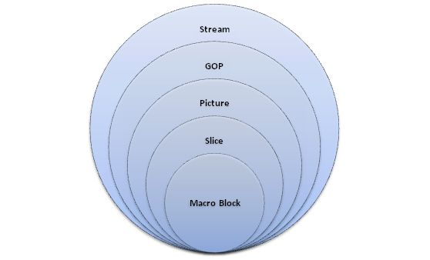
H.264 syntax and semantics
H.264 function:
  VCL(Video Codec Layer)
  NAL(Network Abstract Layer)
Structure of syntax
Notes:
在编码器输出的码流中，数据的基本单位是句法元素，每个句法元素由若干比特组成，它表示某个特定的物理意义，例如：宏块类型、量化参数等。句法表征句法元素的组织结构，语义阐述句法元素的具体含义。所有的视频编码标准都是通过定义句法和语义来规范编解码器的工作流程。
编码器输出的比特码流中，每个比特都隶属某个句法元素，也就是说，码流是由一个个句法元素依次衔接组成的，码流中除了句法元素并不存在专门用于控制或同步的内容。在H.264 定义的码流中，句法元素被组织成有层次的结构，分别描述各个层次的信息。
句法元素的分层结构有助于更有效地节省码流。例如，在一个图像中，经常会在各个片之间有相同的数据，如果每个片都同时携带这些数据，势必会造成码流的浪费。更为有效的做法是将该图像的公共信息抽取出来，形成图像一级的句法元素，而在片级只携带该片自身独有的句法元素。

Slide 4
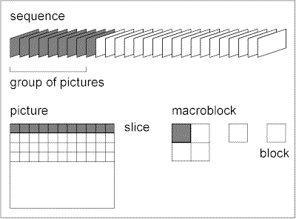
H.264 syntax and semantics
Structure of H.264 syntax
  Sequence
  Group of Picture
  Picture
  Slice
  MacroBlock

Slide 5
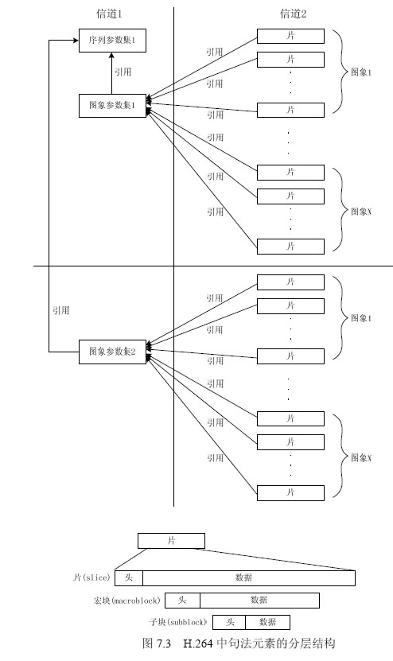
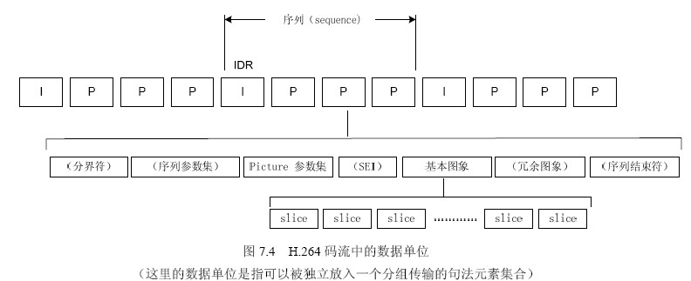
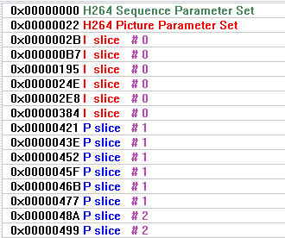
H.264 syntax and semantics
Notes:
H.264 中，分层结构最大的不同是取消了序列层和图像层，并将原本属于序列和图像头部的大部分句法元素游离出来形成序列和图像两级参数集，其余的部分则放入片层。参数集是一个独立的数据单位，不依赖于参数集外的其他句法元素。图7.3 描述了参数集与参数集外句法元素的关系，在图中我们可以看到，参数集只是在片层句法元素需要的时候被引用，而且，一个参数集并不对应某个特定的图像或序列，同一个序列参数集可以被多个序列中的图像参数集引用，同理，同一个图像参数集也可以被多个图像引用。只在编码器认为需要更新参数集的内容时，才会发送出新的参数集。在这种机制下，由于参数集是独立的，可以被多次重发或者采用特殊技术加以保护。
参数集与参数集外部的句法元素处于不同信道中，这是H.264 的一个建议，我们可以使用更安全但成本更昂贵的通道来传输参数集，而使用成本低但不够可靠的信道传输其他句法元素，只需要保证片层中的某个句法元素需要引用某个参数集时，那个参数集已经到达解码器，也就是参数集在时间上必须先被传送。当然，在条件不允许的情况下，我们也可以采用妥协的办法：在同一个物理信道中传输所有的句法元素，但专门为参数集采用安全可靠的通信协议，如TCP。
在编码时，H.264 的规范要求将参数集、片这些独立的数据单位尽可能各自完整地放入一个分组中被传送。
从表面上看来，H.264 关于参数集和片层的结构增加了编码后数据的冗余度,但这些技术的采用使得通信的鲁棒性大大增强，当数据传输中出现丢包，能够将使错误限制在最小范围，防止错误的扩散，解码后对错误的掩藏和恢复也能起到很好的作用。
一个序列的第一个图像叫做IDR 图像（立即刷新图像），IDR 图像都是I图像。H.264 引入IDR 图像是为了解码的重同步，当解码器解码到IDR 图像时，立即将参考帧队列清空，将已解码的数据全部输出或抛弃，重新查找参数集，开始一个新的序列。这样，如果在前一个序列的传输中发生重大错误，如严重的丢包，或其他原因引起数据错位，在这里可以获得重新同步。IDR 图像之后的图像永远不会引用IDR 图像之前的图像的数据来解码。

Slide 6

H.264 syntax and semantics
NALU(NAL unit)
  NAL Header
  RBSP(raw byte sequence payload): PS(SPS,PPS), SEI, Slice, End of Sequence, End of Stream, etc.
  Start Code Prefix : 0x000001
Nalu_type | semantic
01 | P-slice, B-slice
05 | I-slice
06 | SEI
07 | SPS
08 | PPS
09 | AU delimiter
Notes:
nalu 是H.264 的最高抽象层，H.264 的所有语法结构最终都被封装成nalu。
RBSP: 一个语法结构，包含整数个封装于NAL 单元中的字节.
在网络传输的环境下，编码器将每个NAL 各自独立、完整地放入一个分组，每个分组都有头部，解码器可以很方便地检测出NAL 的分界，依次取出NAL 进行解码。
如果编码数据存储在介质上，由于NAL 是依次紧密排列，解码器将无法在数据流中分辨每个NAL的起始和终止，所以必须要有另外的机制来解决这个问题。Start Code prefix.
nalu 有自己的语法元素，但是仅占用一个字节，即nalu 单元除了紧跟前缀码“00 00 01”之后的第一个字节外，其他载荷都是H.264 某种语法结构的有效载荷。
AU delimiter帧分界符
H.264 将构成一帧图像所有nalu 的集合称为一个AU，帧边界识别实际上就是识别AU。因为H.264 取消帧级语法，所以无法简单地从码流中获取AU。解码器只有在解码的过程中，通过某些语法元素的组合才能判断一帧图像是否结束。一般来说，解码器必须在完成一帧新图像的第一个slice_header 语法解码之后，才能知道前一帧图像已经结束。

Slide 7
Error Concealment Scenario
Bit stream storage and transmission
Real-time transmission over erroneous network
  Dynamic rate control
  Dynamic resolution change
  Error concealment
Notes:
For real-time transmission of video over networks, video bitrate must adapt to dynamic network bandwidth conditions during a call/session. If available bandwidth drops, it must drop the encoder bit rate, and potentially frame rate and resolution as well to maintain video quality. The coded slice size also must be limited and usually less than network MTU size to avoid large RTP packets in transmission modes that do not allow packet fragmentation.

Slide 8
Error Concealment Scenario
Error Concealment in our driver:
  VCM(Video conference mode)
  Missing or corrupted data must be detected and concealed without application intervention
  Report to application with indication of the affected macroblocks
  Provide APIs to allow the application to get the detailed information on the corrupted macroblocks
Notes:
During network transition, the data may be lost. The decoder must be resilient to errors in the input bitstream. Missing or corrupted data must be detected and concealed using temporal or spatial interpolation, or simply repetition using the nearest temporal and spatial reference data by the decoder without application intervention. It also needs a way to report to the application with indication of the affected macroblocks, so the application can request a refresh of the affected macroblocks from the peer to avoid error accumulation and propagation.
It is expected that the application will call the libVA interfaces to get the detailed information on the corrupted macroblocks, as the errors are only known after the hardware has finished decoding of the frame. The application typically calls vaSyncSurface() to make sure all pending hardware commands for decoding the frame has been completed, and this function will now return a new error code to indicate that the frame has a number of corrupted macroblocks.

Slide 9
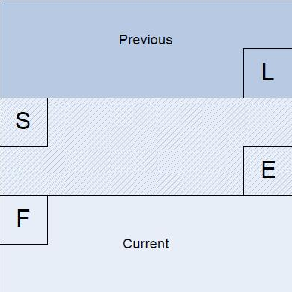
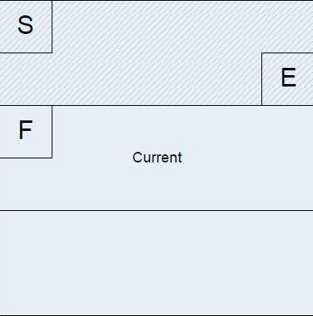
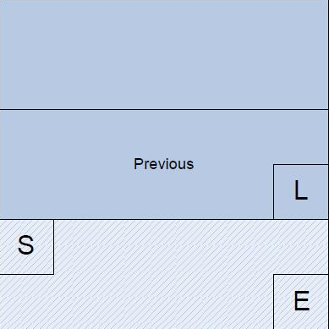
Errors handled by driver
Missing Frames, all slices of a frame lost.
Missing slices:
  Missing mid slice of frame
  Missing first slice of frame
  Missing end slice of frame
Notes:
The firmware has the ability to detect and warn the host that a slice is missing, this is detected by a slice being non contiguous with the previous slice. The message sent to the host will contain the start and end macroblock number for the missing range ( where this is detectable ) .This can only be done in frame switching mode and where the slices are guaranteed to be consecutive
Mid slice contiguity issues are detected by checking that the a slice starts on the macroblock immediately following the last macroblock decoded by the previous slice
No checks are performed on a slice that starts at macroblock 0, however the mid frame slice loss code will detect the loss of the first slice.
On reception of a FW_DEVA_HOST_BE_OPP message, the firmware will check that the previous slice finished on the last macroblock of the frame.

Slide 10
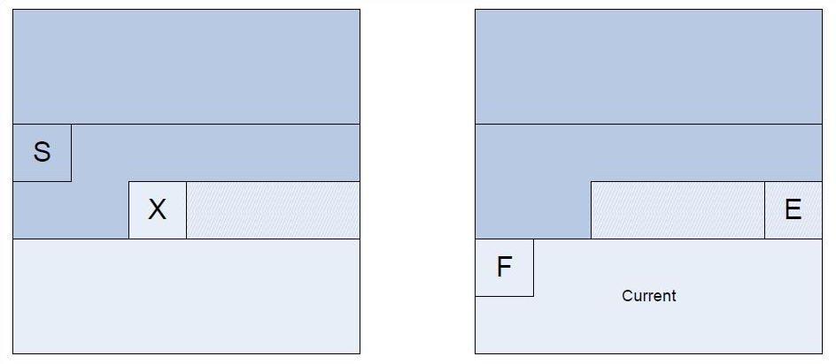
Errors handled by driver
Error Detection
  The diagram above shows the macroblocks S and X which are returned to the host in the panic message. The contiguity warning will provide the end Macroblock E which allows the host to determine that the range in error is from X to E.
Notes:
When errors are detected, the firmware will return a panic message to the host. This will contain the number of the last macroblock processed by the back end and also the first macroblock of the slice that faulted.
On continuation of decode after the core reset, a continuity warning will be sent which will indicate the end location of the fault range.
These two messages will allow the host code to determine the fault range, and make a decision on what to conceal.
Due to the many possible types of error that may be present in the bitstream, it is not always possible to trust the faulted macroblock value returned from the host in the panic message ( X ). It is therefore necessary for the host code to validate the values and make adjustments to the values.

Slide 11
Error handled by driver
Slice layer encode/decode
Input Macroblock
header and data
into driver
➔ Introduce errors
into MB header and
MB data or abandon
the whole slice for testing.

Slide 12
Errors handled by driver
Examples in our test:
  I frame, P frame
  First slice, mid slice, end slice
  First MB, mid MB, end MB
  Etc.

Slide 13
Related APIs in LIBVA
Error status to indicate that the frame contains corrupted MBs:
    VA_STATUS_ERROR_DECODING_ERROR
How to get the error status if there are corrupted MBs in the frame:
    vaSyncSurface()
To get further details on the particular error, call
    vaQuerySurfaceError(
        VADisplay dpy,
        VASurfaceID surface,
        VAStatus error_status,
        void **error_info
        );

Slide 14
Related APIs in LIBVA
The detailed error information will be stored in the structure pointed by “error_info”, the structure is defined in LIBVA as:
      typedef struct _VASurfaceDecodeMBErrors
      {
      int status; /* 1 if hardware has returned detailed info below, -1 means this record is invalid */
      unsigned int start_mb; /* start mb address with errors */
      unsigned int end_mb; /* end mb address with errors */
      VADecodeErrorType decode_error_type;
      } VASurfaceDecodeMBErrors;
Notes:
upon returning from this function, “error_info” will point to an array of data structure which is allocated and filled by libVA with detailed information on the missing or error macroblocks.

Slide 15
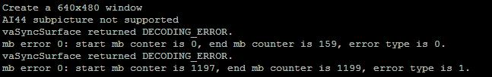
Examples:
For clip “cbw_1205frame_640x480_8slices_frame0_slice0_frame99_slice7_mb1199-1120&1199.264”

Slide 16
Q&A
Thanks!
Baowang Chi

