Slide 1

Care about android phone PR2 USB features---HNP, SRP UMG-YANG BO
.

Slide 2
Targets
Destination:
Your Puzzles: Distinguish all kinds of USB cables.
What is the OTG?
Understand your popular android phone USB features---SRP, HNP.
Solve your common issue---ADB detection.

Slide 3
Do you know the cable on your hand now???
Now, many kinds of USB cables on our lab, we are confused by these cables. And for some special cases, we also used some new cables, for examples, special cable A that is different from Nokia A cable.
For android phones, many products or test modes use the micro cables. So distinguishing your cables.

Slide 4
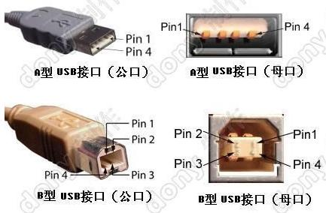
Common USB cables (1)

Slide 5
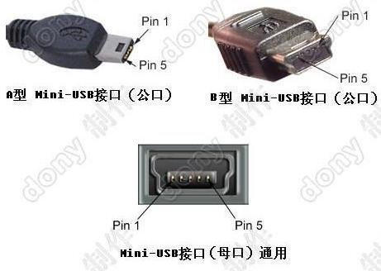
Common USB cables (2)

Slide 6
What is the OTG?
OTG:
OTG complies with USB2.0 spec.
These non-PCs have the computing resources to manage a USB host function, but they need to function in ways that differ from standard PC hosts. Although they will provide host capability for some devices, it's unreasonable to require them to support the full range of USB peripherals.
Simple example.
your camera with printer. You will connect your camera to printer directly and your printer will print the photos from your camera without PC.
Two MP3s. These two MP3 should be OTG devices. They will be transfer data directly.

Slide 7
A-Devices and B-Devices
OTG devices: A-deices and B-devices:
OTG devices distinguish A/B devices based on ID pin on plug. ID pin connecting ground is A-device(Host), and ID pin hanging in air is B-device(Slave). And both two OTG devices connected, A devices always provide power to B devices. Especially, A-devices can change the host role with B-devices with new protocol HNP.
Difference between OTG host and Embedded Host:
OTG devices will turn on Vbus, if they are plugged cables. And will turn off Vbus. If they detect no devices. Bug EH will not.

Slide 8
Android phone PR2---SRP(1)
SRP:
The Session Request Protocol (SRP) allows a B-device to request the A-device to turn on VBUS and start a session. This protocol allows the A-device, which may be battery powered, to conserve power by turning VBUS off when there is no bus activity while still providing a means for the B-device to initiate bus activity.

Slide 9
Android phone PR2---SRP(2)
OTG with SRP :
OTG Host connect only B-device(plug A is cable). Host detect A plug, stop ADP, turn on Vbus. At this time B-device maybe connect A cable, so A turn off Vbus for timeout. B really connect A cable causing ADP changing, A will turn Vbus, and start to enumeration.
OTG connect OTG. Host detect A plug, turn on Vbus. If no B device, turn off Vbus. Turn on ADP Probing. However, B device detect plug, turn on SRP, but A and B still disconnect, SRP timeout, and turn on ADP Probing. When A connect B. B turns on SRP for ADP changing, and sent SRP to request A turn on Vbus. A responds SRP and turn Vbus.

Slide 10
Android phone PR2---SRP(3)
How to operator in Linux level?
A device plug A cable, and check ‘hsm’ interface, its status is a_wait_bconn.
B device plug B cable, and check ‘hsm’ interface, its status is ‘b_idle’.
Connect B device to A device. And check their statuses. A device status ‘a_host’ and B device status is ‘b_ peripheral’.
echo 1 > a_bus_drop on A device. Check A device status, it will be a_idle. And B device status is b_idle.
echo 0 > a_bus_req and echo 0 > a_bus_drop on A device and echo 1 > b_bus_req on B device. Check their statuses. A device status is ‘a_host’ and B device status is ‘b_peripheral’.

Slide 11
Android phone PR2---HNP(1)
HNP:
Since On-The-Go devices have a Micro-AB receptacle, an On-The-Go device can default to being either Host or Peripheral, depending upon which type of plug (Micro-A plug for Host, Micro-B plug for Peripheral) is inserted. By utilizing the Host Negotiation Protocol (HNP), an On-The-Go B-device, which is the default Peripheral, may make a request to be Host. The process for this exchange of the role of Host is described in this section. This protocol eliminates the need for the consumer to swap the cable connection in order to change the roles of the connected devices.

Slide 12
Worry about My XP/WIN7 can’t detect ADB(1)
Since PR2 come, many developers and testers WINDOWS OS can’t detect PR2 with ADB, or ‘adb devices offline’. It was a critical bug. And now we can simply understand this issue we often meet.

Slide 13
Worry about My XP/WIN7 can’t detect ADB(2)
Issue on Windows
Microsoft MSDN has clear statement that a composite USB device with multi-configuration can’t be recognized successfully as a composite device, that is, only the first function of the device will be enumerated, and all the other functions in that device will be discarded by Windows. Device manufacture has to provide their own specific INF file in order to fix this issue. That’s why gadget_multi.inf is needed in this document. If one could read through the following links and understand more about composited device enumeration process on Windows, it’d be very helpful to fix the issues during driver installation by yourself.

Slide 14
Worry about My XP/WIN7 can’t detect ADB(3)
Issue on PR2
According to the developer debugged. They made sure host send signal, but PR2 didn’t respond during ADB processing. So the different USB driver and different ADB version will cause this issue. So we should always update our ADB.

Slide 15
Worry about My XP/WIN7 can’t detect ADB(4)
How to solve it?
(1)Install WINDOWS ADB
It will not be necessary to use all android SDK package to install ADB. Put ‘adb.exe’ ‘AdbWinApi.dll’ ‘AdbWinUsbApi.dll’ files on C:
(2)Update your drivers
Connect you pr2 to WINDOWS.
You will find ‘USB Mass Storage’ on Device Manager. And update it with new driver---’gadget_multi.inf’.
You will find new driver ‘Android Phone’ and it will not work normally.
Update this driver with new driver---’ android_winusb.inf’

Slide 16
Thanks your coming!!!
Connect me:
Email: box.x.yang@intel.com
Tel: 13311037917

