Slide 1
AV_Streaming jintao.bai March, 2012

Slide 2
Agenda
Introduction
Summary
Http streaming work flow Brief
RTSP streaming work flow Brief
Http live streaming work flow Brief
Q & A

Slide 3
The way of Playing multimedia:
Not real-time way:
When all the multimedia files downloaded to your local disk and then play the file.
Real –time way:
Play the multimedia files during downloading multimedia files.

Slide 4
Streaming
Streaming definition
Streaming refers to using streaming media formats to play in the Internet.
Streaming characteristic
Streaming not need to downloaded all the multimedia files before playing multimedia files. Client can Play the multimedia files during downloading multimedia files.
The way of transfer streaming :
progressive streaming:http,quality is better
Realtime streaming:rtsp, speed is better

Slide 5
Agenda
Introduction
Summary
Http streaming work flow Brief
RTSP streaming work flow Brief
Http live streaming work flow Brief
Q & A

Slide 6
three most widely used streaming protocol
HTTP progressive streaming protocol.
Realtime streaming protocol based on RTSP/RTP.
3. HTTP live streaming protocol introduced by apple.

Slide 7
Agenda
Introduction
Summary
Http streaming work flow Brief
RTSP streaming work flow Brief
Http live streaming work flow Brief
Q & A

Slide 8
Http streaming introduction
This is the simplest and cheapest way to stream video from a website.
For this method you don't need any special type of website or host . just a host server which recognise common video file types . You also need to know how to upload files and how to create hyperlinks.
Client can play the multimedia files during downloading multimedia files.

Slide 9
http Streaming process.
1、The user to select a first-class media services between Web browsers and Web servers use HTTP / TCP to exchange control information to the need to transfer real-time data retrieved from the original information;
2、The the Web browser to start the audio and video client using HTTP from a Web server to retrieve parameters of audio and video client initialization, these parameters may include directory information, the type of encoding of audio and video data or audio and video retrieval server address;
3、 audio and video client and audio and video server is running real-time streaming protocol to exchange control information required for audio and video transmission, real-time streaming protocol to perform the play, fast forward, rewind, pause and record the method of the command;
4、audio and video server uses the RTP / UDP protocol transmission of audio and video data to the audio and video client, once the audio and video data arrived at the client program to play the output of audio and video customers.

Slide 10
Agenda
Introduction
Summary
Http streaming work flow Brief
RTSP streaming work flow Brief
Http live streaming work flow Brief
Q & A

Slide 11
RTSP streaming introduction
Real Time Streaming Protocol RTSP is an application layer protocol used to control the transmission of data with real-time characteristics (such as multimedia streaming). For multimedia data streams to provide remote control functions, such as play, stop. The agreement supports the following operations.
RTSP protocol is generally associated with the underlying protocol such as RTP / RTCP and RSVP to work together to provide a comprehensive set of Internet-based streaming service. It can choose to send the channel (eg: UDP, multicast UDP and TCP) and the delivery mechanism based on RTP.

Slide 12
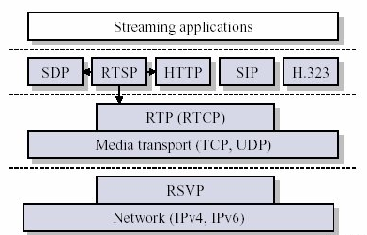
streaming architecture.

Slide 13
UDP、TCP、RTP、RTCP、RSVP protocol
UDP protocol : UDP is a connectionless transport layer protocol in the OSI reference model, provided a simple transaction-oriented unreliable messaging services.
TCP protocol :TCP is transmission Control Protocol . TCP is oriented to connection (connection-oriented), and a reliable byte stream transport layer (Transport layer) communication protocol.
RTP protocol : RTP full name is Real-time Transport Protocol, (Real-time Transport Protocol)
RTCP protocol : Main functions of RTCP are quality of service monitoring and feedback, media synchronization, and the identity of the members of the multicast group.
RSVP protocol : RSVP is Resource Reservation Protocol. It works below the IP layer and above the transport layer, a network control protocol.

Slide 14
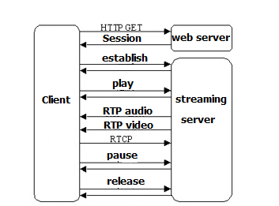
The RTSP functional chart.

Slide 15
Agenda
Introduction
Summary
Http streaming work flow Brief
RTSP streaming work flow Brief
Http live streaming work flow Brief
Q & A

Slide 16
Introduction
HTTP Live Streaming lets you send audio and video over HTTP from an ordinary web server for playback on iOS-based devices—including iPhone, iPad, iPod touch, and Apple TV—and on desktop computers (Mac OS X). HTTP Live Streaming supports both live broadcasts and prerecorded content (video on demand). HTTP Live Streaming supports multiple alternate streams at different bit rates, and the client software can switch streams intelligently as network bandwidth changes. HTTP Live Streaming also provides for media encryption and user authentication over HTTPS, allowing publishers to protect their work.

Slide 17
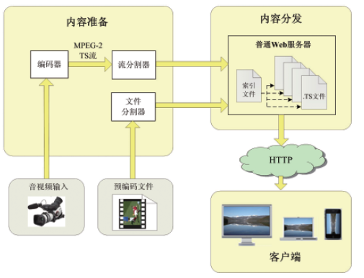
Http live streaming System architecture

Slide 18
Components prepare
1、Download the http live streaming tool to windows OS:
Get the package from: http://172.16.123.119/httplive/HLS_tool.zip
2、Uncompress HLS_tool.zip. ffmpeg.exe、neroAacEnc.exe、segmenter.exe、x264.exe。
3. Extract WAV file from original video:
ffmpeg.exe -i INPUT.MP4 -vn -acodec pcm_s16le AUDIO.WAV
4、Produce an AAC file:
neroAacEnc.exe -cbr 64000 -he -if AUDIO.WAV -of AUDIO.AAC
5、Choose a bitrate, and encode the video for one of those bitrates：
x264.exe --level 30 --profile baseline --bitrate 96 --keyint 30 -o LOW.MP4 INPUT.MP4
6、Mux the audio and video together to produce an MPEG2 Transport Stream:
ffmpeg.exe -i LOW.MP4 -i AUDIO.AAC -f mpegts -vcodec copy -acodec copy -vbsf h264_mp4toannexb VIDEO-96KB.TS
7、Segment the stream: segmenter.exe VIDEO-96KB.TS 10 Kauai_HLS/LOW Kauai_HLS/LOW-96KB.m3u8 http://172.16.123.146/http/clips/

Slide 19
M3U8 index file
#EXTM3U
#EXT-X-TARGETDURATION:10
#EXTINF:10,
http://192.168.11.5/httplive/284-hls-he-aac/284-1280x544-800kb-1.ts
#EXTINF:10,
http://192.168.11.5/httplive/284-hls-he-aac/284-1280x544-800kb-2.ts
#EXTINF:10,
………………………………………
http://192.168.11.5/httplive/284-hls-he-aac/284-1280x544-800kb-10.ts
#EXT-X-ENDLIST

Slide 20
Components Distribution
The distribution system is a web server or a web caching system that delivers the media files and index files to the client over HTTP.
Prepare the this web server
Modify linux Apache server httpd.conf file, Add below sentence into httpd.conf :
AddType application/x-mpegURL .m3u8
AddType video/MP2T .ts

Slide 21
Deploying HTTP Live Streaming
Creating an HTML Page:
<html>
<head>
<meta http-equiv="Content-Type" content="text/html; charset=utf-8">
</head>
<body>
<div style=" text-align:center">
<video width='500' height='400' src="284-1280x544-800kb.m3u8" controls autoplay ></video>
</div>
</body>
</html>

Slide 22
Create a variable rate HTTP stream
Once you have creating a single stream down you need to try out creating a variable bitrate stream. There isn't much to it, just create different bitrate encoded streams and link to their stream definition files in a separate stream definition file. Here is an example:
[root@video-machine kauai_HLS]# cat kauai_video_play.m3u8
#EXTM3U
#EXT-X-STREAM-INF:PROGRAM-ID=1, BANDWIDTH=256000
http://172.16.123.146/http/clips/kauai_HLS/Medium_256KB.m3u8
#EXT-X-STREAM-INF:PROGRAM-ID=1, BANDWIDTH=800000
http://172.16.123.146/http/clips/kauai_HLS/High_800KB.m3u8
#EXT-X-STREAM-INF:PROGRAM-ID=1, BANDWIDTH=96000
http://172.16.123.146/http/clips/kauai_HLS/LOW_96KB.m3u8
#EXT-X-ENDLIST

Slide 23
encryption streaming
1. You can protect your media by encrypting it. You can encrypt streaming with OpenSSL tool.
Create one m3u8 file of encryption streaming
root@video-machine kauai_HLS]# cat kauai_High_enc.m3u8
#EXTM3U
#EXT-X-TARGETDURATION:10
#EXT-X-KEY:METHOD=AES-128,URI="static.key"
#EXTINF:10,
http://172.16.123.146/http/clips/kauai_HLS/kauai_High_800KB_enc-1.ts
…………..
http://172.16.123.146/http/clips/kauai_HLS/kauai_High_800KB_enc-19.ts
#EXT-X-ENDLIST

Slide 24
Deploying HTTP Live Encryption Streaming
Creating an HTML Page:
[root@video-machine kauai_HLS]# cat test_enc.html
<html>
<head>
<meta http-equiv="Content-Type" content="text/html; charset=utf-8">
</head>
<body>
<div style=" text-align:center">
<video src="kauai_High_enc.m3u8" controls autoplay ></video>
</div>
</body>
</html>

Slide 25
Q & A

Slide 26
Thank you all!

Slide 27


