Slide 1
Joy of Async programming ☺
Introduction to NodeJS

Slide 2

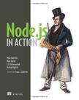
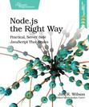
Notes:
Demo
➜ chat find . -type f | grep -v node_modules | grep -v package.json | xargs wc -l
112 ./lib/chat_server.js
53 ./public/stylesheets/style.css
43 ./public/javascripts/chat.js
79 ./public/javascripts/chat_ui.js
34 ./public/index.html
60 ./server.js
381 total

Slide 3
Another language ?
TIOBE
PHP(7) – Python(8) – Ruby(11)
Javascript: 9
MATLAB(18) – R(40)
Lua(35) – Go(36) – Erlang(50)
Lisp(16) - Scala(48) – Haskell(>50)
Notes:
http://www.tiobe.com/index.php/content/paperinfo/tpci/index.html
http://www.tiobe.com/index.php/content/paperinfo/tpci/JavaScript.html

Slide 4
History
Chrome V8 – Started from 2008
Chrome speed test
NodeJS
Started from 2009
Published in 2011 MIT, npm
Roadmap
ES6 (Harmony)
Notes:
Chrome speed test: https://www.youtube.com/watch?v=nCgQDjiotG0
Dart, 2011 – replacement for client side of js – 1.3 Apri 9 2014 - Lingua franca(bridge language) for JS
CoffeeScript
http://venturebeat.com/2011/11/28/node-is-one-of-the-cool-kids-now/
http://wiki.ecmascript.org/doku.php?id=harmony:specification_drafts
https://wiki.mozilla.org/ES6_plans
http://globaldev.co.uk/2013/09/es6-part-1/
http://en.wikipedia.org/wiki/ECMAScript
http://en.wikipedia.org/wiki/Ecma_International ECMA-262
Joyent: Found in 2004
https://github.com/joyent/node/wiki#the-future

Slide 5
WWW (Who When Where)
What it really means is that Node.js is not a silver-bullet new platform that will dominate the web development world. Instead, it’s a platform that fills a particular need.
Data-intensive Real-time
Notes:
https://github.com/joyent/node/wiki/Projects,-Applications,-and-Companies-Using-Node
http://www.quora.com/Node-js/What-are-the-biggest-websites-built-with-Node-js-on-the-server-side

Slide 6


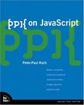


Javascript 101
Var/if/for/object(JSON)/prototype/constructor/this/scope
Brower site DOM: getElementById/window/eventListener
Object Oriented vs. Functional language
Distinctive
Good and Bad Parts
Notes:
http://book.douban.com/subject/1232061/
http://book.douban.com/subject/2994925/
http://book.douban.com/subject/1808399/
http://book.douban.com/subject/2084131/
http://book.douban.com/subject/3686503/

Slide 7
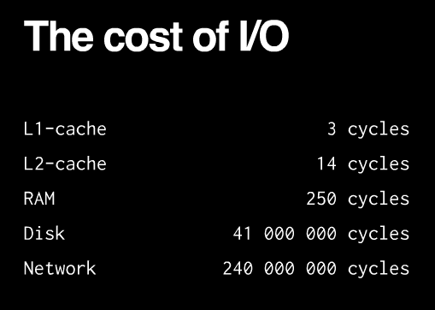
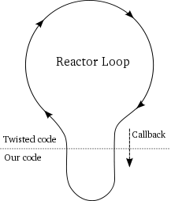
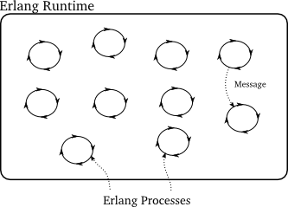
Event loop
Notes:
CPU/MEM/IO
C10K: http://www.kegel.com/c10k.html

Slide 8
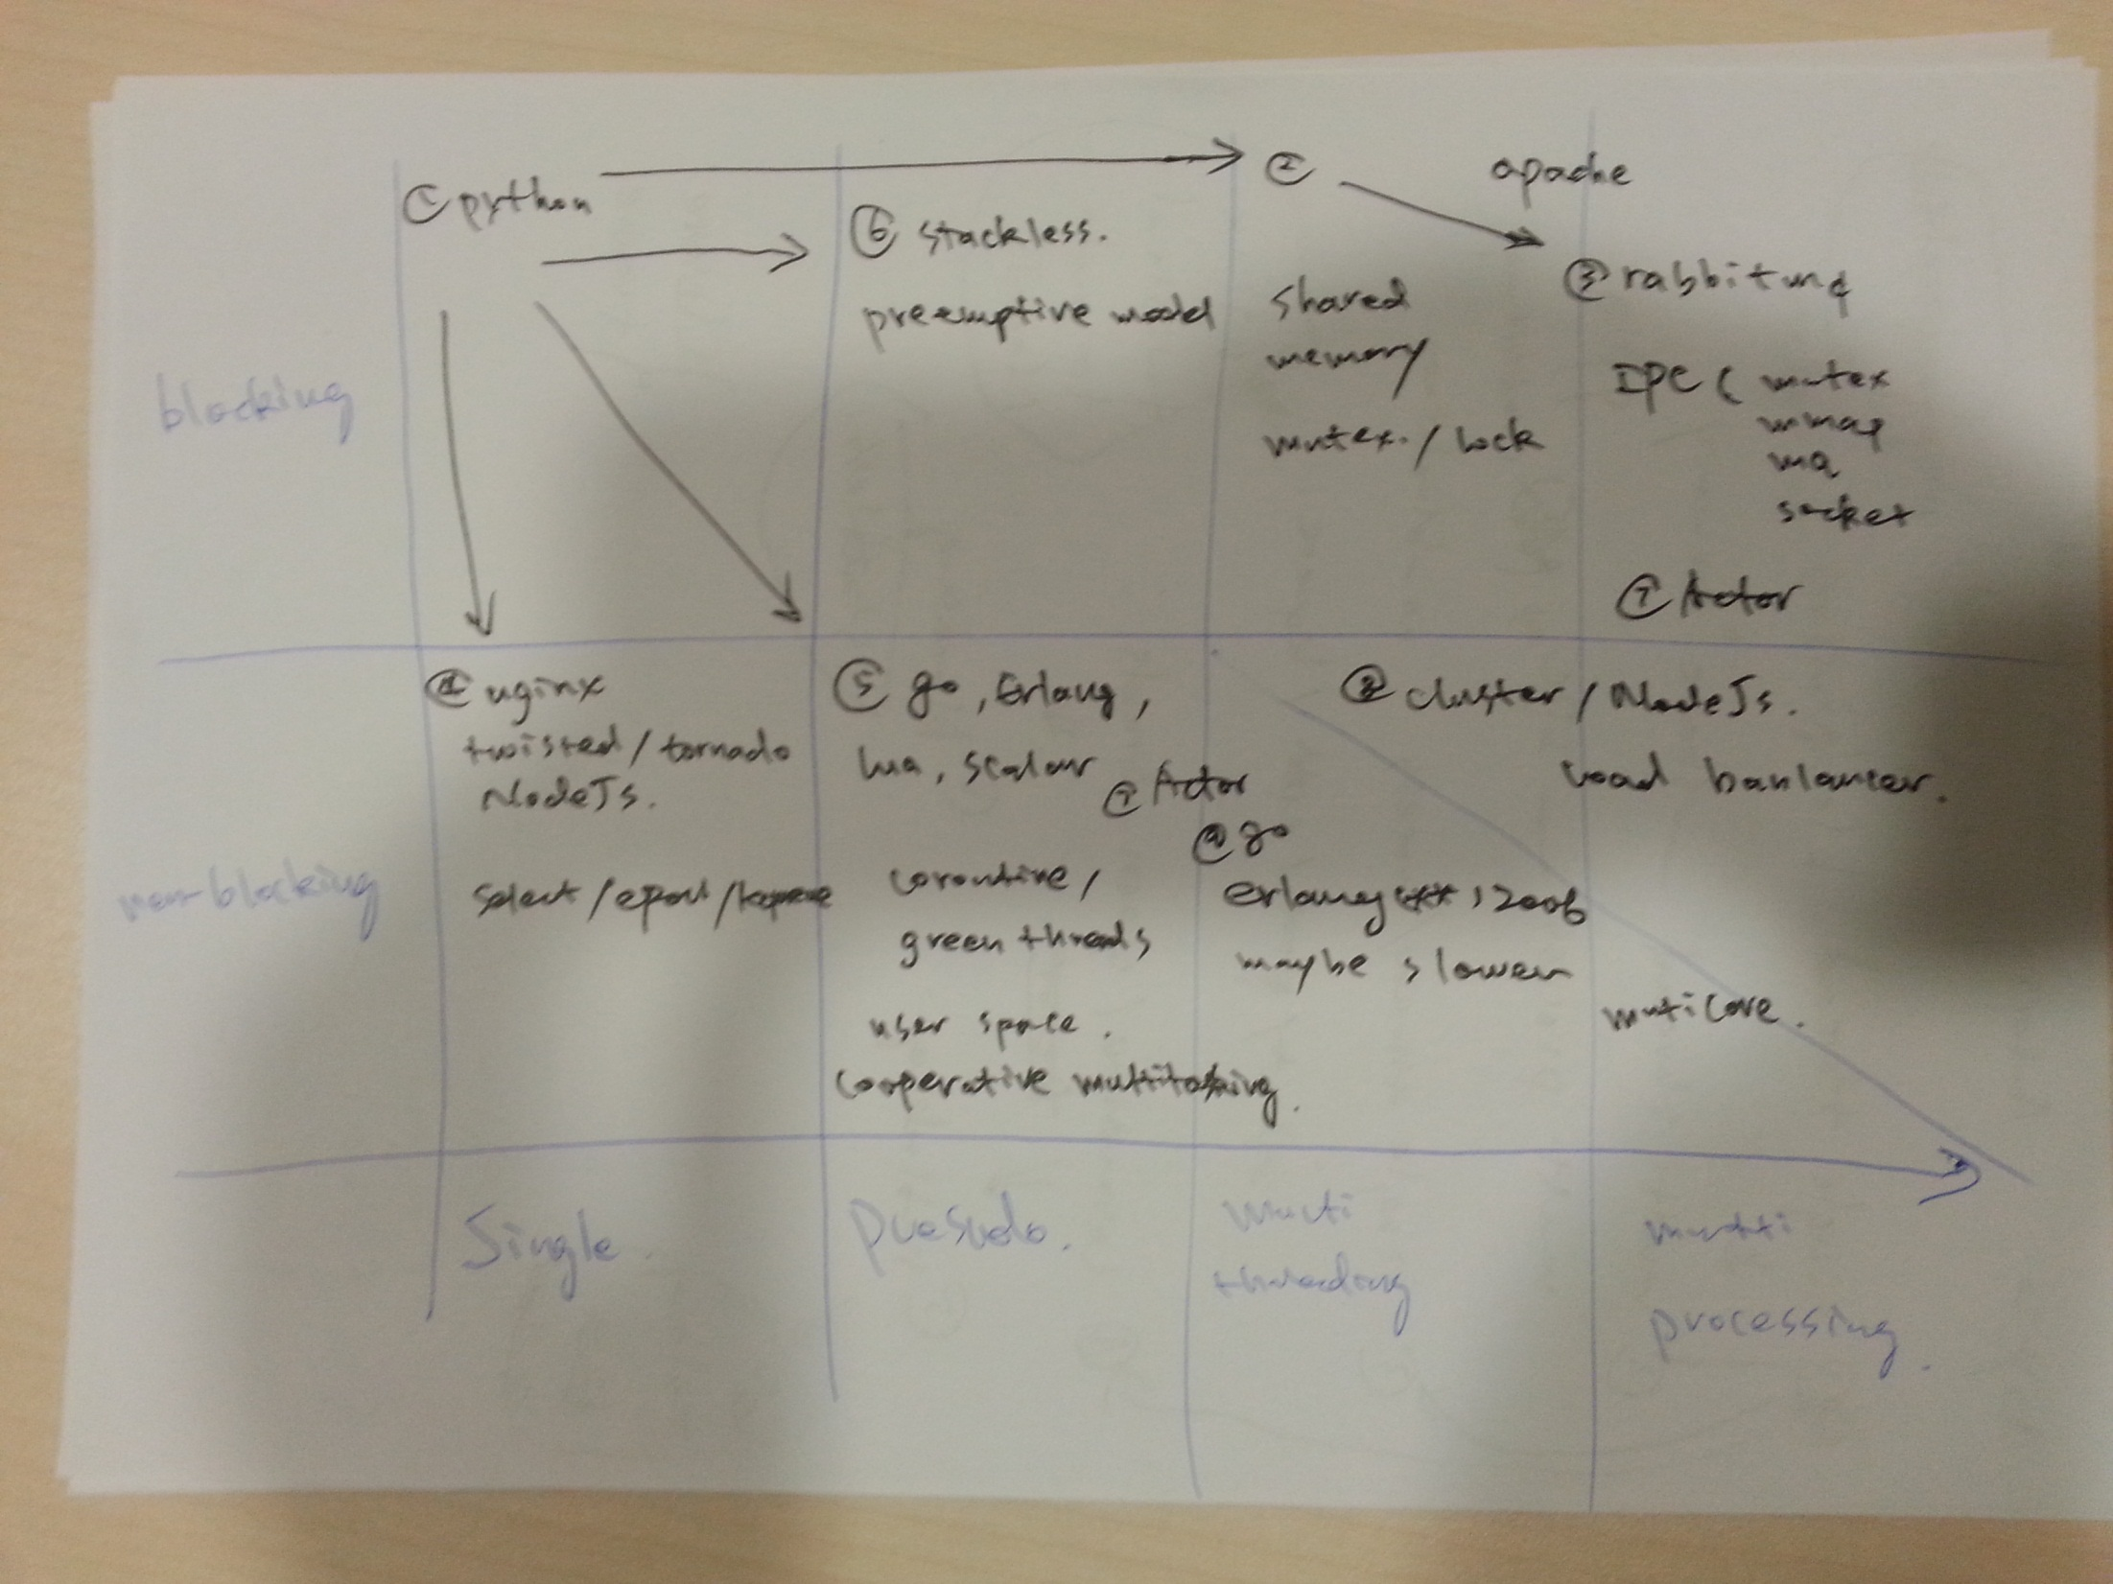
Async
Notes:
From twisted.internet import reactor
Python coressponding libs: Message queue(rabbitmq/redis/zeromq), Blocked Queue, Twisted/Tornado/Tulip
https://docs.python.org/3/library/asyncio-task.html coroutine, generator
http://golang.org/doc/faq#Why_no_multi_CPU
https://docs.python.org/3/library/asyncio-eventloop.html#example-hello-world-callback
cdpylib asyncio
base_events.py:176: def run_forever(self)
Tornado
ioloop.py
662 event_pairs = self._impl.poll(poll_timeout)
Twisted:
Base.py
self.doIteration(t)
selectreactor.py
95 def doSelect(self, timeout):

Slide 9


Many are called, but few are callbacks.
Callback & Errback
Deferred, Promise/Future
Notes:
Many are called, but few are chosen, to enter the heaven
Callback Hell: http://callbackhell.com/
TWISTED INTRODUCTION: http://krondo.com/?page_id=1327
Learning jQuery Deferreds: http://book.douban.com/subject/25843040/
http://book.douban.com/subject/1452125/
Py34 future: https://docs.python.org/dev/library/asyncio-task.html#future

Slide 10
Std libraries
requires (the only special point)
More than 30 libs
events.EventEmitter
cluster
Notes:
http://nodejs.org/api/
http://www.sitepoint.com/nodejs-events-and-eventemitter/
https://devcenter.heroku.com/articles/node-cluster

Slide 11
npm
Clever
Package.json
Npm install –save –dev-save
Notes:
https://www.npmjs.org/
Total Packages: 72 676

Slide 12
Most famous
socket.io
connect/express
when
redis
mongojs
coffee-script
underscore
forever
jade

Slide 13
JS ecosystem
Npm, package.json
Bower, bower.json
Grunt, gruntfile
Number of libraries
Github statistics

Slide 14
Thanks!

