Slide 1
Nagios

Slide 2
Nagios?
Nagios /ˈnɑːɡiːoʊs/ is an open source computer system monitoring, network monitoring and infrastructure monitoring software application.
Nagios was originally designed to run under Linux but also runs well on other Unix variants. It is a free software licensed under the terms of the GNU General Public License version 2 as published by the Free Software Foundation.

Slide 3
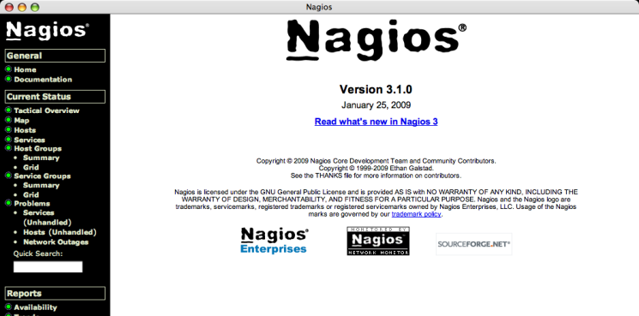
Nagios Core(Free Open Source)
Notes:
Nagios Core is a free, Open Source monitoring engine that provides basic alerting and reporting capabilities.

Slide 4
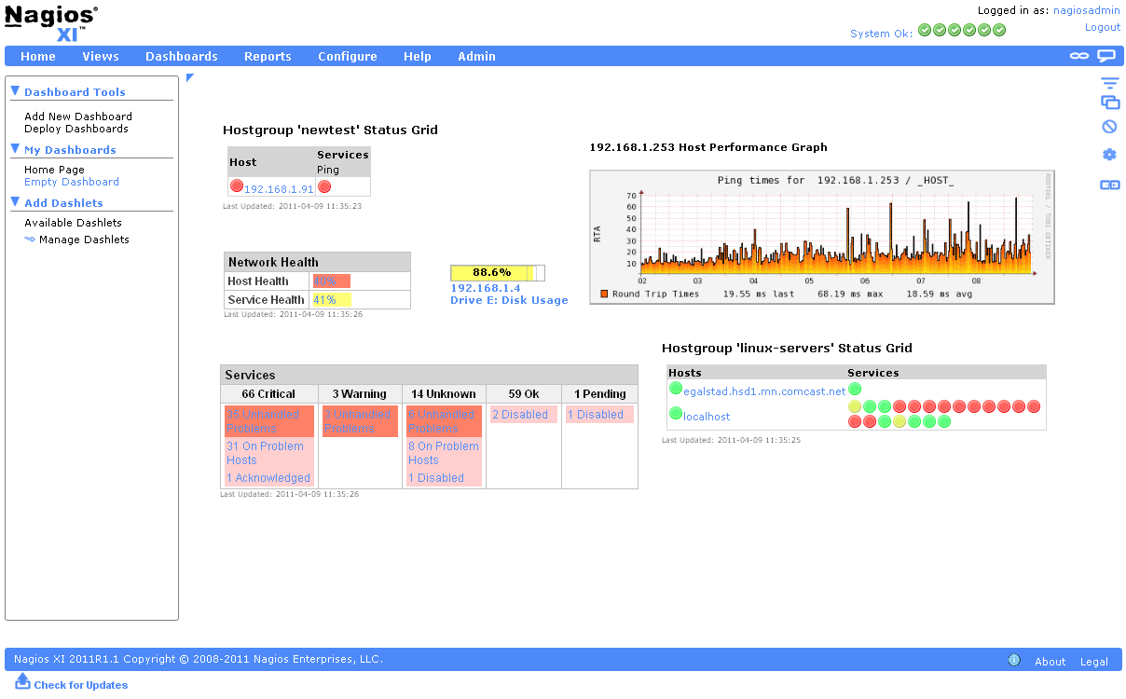
Nagios XI (commercial)
Notes:
Nagios XI is a commercial monitoring solution that is built on Nagios Core and includes dashboards, web-based configuration, advanced reporting, and rich data visualizations.

Slide 5
Features
Monitoring of network services and host resources
Monitoring of anything else like probes which have the ability to send collected data via a network to specifically written plugins
Monitoring via remotely-run scripts via Nagios Remote Plugin Executor, Windows with the NSClient++plugin
Remote monitoring supported through SSH or SSL encrypted tunnels.
A simple plugin design that allows users to easily develop their own service checks depending on needs
The ability to define network host hierarchies using 'parent' hosts
Contact notifications when service or host problems occur and get resolved
Web-interface, data graphing plugins, parallelized service checks, Data storage via text, automatic log file rotation
Notes:
Nagios is open source software licensed under the GNU GPL V2. It provides:
Monitoring of network services (SMTP, POP3, HTTP, NNTP, ICMP, SNMP, FTP, SSH)
Monitoring of host resources (processor load, disk usage, system logs) on a majority of network operating systems, including Microsoft Windows with the NSClient++plugin or Check MK.
Monitoring of anything else like probes (temperature, alarms,etc.) which have the ability to send collected data via a network to specifically written plugins
Monitoring via remotely-run scripts via Nagios Remote Plugin Executor
Remote monitoring supported through SSH or SSL encrypted tunnels.
A simple plugin design that allows users to easily develop their own service checks depending on needs, by using their tools of choice (shell scripts, C++, Perl, Ruby,Python, PHP, C#, etc.)
Available data graphing plugins
Parallelized service checks
The ability to define network host hierarchies using 'parent' hosts, allowing the detection of and distinction between hosts that are down or unreachable
Contact notifications when service or host problems occur and get resolved (via e-mail, pager, SMS, or any user-defined method through plugin system)
The ability to define event handlers to be run during service or host events for proactive problem resolution
Automatic log file rotation
Support for implementing redundant monitoring hosts
An optional web-interface for viewing current network status, notifications, problem history, log files, etc.
Data storage via text files rather than database

Slide 6
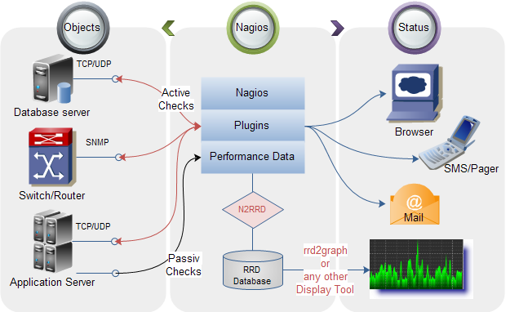
Operating principle of Nagios

Slide 7
Agents
NRPE(Nagios Remote Plugin Executor)
Allows remote system monitoring using scripts that are hosted on the remote systems
Monitoring of resources such as disk usage, system load or the number of users currently logged in.
Periodically polls the agent on remote system using the check_nrpe plugin.
NRDP(Nagios Remote Data Processor)
Flexible data transport mechanism and processor.
Designed with an architecture that allows it to be easily extended and customized
Uses standard ports and protocols (HTTP(S) and XML) and can be implemented as a replacement for NSCA.
NSClient++
Monitor Windows machines.
Collect information from this addon is called check_nt.
Notes:
NRPE
Nagios Remote Plugin Executor (NRPE) is a Nagios agent that allows remote system monitoring using scripts that are hosted on the remote systems. It allows for monitoring of resources such as disk usage, system load or the number of users currently logged in. Nagios periodically polls the agent on remote system using the check_nrpe plugin.
NRDP
Nagios Remote Data Processor (NRDP) is a Nagios agent with a flexible data transport mechanism and processor. It is designed with an architecture that allows it to be easily extended and customized. NRDP uses standard ports and protocols (HTTP(S) and XML) and can be implemented as a replacement for NSCA.
NSClient++
This program is mainly used to monitor Windows machines. Being installed on a remote system NSClient++ listens to port TCP 12489. Nagios plugin that is used to collect information from this addon is called check_nt. As NRPE, NSClient++ allows to monitor the so-called 'private services' (memory usage, CPU load, disk usage, running processes, etc.)

Slide 8
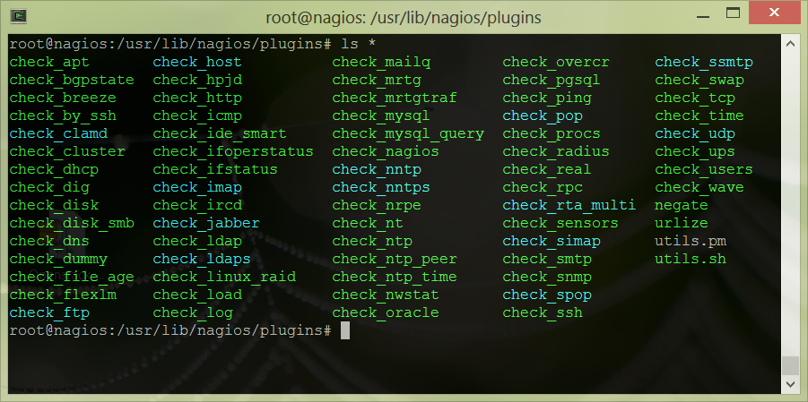
Plugins
Notes:
The official Nagios Plugins package contains over 50 plugins to get you started monitoring all the basics
http://www.nagios.org/download/plugins

Slide 9
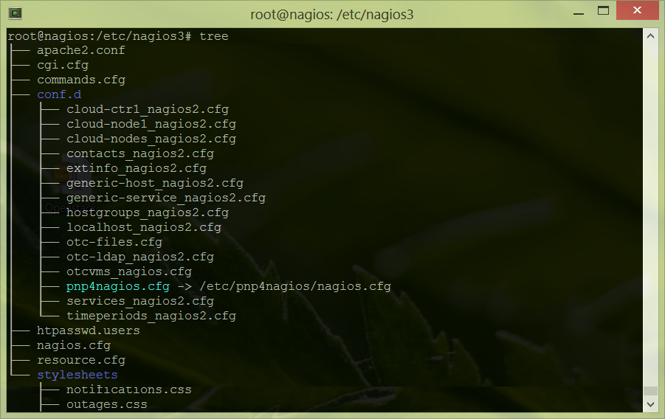
Nagios Configurations
Notes:
define host{
use generic-host
host_name node1
alias node1
address node1.bj.intel.com
notifications_enabled 1 ; Host notifications are enabled
event_handler_enabled 1 ; Host event handler is enabled
flap_detection_enabled 1 ; Flap detection is enabled
failure_prediction_enabled 1 ; Failure prediction is enabled
process_perf_data 1 ; Process performance data
retain_status_information 1 ; Retain status information across program restarts
retain_nonstatus_information 1 ; Retain non-status information across program restarts
check_command check-host-alive
max_check_attempts 10
notification_interval 0
notification_period 24x7
notification_options d,u,r
contact_groups admins
register 1
}
define service{
use generic-service ; Name of service template to use
host_name node1
service_description Cinder VG Usage
check_command check_nrpe!check_vg_size!20% 10% cinder-volumes
}
define service{
use generic-service ; Name of service template to use
host_name node1
service_description Root Space
check_command check_nrpe_1arg!check_disk
}
define service{
use generic-service ; Name of service template to use
host_name node1
service_description System Load
check_command check_nrpe_1arg!check_load
}
define service{
use generic-service
host_name node1
service_description System Users
check_command check_nrpe_1arg!check_users
}
define service{
use generic-service
host_name node1
service_description Total Procs
check_command check_nrpe_1arg!check_total_procs
}
define service{
use generic-service
host_name node1
service_description Zombie Procs
check_command check_nrpe_1arg!check_zombie_procs
}

Slide 10
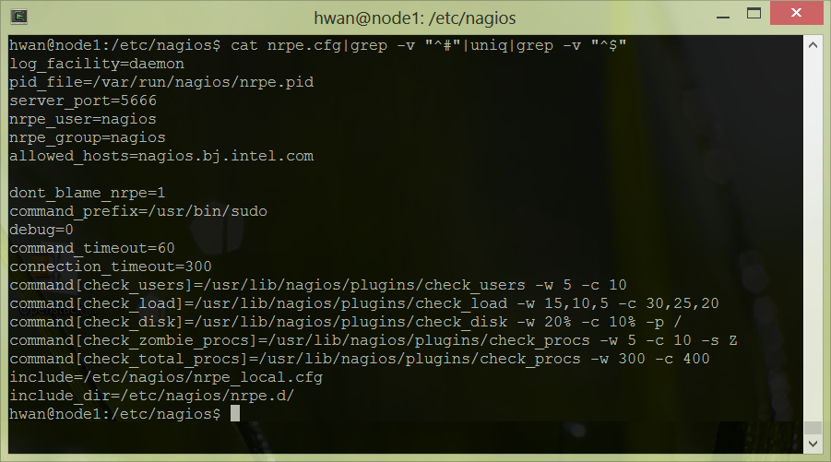
NRPE Configurations

Slide 11
BJ Cloud Cluster

Slide 12
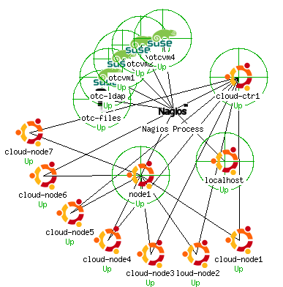
BJ Nagios

Slide 13
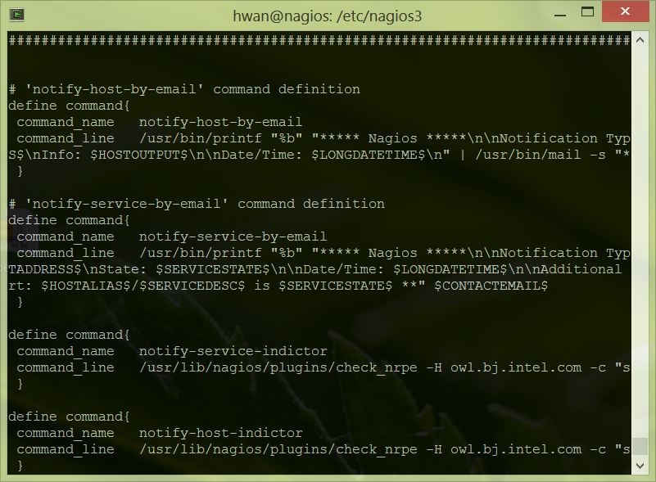
USB LED notification

Slide 14
NRPE server commands
command[server_OK]=/usr/local/bin/server_ok
command[server_WARNING]=/usr/local/bin/server_warning
command[server_CRITICAL]=/usr/local/bin/server_critical

Slide 15
Resources
http://en.wikipedia.org/wiki/Nagios
http://www.nagios.com/

