Slide 1
Turnkey Linux

Slide 2
01
What is TKL
Contents
How to use
02
03
How to create

Slide 3
What is TKL
Turnkey Linux is a virtual appliance library that integrates and polishes the very best open source software into ready to use solutions.

Slide 4
What is TKL
Virtual Appliance = JeOS + Software Application

Slide 5
What is TKL
JeOS is the abbreviation for Just Enough Operating System.
OS core (kernel, drives, etc.)
OS minimum maintenance tools
Minimum user space tools
Packages repository (DVD or network based)

Slide 6
What is TKL
Virtual Appliance is a virtual machine image designed to run on a virtualization platform.
VirutalBox
Vmware
LXC
OpenStack
OpenVZ
Xen

Slide 7
What is TKL
Save time and money with 100+ ready-to-use solutions
It just works
Easy to use
100% Open Source
Lightweight (starting from 150MB)

Slide 8








What is TKL

Slide 9
01
What is TKL
Contents
How to use
02
03
How to create

Slide 10
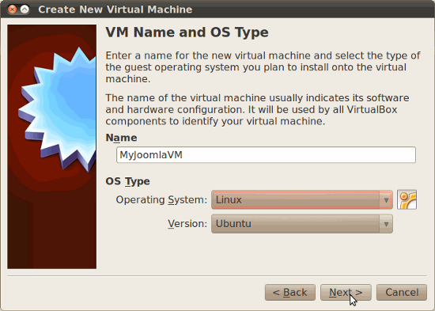
How to use

Slide 11
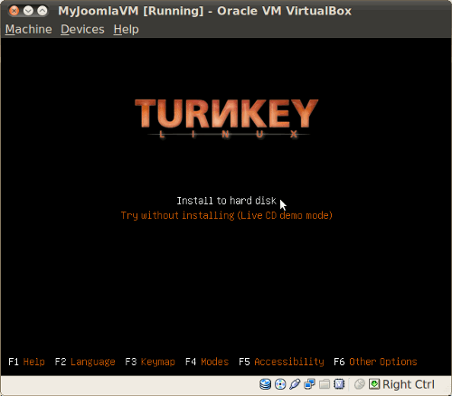
How to use

Slide 12
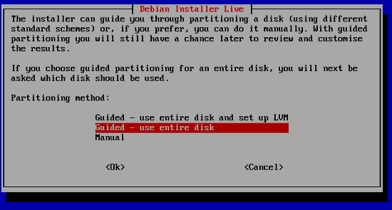
How to use

Slide 13
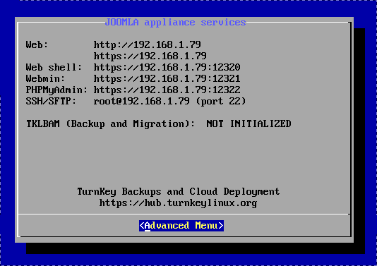
How to use

Slide 14
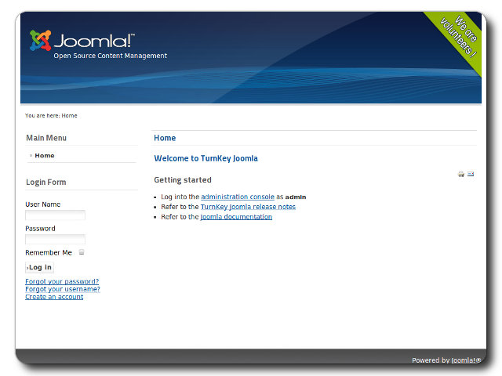
How to use

Slide 15
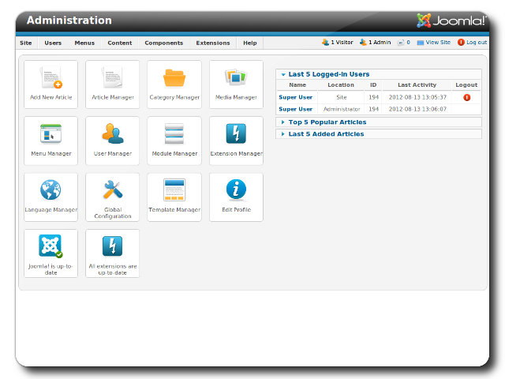
How to use

Slide 16
How to use
Create a new account @ turnkeylinux.org
Create an AWS account @ amazon.com
Enable TurnKey on Amazon EC2
Launch TurnKey appliance on Amazon EC2

Slide 17
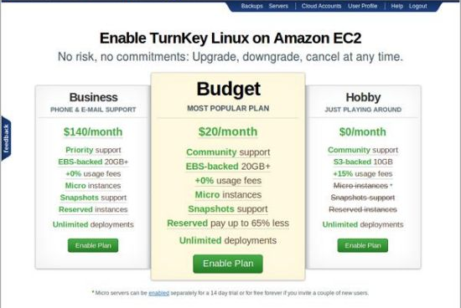
How to use

Slide 18
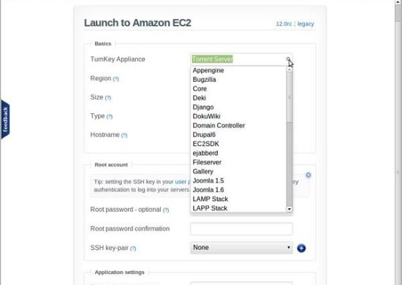
How to use

Slide 19
01
What is TKL
Contents
How to use
02
03
How to create

Slide 20


How to create
TKLDev is the mother of all TurnKey appliances. Inside is a development toolchain and build system.
Core is the common base system on top of which all TurnKey Linux appliances are built.

Slide 21
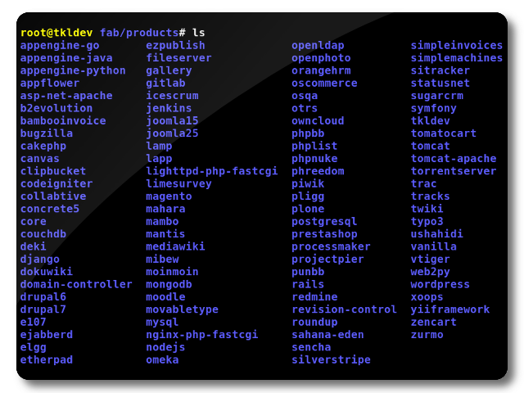
How to create

Slide 22
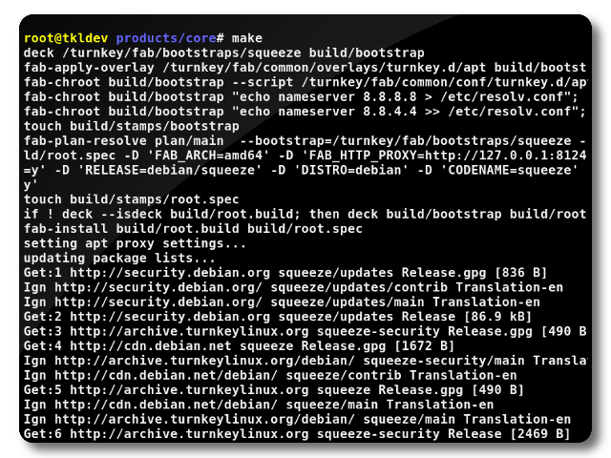
How to create

Slide 23
How to create
Fab provides toolchain utilities, which leverages make to implement the 'build pipeline'.
fab-apply-overlay
fab-apply-removelist
fab-chroot
fab-cpp
fab-install
fab-plan-annotate
fab-plan-resolve
fab-query

Slide 24
How to create
Deck is very simple, but it’s a bit hard to explain.
deck /path/to/dir/or/deck /path/to/new/deck
deck [ -options ] /path/to/existing/deck
-m mounts deck (the default)
-u unmount deck
-r refresh the deck's fstab
-d delete the deck

Slide 25
How to create
1. bootstrap
4. root.patched
2. root.spec
5. root.tmp
3. root.build
6. product.iso

Slide 26
How to create
Makefile
plan
overlay
Conf.d

Slide 27
How to create
/ turnkey / fab / products / core / Makefile
WEBMIN_FW_TCP_INCOMING = 22 12320 12321
include $(FAB_PATH)/common/mk/turnkey.mk

Slide 28
How to create
/ turnkey / fab / common / mk / turnkey.mk
# Setting product configuration variables
...
FAB_SHARE_PATH ?= /usr/share/fab
...

Slide 29
How to create
/ turnkey / fab / common / mk / turnkey.mk
# Define hook functions
...
define _bootstrap/post
...
endef
bootstrap/post += $(_bootstrap/post)
...

Slide 30
How to create
/ turnkey / fab / common / mk / turnkey.mk
...
include $(FAB_SHARE_PATH)/product.mk

Slide 31
How to create
/ usr / share / fab / product.mk
product.iso: root.tmp cdroot
root.tmp: root.patched
root.patched: root.build removelist conf
root.build: bootstrap root.spec
root.spec: bootstrap plan
bootstrap: /turnkey/fab/bootstrap/wheezy

Slide 32
How to create
1. bootstrap
The minimal chrootable filesystem used to bootstrap the root, built from a "bootstrap.spec".

Slide 33
How to create
2. root.spec
A set of (package name, package version tuples):
a spec is created from a plan against a specific pool
the same plan will generate different specs against different pools

Slide 34
How to create
3. root.build
The chrootable root filesystem of a product, built by applying the "root.spec" on the bootstrap.

Slide 35
How to create
4. root.patched
The chrootable root filesystem of a product:
patched manually or automatically
can be re-created by applying the root patch as an overlay

Slide 36
How to create
5. root.tmp
Temporary changes here are squashed into a separate layer named " product.iso / cdroot / casper / 20tmp.squashfs ".

Slide 37
How to create
6. product.iso
The final product used by the end-user. The product is generated by formatting the "patched root" with "genisoimage".

Slide 38
THANK YOU

