Slide 1
MongoDB
Deploy Sharding Cluster

Slide 2
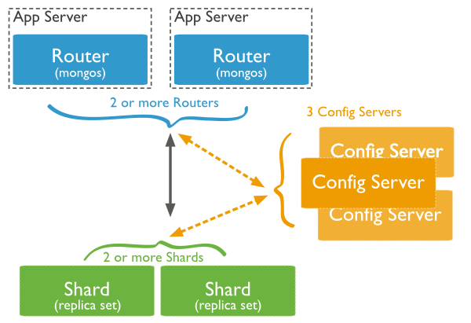
Sharding in MongoDB
MongoDB supports sharding through the configuration of a sharded clusters.
components:
Shards
Query routers
Ping config server per 30 sec.
Config servers

Slide 3
Data Partitioning
Shard Keys
The shard key determines the distribution of the collection’s documents among the cluster’s shards.
Immutable.
Range Based Sharding
Hash Based Sharding

Slide 4
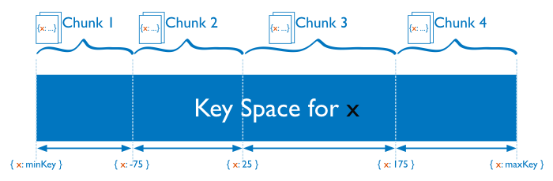
Range Based Sharding

Slide 5
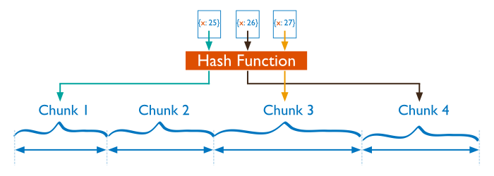
Hash Based Sharding

Slide 6
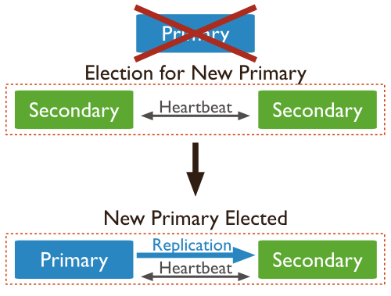
Replication
Heartbeats
2s and 10s.
Replica Set Elections
Data Synchronization
Initial sync to populate new members(empty)
with the full data set
Replication to apply ongoing changes
to the entire data set.
Automatic failover

Slide 7
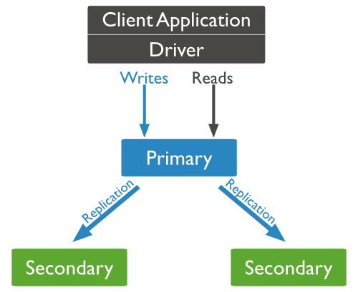
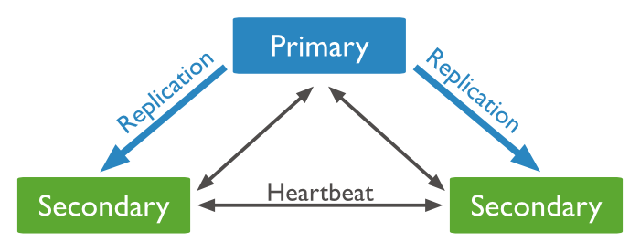
Replica Set Members
Primary
Only the primary receives all write operations.
Records the operations on the primary’s oplog.
Secondaries
Replicate data from primary’s oplog asyn.

