Slide 1
Mesos

Slide 2
Agenda
Introduction
History
Features
Architecture

Slide 3
Introduction
Apache Mesos is an open source cluster manager that abstracts CPU, memory, storage and other compute resources away from machines (physical or virtual), and supports the execution of fault-tolerant and elastic distributed systems. A Mesos kernel runs on each machine in the cluster and provides applications with APIs for resource management and scheduling across the entire cluster.

Slide 4
History
genesis: Borg from google
a research project in the Berkeley AMPLab Lab by PhD students Benjamin Hindman
develop at Twitter.
Written in C++
Notes:
1. Mesos manages the placement of workloads for over 30,0000 servers at Twitter

Slide 5
Features
Scalability to 10,000s of nodes
Fault-tolerant replicated master and slaves using ZooKeeper
Support for Docker containers
Native isolation between tasks with Linux Containers
Multi-resource scheduling (memory, CPU, disk, and ports)
Java, Python and C++ APIs for developing new parallel applications
Web UI for viewing cluster state

Slide 6
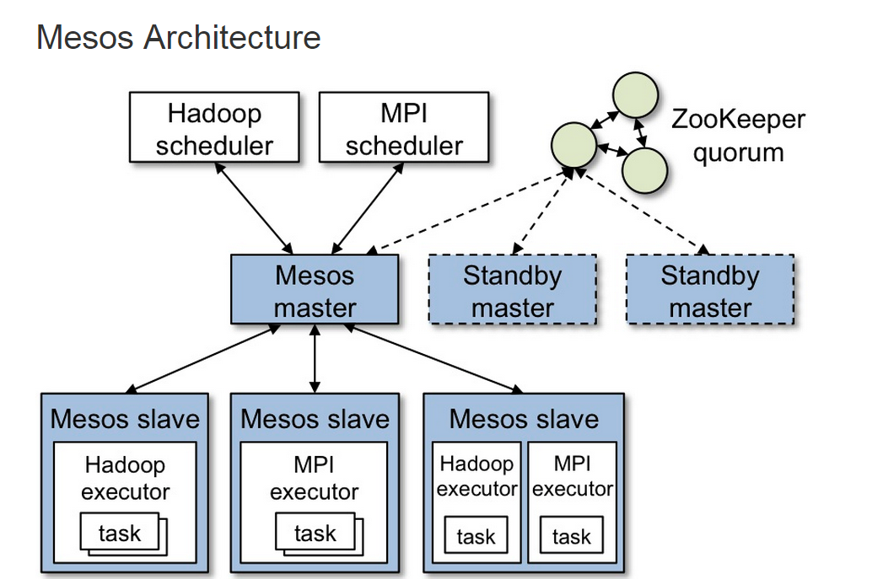
Architecture

Slide 7
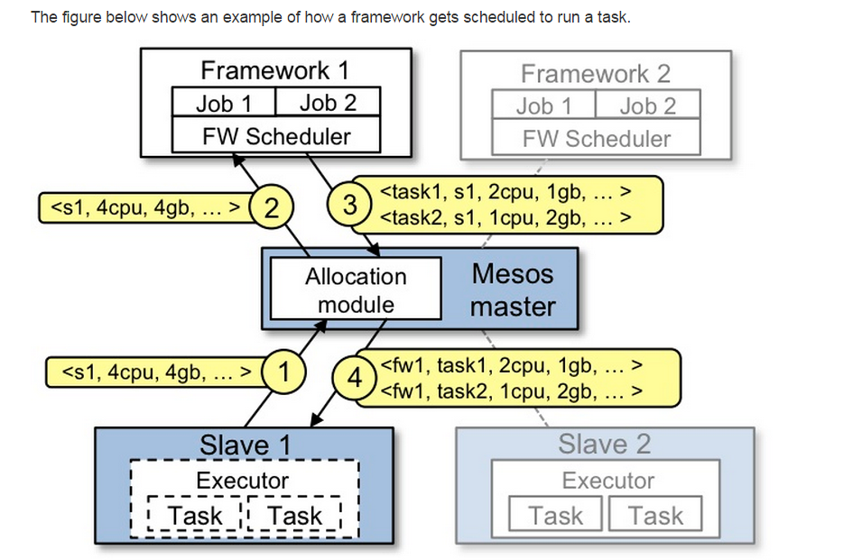
Resource Offer

Slide 8
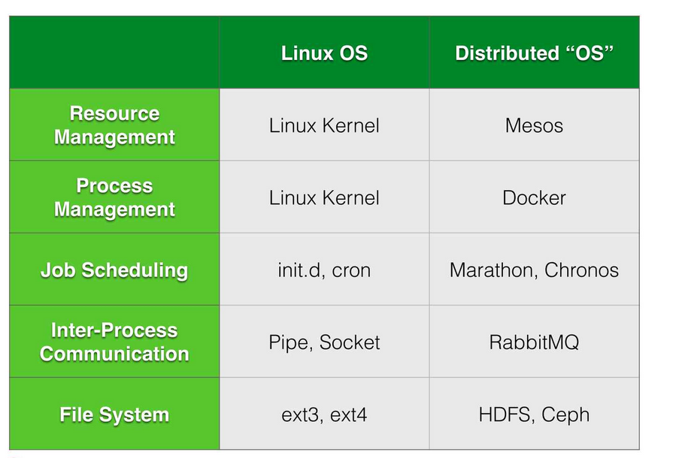
Comparation

