Slide 1
Spark

Slide 2
Agenda
Introduction
History
Features
Architecture
Ecosystem
Resilient Distributed Datasets
Interact with Spark

Slide 3
Introduction
Apache Spark is a fast and general-purpose cluster computing system. It provides high-level APIs in Java, Scala and Python, and an optimized engine that supports general execution graphs. It also supports a rich set of higher-level tools including Spark SQL for SQL and structured data processing, MLlib for machine learning, GraphX for graph processing, and Spark Streaming.

Slide 4
History
Spark was initially started by Matei Zaharia at UC Berkeley AMPLab in 2009, and open sourced in 2010 under a BSD licensedevelop at Twitter.
In 2013, the project was donated to the Apache Software Foundation and switched its license to Apache 2.0. In February 2014, Spark became an Apache Top-Level Project
In November 2014, the engineering team at Databricks used Spark and set a new world record in large scale sorting

Slide 5
Features
Speed: Run programs up to 100x faster than Hadoop MapReduce in memory, or 10x faster on disk.
Ease of Use: Write applications quickly in Java, Scala or Python
Generality: Combine SQL, streaming, and complex analytics
Runs Everywhere: Spark runs on Hadoop, Mesos, standalone, or in the cloud. It can access diverse data sources including HDFS, Cassandra, HBase, and S3
Cache: Ability to cache datasets in memory for interactive data analysis

Slide 6
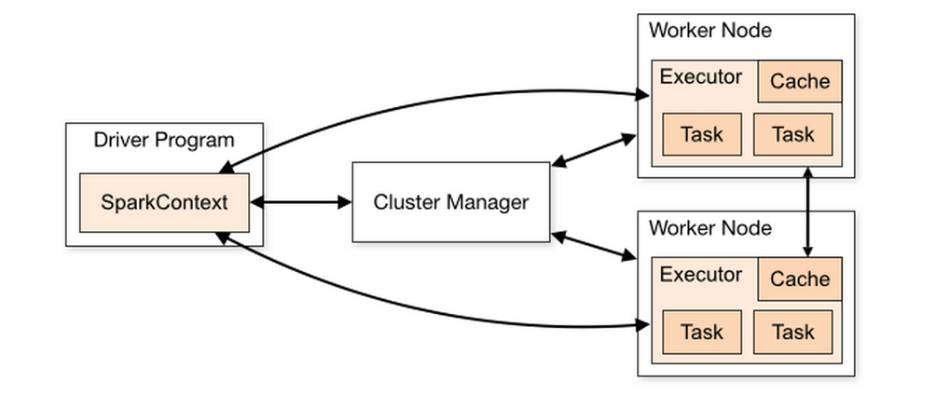
Components

Slide 7
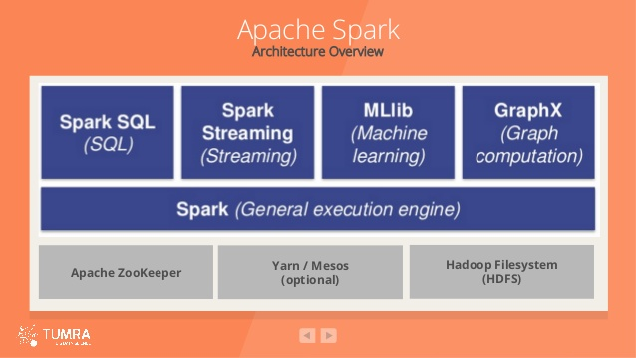
Ecosystem

Slide 8
Resilient Distributed Datasets
RDD: Resilient Distributed Datasets is the core concept in Spark framework. Think about RDD as a table in a database. It can hold any type of data. Spark stores data in RDD on different partitions. It can be operated on in parallel.

Slide 9
Resilient Distributed Datasets
RDD supports two types of operations:
Transformation
Action

Slide 10
Resilient Distributed Datasets
Transformation: create a new dataset from an existing one. RDDs are immutable. You can modify an RDD with a transformation but the transformation returns you a new RDD whereas the original RDD remains the same
Transformation functions: map, filter, flatMap, groupByKey, reduceByKey, aggregateByKey, pipe, and coalesce
All transformations in Spark are lazy

Slide 11
Resilient Distributed Datasets
Action: return a value to the driver program after running a computation on the dataset.
Action operations: reduce, collect, count, first, take, countByKey, and foreach.

Slide 12
Interact with Spark
Master web ui: http://xxx:8080(default)
Application web ui: http://node:4040 (default)

