Slide 1

Puppet
--The industry-leading conﬁguration management toolkit

Slide 2
Introduction
Founded by Luke Kanies in 2005,managed by Puppet Labs
Open source, Written in Ruby
Platform support
Linux distributions: CentOS, Debian, Fedora, Mandriva, Oracle Linux, RHEL, Scientific Linux, SUSE and Ubuntu
multiple Unix systems (Solaris, BSD, Mac OS X, AIX, HP-UX)
Microsoft Windows
Users
Google, Dell, RackSpace, Twitter, Oracle, ARIN, Zynga……
Charge
Community Edition: Free
Enterprise Edition : charge, Free (less than 10 nodes)

Slide 3
Why Puppet
It provides a powerful framework to simplify the majority of the technical tasks that sysadmins need to perform
The sysadmin work is written as code in Puppetʼs custom language which is shareable just like any other code.
Modules
Network, openstack, ssh, apt, yum, mysql, tomcat
https://forge.puppetlabs.com/puppetlabs

Slide 4

System Components
Or Whatever
SVN
Puppet Master
Reports Collector
Open API
Facts
The client sends normalized data about itself.
1
2
Calatog
Master compiles a Catalog to tell client how to config
3
SSL secure encryption
Report
reports back whether the configuration is complete or not.
client
……
client

Slide 5
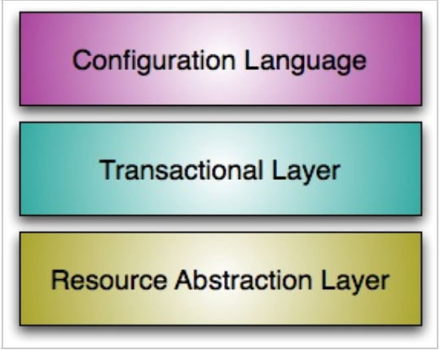
System Components

Slide 6
Resources
Any of the following (and more) can be modeled as a single resource:
A user account
A specific file
A directory of files
A software package
A running service
A scheduled cron job
An invocation of a shell command, when certain conditions are met

Slide 7
Resources
puppet resource user
user { 'root':
ensure => 'present',
comment => 'root',
gid => '0',
groups => ['root', 'bin', 'daemon', 'sys', 'adm', 'disk', 'wheel'],
home => '/root',
password => '$1$jrm5tnjw$h8JJ9mCZLmJvIxvDLjw1M/',
password_max_age => '99999',
password_min_age => '0',
shell => '/bin/bash',
uid => '0',
}

Slide 8
Resources
puppet resource file
file {"/tmp/test2":
source => "puppet://puppetmaster.bj.intel.com/files/test2“
backup => “localpath or remote path",
group => “root”,
owner => “root”,
mode => 600;
content=>”hello, puppet!”
}

Slide 9
Resources
puppet resource package
package {
["vim",“wget"]:
ensure => installed/latest;
provider=>rpm;
["pppoe","pppoe-conf"]:
ensure => absent;
}

Slide 10
Resources
puppet resource service
service { 'NetworkManager':
ensure => 'stopped',
enable => 'false',
}
service { "sshd":
ensure => "running",
enable => "true",
require => Package["openssh-server"],
}

Slide 11
Structure
/etc/puppet
puppet.conf
manifests
modules
files
templates
site.pp
mic
gbs
……
manifests
files
manifests
files
init.pp
init.pp

Slide 12
Puppet VS Ansible (1)
 | Puppet | Ansible
logical construction | Agent required. Client get configuration from master. Push commands let you trigger modifications immediately | No agent required on clients. Master manages clients.
Modules | Modules can be written in Ruby or a simpler, Puppet-specific subset of Ruby | Modules can be written in nearly any language
complexity | Relatively complex | Extremely simple to set up and get running

Slide 13
Puppet VS Ansible (2)
 | Puppet | Ansible
Support | Almost support all systems. | Lacks support for Windows clients
UI | Web UI handles reporting, inventorying, and real-time node management | Web UI lets you configure users, teams, and inventories, and apply Playbooks to inventories
Pricing | Free open source version; Puppet Enterprise costs $100 per machine per year | Free open source version; AWX free for 10 machines, then $100 or $250 per machine per year depending on support

Slide 14
Puppet VS Ansible (3)
InfoWorld Test Center Scorecard NOVEMBER 21, 2013
 | Puppet 3.0 | Ansible1.3
Availability | 9 | 9
Interoperability | 9 | 7
Management | 9 | 8
Scalability | 9 | 8
performance | 9 | 9
Value | 9 | 9
Overall Score | 9 | 8.2

Slide 15
Thank you!

Slide 16
Demo configuration
Vagrant puppet client
config.vm.box = "mic-ubuntu"
config.vm.box_url = "/home/sunrise/vagrant/baseboxes/ubuntu_puppet_13.10_32.box"
config.ssh.private_key_path ="/home/sunrise/vagrant/id_rsa"
config.vm.provision "puppet_server" do |puppet|
puppet.puppet_node = "mic-ubuntu4.bj.intel.com"
puppet.puppet_server = "puppetmaster.bj.intel.com"
puppet.options = "--verbose --no-daemonize --onetime"
end

Slide 17
Demo configuration
puppet master /etc/puppet/manifests/site.pp
node default{
case $operatingsystem{
Ubuntu: {
include env-ubuntu
}
CentOS: {
include env-centos
}
default: {
include env-centos
}
}
include mic
}

Slide 18
Demo configuration
puppet master /etc/puppet/modules/env-ubuntu/manifests/init.pp
class env-ubuntu
{
file{"/etc/apt/sources.list":
ensure=>"present",
group=>"root",
owner=>"root",
mode=>"0644",
replace=>"yes",
source=>"puppet:///files/sources.list"
}
file{"/etc/apt/apt.conf":
ensure=>"present",
group=>"root",
owner=>"root",
mode=>"0644",
source=>"puppet:///files/apt.conf"
}

Slide 19
Demo configuration
puppet master /etc/puppet/modules/mic/manifests/init.pp
class mic{
file{"/vagrant/handset_blackbay.ks":
ensure=>"present",
group=>"vagrant",
owner=>"vagrant",
mode=>"0644",
source=>"puppet:///files/handset_blackbay.ks"
}
if ($operatingsystem == "Ubuntu"){
exec{"apt-get update":
command=>"apt-get update",
path=> "/usr/bin:/usr/sbin:/bin:/sbin",
user=>"root",
require=>[File["/etc/apt/sources.list"],File["/etc/apt/apt.conf"]]
}
}
package { 'mic':
ensure => installed,
# install_options => ['-y --force-yes'],
}
exec{"build package":
cwd=>"/vagrant",
command=>"mic cr auto handset_blackbay.ks",
path=> "/usr/bin:/usr/sbin:/bin:/sbin",
require=>[Package["mic"],File["/vagrant/handset_blackbay.ks"]]
}
}

