Slide 1
Yocto intro.
devtool toaster hob ADT

Slide 2
devtool
$ cd ~
$ wget http://www.ivarch.com/programs/sources/pv-1.5.7.tar.bz2
$ tar -xf pv-1.5.7.tar.bz2
$ cd poky && source oe-init-build-env
$ devtool add pv ~/pv-1.5.7
$ devtool status
$ devtool build pv
$ devtool deploy-target root@192.168.7.4
$ ssh root@192.168.7.6
$ which pv
$ pv

Slide 3
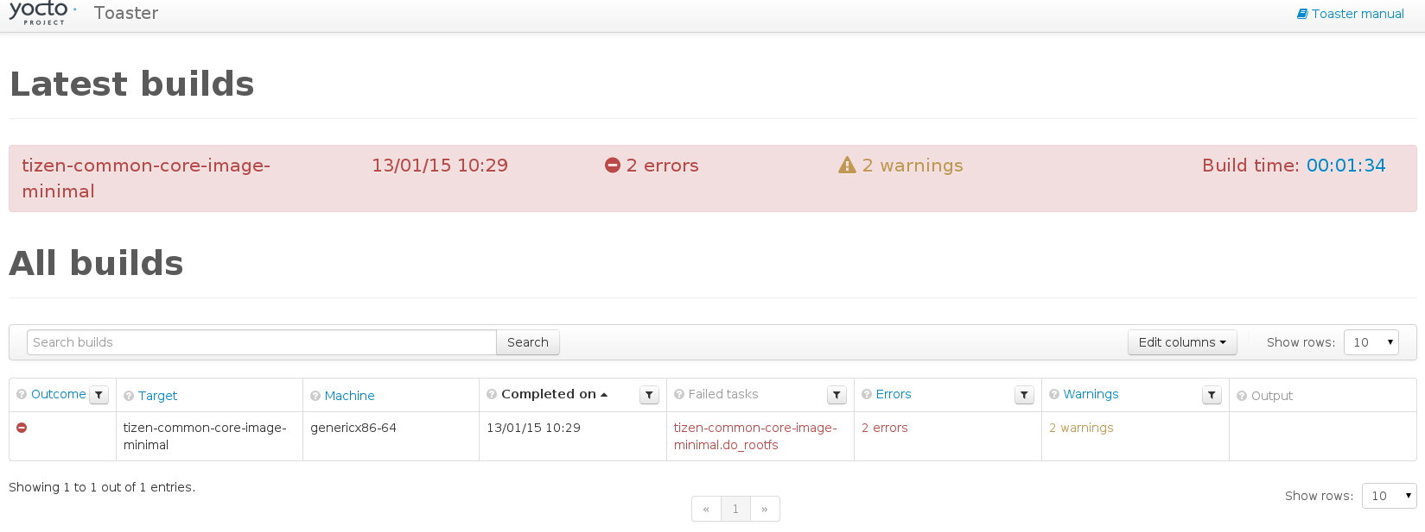
Toaster
$ virtualenv venv
$ source venv/bin/active
$ pip install django==1.6
$ pip install South==0.8.4
$ git clone http://git.yoctoproject.org/git/poky
$ source poky/oe-init-build-env
$ source toaster start
$ bitbake core-image-minimal
$ hob // GUI for bitbake
$ xdg-open http://localhost:8000/

Slide 4
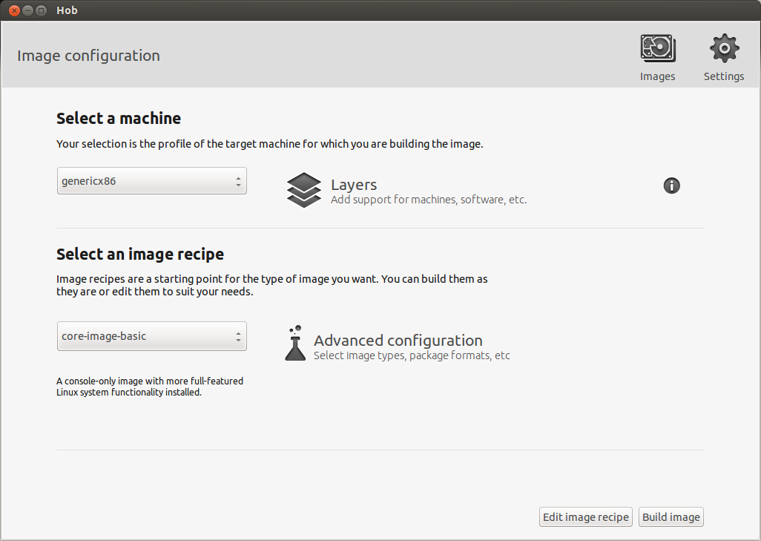
Hob
Hob document
Usage:
$ source oe-init-build-env
$ hob

Slide 5
Yocto ADT Pratice
Install ADT
$ wget http://downloads.yoctoproject.org/releases/yocto/yocto-1.7/adt-installer/adt_installer.tar.bz2
$ tar -jxf adt_installer.tar.bz2
$ cd adt_installer && ./adt_installer
Install eclipse
$ wget http://www.eclipse.org/downloads/download.php?file=/eclipse/downloads/drops4/R-4.3.2-201402211700/eclipse-SDK-4.3.2-linux-gtk-x86_64.tar.gz
$ tar -xf eclipse-SDK-4.3.2-linux-gtk-x86_64.tar.gz
$ cd eclipse && ./eclipse # running eclipse 4.3
Config yocto pluign for eclipse
Refer to http://www.yoctoproject.org/docs/1.7/dev-manual/dev-manual.html#adt-eclipse

