Slide 1
Toaster Introduction

Slide 2
Agenda
Introduction
Setting up a Local Instance of Toaster
Setting up a Toaster Instance on a Remote Host
Toaster Architecture
Web Interface Presentation
Commands Supported by Toaster
Feature Plan
References

Slide 3
Introduction
Toaster is a web interface to display BitBake Output, the Yocto Project build system.
What does Toaster do?
Toaster is a build analysis tool. It collects data about the build process and its outcome and presents it in a web interface that lets you browse, search, and query the information in different ways.

Slide 4
Introduction
Toaster collects the following information about the build process:
Outcome of the build, errors and warnings thrown
Packages included in an image
Image directory structure
Build configuration
Recipes and packages built
Full dependency chain for tasks, recipes and packages
Tasks run by the build system
Performance information: time, CPU usage and disk I/O per task

Slide 5
Setting up a local instance of Toaster
Install django and south
$pip install django==1.6
$pip install South==0.8.4
Note: make sure port 8000 and 8200 are free

Slide 6
Setting up a local instance of Toaster
Get Toaster up or stop
$ git clone –b dizzy git://git.yoctoproject.org/poky.git
$ source poky/oe-init-build-env
$ source toaster start/stop
Check http://localhost:8000 in your browser

Slide 7
Setting up a Toaster Instance on a Remote Host
Set up Web Server:
update settings.py with database information(e.g.MySQL)
$ python bitbake/lib/toaster/manage.py syncdb
$ python bitbake/lib/toaster/manage.py migrate orm
$ python bitbake/lib/toaster/manage.py runserver

Slide 8
Setting up a Toaster Instance on a Remote Host
Start BitBake Server:
Edit local bitbake/lib/toaster/toastermain/settings.py to alter the DATABASES value to point to the sql server configured last step.
Create and configure conf/toaster.conf
$ bitbake --postread conf/toaster.conf --server-only -t xmlrpc -B localhost:0 && export BBSERVER=localhost:-1

Slide 9
Setting up a Toaster Instance on a Remote Host
Start Toaster UI Observer:
$ nohup bitbake --observe-only -u toasterui >toaster_ui.log &

Slide 10
Setting up a Toaster Instance on a Remote Host
Kill Bitbake Server When You Finished
$ bitbake -m

Slide 11
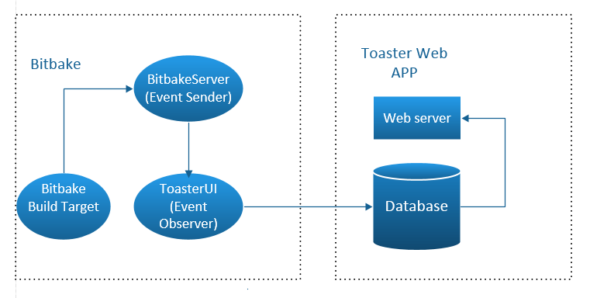
Toaster Structure

Slide 12
Web Interface Introduction
Two Main Part:
Builds List
Build Detail

Slide 13
Demo

Slide 14
Web Interface Introduction
Builds List:
Latest builds: the first 3 builds, including builds in progress
in progress: blue
success: green
fail: red
All builds: exclude builds in progress

Slide 15
Demo

Slide 16
Web Interface Introduction
Build Detail:
Images(only shows when image build successfully)
Build Info
Performance

Slide 17
Demo

Slide 18
Commands Supported by Toaster
List Builds:
$ python ../bitbake/lib/toaster/manage.py buildslist
Delete a Specific Build:
$ python ../bitbake/lib/toaster/manage.py builddelete <build_id>

Slide 19
Feature Plan
Currently Toaster does not allow you to configure and launch a build.
However, future development includes plans to integrate the configuration
and build launching capabilities of “Hob”.

Slide 20
References
https://wiki.yoctoproject.org/wiki/Setting_up_a_local_instance_of_Toaster
https://wiki.yoctoproject.org/wiki/Setting_up_a_production_instance_of_Toaster
https://wiki.yoctoproject.org/wiki/Working_Behind_a_Network_Proxy
https://wiki.yoctoproject.org/wiki/How_to_delete_information_from_the_Toaster_database
http://www.yoctoproject.org/docs/1.7.1/yocto-project-qs/yocto-project-qs.html

