Slide 1
Exceptions and Error Handling

Slide 2
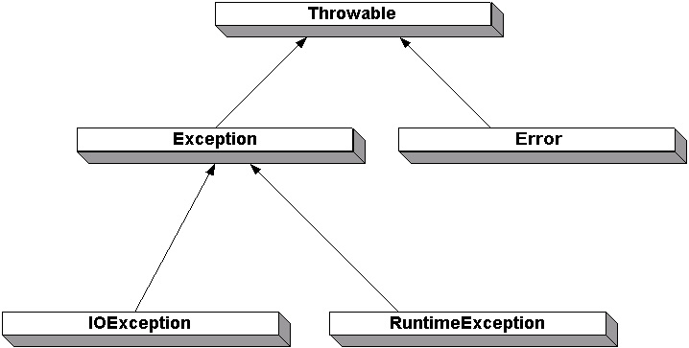
Exception Hierarchy

