Slide 1
Inheritance, Interfaces, Inner Classes

Slide 2
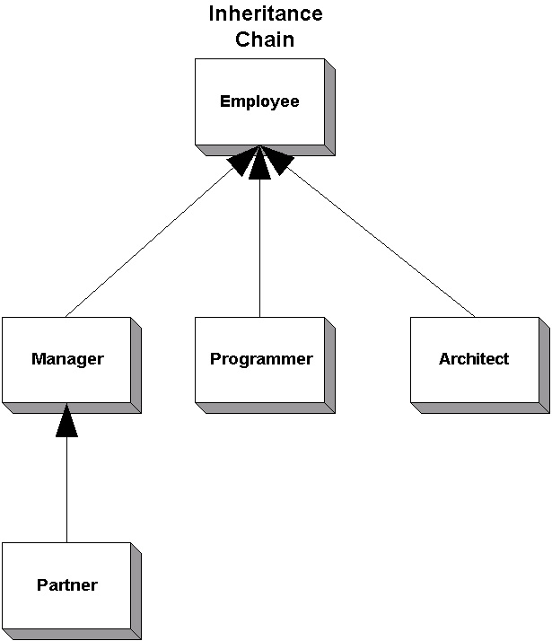
Inheritance Chain

