Slide 1

Object-Oriented Design Overview
Object-Oriented Paradigm
Two Levels of Abstraction
Basis of UML (Unified Modeling Language)

Slide 2

History Of Java
Started as a secret project called the “Green Project”
Originally designed for small appliances and remote devices

Slide 3

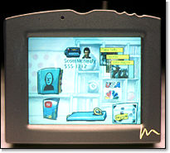

Star 7 devices

Slide 4
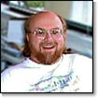
Oak
James Gosling, known as the “father of Java”
Oak programming language was renamed to Java

Slide 5
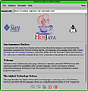
May 23, 1995
Java officially announced as a language
To be incorporated with Netscape Navigator’s browser
HotJava Browser preceded this

Slide 6
Advantages of Java
Simple
Object-Oriented
Distributed
Robust
Secure
Architecture Neutral
Portable
Multithreading

Slide 7
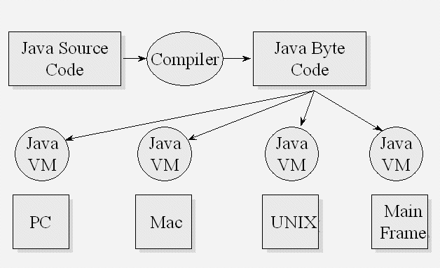
JVM

Slide 8
Disadvantages of Java
Speed

Slide 9
Java
Editions
  J2SE
  J2EE
  J2ME
JDK versions
  1.4
  1.3.x
  1.2.x
  1.1.x
IDE products

