Slide 1
TicketMonster
IS4302 · BLOCKCHAIN GROUP PROJECT
THE ADMIT-ONE REVOLUTION
YOU’RE
ON THE LIST.
Face-value tickets, fair resale and verifiable check-in, enforced by one smart contract.
FACE VALUE. EVERY TIME.
↗
Ownership on-chain. Good times in real life.
Notes:
[0:15] Hi, we're presenting TicketMonster: a ticketing system where buying, reselling and checking in are enforced by one smart contract.
Plan for the next ten minutes: why we built it, six design decisions and the reasons behind each, a short live demo, and what a blockchain still can't fix.

Slide 2



Fans overpay, get scammed and trust blindly
WHY WE BUILT IT
IN SINGAPORE ALONE
Scalping & markups
S$480k+
Touts buy up seats on release and resell them far above face value.
lost by 462+ people to concert ticket scams in just over six months
Fake or double-sold tickets
A resale buyer can’t check that a ticket is real, or that it wasn’t sold twice.
Trusting the platform
Singapore Police Force advisory, 6 July 2023 (January to early July 2023)
One company runs the order book, holds the money and decides refunds.
Notes:
[0:45] Three problems motivated us.
1. Scalping: touts buy seats the moment sales open and resell at multiples of face value.
2. Fake or double-sold tickets: a resale buyer has no way to check a ticket is genuine, or that the same ticket wasn't sold to several people. In Singapore, police reported at least 462 victims and at least S$480,000 lost to concert-ticket scams between January and early July 2023, around the Taylor Swift and Coldplay sales.
3. Trusting the platform: one company controls the order book, holds everyone's money and decides refunds.
Our goal: make the rules for buying, reselling and entering public and self-enforcing.
Source: Singapore Police Force, 'Police advisory on scams involving the sale of concert tickets', 6 July 2023, https://www.police.gov.sg/media-hub/news/2023/20230706_police_advisory_on_scams_involving_the_sale_of_concert_tickets

Slide 3





One contract replaces the ticket exchange
DESIGN 1 / 6 · ARCHITECTURE
FIRST DRAFT · 9 OCT
FINAL DESIGN · 10 OCT
Redis / RabbitMQ queues
TicketMonster contract
Browser
Matching server
Wallet
Postgres inventory
Inventory · seat ownership · buy & sell queues · escrow & credits · check-in record
Everyone must trust whoever runs the server with the order book, escrow and refunds.
Rules run as public code: no company holds the money or controls the queue.
No trusted middleman
Anyone can audit
Any frontend works
Matching, escrow and refunds execute exactly as coded.
Stock, prices and ownership history are public.
Third-party apps can use the same contract and rules.
Notes:
[0:45] Our first diagram, on 9 October, kept the queues in Redis and RabbitMQ and the inventory in Postgres, behind a matching server. That design asks everyone to trust whoever runs that server.
On 10 October we moved all of it on-chain: inventory, seat ownership, both queues, escrow, credits and the check-in record live in one contract. The browser only reads the chain and sends wallet-signed transactions.
Why: no trusted matching server or inventory database; anyone can audit stock and ownership; and any third-party frontend can use the same rules.
The cost is gas, public data and lower throughput than a database. We come back to that at the end.

Slide 4


Resale happens at face value, through a queue
DESIGN 2 / 6 · FAIR RESALE
1
Primary stock
2
Seller queue
3
Buyer queue
Buy 3 tickets
Organiser’s seats, assigned in order
Resold seats, oldest listing first
Prepaid escrow, filled by the next resale
Each step runs only if the one before is empty. A resale runs in reverse: it first fills waiting buyers (step 3), then lists in step 2.
Fixed price, no markup
The contract is the counterparty
CONSIDERED & REJECTED
Every resale pays exactly price + deposit: no profit in scalping.
Payment and seats swap in one transaction; no one pays a stranger.
Transferable NFT tickets
Holders could sell at any price on open NFT markets, bypassing the queue and its fixed price.
Primary stock sells first
Orders are final until doors open
Resellers can’t take sales from the organiser while original seats remain.
Queues never have gaps, so matching stays cheap and predictable.
Notes:
[1:00] Every purchase goes through three steps, in order: the organiser's primary stock, then the seller queue (oldest listing first), and anything still unfilled waits in a prepaid buyer queue. A resale works the other way: it first serves buyers already waiting, then lists the remaining seats.
Example from the demo: Charlie is waiting for 3 tickets; when Alice resells 4, Charlie gets 3 immediately and her 4th seat waits for the next buyer.
Why:
- Resale is fixed at face value (price plus deposit), so there is no markup to capture inside the system.
- The contract is the counterparty: payment and seats swap atomically, so buyers never pay a stranger and hope.
- Primary stock sells first to protect the organiser: resellers can't take sales from it while original seats remain.
- Orders can't be cancelled while sales are open, so queues never have gaps and matching stays cheap and predictable. Unfilled orders are reclaimed after doors open.
Rejected: transferable NFT tickets. A freely tradable token would let anyone sell at any price on open marketplaces and bypass the whole fixed-price market, so the contract has no transfer function at all.

Slide 5




A refundable deposit makes hoarding costly
DESIGN 3 / 6 · ATTENDANCE DEPOSIT
Ticket price
0.010 ETH
Resell
Attend
No-show
Attendance deposit
+ 0.002 ETH
0.012 back
0.002 back
0.002 lost
You pay
0.012 ETH
Price + deposit, paid by the next buyer
Deposit refunded at check-in
Paid to the organiser for the empty seat
Hoarding seats you won’t use forfeits the deposit
CONSIDERED & REJECTED
Reselling refunds everything, so the honest exit is free
Credit-score priority
Resale is capped at face value, so hoarded seats can’t be flipped
Favour “real fans” by wallet history. Dropped: it can’t reliably spot scalpers (new wallets are free), and a deposit is simpler.
Trade-off: the organiser profits from no-shows, so may deny honest entry.
Notes:
[0:45] Every ticket costs its price plus a refundable attendance deposit: here 0.010 + 0.002 ETH.
Three outcomes: resell and you get all 0.012 back from the next buyer; attend and the 0.002 deposit comes back at check-in; don't show up and the deposit goes to the organiser to compensate for the empty seat.
Why: to deter hoarding. Holding seats you won't use now costs money, the honest exit (reselling) is free, and since resale is capped at face value, hoarded seats can't be flipped for profit.
Rejected: our early idea of a credit score that prioritises 'real fans' by wallet history. Wallet history can't reliably identify scalpers, since anyone can create new wallets for free, and a deposit achieves the goal far more simply.
Trade-off we acknowledge: because the organiser receives no-show deposits, it has an incentive to deny honest check-ins. The gate is a trusted oracle.

Slide 6
Groups sit together, and storage stays cheap
DESIGN 4 / 6 · SEATS & STORAGE
WHY: STORAGE WRITES ARE THE BIGGEST GAS COST
STAGE
≤ 10
reads per owner lookup
→
0
1
2
3
4
5
6
7
Owner stored once per bought block, anchored every 10 seats.
←
15
14
13
12
11
10
9
8
256
seats per storage slot
Check-in is a bitmap: one bit per seat.
→
16
17
18
19
20
21
22
23
1
slot per record
Event, category and order data are each packed into 32 bytes.
Seats are numbered in a snake: row 2 runs right to left. A group of four buying seats 6–9 spills past the row end and lands directly behind itself.
CONSIDERED & REJECTED
Why: one purchase gets consecutive seats, so friends sit together with no seat-picking step.
One storage entry per seat: simplest, but a 10-seat purchase would write 10 slots instead of 1–2.
Notes:
[0:45] Seats in a category are numbered from 0 and sold in order, so a group that buys in one transaction gets consecutive seats. Off-chain, rows alternate direction like a snake: a group of four buying seats 6 to 9 spills over the end of row 1 and lands directly behind itself in row 2.
Why: friends who buy together sit together, with no seat-picking step.
Storage is the expensive part of Ethereum, so we write as little as possible:
- Ownership is written once per purchased block (the ERC-721A idea) plus an anchor every 10 seats, so any owner lookup reads at most 10 slots.
- Check-in is a bitmap: one bit per seat, 256 seats per storage slot.
- Event, category and order records are each packed into a single 32-byte slot.
Rejected: one storage entry per seat. Simplest, but a 10-seat purchase would write 10 slots instead of 1 or 2.
Also: every call handles at most 10 seats, which bounds gas per transaction. It is a transaction limit, not a per-person cap.

Slide 7



Timeline rules keep every refund funded
DESIGN 5 / 6 · MONEY SAFETY
salesEnd
checkInEnd
ON SALE
DOORS OPEN
CHECK-IN CLOSED
Buy and resell through the queues
Organiser may cancel: full refunds
Trading stops; gate check-in opens
Organiser can withdraw proceeds
Unfilled orders can be reclaimed
No-show deposits go to the organiser
Settled in bounded batches
time
Proceeds locked until doors open
Pull, don’t push, payments
Bounded batches
Cancelling is only allowed before then, so the contract always holds enough to refund every ticket.
Credits are recorded first and each user withdraws, so a failing recipient can’t break matching.
No-show settlement covers 4,096 seats per call, so no call can run out of gas.
Notes:
[0:40] Each event has two deadlines, and they decide when money can move.
Before salesEnd (doors open): trading happens and the organiser can cancel, which refunds price plus deposit to every holder.
From salesEnd: trading stops, gate check-in opens, the organiser can withdraw primary proceeds, and unfilled queue orders can be reclaimed.
From checkInEnd: check-in closes and no-show deposits go to the organiser. Check-in closes first because a late check-in after the deposits were claimed would pay the same deposit twice.
Why:
- Proceeds stay locked until doors open and cancellation is only possible before then, so every refund is always funded. This replaced the original sketch's deleteEvent.
- Payments are pulled, not pushed: matching only records credits, and users withdraw. State changes before any ETH is sent, which blocks reentrancy, and a failing recipient can't block anyone else.
- No-show settlement processes at most 16 bitmap words (4,096 seats) per call, so even a stadium settles in repeated calls without hitting the gas limit.

Slide 8
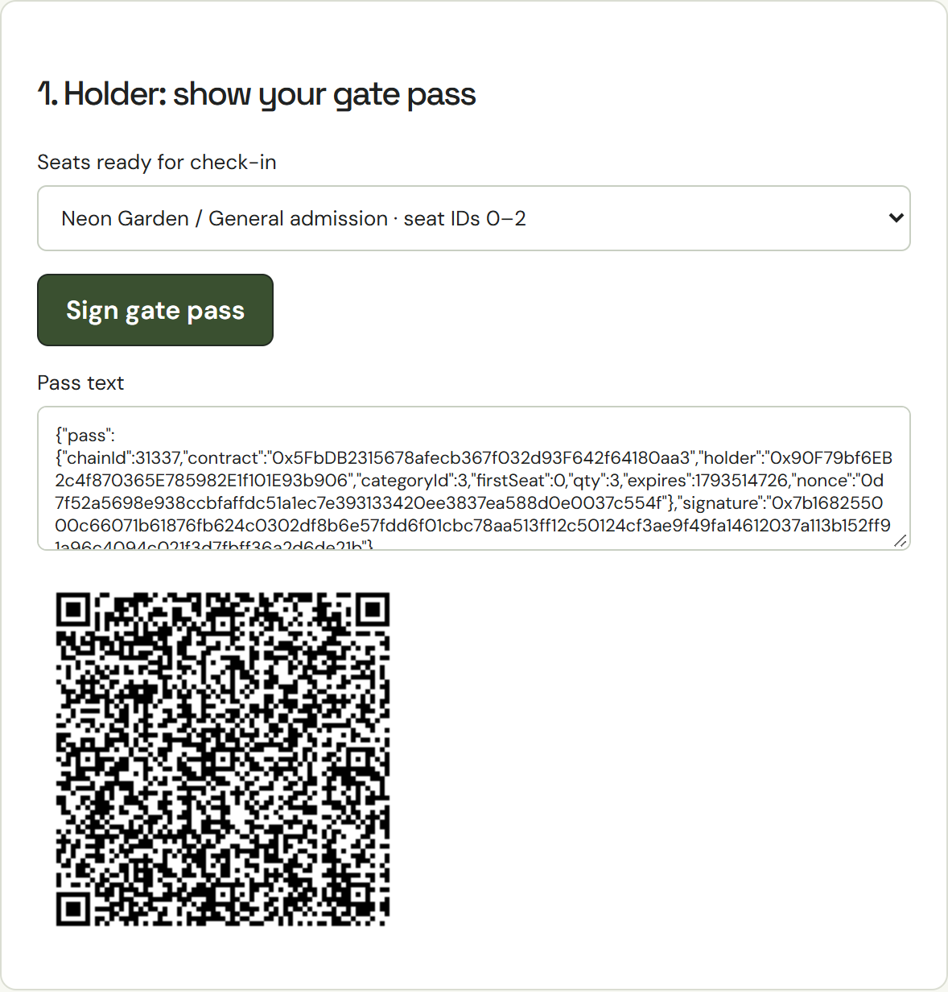
One signed QR gets the whole group in
DESIGN 6 / 6 · CHECK-IN
THE GATE CHECKS
Signature recovers the holder named in the pass
Pass hasn’t expired and is for this chain and contract
Holder still owns every seat in the range, on-chain
Seats unused, then consumeTicket marks them in the bitmap
Limit: this proves control of the wallet, not who is holding the phone.
WHY
CONSIDERED & REJECTED
Any edit breaks the signature
Copies are useless after entry
One scan, nothing to type
Gate-issued challenge
Our first version: two exchanges per attendee, and the gate needed your address in advance.
The holder’s screen in our app
Notes:
[0:45] At the gate, the holder picks their seats in the app and their wallet signs a gate pass: holder address, category, seat range, a 5-minute expiry and a random nonce. It is shown as a QR code.
The organiser scans it, and the app checks that: the pass hasn't expired and is for this chain and contract; the signature recovers the holder named in the pass; the holder still owns every seat on-chain; the seats are unused. Then consumeTicket marks the seats in the bitmap and credits the deposit.
Why: editing any field (say, the seats or the holder) changes the recovered signer, so passes can't be forged or re-targeted. The on-chain bitmap makes every copy useless once the seats are used, across all gates. And it is a single scan with nothing to type.
Rejected: our first version had the gate issue a challenge for the holder to sign. That proves freshness to the gate but needs two exchanges per attendee and the holder's address in advance, and a copied proof is still usable within its window, so it didn't buy real security.
Honest limit: a signature proves control of a wallet, not who holds the phone. A copied, unexpired, unused pass admits whoever shows it first. The 5-minute expiry narrows that window, and the organiser remains the attendance oracle.

Slide 9
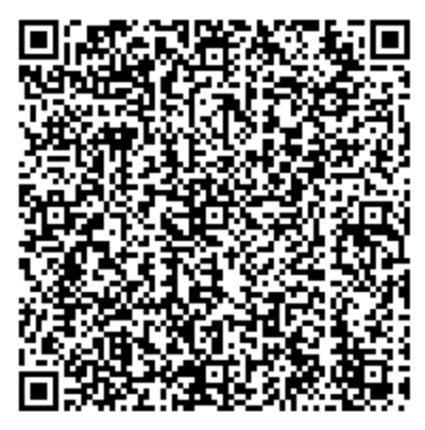
From sold out to checked in
LIVE DEMO · ABOUT 3 MINUTES
1
Resell through the queue
2
Sign a gate pass
3
Scan & admit
Alice resells 4 seats. Charlie, already waiting for 3, gets seats 0–2 at once.
Doors open. Charlie picks seats 0–2; his wallet signs a 5-minute QR pass.
The organiser checks Charlie in, then the same pass is rejected.
NEON GARDEN · SEATS AFTER THE RESALE
Checked in seat IDs 0–2 for 0x90F7…b906; their deposit is now withdrawable credit.
0
1
2
3
4
5
Charlie
Alice
Bob
Seat 0 is already used.
Seat 3 is still listed in the seller queue (amber).
Alice: +0.03 ETH resale credit
Charlie: +0.006 ETH deposit credit
Expires in 5 minutes
Staged before the talk: Alice bought 4 seats and Bob 2 (sold out); Charlie joined the queue for 3.
Notes:
[3:00] LIVE DEMO. If the live app fails, talk through this slide instead: it shows the outcome of each step (the QR code is a real pass signed in the app; the messages are the app's exact wording).
BEFORE THE TALK, on a fresh chain (docker compose up --build): select Alice, buy 4 Neon Garden tickets (seats 0-3). Select Bob, buy 2 (seats 4-5): sold out. Select Charlie, buy 3: no seats left, so his order waits in the buyer queue with 0.03 ETH in escrow.
1. [0:00-0:50] Discover: Neon Garden shows 0/6 primary seats and Charlie's waiting buyer order. Select Alice, open My tickets & orders, Resell group. Charlie receives seats 0-2 immediately; seat 3 waits in the seller queue. Alice has 0.03 ETH credit: click Withdraw and point at her wallet balance beside the account selector rising.
2. [0:50-1:10] Select Organiser, Organiser studio, Demo: open doors for Neon Garden. Trading stops.
3. [1:10-1:50] Select Charlie, At the gate: choose seat IDs 0-2, Sign gate pass. The QR and pass text appear. Copy the pass text.
4. [1:50-2:35] Select Organiser, At the gate: paste the pass, Verify & check in. Status: checked in seats 0-2. Click Verify again: 'Seat 0 is already used'. That rejection comes from the on-chain bitmap.
5. [2:35-3:00] Select Charlie, My tickets & orders: 0.006 ETH available, his 3 deposits back.

Slide 10



What the blockchain does not fix
HONEST LIMITS
Solved by the contract
Still open
Face-value resale inside the app
Sales-day surges become a gas auction, so bots can outbid fans
Ticketmaster’s Eras Tour presale drew 3.5 billion system requests (Nov 2022)
Future work: a pre-sale waiting room, shuffled by a verifiable random oracle, so gas and speed buy no advantage
No fake or double-sold seats: each has one on-chain owner
Side deals: selling a wallet key or paying off-chain skips face value
Escrow, refunds and payouts enforced by code
No Sybil resistance: the 10-seat limit is per transaction, not per person
Rules and history anyone can audit
The organiser is the attendance oracle, and gains from no-shows
Gas costs, ETH price swings and public attendance history
Notes:
[0:45] What the contract does solve: resale stays at face value inside the app; a seat has exactly one on-chain owner, so it can't be faked or sold twice; escrow, refunds and payouts are enforced by code; and anyone can audit the rules and history.
What it does not solve:
- Sales-day surges. A blockchain doesn't remove the load of a huge on-sale; it turns the queue into a gas-fee auction where whoever pays most is mined first, which favours bots. For scale, Ticketmaster's Eras Tour presale saw 3.5 billion system requests, about 4x its previous peak. First-come-first-served on-chain means transaction order, which validators and priority fees influence.
Future work: a pre-sale waiting room. Buyers register with prepaid escrow during a window; when it closes, a verifiable random function shuffles them into the queue, so speed and gas stop mattering and demand is spread over the window instead of one instant. The trade-offs: it needs a randomness oracle (e.g. Chainlink VRF, which can't fake the draw but could fail to deliver it, so we'd need a fallback such as refunding every entry after a deadline), and it doesn't stop one person entering with many wallets. Prepaid escrow per entry at least makes every extra entry tie up real money. This is the random pre-order idea from our 12 October discussion, listed in DESIGN.md as a potential extension.
- Side deals: someone can sell their wallet key, or take payment off-chain, and bypass face value.
- Sybil attacks: one person can use many wallets; the 10-seat limit is per transaction, not per person.
- The organiser is the attendance oracle and earns no-show deposits.
- Gas, ETH volatility, and the fact that attendance is public.
Source: Ticketmaster's statement on the November 2022 Eras Tour presale, as reported by NBC News (https://www.nbcnews.com/pop-culture/pop-culture-news/ticketmaster-cancels-public-sale-taylor-swift-tour-citing-high-demand-rcna57758) and NBC Chicago (https://nbcchicago.com/news/local/ticketmaster-breaks-down-what-happened-during-taylor-swift-presale-snafu/2999756).

Slide 11


Face value.
Every time.
THANK YOU
Resale at face value, through on-chain queues
A refundable deposit makes hoarding costly
A database would be cheaper and more private. We chose a blockchain for shared, verifiable settlement that no single company controls.
One signed QR gets the group in
Questions?
Notes:
[0:10] To sum up: resale happens at face value through on-chain queues, a refundable deposit makes hoarding costly, and one signed QR gets a group in. A database would be cheaper and more private; we chose a blockchain because shared, verifiable settlement that no single company controls was worth that cost. Thank you, we're happy to take questions.

