Slide 1
Natural language processing for healthcare
Motivation
Angus Roberts, Senior Lecturer in Health Informatics
Institute of Psychiatry, Psychology and Neuroscience
King’s College London

Slide 2
Contents
Background and motivation
Free text in the Electronic Health Record (EHR)
Tackling text with Natural Language Processing (NLP)
Information extraction
Tools for the job

Slide 3
Background and motivation

Slide 4
Motivation
Thomas Willis in Dr. Willis’s Practice of Physick Being All the Medical Works of That Renowned and Famous Physician. 1684.
  weigh all the symptoms, and to put them, with exact Diaries of the Diseases, into writing; then diligently to meditate on these, and to compare some with others; and then [begin] to adopt general Notions from particular Events
Reuse of the medical record
Computerisation of the record allows us to magnify the efforts of Willis by many degrees

Slide 5
EHRs vs traditional studies
Clinical cohort studies…
expensive and time consuming, especially for rarer disorders, to recruit and follow enough people
RCTs / experimental studies…
Often cannot do these for ethical reasons
Relapse of mental disorder…
Lack of patient capacity to consent
Allows us to include…
Representative samples, patients who may not be able to take part in clinical studies – e.g. suicidal patients, very sick and marginalised
Notes:
Other methods
e.g. clinical cohort studies recruite and follow-up women themselves. What are the tricky htings about this/ how might ‘big data’ help get around this?
In order to look at treatment effects for example, RCTs are known as the gold standard. What might be an issue here? Why might we not be able to conduct RCTs?
What about women who are very ill/ relapse through the study?
How might big data be better in terms of including people?

Slide 6
Free text in the electronic health record (EHR)

Slide 7
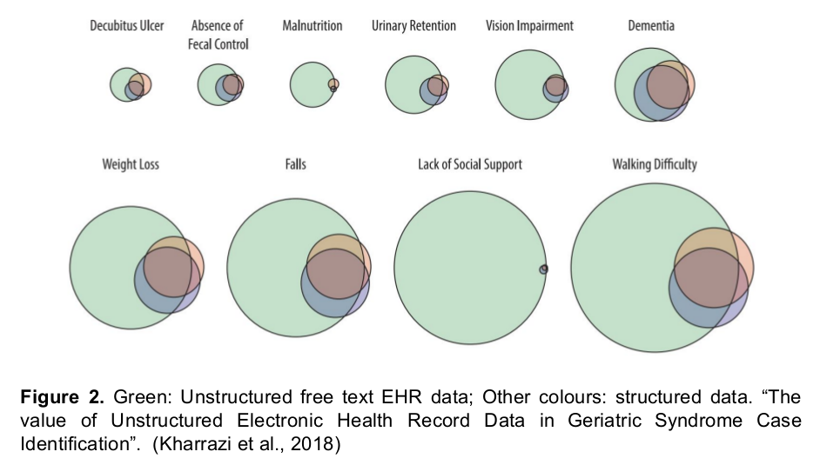

Slide 8
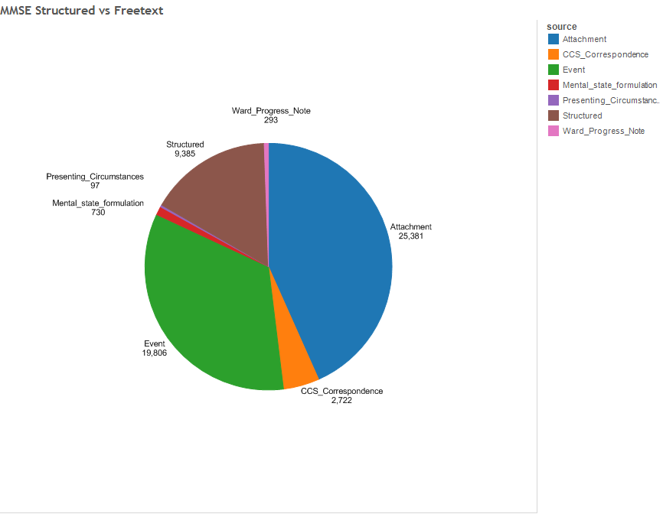
MMSE: text vs structured data

Slide 9
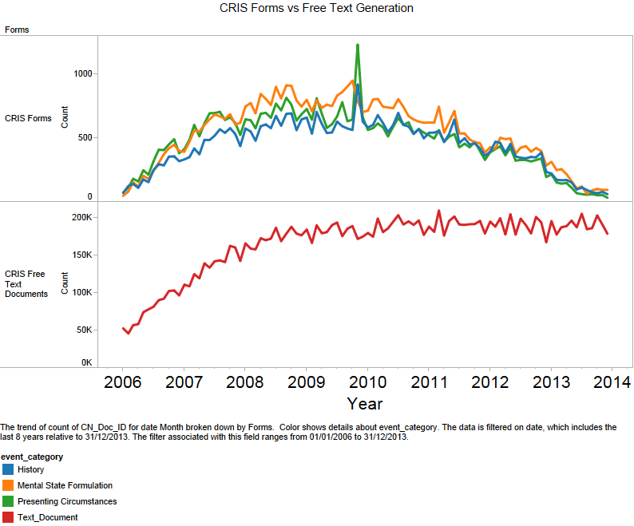
Structured data capture is ‘unpopular’
Notes:
What this is showing is a software cycle with real world data,
Adoption , stable usage and decline.
The more this trend occurs, the less likely Clinicians are to rely on structured data for their decision making – they know it’s unreliable, which compounds the problem. Worse case scenario, it ends up as ‘another place they need to look for data’
Contrast with the versatility of natural language – stable since mid 2008
Graph of structured field usage 2006-2013
Key message – freetext is here to stay, whereas structured parts of an EMR are subject to strange happenings…
Matter of favour – management policy often determines what is populated

Slide 10
The problem with language
Ambiguity | To some degree Finishing her degree
Grammatical subject | She smokes Her mother smokes
Hedging | Probably a possible tumour
Negation | He no longer smokes
Synonymy, abbreviations, acronyms | MMSE, Mini Mental State Exam, Folstein
Extracting patterns | 17th percentile 5 weeks and 3 days
Relationships and events | His MMSE was 24/30 a week before the appointment

Slide 11
Natural language processing (NLP)

Slide 12
NLP origins
50s and 60s
  Machine Translation
    Russian – English
    Hand coded rules and large dictionaries
Late 60s to late 70s
  Failure to deliver and cut in funding
Mid 80s to mid 90s
  Competitive challenges, e.g. Message Understanding Conferences
    Organised by Naval Command, Control and Ocean Surveillance Center
    Originally, extraction of information from military messages
    Moved on to news reports on terrorist attacks, and trade union disputes…
    Largely rule based systems

Slide 13
Natural Language Processing
a theoretically motivated range of computational techniques for analyzing and representing naturally occurring texts at one or more levels of linguistic analysis for the purpose of achieving human-like language processing for a range of tasks or applications
(Liddy, in Encyclopedia of Library and Information Science, 2nd edition, 2003. page 137)

Slide 14
Natural Language Processing
a theoretically motivated range of computational techniques for analyzing and representing naturally occurring texts at one or more levels of linguistic analysis for the purpose of achieving human-like language processing for a range of tasks or applications
(Liddy, in Encyclopedia of Library and Information Science, 2nd edition, 2003. page 137)

Slide 15
Natural Language Processing
a theoretically motivated range of computational techniques for analyzing and representing naturally occurring texts at one or more levels of linguistic analysis for the purpose of achieving human-like language processing for a range of tasks or applications
(Liddy, in Encyclopedia of Library and Information Science, 2nd edition, 2003. page 137)

Slide 16
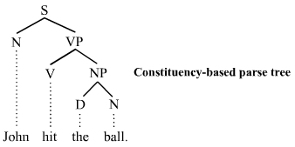
Levels of linguistic analysis
Lexicon - the words
A foul and pestilent congregation of vapours.
1.30pm: Cx: 3cm. Contractions q2-3 min. FHR: reassuring.
Syntax - the grammatical structure

Slide 17
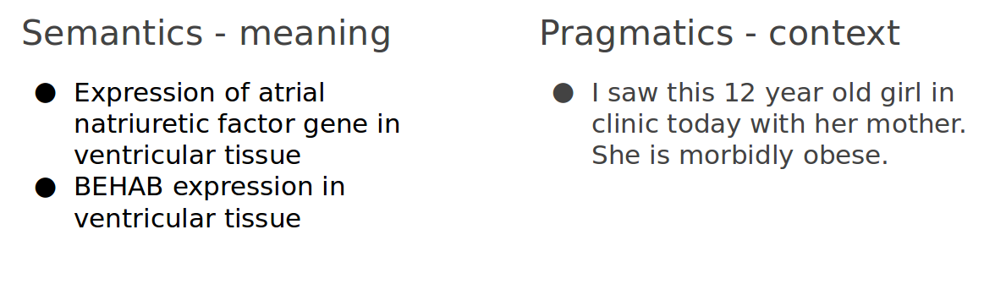
Levels of linguistic analysis

Slide 18
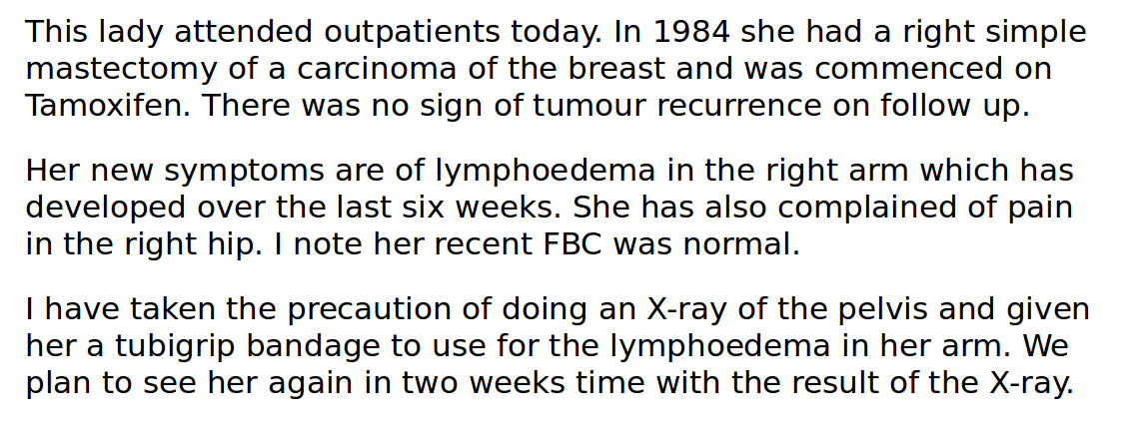
Levels of linguistic analysis

Slide 19
Many applications...
Search - information retrieval
Information extraction
Question answering
Document summarisation
Dialogue
Machine translation
Document classification
Social media tracking
….
Notes:
Angus - can you add in some of your experience here?

Slide 20
Information extraction

Slide 21
Information extraction
the process of deriving disambiguated quantifiable data from natural language texts in service of some pre-specified precise information need
(Cunningham, in Encyclopedia of Language and Linguistics, 2nd Edition, pages 665–677, 2005.).

Slide 22
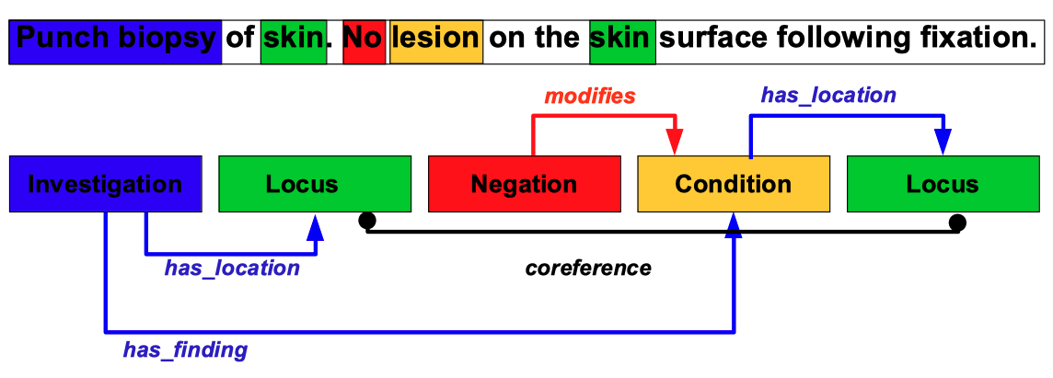
Information extraction
We might extract:
  Entities and their co-referents
  Negation, certainty, time
  Relations
  Events
Notes:
Angus - can you add in some of your experience here?

Slide 23
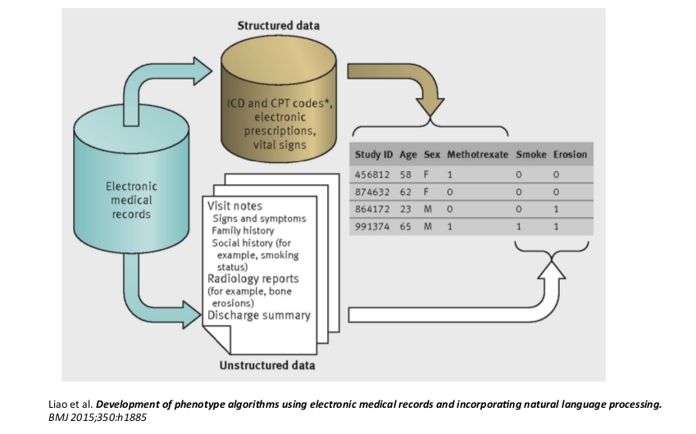
Information extraction

Slide 24
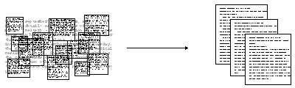
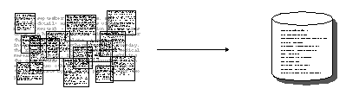
Information extraction vs information retrieval
IR pulls documents from large text collections in response to specific keywords or queries. You analyse the documents.
IE pulls facts and structured information from the content of large text collections. You analyse the facts.

Slide 25
Tools for the job

Slide 26

GATE
A widely used open source NLP toolkit, 20+ years old, 35 000+ downloads per year
Graphical user interface
Plug and play approach
No programming skills required
Large user community
100s of modules for all kinds of language processing tasks
Scales to large distributed systems and data
Limited support for state of the art NLP

Slide 27





Python
Currently the most popular way of doing NLP
Requires programming skills
Most popular Python packages:
  RE – python regular expressions
  NLTK – general NLP and pre-processing
  spaCy – “best of breed” statistical models
  SciPy – lots of machine learning
  Hugging Face – language models
  TensorFlow – neural nets

Slide 28
Thank you.
Any questions?
angus.roberts@kcl.ac.uk

