Slide 1
Annotation guidelines / Define concept
Concept definition
Diagnosis, lab test, action, event…
Variable definition
Diagnosis: explicitly mentioned or inferred
Lab test: exact numeric value or range or direction
Action: planned or occurred
Event: explicitly mentioned or inferred
Acknowledgements: Uni. of Utah DeCART summer school: https://github.com/jianlins/AnnotationNLP/blob/master/01_Introduction_to_Annotation.ipynb

Slide 2
Annotation guidelines / Define concept
Annotation level/unit
Patient, document, sentence, phrase…
Attribute definition
Polarity
Severity
Frequency
…
Acknowledgements: Uni. of Utah DeCART summer school: https://github.com/jianlins/AnnotationNLP/blob/master/01_Introduction_to_Annotation.ipynb

Slide 3
Annotation guidelines / Define concept
Examples:
i2b2 2006 Smoking challenge:
Past Smoker
Current Smoker
Smoker
Non-Smoker
Unknown
What level/unit would be appropriate to annotate?
Uzuner O, Goldstein I, Luo Y, Kohane I. Identifying patient smoking status from medical discharge records.
J Am Med Inform Assoc. 2008;15(1):14–24. doi:10.1197/jamia.M2408
Notes:
Past smoker: is a patient whose discharge summary asserts explicitly that the patient was a smoker one year or more ago but who has not smoked for at least one year. The assertion “past smoker” without any temporal qualifications means Past Smoker unless there is text that says that the patient stopped smoking less than one year ago.
Current smoker: is a patient whose discharge summary asserts explicitly that the patient was a smoker within the past year. The assertion “current smoker” without any temporal qualifications means Current Smoker unless there is text that says that the patient stopped smoking more than a year ago.
Smoker: is a patient who is either a Current or a Past Smoker but whose medical record does not provide enough information to classify the patient as either.
Non-smoker: ’s discharge summary indicates that they never smoked.
Unknown: is a patient whose discharge summary does not mention anything about smoking. Indecision between Current Smoker and Past Smoker does not belong to this category.

Slide 4
Annotation guidelines / Define concept
Examples:
i2b2 2010 challenge:
Concepts: medical problem, treatment, test
Assertion: present, absent, possible in the patient; associated with someone else
Relation: improves, causes, worsens…
What level/unit would be appropriate to annotate?
Uzuner Ö, South BR, Shen S, DuVall SL. 2010 i2b2/VA challenge on concepts, assertions, and relations in clinical text.
J Am Med Inform Assoc. 2011;18(5):552–556. doi:10.1136/amiajnl-2011-000203

Slide 5
Annotation guidelines / Define concept
Examples:
ShARe CLEF eHealth 2013 challenge:
Disorder mentions mapped to SNOMED-CT
What level/unit would be appropriate to annotate?
Uzuner Ö, South BR, Shen S, DuVall SL. 2010 i2b2/VA challenge on concepts, assertions, and relations in clinical text.
J Am Med Inform Assoc. 2011;18(5):552–556. doi:10.1136/amiajnl-2011-000203

Slide 6
Natural Language Processing - workflow
Data
Develop NLP solution
Representation
What unit was annotated?
What would be an appropriate way to represent the data?
Entities
What is the distribution? Is the there a lot of variation, or are there clear patterns?
Approach: Patterns? Machine learning? Adaptation?
Off-the-shelf-tools often have default baseline representations, standard parameter settings etc – can this be a problem, or something you can re-use?
Define problem/concept
Create gold standard
Develop NLP solution
Evaluate
Deployment

Slide 7
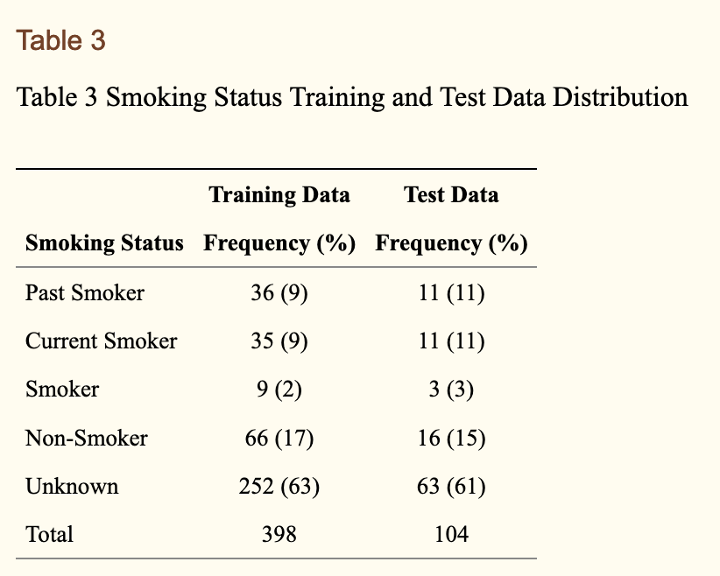
i2b2 2006 smoking challenge - distributions
Uzuner O, Goldstein I, Luo Y, Kohane I. Identifying patient smoking status from medical discharge records.
J Am Med Inform Assoc. 2008;15(1):14–24. doi:10.1197/jamia.M2408
Notes:
Past smoker: is a patient whose discharge summary asserts explicitly that the patient was a smoker one year or more ago but who has not smoked for at least one year. The assertion “past smoker” without any temporal qualifications means Past Smoker unless there is text that says that the patient stopped smoking less than one year ago.
Current smoker: is a patient whose discharge summary asserts explicitly that the patient was a smoker within the past year. The assertion “current smoker” without any temporal qualifications means Current Smoker unless there is text that says that the patient stopped smoking more than a year ago.
Smoker: is a patient who is either a Current or a Past Smoker but whose medical record does not provide enough information to classify the patient as either.
Non-smoker: ’s discharge summary indicates that they never smoked.
Unknown: is a patient whose discharge summary does not mention anything about smoking. Indecision between Current Smoker and Past Smoker does not belong to this category.

Slide 8
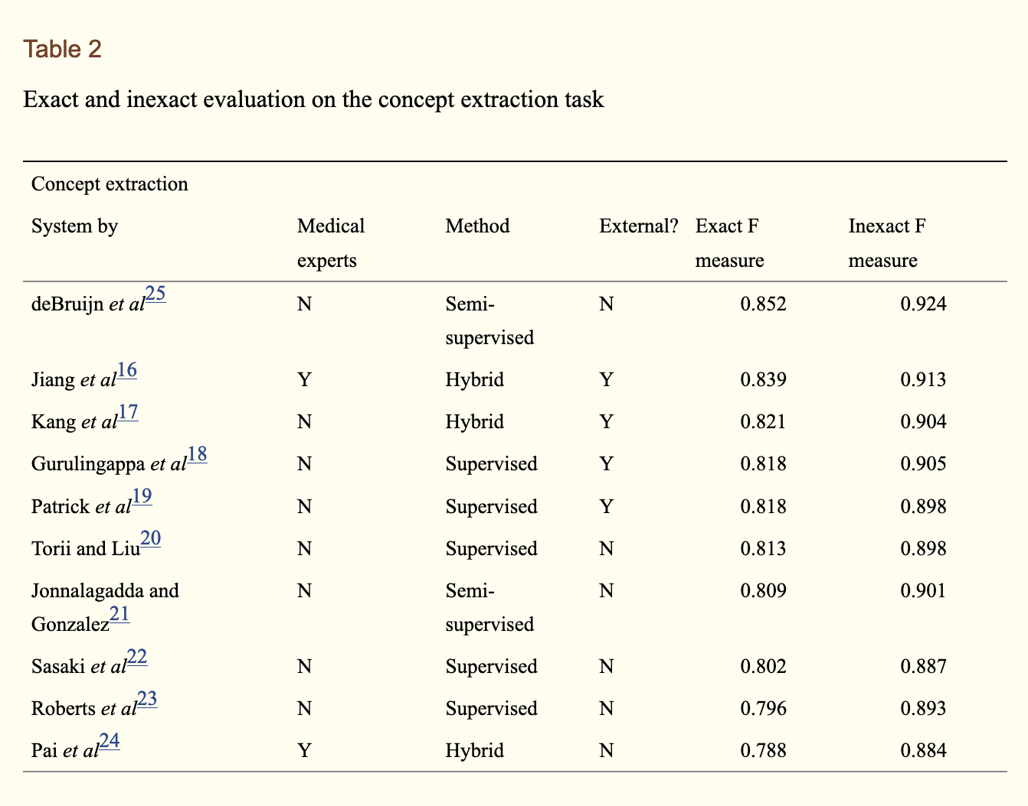
i2b2 2010 concept challenge - approaches
Uzuner Ö, South BR, Shen S, DuVall SL. 2010 i2b2/VA challenge on concepts, assertions, and relations in clinical text.
J Am Med Inform Assoc. 2011;18(5):552–556. doi:10.1136/amiajnl-2011-000203

Slide 9
Natural Language Processing - workflow
Data
Evaluation
What type of performance is acceptable? What type of evaluation is appropriate?
Intrinsic? Extrinsic?
Is the solution specific to a particular clinical population, or generic to the entire population?
Define problem/concept
Create gold standard
Develop NLP solution
Evaluate
Deployment

Slide 10
i2b2 2010 concept challenge - evaluation
Uzuner Ö, South BR, Shen S, DuVall SL. 2010 i2b2/VA challenge on concepts, assertions, and relations in clinical text.
J Am Med Inform Assoc. 2011;18(5):552–556. doi:10.1136/amiajnl-2011-000203

Slide 11
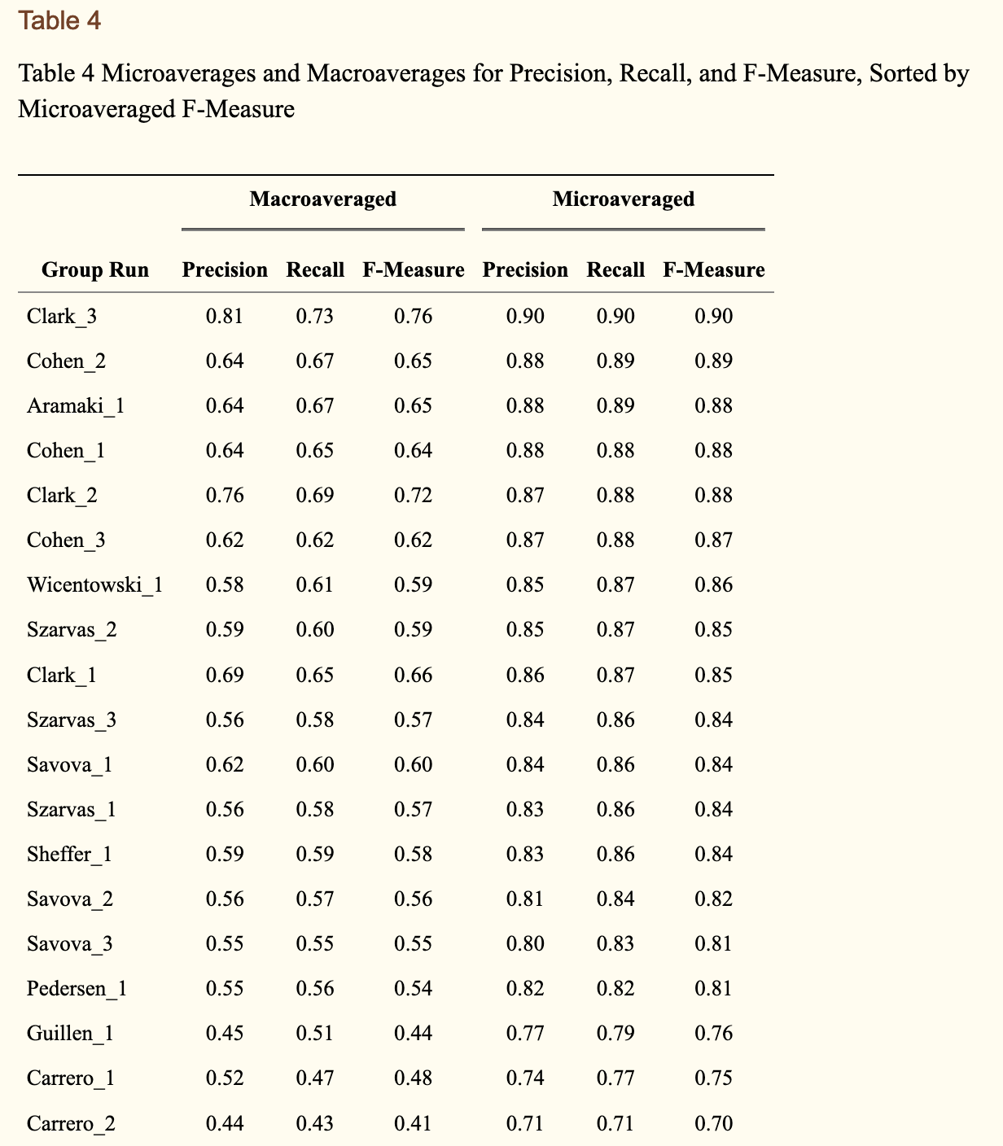
i2b2 2006 smoking challenge - evaluation
Uzuner O, Goldstein I, Luo Y, Kohane I. Identifying patient smoking status from medical discharge records.
J Am Med Inform Assoc. 2008;15(1):14–24. doi:10.1197/jamia.M2408

Slide 12
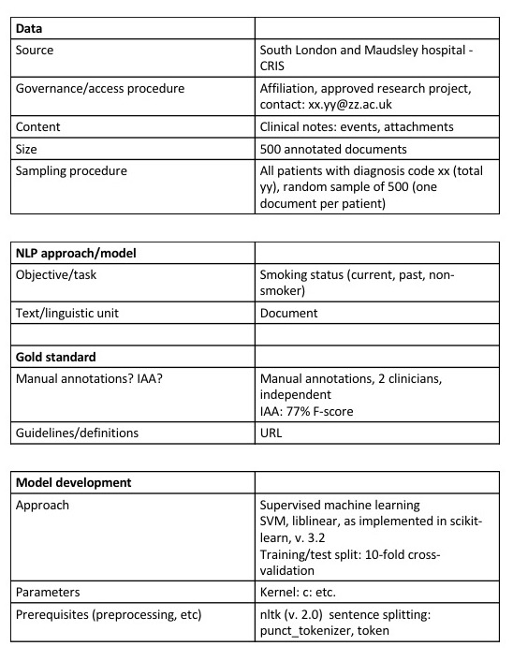
Velupillai et al. 2018. Using clinical Natural Language Processing for health outcomes research: Overview and actionable suggestions for future advances. Journal of Biomedical Informatics
Volume 88, December 2018, Pages 11-19

Slide 13
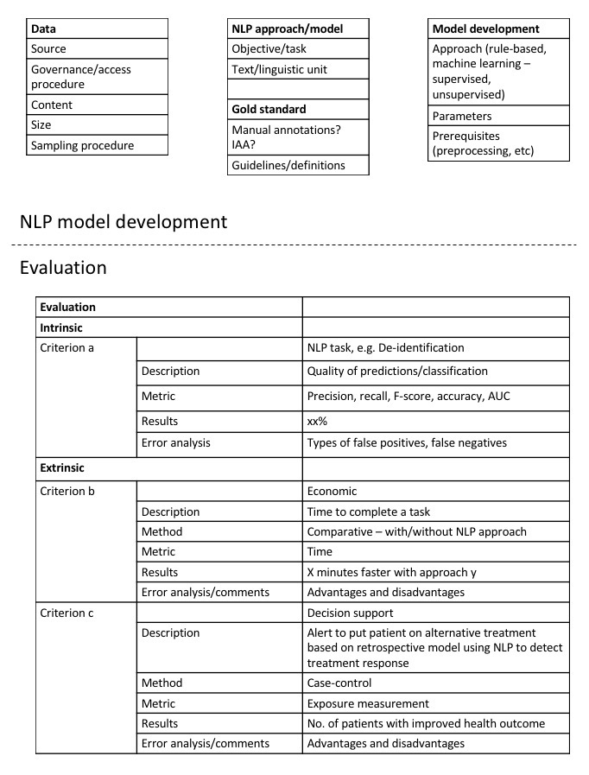
Velupillai et al. 2018. Using clinical Natural Language Processing for health outcomes research: Overview and actionable suggestions for future advances. Journal of Biomedical Informatics
Volume 88, December 2018, Pages 11-19

Slide 14
Natural Language Processing - workflow
Data
Example case:
A clinical NLP algorithm has developed to extract smoking status from EHRs and the algorithm has been made available. You want extract similar information from your EHR database for a particular clinical use-case.
What do you need to know about the algorithm and its development? How do you decide if it works well enough on your data?
Define problem/concept
Create gold standard
Develop NLP solution
Evaluate
Deployment

Slide 15
Thank you! sumithra.velupillai@kcl.ac.uk

